Slide 1
Open Justice in the Court of Protection
Dr Jaime Lindsey, University of Essex
Professor Celia Kitzinger, Cardiff University

Slide 2
Overview
  What is the project? (JL)
  What is the Court of Protection (JL)
  Background to Mental Capacity Law (JL)
  Observing hearings in the CoP – our experience (JL and CK)
  Rules for observing (CK)
  The Transparency Order (CK)
  What to do next (CK)

Slide 3
Introductions
  Dr Jaime Lindsey, Lecturer in Law
  Teach on Law Clinic modules and LW108
  Research on mental capacity and the Court of Protection
    Professor Celia Kitzinger, Cardiff University (@kitzingercelia)
    Psychology Professor, scholar-activist
    Family experience of COP + support for c. 50 families in COP
    Launched Open Justice in the Court of Protection project, see https://openjusticecourtofprotection.org @OpenJusticeCoP

Slide 4
What is the project?
  An opportunity to:
    Learn more about open justice
    Learn more about a controversial and interesting area of law which will affect many of us
    Learn about court etiquette
    See first-hand a court case (can put on CV!)
    Write a blog post (also good for a CV)
    Currently running in July only – but will reflect after summer on future plans

Slide 5
Open Justice
  Open Justice is essentially about ensuring that justice is not just done but is seen to be done
    Important safeguard against corruption
    To ensure fairness
    Equal treatment before the law
“Open justice reflects the wider values of public space, democracy and accountability” (Lindsey, 2020)

Slide 6
What is the project?
    What you need to do:
    Attend this training
    Be pro-active – we will not select cases for you (but see “Featured Hearings” on OpenJusticeCOP website)
    Look for a court listing for a case you want to observe (guidance to follow)
    Email to request access to observe
    Observe on the day
    Reflect afterwards and write short blog
    If more than one of you observe the same case, you may wish to write a joint blog

Slide 7
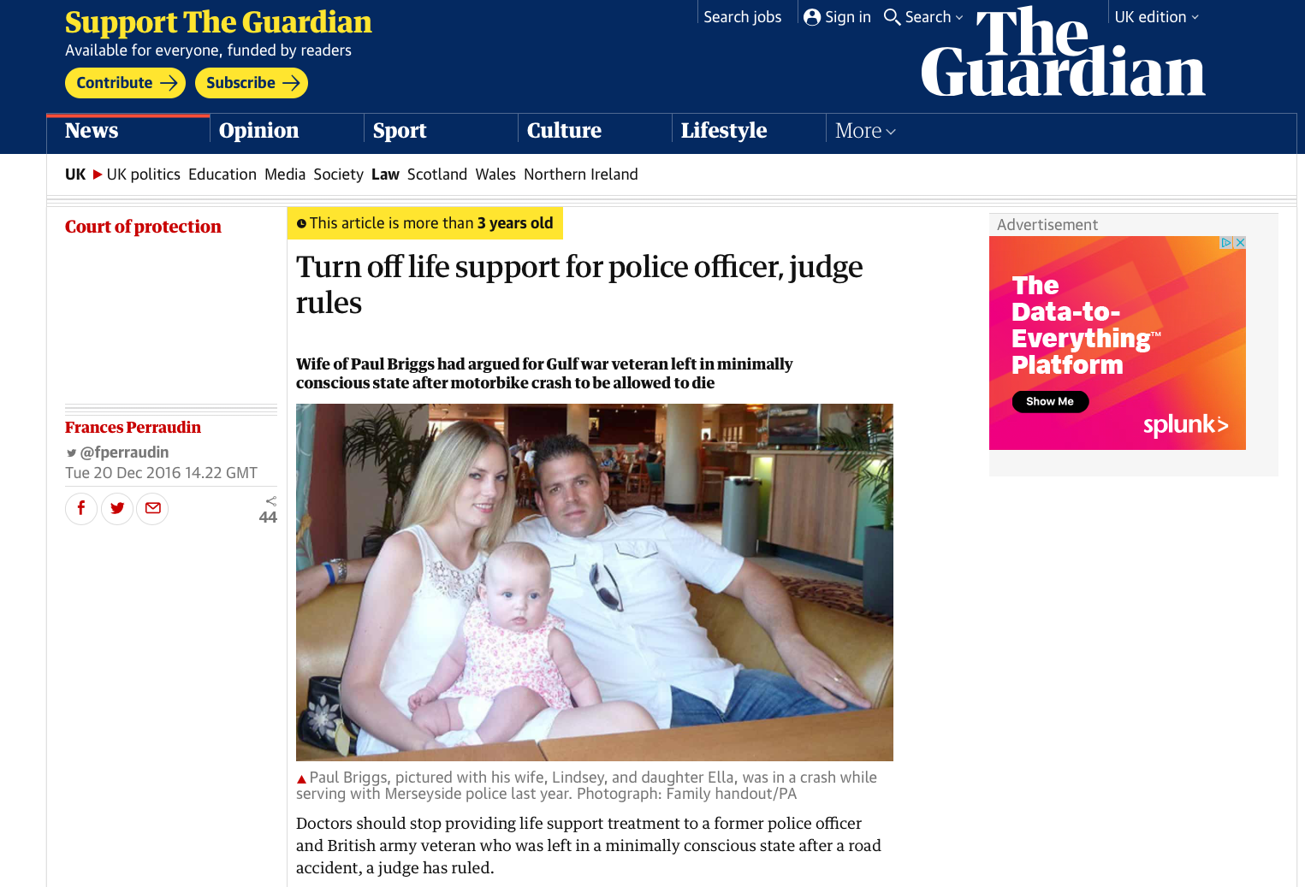
What is the Court of Protection?
  The court that deals with issues under the Mental Capacity Act 2005

Slide 8
Mental Capacity Act 2005
Mental Capacity Act 2005 (MCA)
  Civil law framework to determine whether a person lacks the mental capacity to make their own decisions
  Issue specific not general findings of incapacity
  MCA allows decisions to be made on behalf of an adult who is unable to make a decision because of an “impairment of, or disturbance in the functioning of, the mind or brain” in their best interests

Slide 9
Mental Capacity Act 2005
Mental Capacity Act 2005 (MCA)
  S 2 MCA requirement for impairment/disturbance
  S 3 MCA functional requirement – person must be unable to understand, retain, OR use or weigh information relevant to the decision OR be unable to communicate their decision
  If person lacks capacity then certain decisions can be made on their behalf in their best interests

Slide 10
Mental Capacity Act 2005
Types of cases:
  Welfare e.g. contact between partners, friends, family members, marriage, sexual relationships
  Health/medical treatment e.g. can a person refuse to have a caesarean section or can a person’s life support machine be turned off
  Property e.g. can a person make decisions about how they own a property or whether to sell it
  Financial affairs e.g. whether they can handle their money, make a gift
  Deprivation of liberty e.g. whether a person is able to leave their care home – if not then need authorisation to deprive them of their liberty
  Very wide range of cases BUT many that you observe will be procedural not substantive

Slide 11
Mental Capacity Act 2005
Procedural
  This is an interim hearing
  May talk about expert reports, evidence, time limits, setting dates for future hearings
  Potentially less interesting in terms of subject matter but more reflective of real life practice
Substantive
  Where the main issues are discussed i.e. the trial
  Usually more interesting
  You may hear expert evidence
  Oral argument from counsel
  In some (rare) cases, evidence from P
Any questions at this point?

Slide 12
Observing hearings – Dr Lindsey
My experience
  Observed face to face hearings in 2016
  Observed virtual hearings more recently
  One of my favourite things to do!
  Gives you much better understanding of the legal process
  Need to understand formalities and etiquette
  This is a formal process, even virtually, take it seriously

Slide 13
Observing hearings – Professor Kitzinger
Observed c 25 in-person COP hearings prior to 1 May 2020 – all concerning life-sustaining treatments for patients in vegetative or minimally conscious states. (Often included meeting patient + family, observing independent assessments, attending/chairing Best Interests meetings + once acting as litigation friend) – with Jenny Kitzinger (see Coma + Disorders of Consciousness Research Centre https://cdoc.org.uk)
First remote hearing of COP – 17 March 2020 Re AF before Mostyn
Horrendous experience – wrote a blog about it for Transparency Project here
Since 1 May I’ve observed a further 40+ remote hearings

Slide 14

Set up Open Justice Court of Protection Project jointly with Gill Loomes-Quinn
Disabled scholar-activist with expertise in Mental Capacity Act and disability rights
@GillLoomesQuinn
Observed 14 face-to-face Court of Protection hearings in 2017

Slide 15
Rules for observing
You have the right to attend public hearings, but from the moment you ask to observe a hearing you are using the court’s time. Do so respectfully and do not squander the court’s already stretched resources.
If you are granted admission to a hearing and later find you cannot attend, INFORM THE COURT. They may wait for you. Avoid this situation as far as possible.
Prepare for the hearing by ensuring you have a quiet place where you won’t be interrupted. For video-hearings, dress appropriately and find a neutral background. No eating, smoking, alcohol!
When ‘in court’ you should behave with decorum. Act as if your mike is on, even if muted. Act as if your camera is on at all times.
Do not leave a hearing early – and if you must, send an email explaining and apologizing.
Obey the rules specific to remote hearings – no unauthorized person should be able to see your screen/hear the court. You must not make a recording.

Slide 16
The Transparency Order

Slide 17
What to do next
1. Find a hearing that you want to observe
Where to find Court of Protection listings:
  First Avenue House cause list
  Family Division of the High Court cause list (look for “sitting as a judge in the Court of Protection”)
  Court serve website (more challenging to find CoP cases)
  Please also check the Open Justice in the Court of Protection website/twitter feed for listings for selected listings

Slide 18
What to do next
  2. Contact the relevant court and ask to observe the hearing
  Suggested text for contacting the courts by email is in guidance document circulated

Slide 19
What to do next
3. Write up a short blog post about your experience
This is about your experiences – no set format
Be reflective
Look at previous posts on the website
Be authentic
Do not name or identify in any way any of the participants (check with us if unsure)
Approx 500-1000 words
Email blog to: kitzingerc@cardiff.ac.uk
Any questions?

Slide 20
Have a look on the court listings and Open Justice website over next 4 weeks to identify a case
Locate a hearing and make email contact with the relevant court
After you’ve observed: write a blog post and send to Celia and Jaime
Contact Jaime in the first instance if any questions or issues you would like to discuss j.t.lindsey@essex.ac.uk

Slide 21
Useful links
Celia’s blog on how to observe hearings: http://www.transparencyproject.org.uk/how-to-observe-remote-hearings-in-the-court-of-protection/
Open Justice in the Court of Protection website: https://openjusticecourtofprotection.org
Cause List for First Avenue House: https://www.justice.gov.uk/courts/court-lists/list-cop
Cause List for Family Division: http://www.justice.gov.uk/courts/court-lists/list-family
CourtServe: https://www.courtserve.net/courtlists/current/county/indexv2county.php
Jaime’s blog on the Court of Protection: https://ukaji.org/2020/04/08/virtual-hearings-participation-and-openness-in-the-court-of-protection/

