Slide 1



Remote Justice in Action
Professor Celia Kitzinger
Cardiff University
kitzingerc@Cardiff.ac.uk
@kitzingercelia

Slide 2
Structure of talk
1. Quick summary of my observational data set
2. Some background about the Court of Protection
3. Findings so far
4. Open Justice Court of Protection Project

Slide 3
1. Summary of Observational data set
Observed 70 hearings in the Court of Protection (1 May-mid August 2020) – covering 63 cases
All remote - mix of telephone and video-platforms
Shortest was 16 mins, longest was three and a half days - mostly commonly about an hour (before District Judges)
Total time observed – 120 hours
No recording permitted – rely on notes taken at time, plus sometimes position statements, draft/agreed orders, agreed summaries
Occasionally – conversations with participants (before/after hearing)

Slide 4
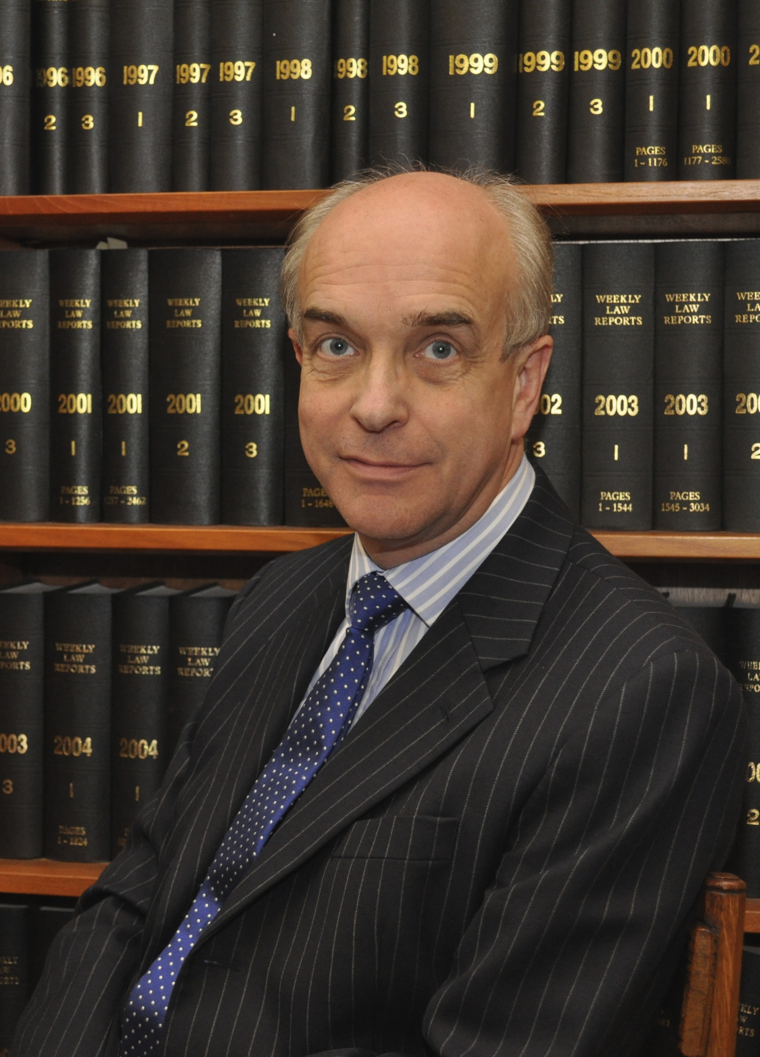
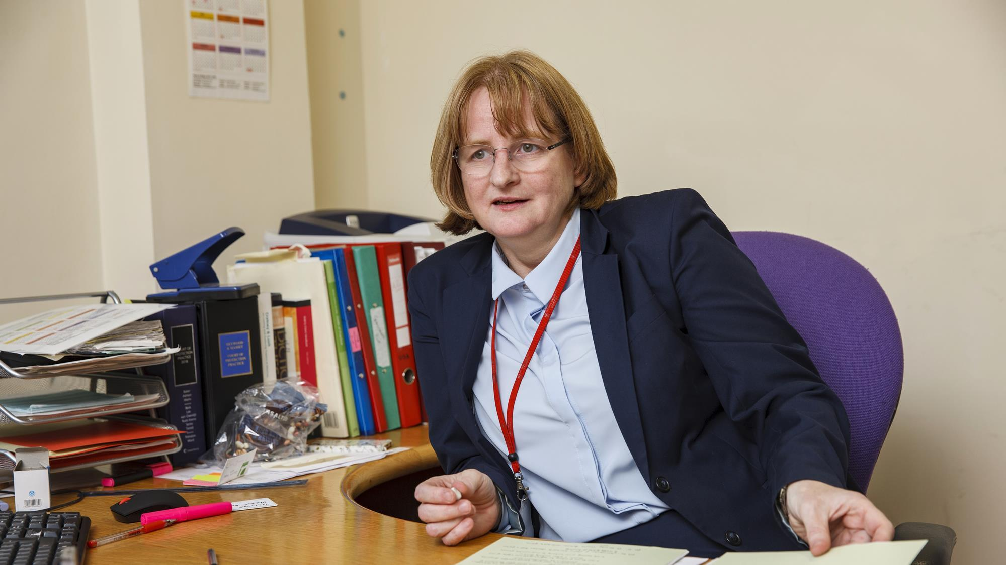
10 hearings before Vice President of the Court of Protection, Mr Justice Hayden
5 hearings before Senior Judge Carolyn Hilder
Other Tier 3 judges (e.g. Knowles, Mostyn,
Williams, Keehan)
Lots of Tier 2 (Circuit judges)
Lots of Tier 1 (District judges)
Mostly hearings at county courts
across England + Wales

Slide 5
2. Some background: the Court of Protection
Court of Protection is responsible for…
deciding whether someone has the mental capacity to make a particular decision for themselves
appointing deputies to make ongoing decisions for people who lack mental capacity
giving people permission to make one-off decisions on behalf of someone else who lacks mental capacity
handling urgent or emergency applications where a decision must be made on behalf of someone else without delay
making decisions about a lasting power of attorney or enduring power of attorney and considering any objections to their registration
considering applications to make statutory wills or gifts
making decisions about when someone can be deprived of their liberty under the Mental Capacity Act
(taken from their website)

Slide 6
Based in London (First Avenue House)
With Regional Hubs in Leeds, Newcastle, Manchester, Reading, Birmingham, Bristol and Cardiff
“Transparency is central to the philosophy of the Court of Protection” (Vice President, Mr Justice Hayden)
But most hearings have NO external observers (including no journalists) and most judgments are not published – both before and since the current public health emergency

Slide 7

“Fine words butter no parsnips”
Open justice. The words express a principle at the heart of our system of justice and vital to the rule of law. The rule of law is a fine concept but fine words butter no parsnips. How is the rule of law itself to be policed? It is an age old question. Quis custodiet ipsos custodes - who will guard the guards themselves? In a democracy, where power depends on the consent of the people governed, the answer must lie in the transparency of the legal process. Open justice lets in the light and allows the public to scrutinise the workings of the law, for better or for worse. Jeremy Bentham said in a well known passage quoted by Lord Shaw of Dunfermline in Scott v Scott [1913] AC 417, 477:
"Publicity is the very soul of justice. It is the keenest spur to exertion
and the surest of all guards against improbity. It keeps the judge
himself while trying under trial."
Lord Justice Toulson R (Guardian News and Media Ltd) v City of Westminster Magistrates’ Court [2012] QB 618

Slide 8
Barriers to transparency…
Lists of hearings – 3 different listing sites, often with errors + omissions including lack of contact details (or typos), can be hard to locate or interpret
Only released late afternoon the day before the hearings
Judicial support team + clerks don’t respond to requests to observe
Approx. 1 in 3 is vacated or adjourned
Judgments only published from approx. 1% of hearings
For 3 month period (May-July) I observed about a third of the hearings with published judgments (5/14 on BAILLI), but most of the hearings I observed (65/70) do NOT have published judgments.

Slide 9
3. Findings so far
(“P” = person at centre of case)
Lack of ability to understand, retain, weigh, communicate information must be caused by an impairment of the mind or brain (MCA 2005)
”Impairments of mind or brain” – dementia + learning disability most common (followed by psychiatric diagnoses)
Most common issues:
Does P have capacity to make the relevant decision – most often found P does NOT have capacity.
Given that P does not have capacity to make this decision, what is in P’s best interests (taking account P’s wishes and feelings)?

Slide 10
Decision needed
Most commonly – residence and care
P (with LD) lives at home with mother – she locks him in house with padlock during day when she’s working + isn’t providing diabetes medication. Is it in his BI to move to residential placement?
P is an artist in 80s with Alzheimer’s + limited mobility, wants to return home to his 4th floor flat/studio and paint
P is in 40s, in alcohol-free care home with Korsakoff’s – want to move somewhere he can drink alcohol
P in prison for arson (burnt own bedding in care home) – unable to make use of bail unless a residential placement can be found
P has brain injury after RTA – hates care home and wants to live independently
Eviction of P’s son so that P (in care home with dementia) can return home
P (hoarding disorder) in alternative accommodation so house can be cleared + made safe

Slide 11
LPAs and Deputies
Grandson appointed as LPA and sold P’s property, put her in care home and spent her money
1 of 3 sisters wants to be Deputy, other 2 sisters object
Parents asking for permission to appeal against decision that they can’t be Welfare Deputies for their 19 year old son

Slide 12
Serious Medical Treatment
Hormonal treatment (for primary ovarian failure)
Hysterectomy (for social reasons)
Feeding tubes (x4) including 2 anorexics, one hunger striker, one post-surgery stoma patient
Kidney dialysis
Covert medication for range of conditions

Slide 13
Remote justice can work as well as justice in physical courtrooms
Courts are overwhelmingly ‘person-centred’ + take account of P’s wishes and feelings
Both the courts and health and social care services are stretched to breaking point
There is a real problem in practice when counsel representing P presents arguments opposite to what P says s/he wants
Transparency + open justice really matter to people

Slide 14
4. Open Justice Court of Protection
Project founded (15 June 2020) and directed jointly with Gill Loomes-Quinn to support transparency and open justice in the Court of Protection.

Slide 15


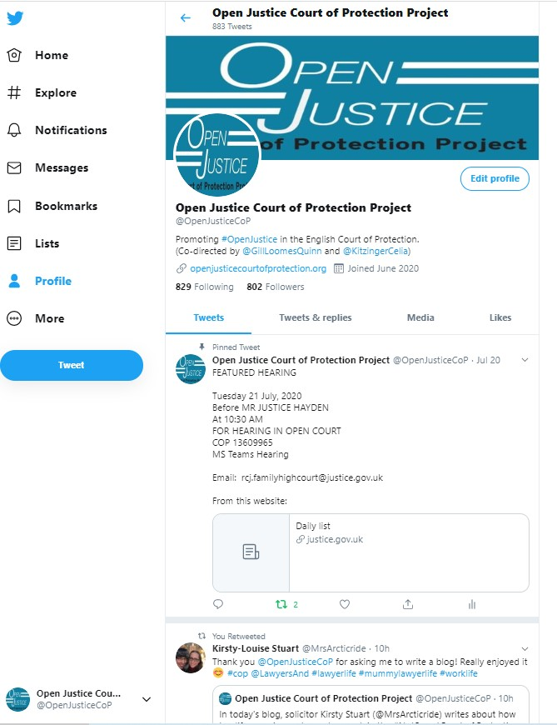
Our Website
Publicising CoP hearings
Twitter
Featured Hearings
Blog post from observers
Providing support and information to Public Observers about what to expect during a CoP hearing.
In particular how to access CoP hearings remotely.
openjusticecourtofprotection.org

Slide 16
Thank you
Comment, Questions, Observations, Feedback Welcome!
@OpenJusticeCOP
openjusticecourtofprotection.org

