Slide 1

Open Justice Court of Protection Project
Celia Kitzinger + Gill Loomes-Quinn

Slide 2
Structure of seminar
Welcome!
A. Introduction to Open Justice Court of Protection Project
Introduction to the Court of Protection
Observation in the Court of Protection – 10 Questions
Discussion/Questions?

Slide 3
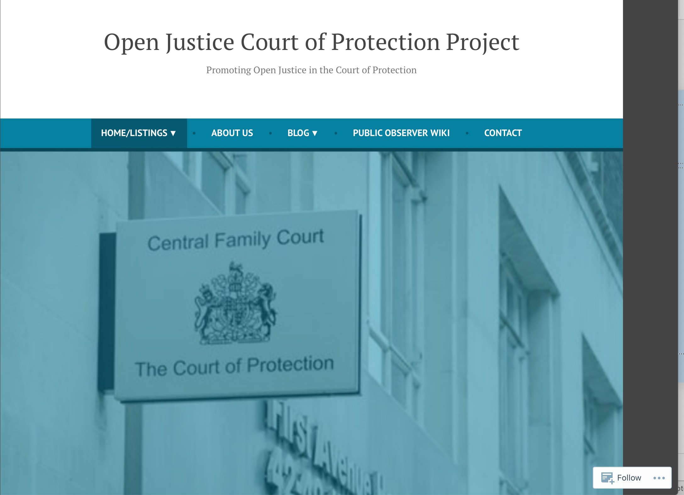
https://openjusticecourtofprotection.org

Slide 4
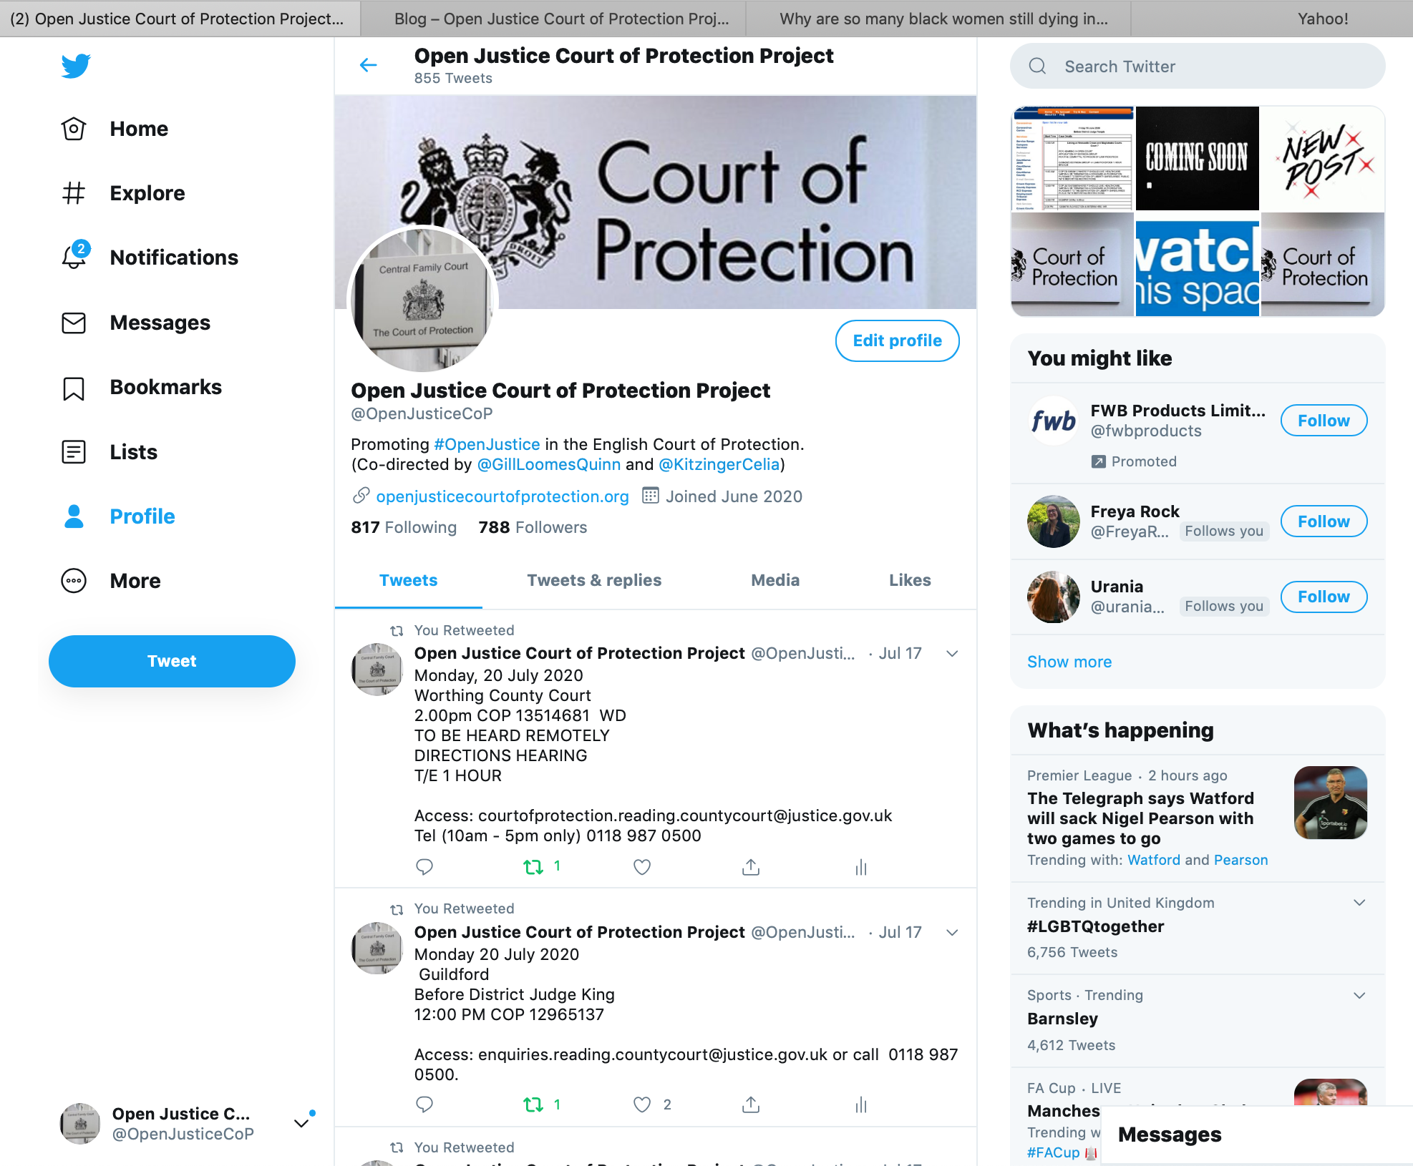
@OpenJusticeCoP

Slide 5
Court of Protection
Makes decisions on behalf of people deemed unable to make these decisions themselves due to impairment of mind or brain (e.g. dementia, autism, learning disability, brain injury)
Makes capacity determinations
Makes best interests determinations
Deals with issues concerning Deputies, Attorneys, Advance Decisions, statutory wills
London + 7 Regional Hubs (Leeds, Newcastle, Manchester, Reading, Bristol, Birmingham, Cardiff)

Slide 6
Relevant law
Mental Capacity Act 2005
Human Rights Act 1998
Also
Mental Capacity Act Code of Practice
Mental Capacity Act Deprivation of Liberty Safeguards Code of Practice
Court of Protection Rules
Court of Protection Practice Directions

Slide 7
Types of cases
Welfare – e.g. where someone should live, what care they should receive, contact between partners, friends, family members, marriage, sexual relationships
Health/medical treatment e.g. can a person consent to contraceptive injections or can they refuse to have a caesarean section or life-sustaining treatment & if not what decision should be made in their best interests?
Property + financial affairs e.g. whether a deputy should be appointed to manage someone’s money, statutory wills
Deprivation of Liberty Safeguards (Section 21A cases)

Slide 8
10 Questions
1. Why observe hearings in the Court of Protection? - What can I gain from it?
2. Where are the hearings – how will I know about them?
3. Can I observe particular issues (e.g. capacity, DOLS, residence, care, contact, medical decision) Or a particular impairment (e.g. learning disability, dementia, schizophrenia)
4. How should I prepare before observing a hearing?
5. How do I choose a hearing (judges, ease of access, platform, telephone or video, duration etc)?

Slide 9
…cont.
6. How do I join a hearing and what should I expect?
7. What information do I need to assemble (often quickly) when observing a hearing?
8. The Transparency Order – what does it mean?
9. How do I leave a hearing?
10. What should I do after the hearing?

Slide 10
1. Why observe hearings in the Court of Protection? - What can I gain from it?
Seeing justice being done
How judges use evidence and make decisions
How P is (or is not) involved in court
The role of expert witnesses
Seeing how judges balance protecting P + self-determination
Use made of records from social workers, doctors, care workers etc.
Better understanding of Mental Capacity Act in action
If you ever need to be in court….

Slide 11

2. Where are the hearings – how will I know about them?
We compile hearings every day and put ‘Featured Hearings’ on our website with information about how to request access.
“Featured Hearings” + others on Twitter
They come from First Avenue House (London), the Family Division (London) and CourtServe (across England + Wales)

Slide 12
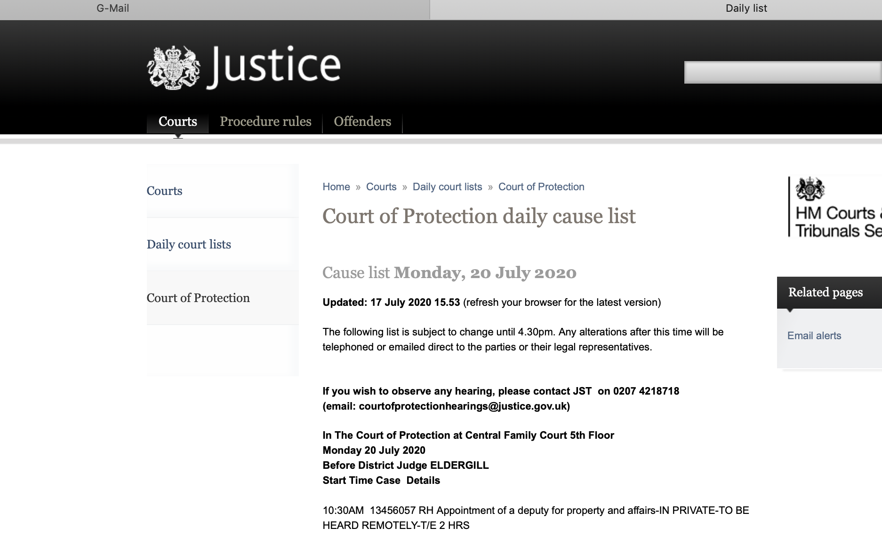
3. Can I observe a hearing dealing with a particular issue or particular impairment?
None of the lists give information about impairments
Only First Avenue House lists give information about issues
Common issues: where P should live, care, contact, DOLS
Rarely: medical decisions, sex, contraception,
Occasional: deputyships
Impairments: dementia, learning disability, mental health issues

Slide 13
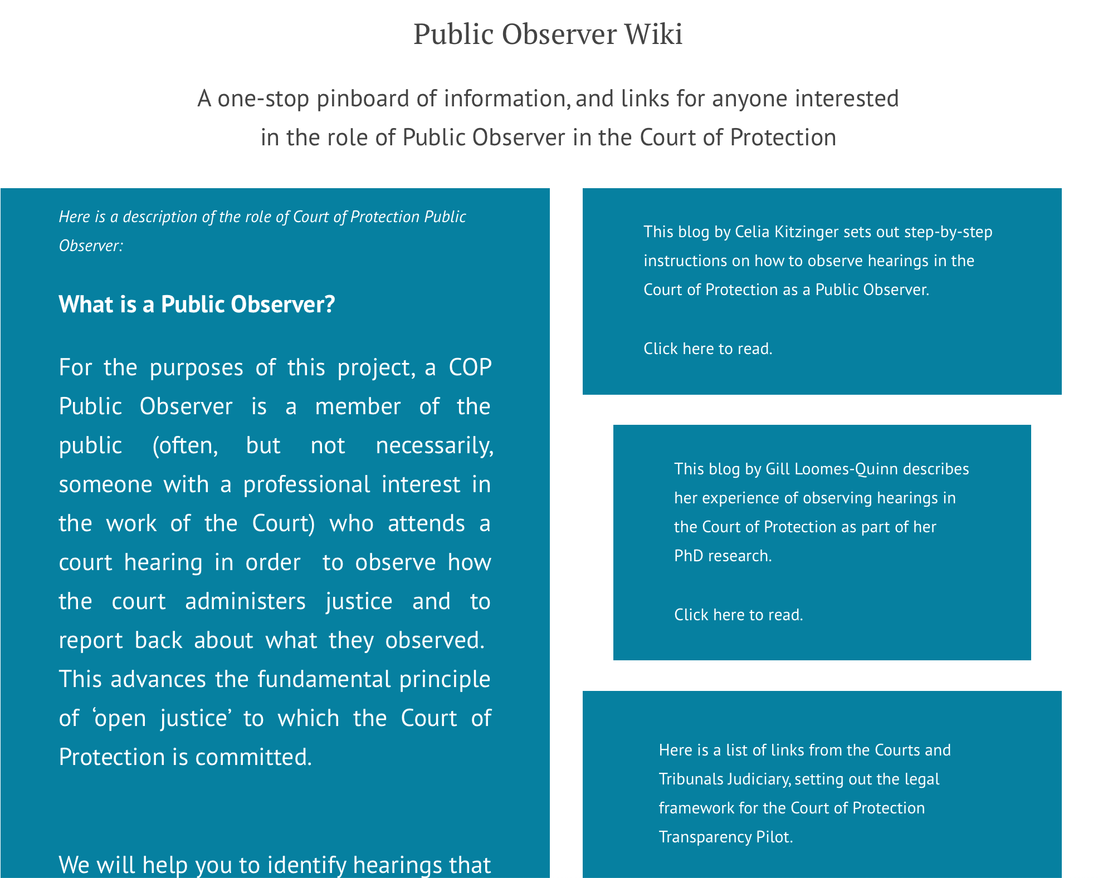
4. Preparing in advance
Check out our
Public Observer Wiki

Slide 14

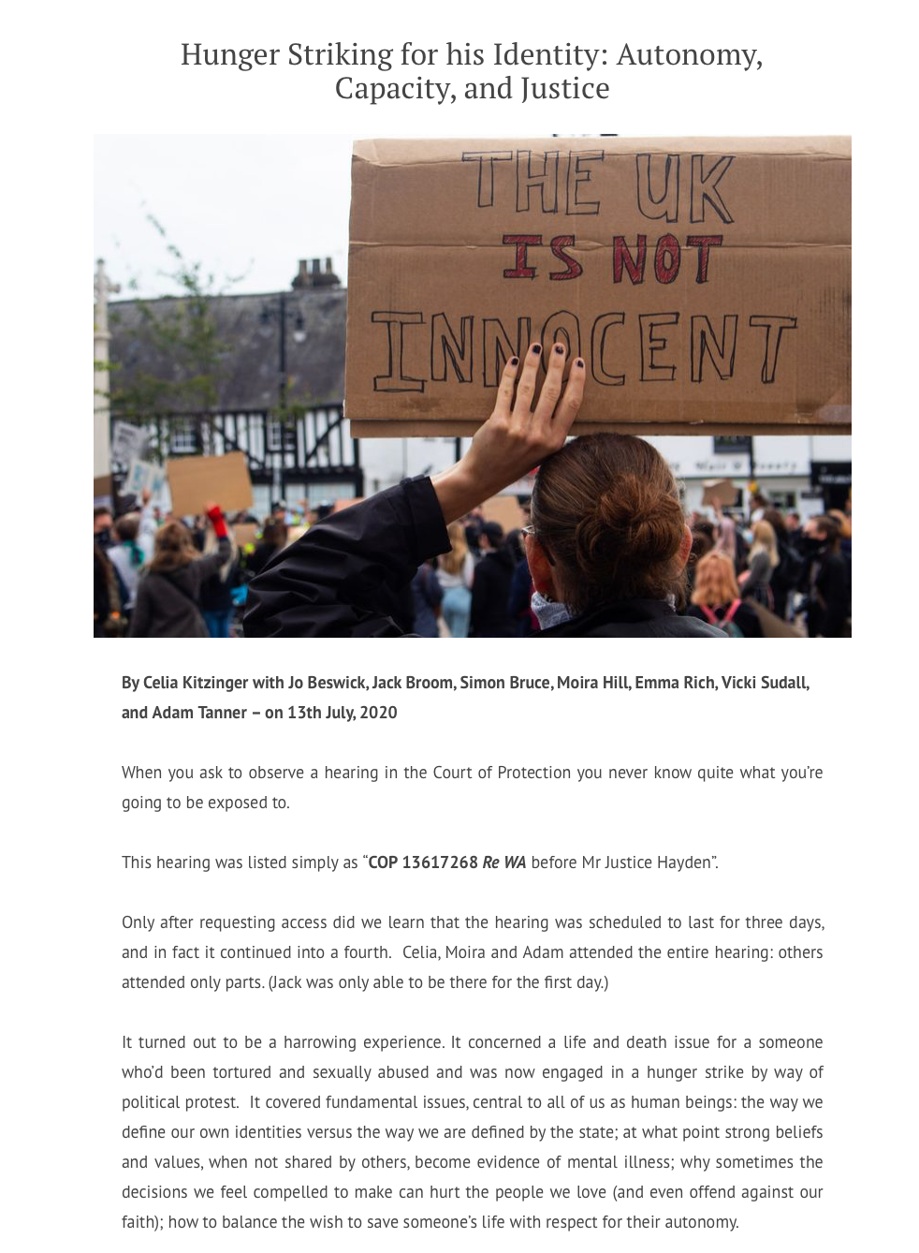


Read the blogs other observers have written

Slide 15
Check you know who you expect to be in court?
Judge (District Judge, Circuit Judge or High Court Judge)
Barristers (counsel) for the parties – maybe litigants in person; if P does not have capacity to instruct a lawyer they will have a ‘litigation friend’ or Accredited Legal Representative – sometimes the Official Solicitor
Instructing solicitors
“P” (person at the centre of the case)
P’s family/friends
Expert witnesses
Check out blog by Victoria Butler-Cole “Who’s Who in the Court of Protection?”
Also “Bundles” by Kyle Squire

Slide 16
5. How do I choose a hearing?
Your availability - date + morning/afternoon slot
“Featured Hearings” – usually chosen for ease of access (but 1/3 are vacated or adjourned)
Issues (in so far as available)
Regional courts?
Duration of hearings (not provided for Family Division hearings)
Judge: District Judge (DJ) Circuit Judge, or High Court (Family Division) – or celebrated judges like Hayden, Hilder, Eldergill
”Public” v. “private” hearings – very little difference in practice. For “private” hearings you must give a reason why you want to attend.
Have a ‘back-up’ second choice hearing! (e.g. 1 hour later or with same judge or via same email address)

Slide 17
6. How do I join a hearing?
Subject header: 10.30am 20 July Case: 13456057 RH DJ Eldergill
Dear Court Staff
I would like to observe this hearing as a member of the public please. It would be invaluable to me as a social worker to understand better the issues that arise in the appointment of deputies. My phone number is: 01234 56899. I look forward to hearing from you.
Amy Boody

Slide 18
…cont
Send an email asking to observe – maybe with a one-sentence reason. Include your phone number in the body of the email. Send it the night before if possible. Follow up (e.g. 8.45am) + later by phone.
Your email will be sent to the judge. Bear that in mind as you write it.
For phone hearings usually the judge will call you. Sometimes it’s a company that organizes the call. Very occasionally you are asked to dial in yourself.
For video-hearings (Skype, Zoom, CVP, Microsoft Teams) you are sent an email with a link. Click on it 5 mins before scheduled start time. You are usually held in a waiting room (and start times are often late)
Check you are in a room with the door closed, nobody can hear you or see your screen – and you won’t be interrupted. (No recording is permitted.)
You are usually asked to turn off your video + mike after joining
You will probably be reminded that proceedings are confidential.

Slide 19
7. Assembling information in a hearing
Who is on the line/in the video call. Write down all names (phonetically if necessary)
There should be an introduction + summary but sometimes there isn’t.
Who is Counsel for the Applicant?
Who is Counsel for the respondent(s)?
What is P’s impairment?
What is P deemed not to have capacity for?
What decision(s) are being made for P?
How are P’s wishes + feelings being factored in?
What still needs to be decided + what evidence is needed
You may not understand everything that is said but you can write it down and look it up afterwards (e.g. “section 48 order”)
Write down any vivid phrases or descriptions

Slide 20
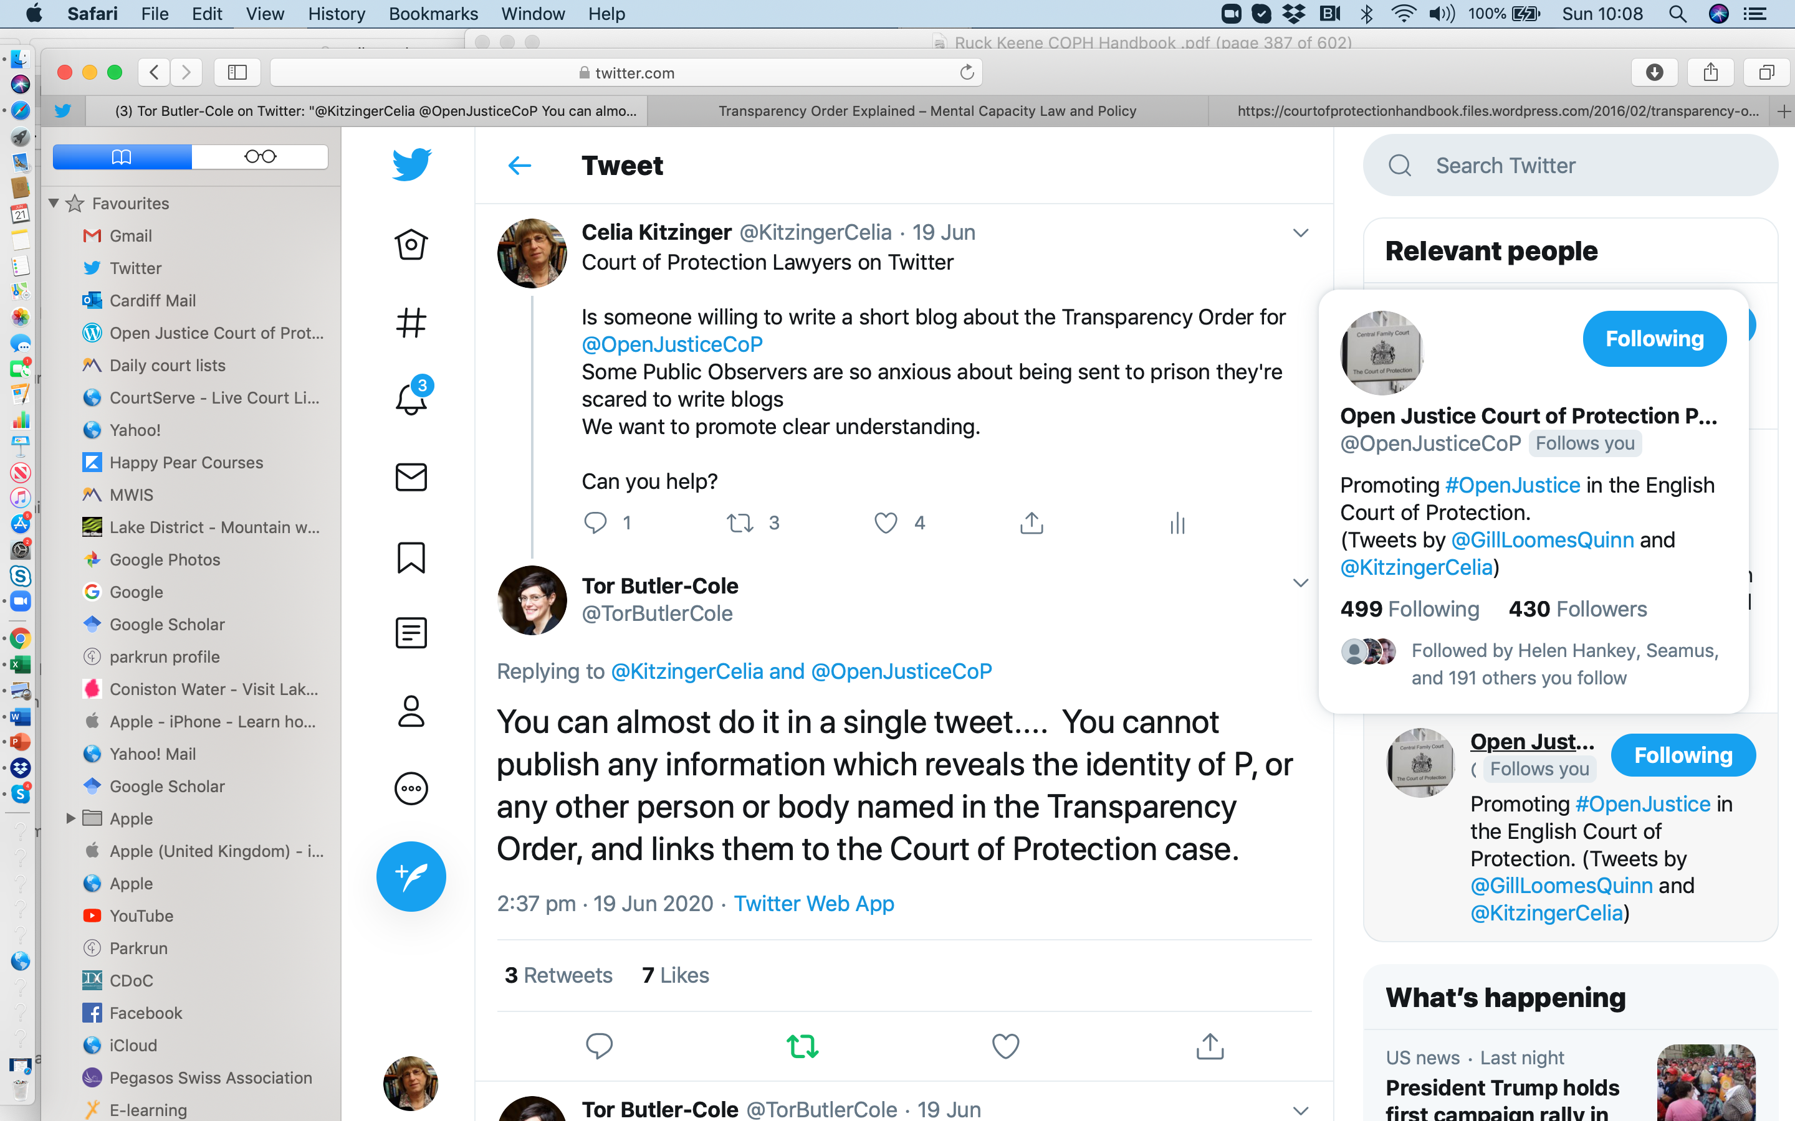
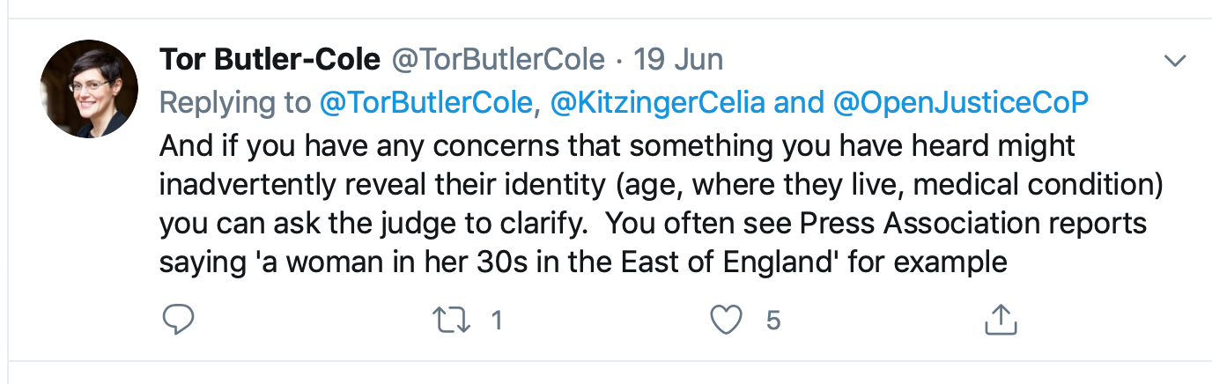
8. Transparency Order
My blog on Transparency Orders here
Email and ask: “Thank you for enabling me to attend the hearing this morning. It was very helpful.
I am hoping to write a bog about it for Open Justice Court of Protection. Please could I also request
the Transparency Order in order to ensure I comply with the injunction.”

Slide 21
9. How do I leave a hearing?
Just hang up or click ‘exit’
Do not ask to observe a hearing unless you are reasonably confident you can stay for the whole thing (it’s rude!) – be aware that they can over-run.
After 2.5 hours of a telephone hearing scheduled for 1 hour I had to leave and just put phone down. Judge rang me back.
After 5 hours of a video-hearing for which NO TIME ESTIMATE was provided in advance some observers sent ‘thank you – no more time’ emails to clerk. (It went on for 4 days)
After 30 mins of a hearing which I could not understand I left + sent polite ‘thank you’ explaining problem.

Slide 22
10. After the hearing…
Reflect on what you have learnt – write down impressions, thoughts, anything that surprised you
Make a list of the things you didn’t understand + try to look them up
Discuss with a colleague
Write us a blog – reflections on your experience and how observing impacted on you personally and/or professionally is more useful than an attempt to produce a narrative of what happened during the hearing
If you send us a blog please send Case Number + date + time of hearing and the Transparency Order if you have it.

Slide 23
Thank you! More questions?
kitzingercelia@gmail.com. @kitzingercelia

