Slide 1
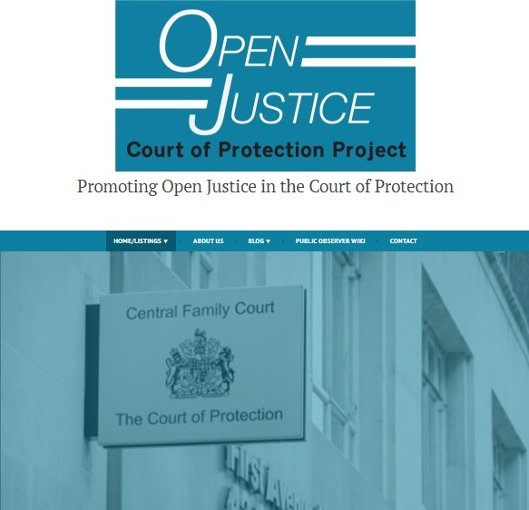
The Open Justice Court of Protection Project:
An opportunity for Legal Scholars
Gill loomes- Quinn and Celia Kitzinger
Mental disability law seminar
22nd July 2020

Slide 2

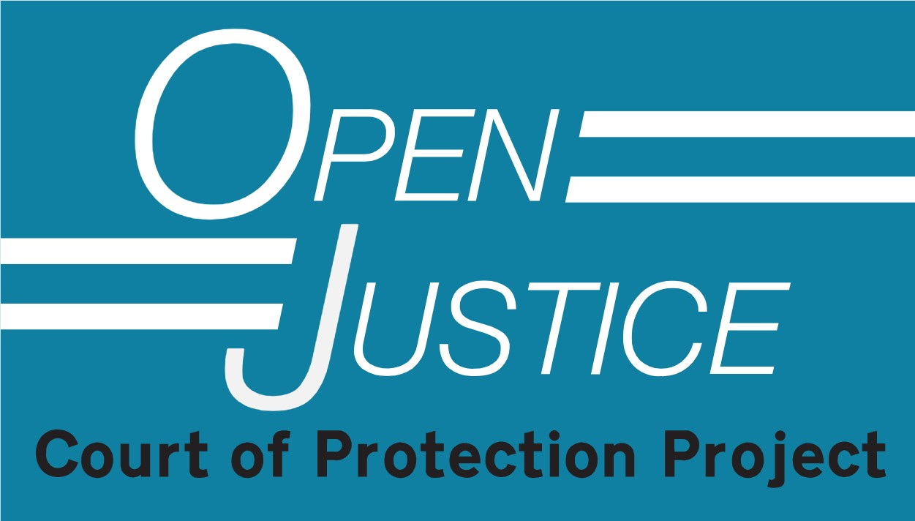
Talk Outline
Introduction to the Court of Protection
About the Open Justice Court of Protection Project
  The Project
  The Website
  The Blog
Why you should observe the CoP

Slide 3

The Court of Protection
Established in current form by the Mental Capacity Act 2005
Makes determinations about mental capacity
Makes Best Interests decisions on behalf of incapacitous adults
Impairments – e.g. dementia, learning disability, autism, psychiatric
Wide range of cases (health, welfare, property and affairs, DoLS)
Significant implications for Disability Justice
Sits in London (RCJ and First Avenue House) and Regions
Approx. 30 hearings scheduled per day
High percentage of adjournments/vacations (impact on observers)

Slide 4







Transparency
From 2007 most hearings held in private (except Serious Medical Treatment and Committal).
From 2009 press gained access (public access still prohibited – balance between public interest and maintaining dignity and privacy of P).
Court of Protection Transparency Pilot launched in 2016 and formalized in 2017.
Assumption that most hearings would be public with Reporting Restrictions (Transparency Order).
“Transparency is central to the culture of the Court of Protection”. (Mr Justice Hayden)
Low public attendance at hearings.
Access challenges (particularly publicizing hearings).

Slide 5
The Project
Provides information and practical support to Public Observers
Shares updates on developments in the CoP
Reports on hearings we’ve observed
Uses our experiences to impact the development of Open Justice in the CoP
Launched 15th June 2020
Shares court listings
Provides links to published judgments

Slide 6


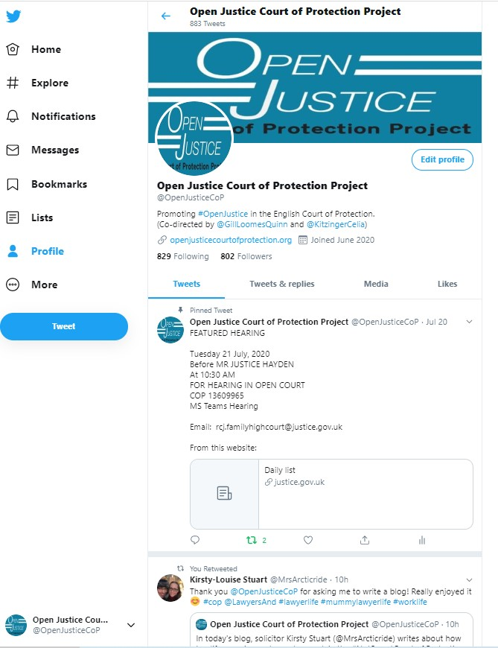
The Website
Publicising CoP hearings
Twitter
Featured Hearings
Complexities: Short notice, incoherent/inconsistent, lack of details (issues, impairments etc)
Providing support and information to Public Observers about what to expect during a CoP hearing.
In particular how to access CoP hearings remotely.
openjusticecourtofprotection.org

Slide 7
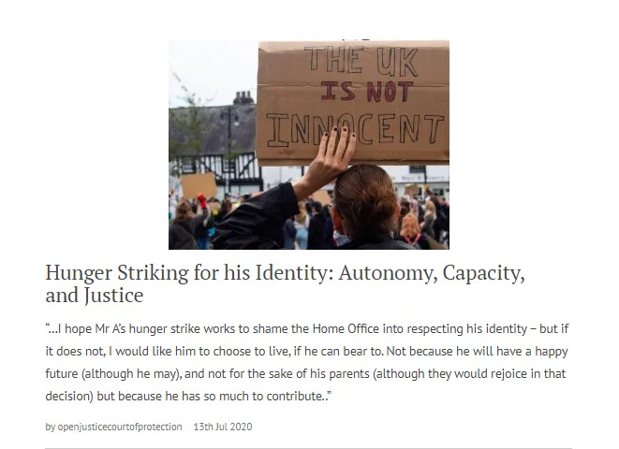
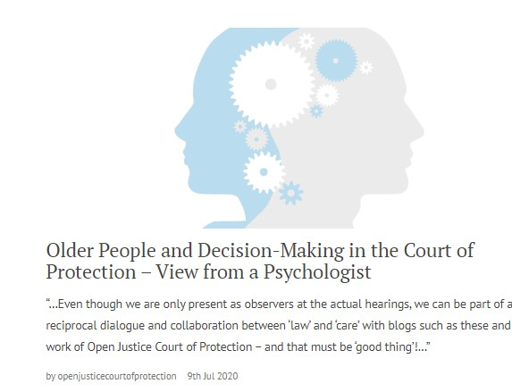
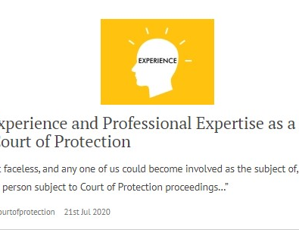
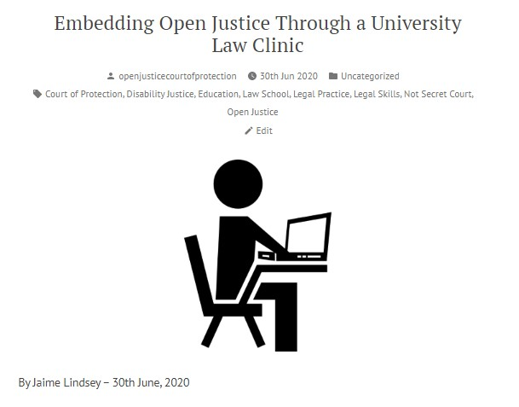
The Blog
Public Observer Reports (including some by multiple authors with a range of perspectives on a hearing) – Ontological implications for lawyers.
Public Observers from a range of relevant professional backgrounds (e.g. psychologists, MCA 2005 trainers).
Information Pieces on aspects of Court of Protection practice – explaining the work of the court and specific key roles (e.g. transparency orders, court bundles, how BSL interpreters work).
Project News – Including details of short-term collaborations with other organizations and projects.

Slide 8

Why Observe the CoP in Action?
See justice being done – Public scrutiny
Experience Law in Action (powerful experience alongside legal scholarship) – Expand your thinking
“Everyday” legal practice
See how judges use evidence in decision-making
Observe professional roles and interactions
Develop legal literacy – and work on embedding this in public and political contexts
Relationship between law and culture
Personal impact (6 million people per year impacted by MCA 2005, either as P or as carers – a small proportion directly encounter CoP, but need to understand its role in the “grand scheme”).

Slide 9
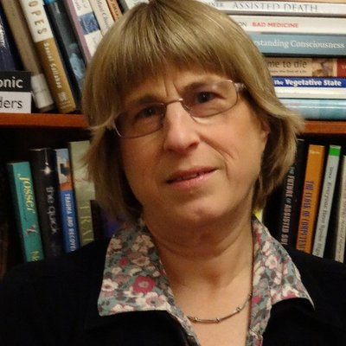
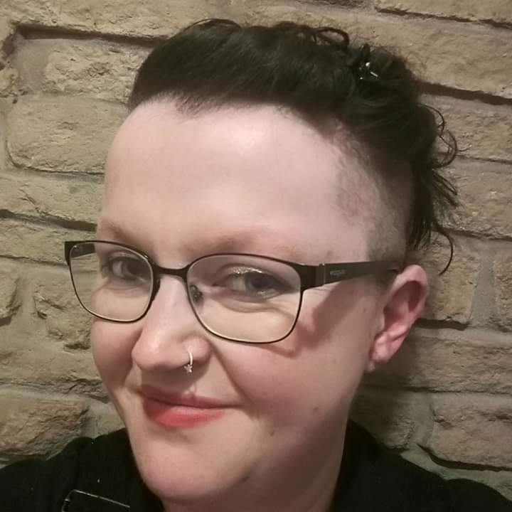
Further Details and Contact
Website:
openjusticecourtofprotection.org
Twitter:
@OpenJusticeCoP
The Open Justice Court of Protection Project is co-directed by Celia Kitzinger and Gill Loomes-Quinn.
This presentation was compiled by GLQ – any errors or omissions are her responsibility alone.
Email:
OpenJustice@yahoo.com

