Slide 1



The Court of Protection: open justice during the pandemic
Celia Kitzinger
Honorary Professor Cardiff University
Co-Director of the Open Justice Court of Protection Project
kitzingerc@Cardiff.ac.uk
@kitzingercelia
Kitzinger
International Pandemic Clinic, Liverpool John Moores University Law School. 17 November 2020

Slide 2
How I got involved
Observed first all-remote hearing in the Court of Protection
Lack of ‘gravitas’: “Court architecture is replaced with the backdrop of barristers’ and witnesses’ living rooms. The judge appears up close and personal, just like anyone else with his face in a little square on the screen. And what we found in practice was that a preoccupation with the technology distracted people’s attention from the substantive content of the case.”
an unseemly and self-congratulatory focus about being “the first” such case, about its “pioneering” role in remote justice. Sarah said: “I’d like the judge and lawyers to know that this hearing was not about bigging yourselves up because you did the first Skype trial. This is about my Dad.”
marked lack of empathy - nobody – except those of us in the room with her – could see how upset Sarah became at various points and so they didn’t modify their behaviour to avoid causing her unnecessary distress.

Slide 3
Celia Kitzinger
104 remote hearings in the Court of Protection since 1 May 2020
Video-platform and telephone
District judges in regions (including Liverpool), Circuit judges + High Court (Tier 3) judges sitting in the Royal Courts of Justice
Founded the Open Justice Court of Protection Project (with Gill Loomes-Quinn), 15 June 2020
We’ve supported 100s of people to observe court hearings – and published 70 blog posts.

Slide 4
Human rights in the Court of Protection

Slide 5
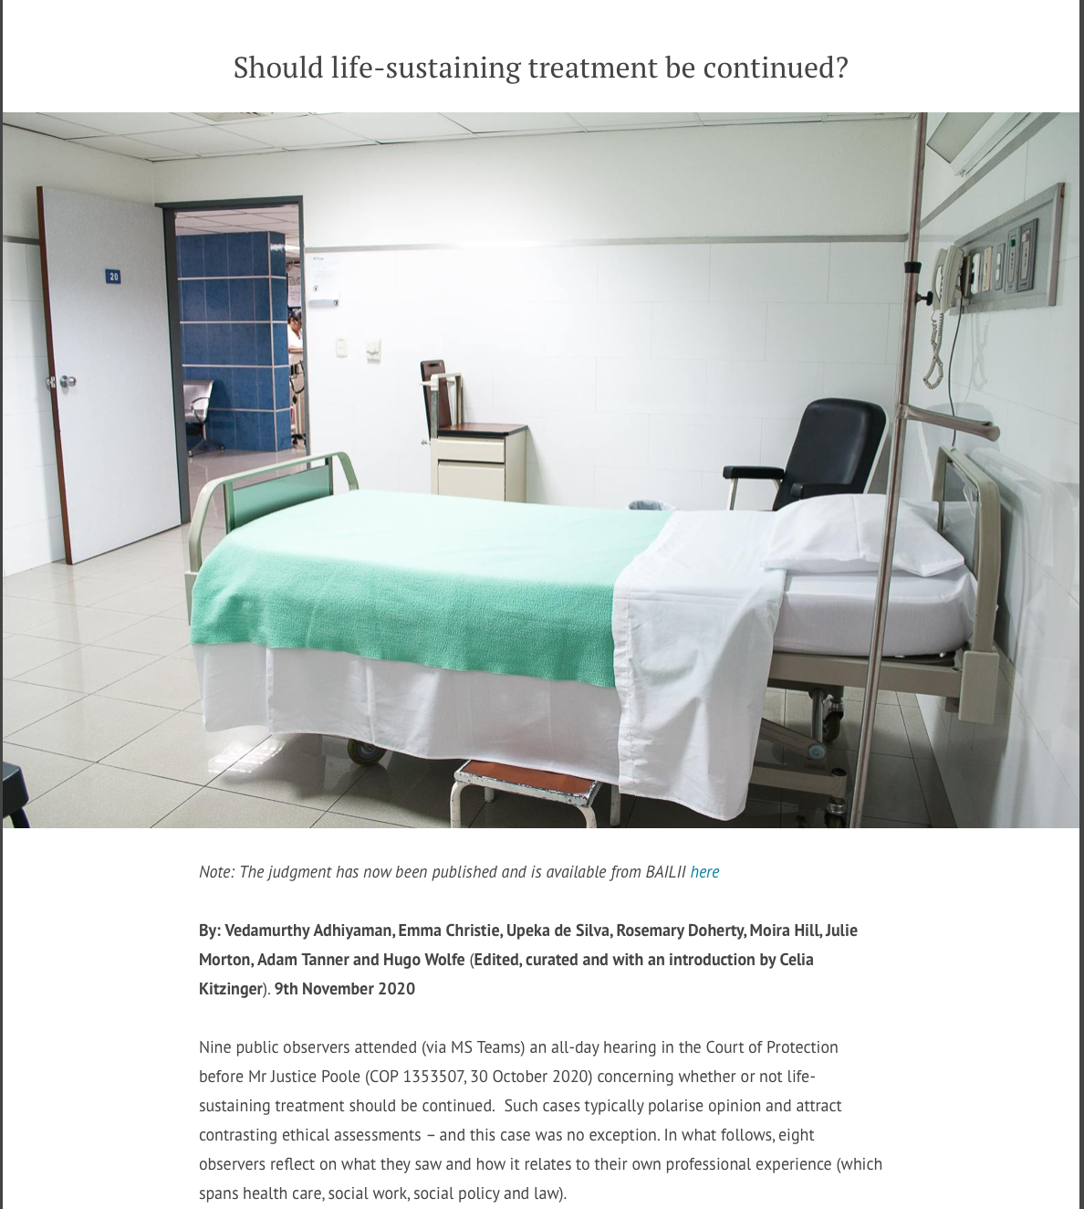

Slide 6
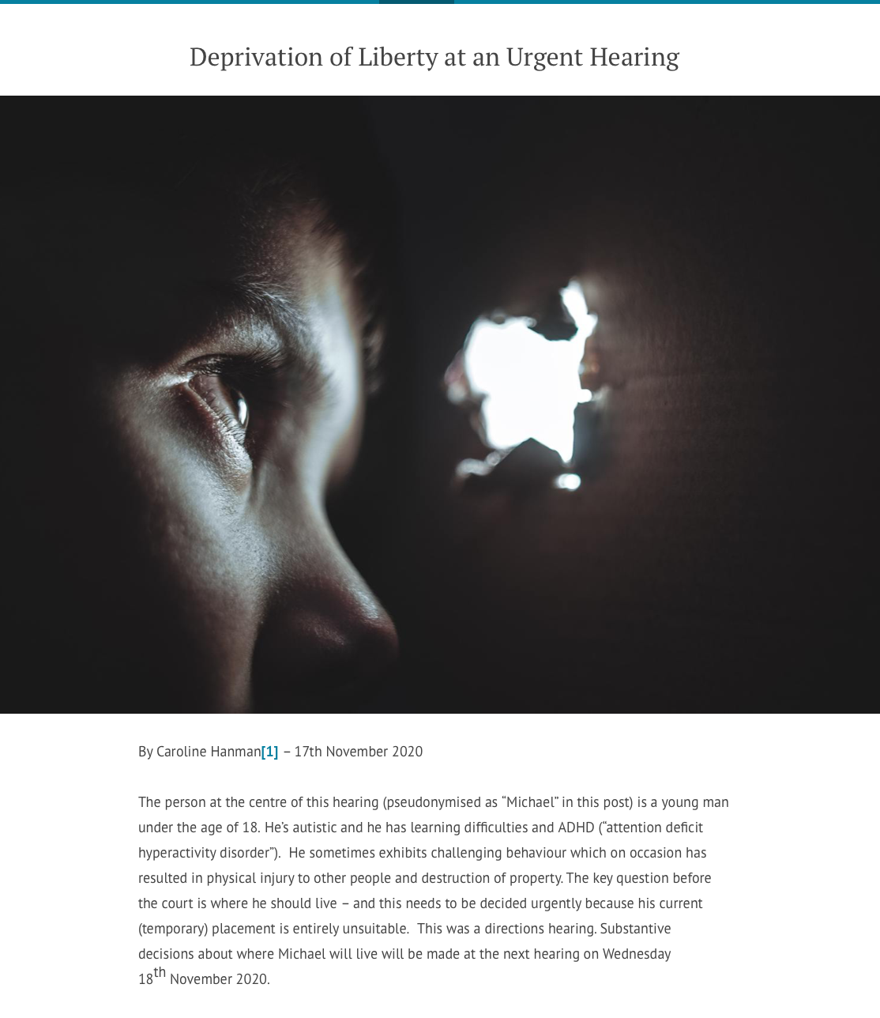

Slide 7
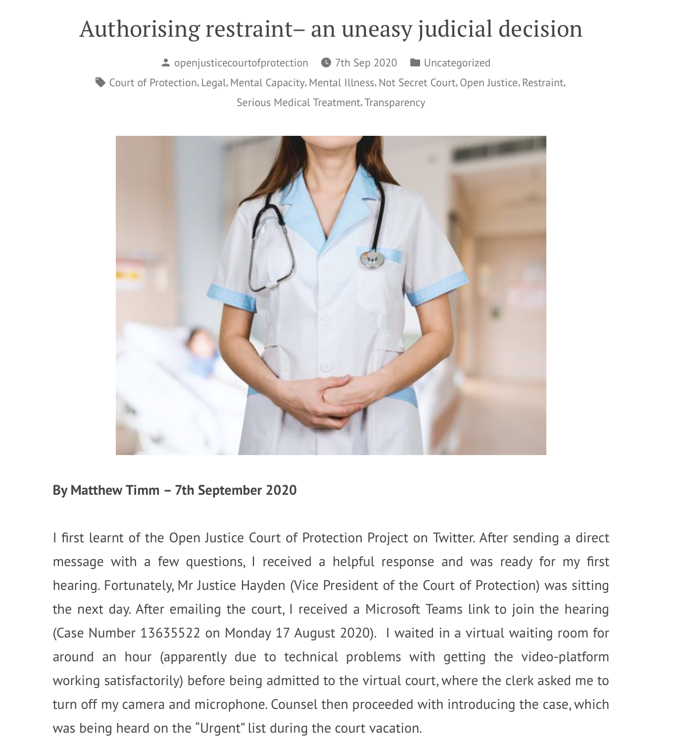

Slide 8
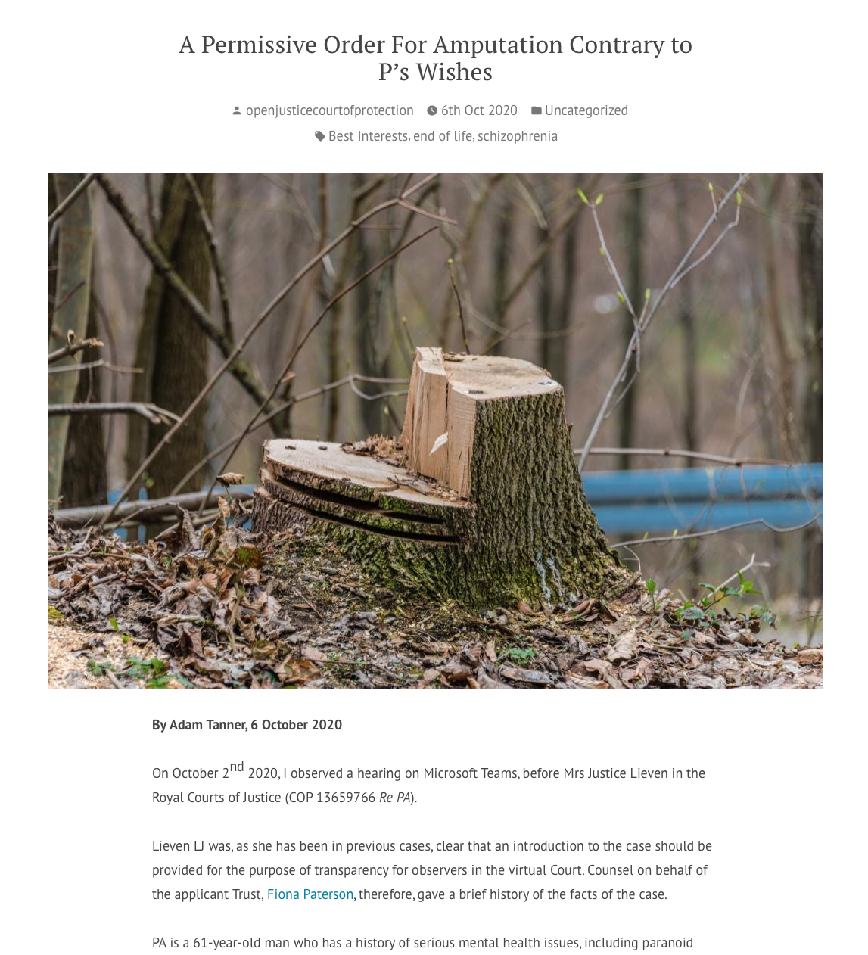

Slide 9
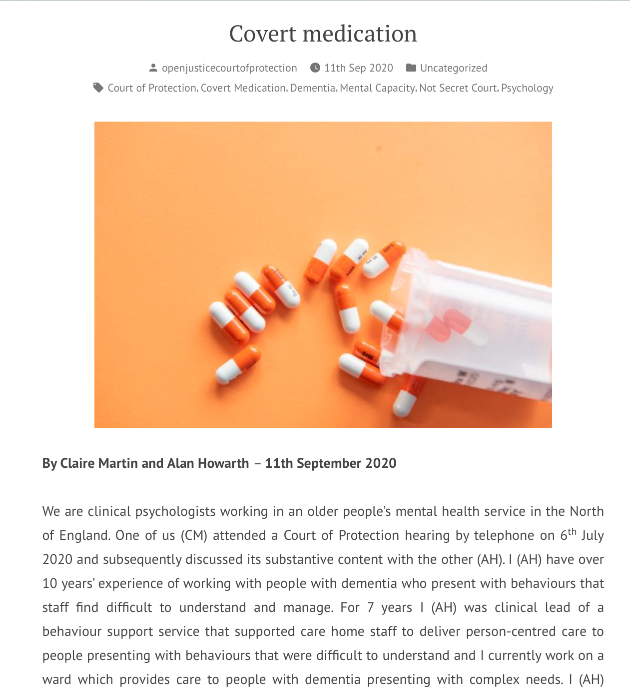

Slide 10
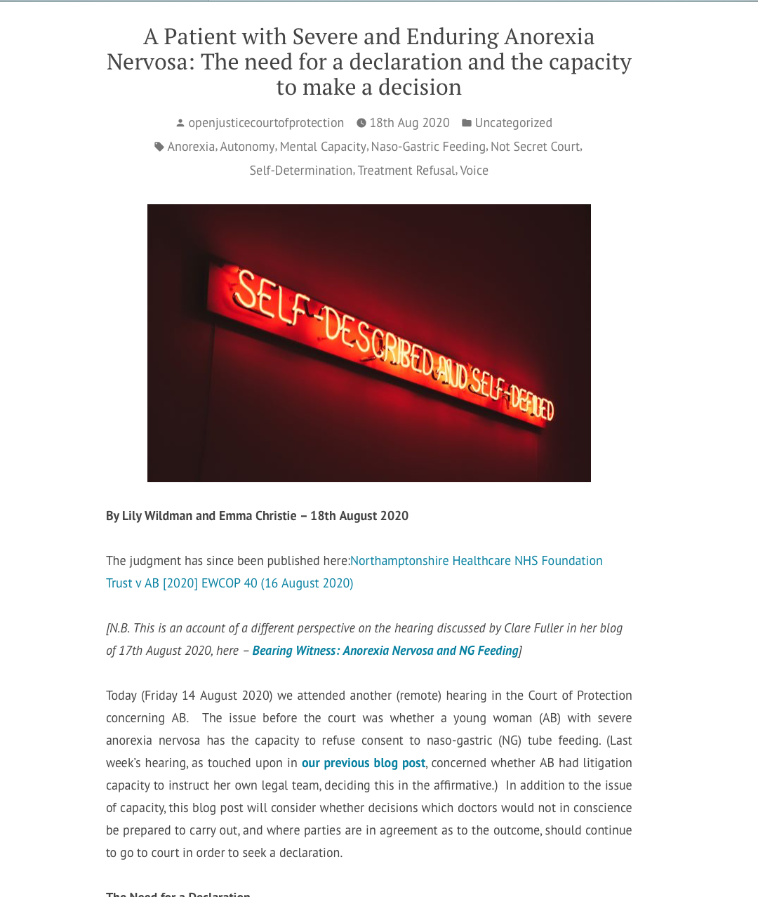

Slide 11
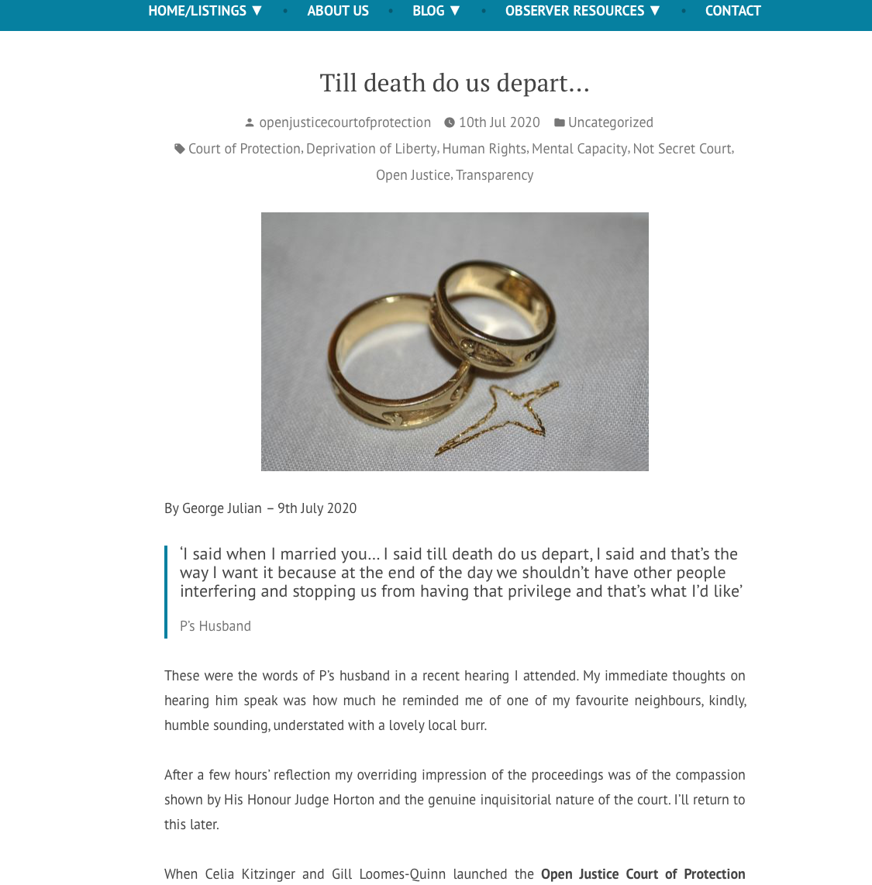

Slide 12
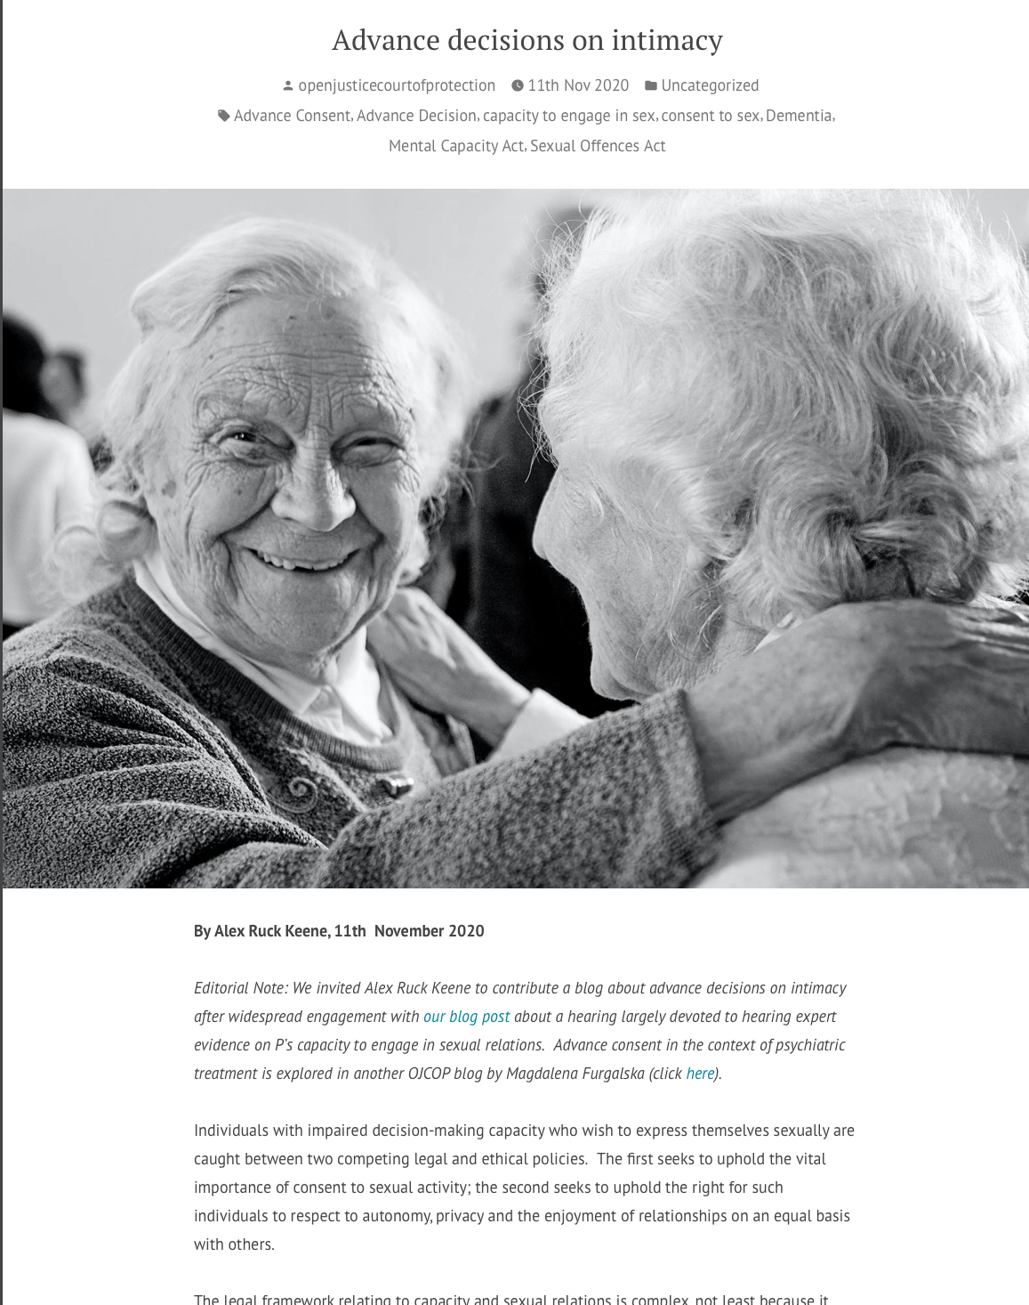

Slide 13
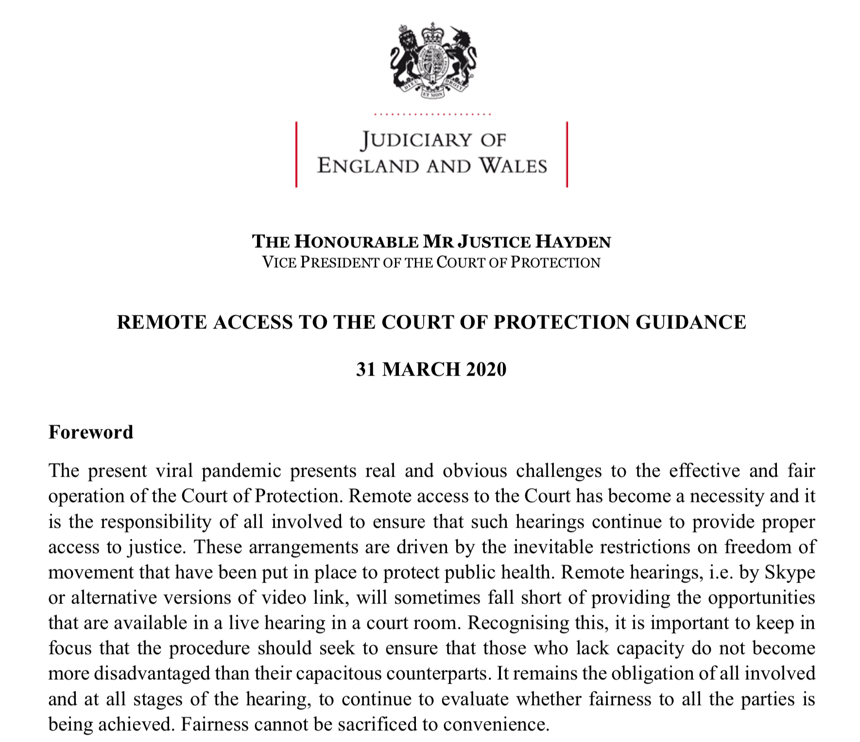
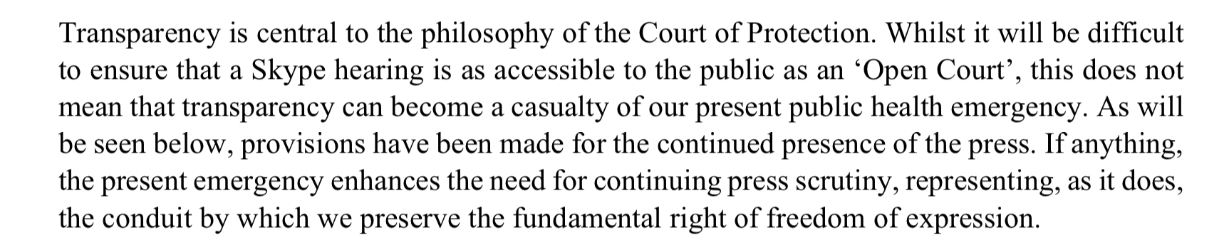
Threat to open justice
Guidance from Mr Justice Hayden 31 March 2020
Created HIVE group (a multi-disciplinary
think tank that has been established to address and
anticipate the impact of COVID-19 on the
litigants in the Court of Protection).

Slide 14
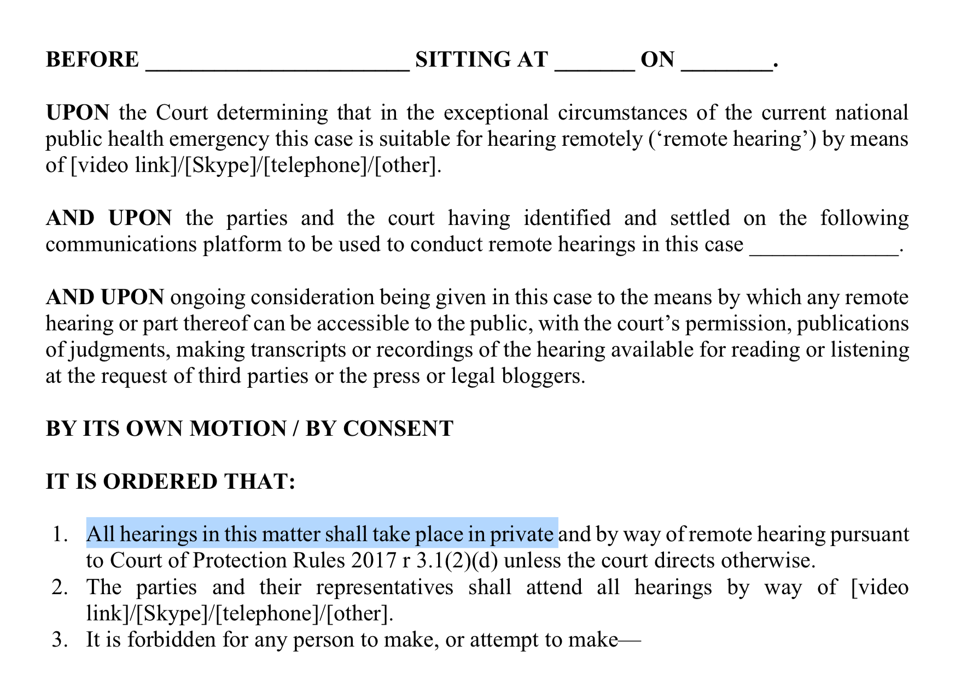
“Remote hearings are the default position until further direction.”
The new template Order in Hayden’s Guidance
Risk that all hearings would now take place in private.

Slide 15

“Fine words butter no parsnips”
Open justice. The words express a principle at the heart of our system of justice and vital to the rule of law. The rule of law is a fine concept but fine words butter no parsnips. How is the rule of law itself to be policed? …. In a democracy, where power depends on the consent of the people governed, the answer must lie in the transparency of the legal process. Open justice lets in the light and allows the public to scrutinise the workings of the law, for better or for worse. Lord Justice Toulson R (Guardian News and Media Ltd) v City of Westminster Magistrates’ Court [2012] QB 618
"Publicity is the very soul of justice. It is the keenest spur to exertion and the surest of all guards against improbity. It keeps the judge himself while trying under trial.” (Jeremy Bentham quoted by Lord Shaw of Dunfermline in Scott v Scott [1913] AC 417, 477)

Slide 16
  “Transparency is central to the philosophy of the Court of Protection […] The Vice President and the Hive group are particularly keen to ensure that the considerable efforts made to achieve a properly transparent Court of Protection are not undermined by the exigencies of the social distancing imperatives. (Mr Justice Hayden)
But most hearings have NO external observers (including no journalists) and most judgments are not published – both before and since the current public health emergency
How to fulfil judicial commitment to transparency and open justice when public don’t attend?
The Open Justice Court of Protection Project is committed to overcoming barriers and highlighting incentives to support public observation of court hearings.

Slide 17


Slide 18
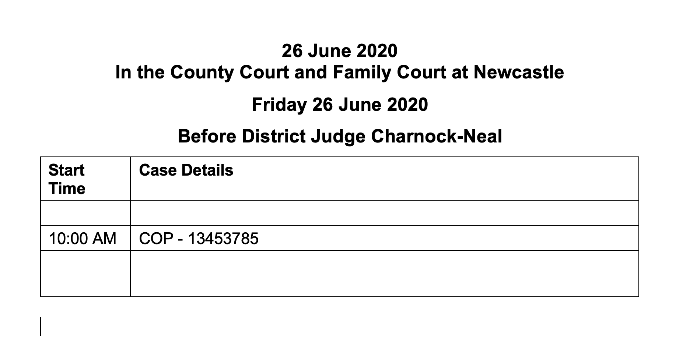
Typical example from CourtServe in June 2020

Slide 19
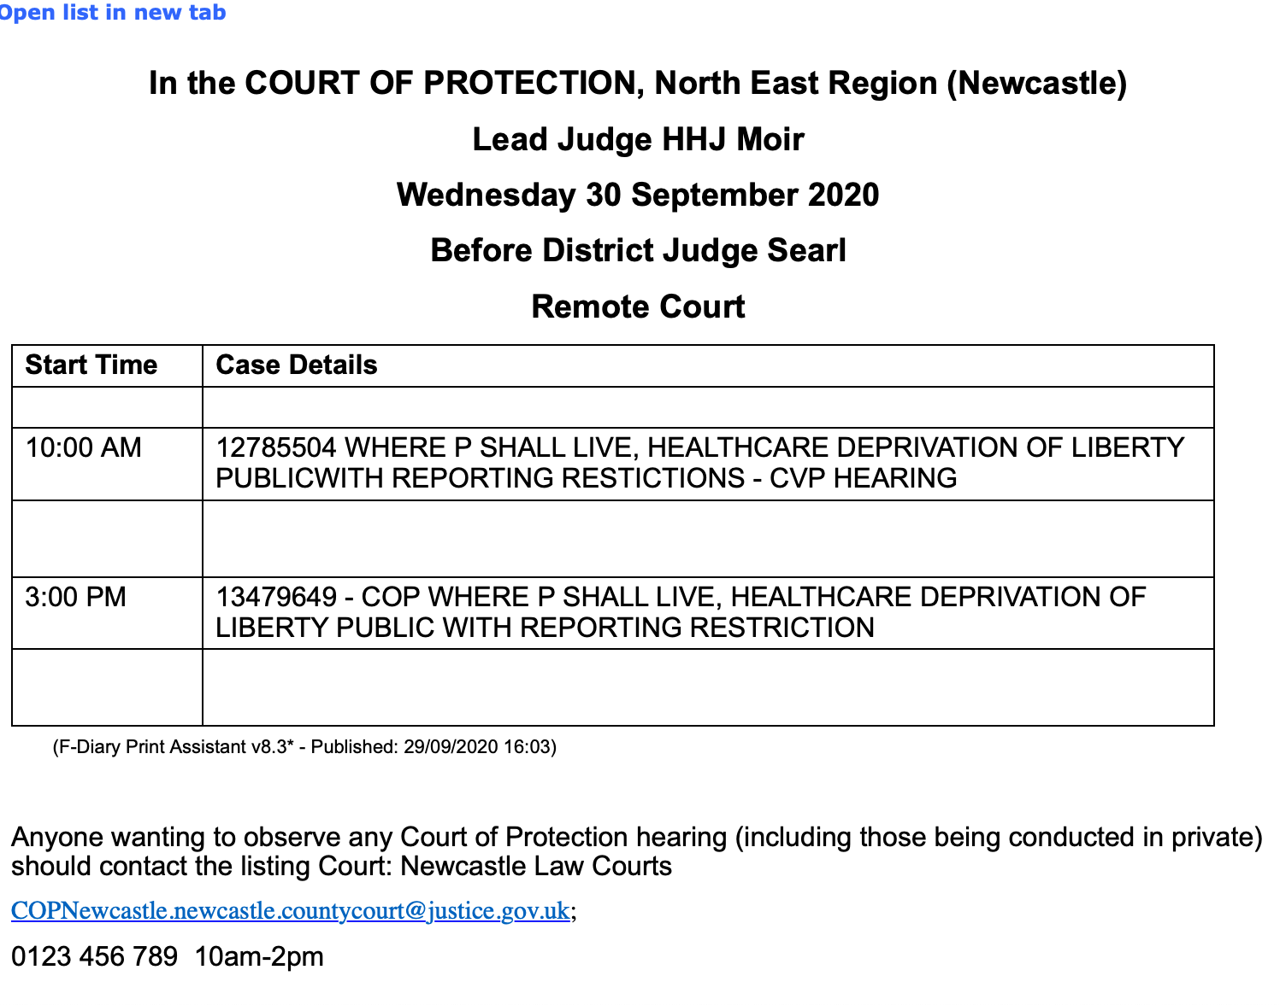
Issues to be addressed
”Public”
“CVP hearing”
Accurate contact information
Exemplary – but not yet typical – from CourtServe in September 2020

Slide 20
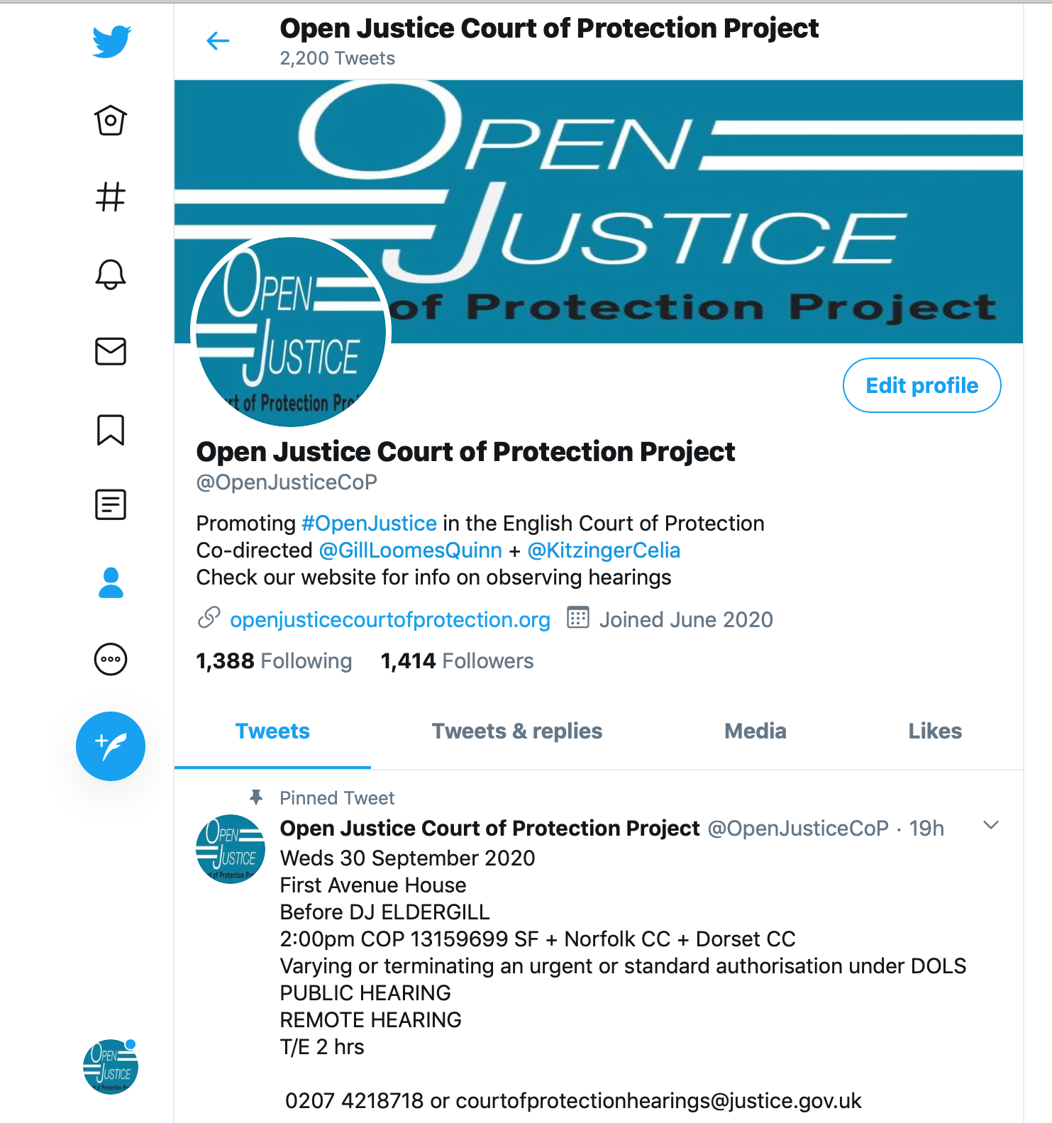

@OpenJusticeCOP

Slide 21
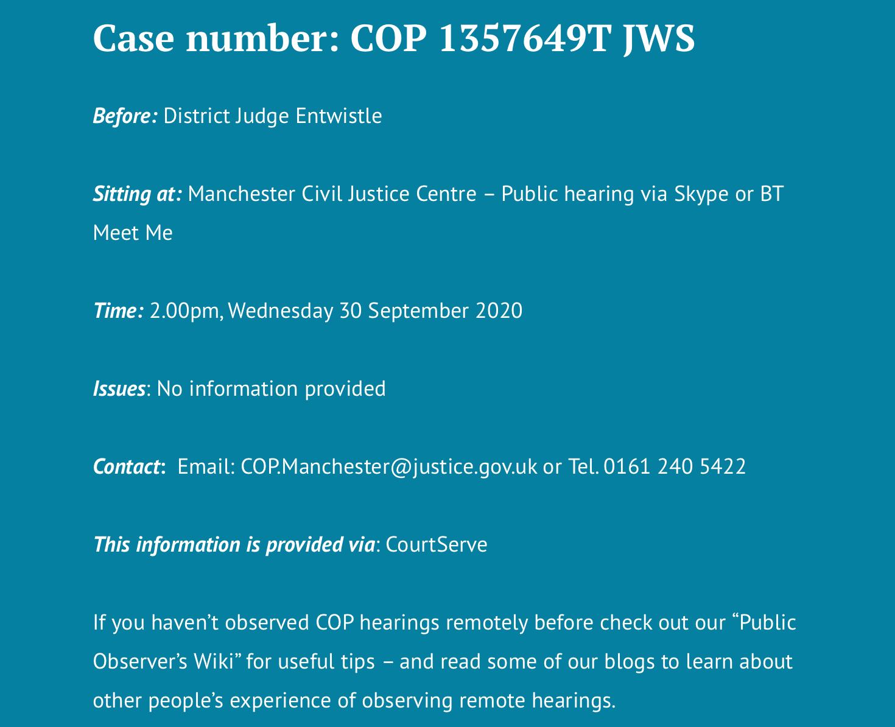
List of ”Featured Hearings” on the home page of our website
Provides correct contact info
Decodes T/E, BTMM, CMH, Dirs, etc
Selects those to which we think access is most likely

Slide 22

By Alex Ruck Keene
39 Essex Chambers

Slide 23

By Victoria Butler Cole QC
39 Essex Chambers

Slide 24

By Kyle Squire
5 Pump Court Chambers

Slide 25
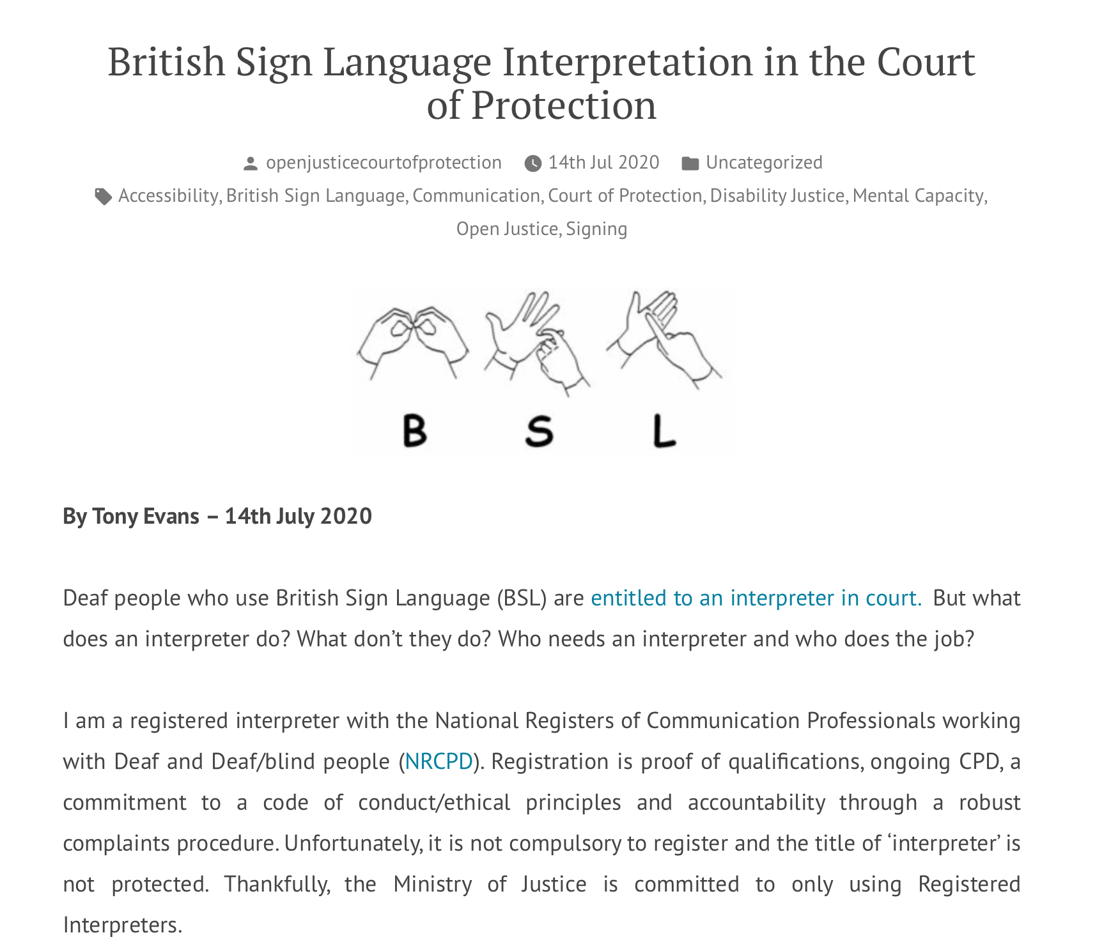
By Tony Evans

Slide 26
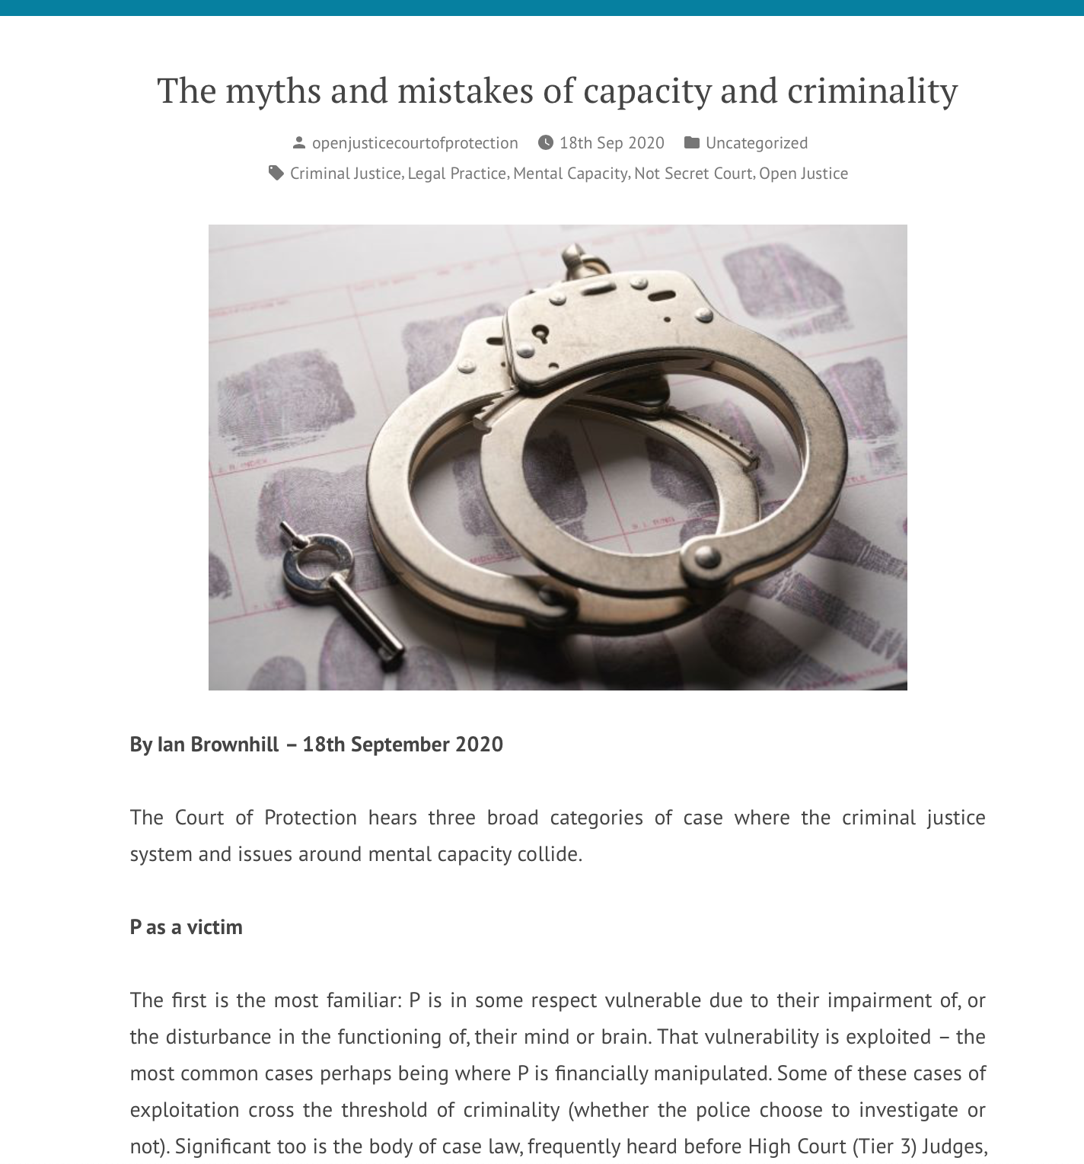
By Ian Brownhill
39 Essex Chambers

Slide 27
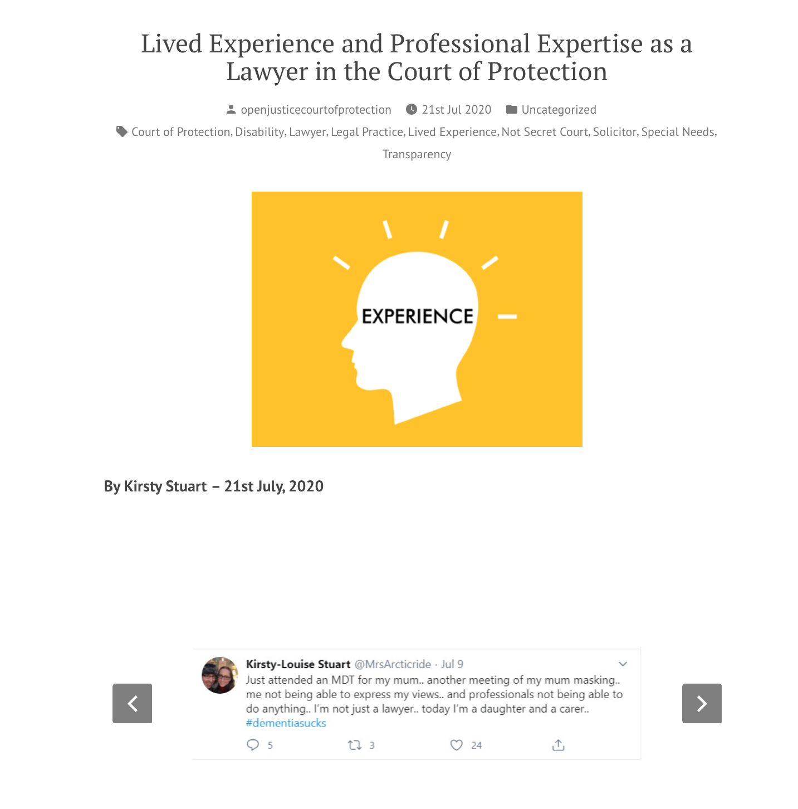
By Kirsty Stuart
Irwin Mitchell

Slide 28
Hearing Feedback Form
Info about observer
How hearing was listed
Access to hearing + Transparency Order
Technology issues (it’s almost always fine – an occasional glitch)
Was there an introductory summary?
Who was there (by role)? (applicant, respondents, P, P’s family, witnesses etc)
How were P’s wishes and feelings represented and by whom?
What order was being sought + what were areas of disagreement?
What did the court decide?
What is going to happen next?

Slide 29
Developing legal literacy through observation
I have found the whole observation experience very beneficial. The googling, looking up of legislation, reading up of quoted case law – both during and after the court attendance – has given me a crash course in legislation, that I now realise, I only thought I understood. Listening to a talk about how the Mental Capacity Act is implemented in the courts is one thing – actually observing it as it happens is very different! (Louise Burrell, social worker)

Slide 30
Developing legal literacy via public discussion and informed critique
The Court of Protection makes decisions that observers (and other members of the public) can find distressing:
ordering that P must remain in a place they don’t want to live
separating a husband and wife against their wishes, by placing one in a care home
prohibiting contact for 6 months between a mother and her adult daughter
declining a family member’s request to act as a deputy for P
preventing P from having sexual relations
compelling P to have medical treatment against their wishes

Slide 31
These issues are often poorly reported in the media (e.g. Hayden’s alleged comment about a man’s ‘right’ to have sex with his wife) and leads to perception of COP as a secret court making arbitrary and draconian decisions
Observing a hearing permits understand of context, multi-disciplinary perspectives, concrete ethical dilemmas, real-world contingencies, ‘least worst’ options – texture and nuance
Court judgments and processes can be criticized and debated but in a more informed way

Slide 32
Other threats to human rights in pandemic as seen in COP hearings
Human rights of people who lack capacity to understand + follow government guidelines
Care homes + visiting guidelines – contact restrictions
Challenges in moving P from one placement to another
Difficulties in getting reports from clinicians
Continuing difficulties in getting expert witnesses for the court
Working conditions (stress, burnout) for judges, lawyers + HCPs
Litigants in Person (before and since pandemic) – usually P’s family members (NB P is always represented)

Slide 33
Human rights achievements in COP
Justice has continued to be done…
… and seen to be done (many more observers than before)
Extremely hard work and long hours from judges and lawyers committed to COP values
Many more Ps and members of Ps family in court than ever before
Judges more likely to have talked to P in advance of the hearing
Creative adaptations with technology to permit Ps involvement
Massive increase in public interest of the COP’s work via Open Justice Court of Protection Project.

Slide 34
Thank you!
Celia Kitzinger
KitzingerC@Cardiff.ac.uk
@kitzingercelia
Get involved! Check out our website and follow us on Twitter

