Slide 1



Transparency in the Court of Protection from the perspective of public observers
Celia Kitzinger
Honorary Professor Cardiff University
Co-Director (with Gill Loomes-Quinn)
Open Justice Court of Protection Project
kitzingerc@Cardiff.ac.uk
@kitzingercelia
Transparency Review 2nd February 2021

Slide 2


Slide 3
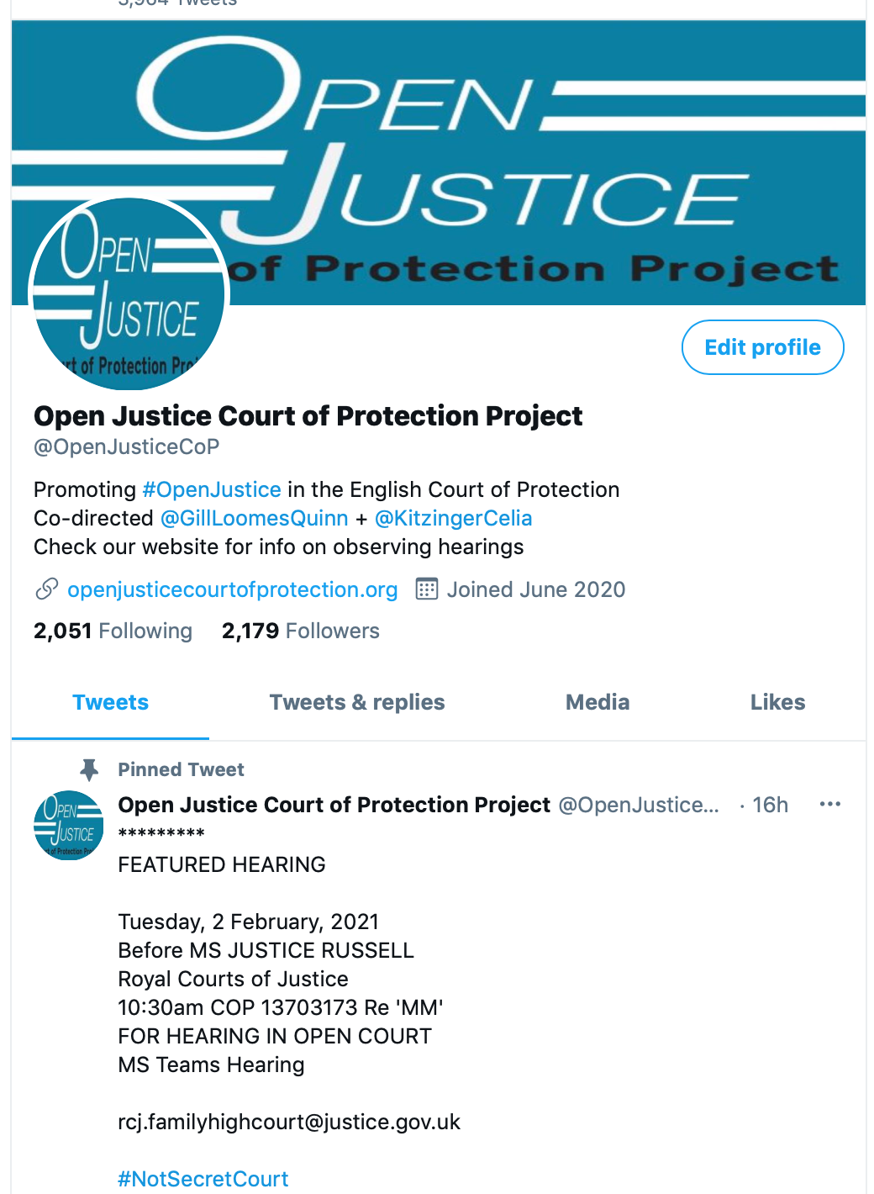
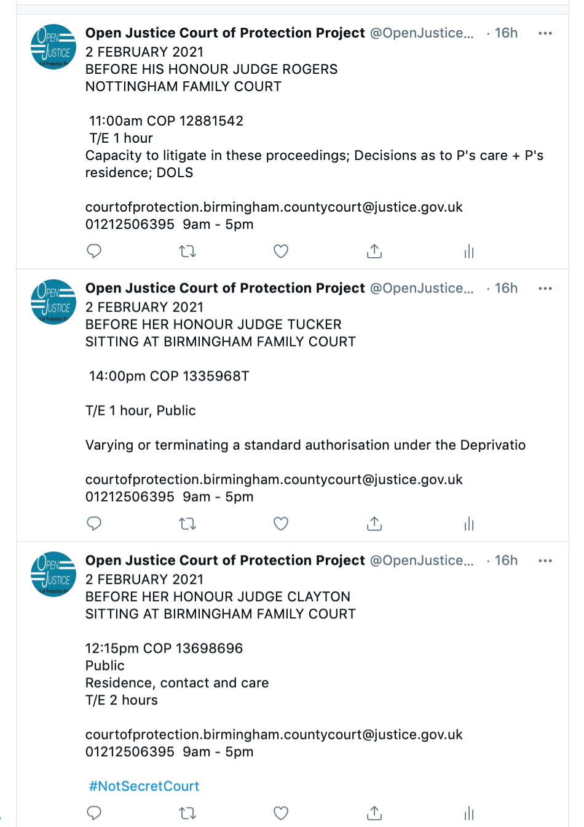

Slide 4
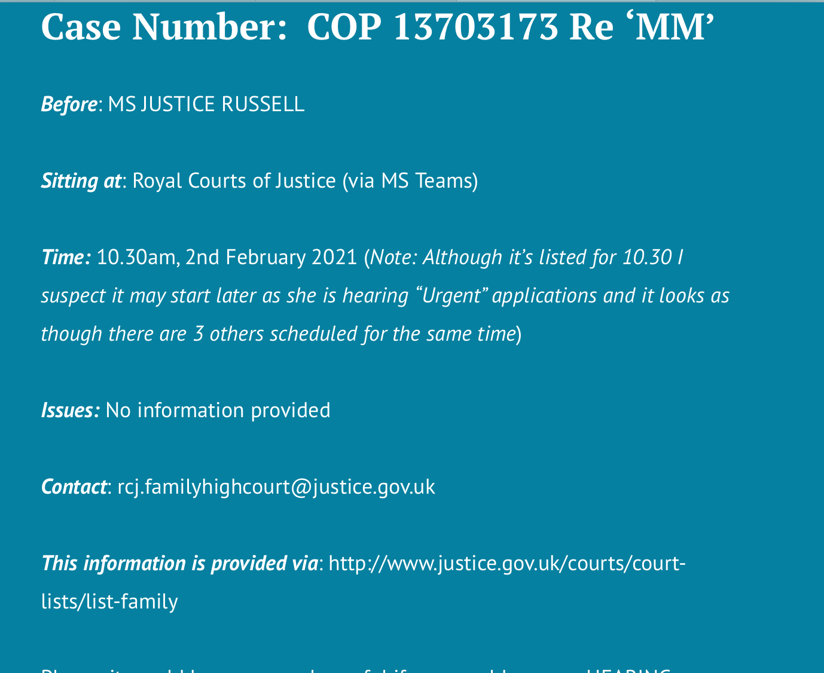
Today’s ‘Featured Hearing’
Current listings are not fit for purpose for observers
List of ”Featured Hearings” on the home page of our website
Provides correct contact info
Decodes T/E, BTMM, CMH, Dirs, etc
Selects those to which we think access is most likely

Slide 5
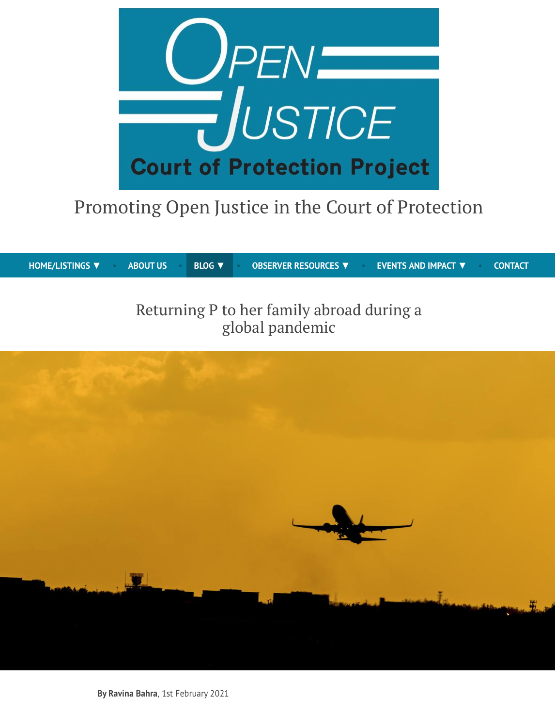
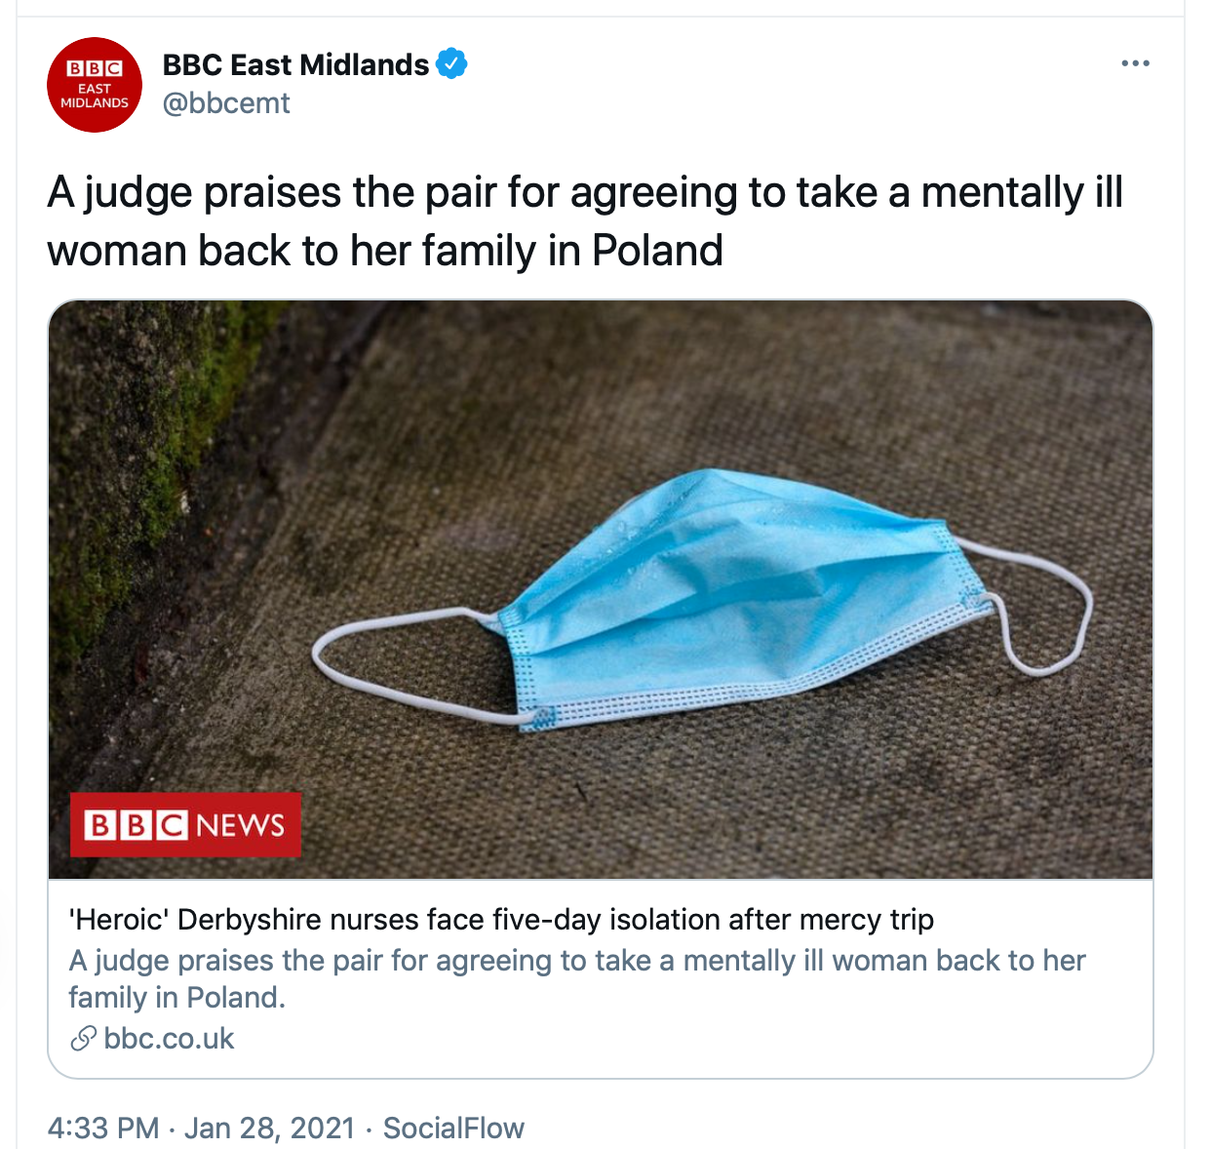
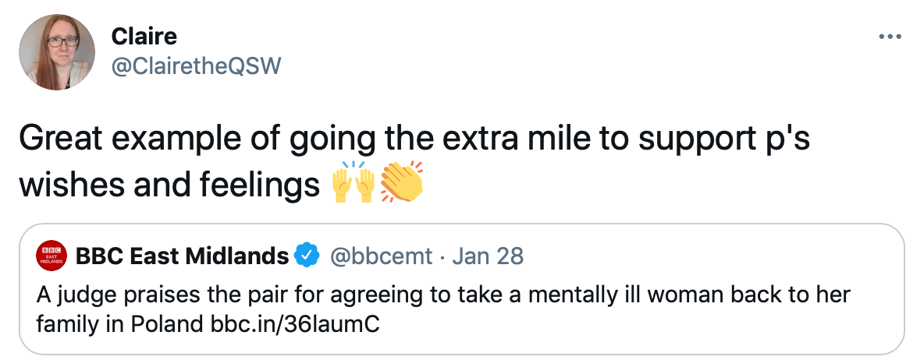
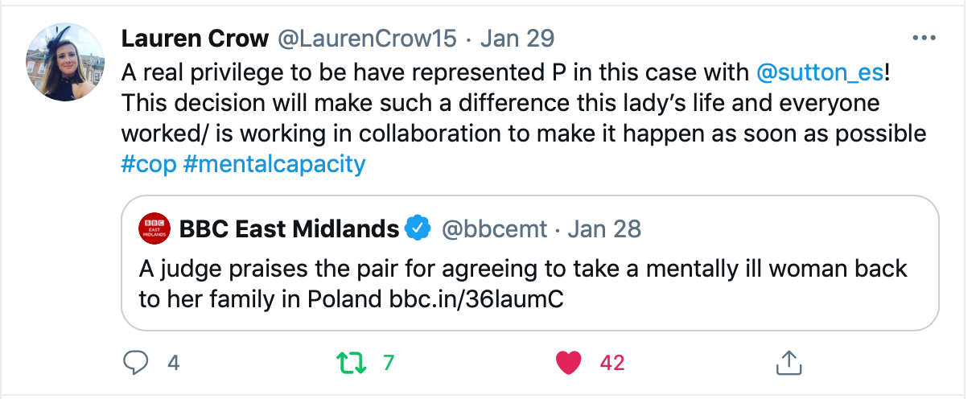
Today’s lead blog post
Compare accounts of same hearings from journalists + public bloggers

Slide 6
  “Transparency is central to the philosophy of the Court of Protection […] The Vice President and the Hive group are particularly keen to ensure that the considerable efforts made to achieve a properly transparent Court of Protection are not undermined by the exigencies of the social distancing imperatives. (Mr Justice Hayden)
The Open Justice Court of Protection Project was created to support the judiciary’s commitment to transparency and open justice.
Supported 100s of people to observe hearings and 90+ blogs in 7 months.

Slide 7
Project rose out of observing the first - disastrous – all-remote hearing in the COP (“Remote Justice: A Family Perspective” – a contribution that led to development of COP Guidelines for remote hearings, e.g. maintaining professional decorum, checking backdrops)
Observed another 19 hearings during May 2020
Realised value beyond ‘policing’ the court – not just guarding against improbity or keeping the judge while judging under trial.
Much to learn about MCA, much to admire about court focus on P, much to defend (in social context of ‘activist lawyers’, ‘enemies of the people’, media outrage e.g. Alfie Evans – and now calls for resignations of prominent QC for representing the ‘wrong’ side etc)
Founded jointly on 15th June 2020 with Gill Loomes-Quinn (disability rights scholar + activist)
Independent of COP and HIVE – we didn’t think to ask ‘permission’ (but have kept informed and liaised re. particular concerns, e.g. listings)

Slide 8
Who is observing hearings?

Slide 9
Health and social care professionals (largest single category)
(Aspiring) Lawyers
Families of ‘vulnerable’ people – some involved in COP hearings themselves

Slide 10
Health and social care professionals
Social workers, case managers, IMCAs, clinical psychologists, speech and language therapists, nurses, care home managers….
  “My interest in wanting to observe a case is really one of professional development and wanting to learn more, so that I can better represent the clients I work with. I also want to be able to enhance my ability to support the team in understanding how the court works and what to expect if we’re called to court or asked to provide information, such as a statement for a hearing.” (Jackie Waggott, Case Manager, Social Return Case Management – blog post for OJCOP)

Slide 11
“As an Adults Social Worker, I consider people’s mental capacity on a daily basis and complete formal documented mental capacity assessments probably once or twice a week. When financial management is involved this often results in paperwork for a Court of Protection (COP) application. I know the COP is there in the background to my work but once my paperwork is sent in, I have never given it much further consideration. When the opportunity to observe a COP hearing arose I was very keen to see ‘what happens next’”.
(Louise Burrell, social worker)

Slide 12
On 29 June I started a job as a 2-day per week trainee Independent Mental Capacity Advocate (IMCA) and Relevant Person’s Representative (RPR) for an advocacy provider in Yorkshire. I am currently doing my induction and lots of training. I have never worked with the Court of Protection and am likely to be involved in cases in my job, so I thought that observing a hearing would enable me to gain some insight into how cases are dealt with by the Court. (Hilary Paxton, trainee IMCA)

Slide 13
(Aspiring) Lawyers
U/g, p/g, Graduate Law Diploma, Bar Practice Course, pupils etc, academics, newly qualified solicitor preparing for first COP hearing, lawyers with no COP experience)
  I am a solicitor working for NWSSP Legal & Risk Services. I started working for Legal & Risk Services on 9th March 2020 (so just before lockdown was imposed). I represent Health Boards across Wales…. As I am new to my role, I thought it would be helpful to attend this hearing as part of my training. …my role involves drafting the witness statements of clinicians like the doctor who gave evidence in this hearing. In my short time at the NHS, whilst I have attended Directions hearings, I have not attended a final hearing and therefore, I am yet to see a clinician give evidence in this way. Mr Justice Hayden challenged the doctor and he was not frightened to question him thoroughly. When it is time for me to attend a final hearing with an NHS Health Board, this experience will be invaluable in preparing them for what is to come. (Natalie Matthews, Solicitor Complex Patient Team of NWSSP Legal & Risk Services)

Slide 14
Family members of ‘vulnerable’ people
Some currently involved in COP hearings of their own.
  “I am in a Court of Protection hearing myself at the moment. And I find the whole process extremely intimidating. So it was very nice to see a hearing that I’m not involved in! I recognised one of the barristers from my own case. He seemed nicer than when he comes up against me…. And I thought that the judge in this case was absolutely brilliant. She was clearly concentrating on what was happening and she was concerned that the right thing be done for P. ” (Observer D, re. Mrs Justice Lieven)

Slide 15
What observers ‘see’

Slide 16
”Person-centred decision-making”
Overwhelmingly, ‘person-centred’ decision-making – to an extent that surprises and delights
  As a nurse my main focus is that the person remains at the centre of everything. It was so reassuring to see that this also was the primary focus within a formal court hearing for Mr Justice Hayden. The person-centred approach to this hearing epitomises and reflects exactly what I believe the Mental Capacity Act is all about.” (Sara Shorten)
  “Mr Justice Williams maintained unwavering focus on what is right for P and preventing him being exposed to a toxic atmosphere … I left feeling reassured that person-centred decision-making, an issue I feel strongly about, prevailed” (Upeka de Silva)

Slide 17
  “Human Rights has become real and applied. I can see more clearly that down at the coal face, we have real opportunity to empower our service users. And based on what I have observed, I have confidence that if the situation of our service users should ever require consideration by the Court of Protection, the judge will ensure their right to participate is facilitated and their right to self-determination, if at all possible, is respected.” (Louise Burrell, social worker)
  “In this virtual courtroom with Mr Justice Hayden the law enabled a person with a learning disability to access the same rights and healthcare as any other citizen. This give me a huge sense of relief that my family member will be safe and listened to with these structures in place, and free to live the life he chooses.” (NB)

Slide 18
Hearing Feedback Form
Info about observer
How hearing was listed
Access to hearing + Transparency Order
Was there an introductory summary?
Who was there (by role)? (applicant, respondents, P, P’s family, witnesses etc)
How were P’s wishes and feelings represented and by whom?
What order was being sought + what were areas of disagreement?
What did the court decide?
What is going to happen next?

Slide 19
I have found the whole observation experience very beneficial. The googling, looking up of legislation, reading up of quoted case law – both during and after the court attendance – has given me a crash course in legislation, that I now realise, I only thought I understood. Listening to a talk about how the Mental Capacity Act is implemented in the courts is one thing – actually observing it as it happens is very different! (Louise Burrell, social worker)

Slide 20
Blogs….
Supporting Guidance (as downloadable pdf bottom of web page here)
Strong editorial hand
Position statements very important in ensuring accuracy
Written and/or edited with a view to the fact that they may be read by P, P’s family, lawyers involved in the case, and the judge.
Contacted only twice (in 93 posts) with requests for corrections (in one, the ‘correction’ requested by the advocate for one party was disputed by the legal representative for the other!)

Slide 21
Building legal literacy

Slide 22

By Alex Ruck Keene
39 Essex Chambers

Slide 23

By Victoria Butler Cole QC
39 Essex Chambers

Slide 24

By Kyle Squire
5 Pump Court Chambers

Slide 25
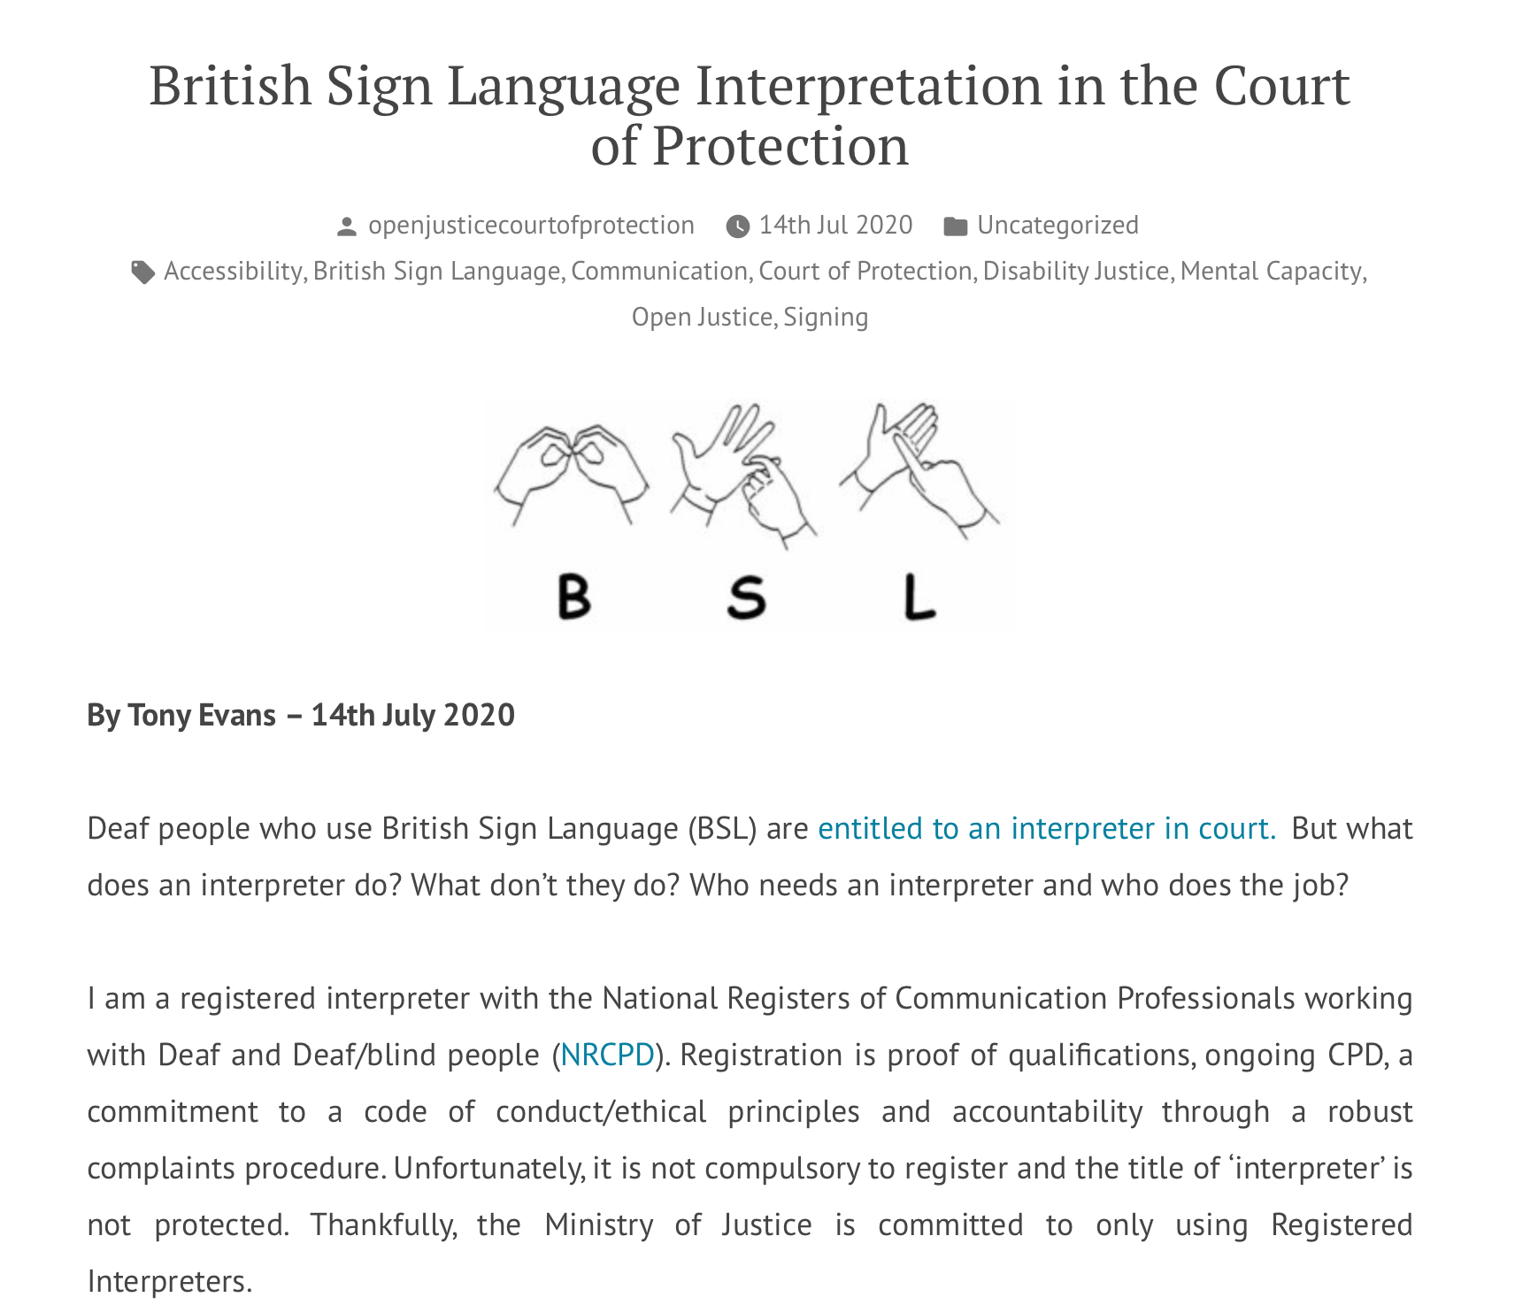
By Tony Evans

Slide 26
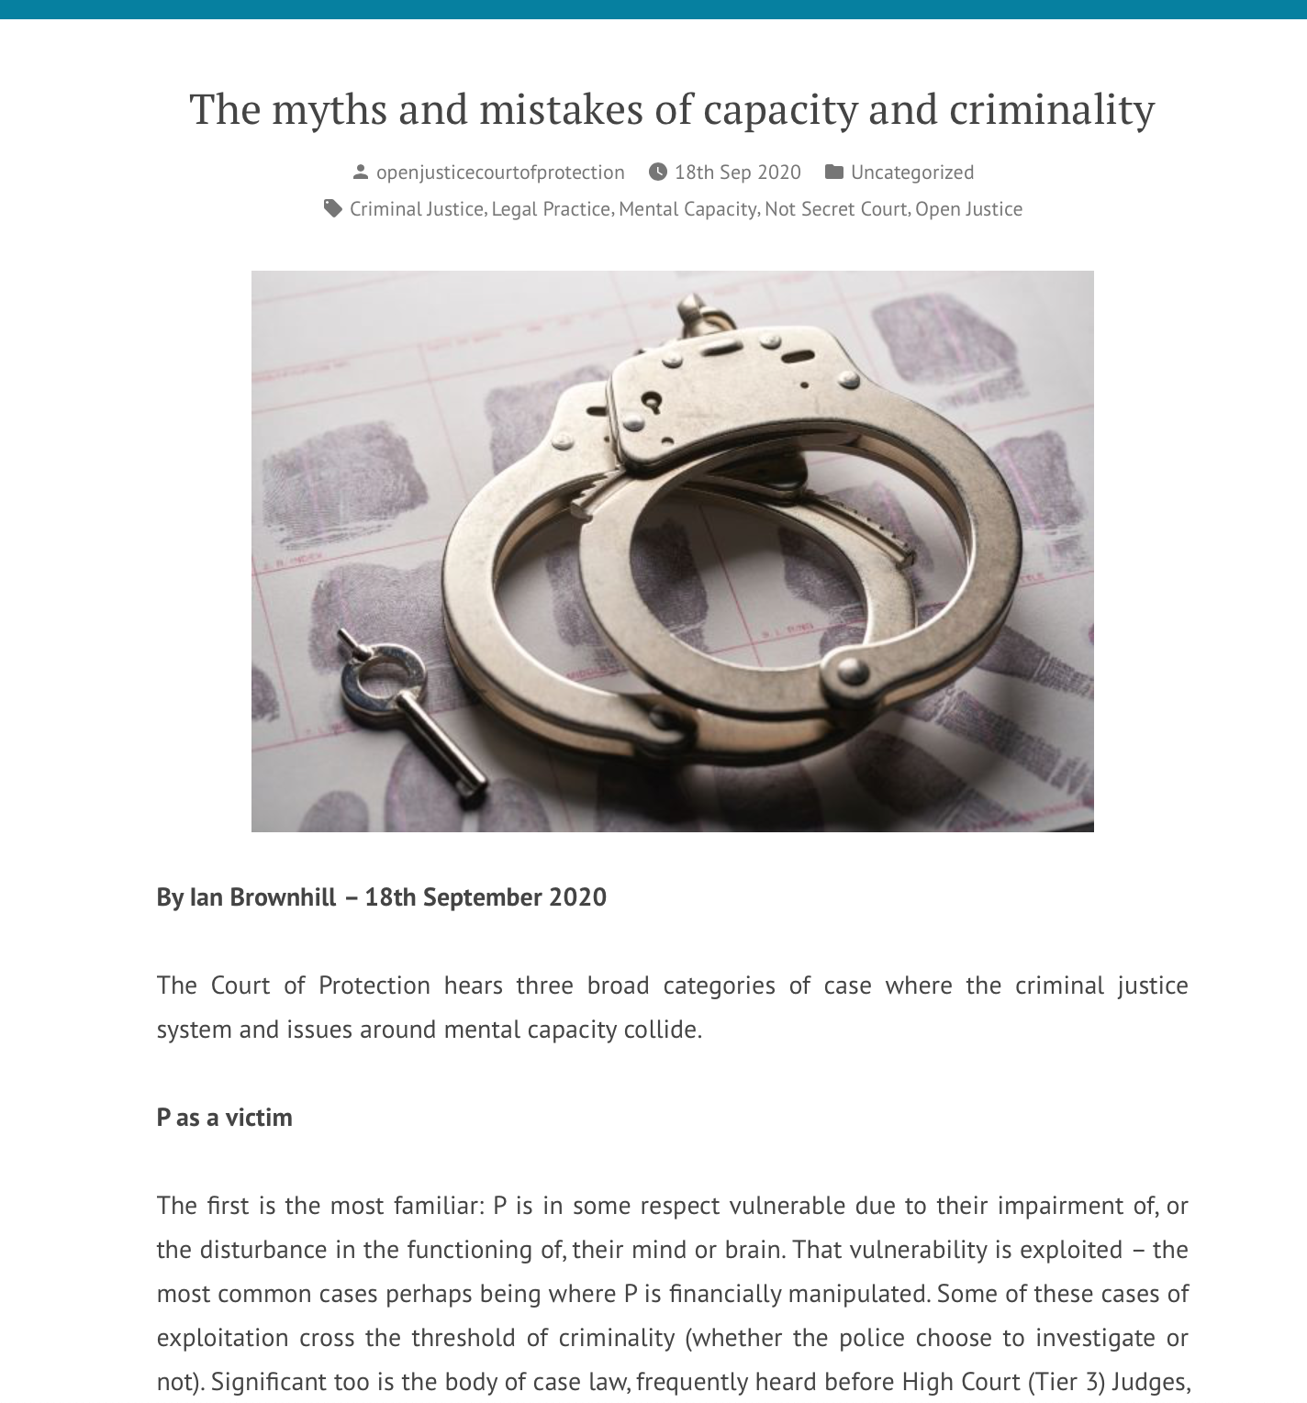
By Ian Brownhill
39 Essex Chambers

Slide 27
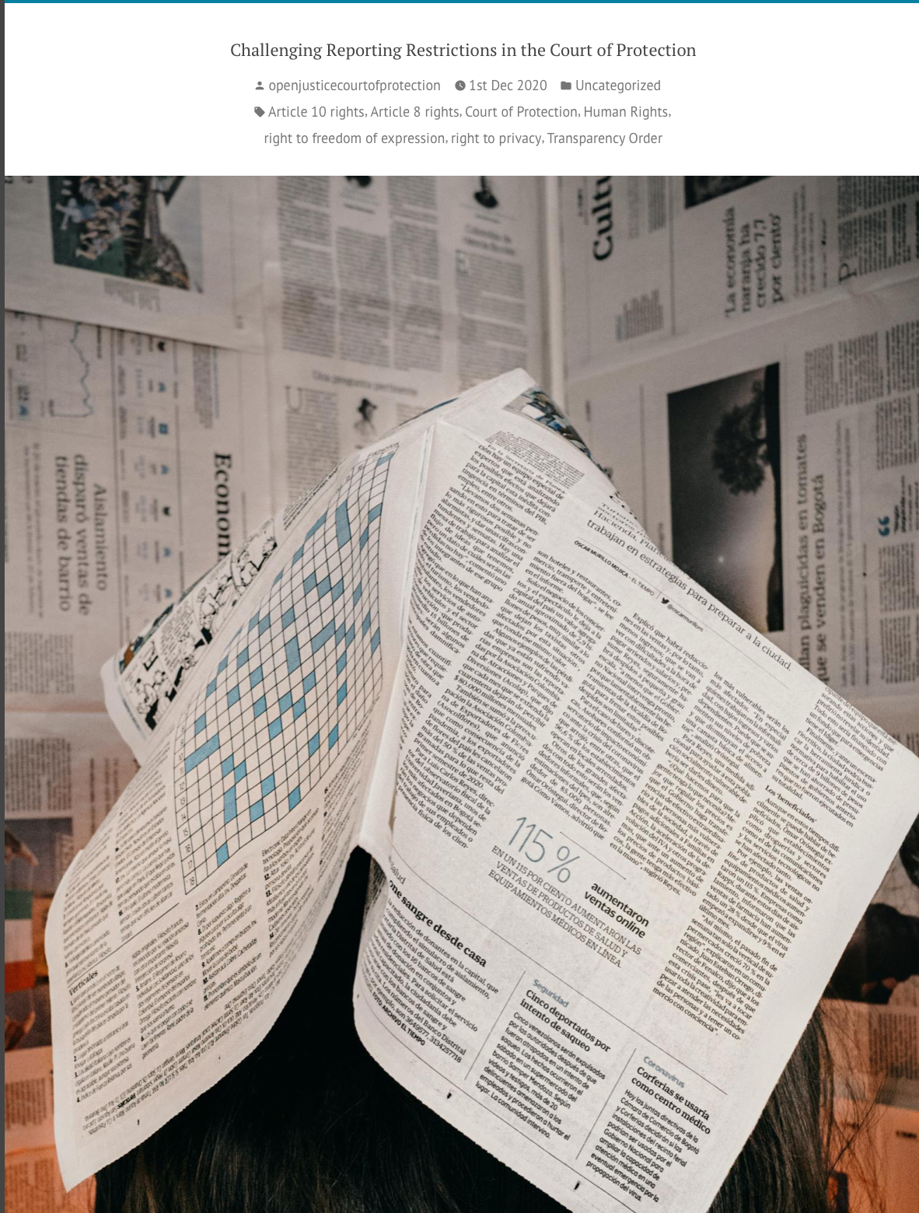
Brian Farmer (PA journalist) shared a letter he wrote to the Court of Protection challenging the reporting restrictions and asking to be allowed to identify the NHS Trust, the Local Authority and the police force.
This letter has been used as an illustration and model of how to address the court in connection with subsequent hearings.

Slide 28
Issue based
(Tend to focus on issues rather than individual story – differentiate from journalists?)

Slide 29
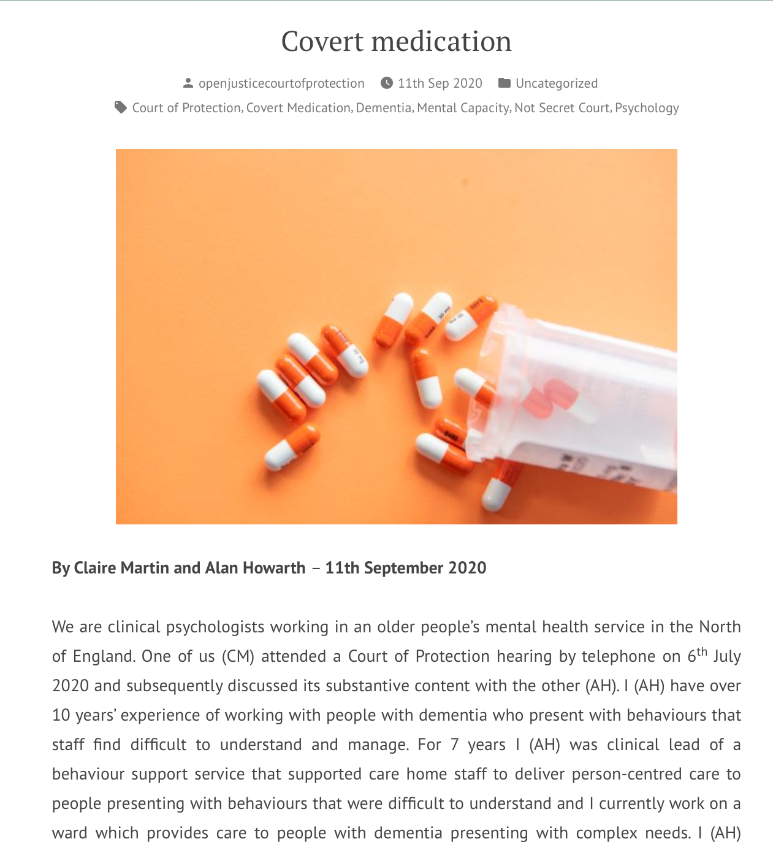
Covert Medication
Two clinical psychologists, Claire Martin and Alan Howarth, criticized a judge for authorizing covert medication for a dementia patient
…without apparently adequate exploration of less restrictive alternatives
… without discussion of P’s wishes and feelings (previous or current)
And included anti-psychotics (side effects, strokes + death)
Is dishonest + means staff have to lie.
Not clear that decision complies with best practice e.g. in British Psychological Society Guidance re. alternatives to antipsychotic medication for people with dementia.

Slide 30
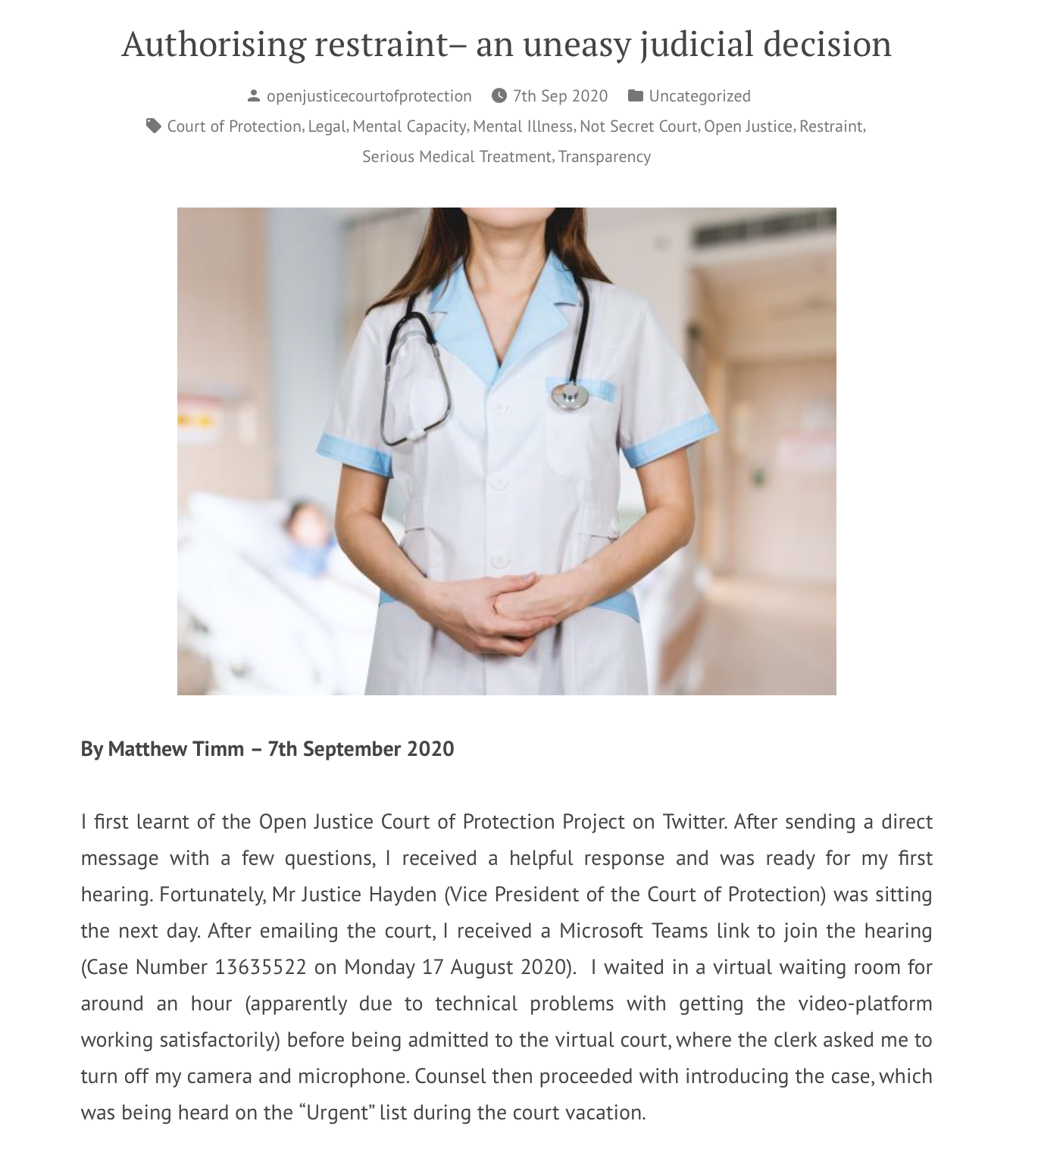
Restraint
Judicial authorization of restraint to administer dialysis – observed by Matthew Timm (BTC student)
Advance Requests for restraint and medication (with fluctuating capacity) – should they be encouraged? ( Magda Furgalska)
Is it lawful to include prone restraint in P’s care plan? (Forthcoming)

Slide 31
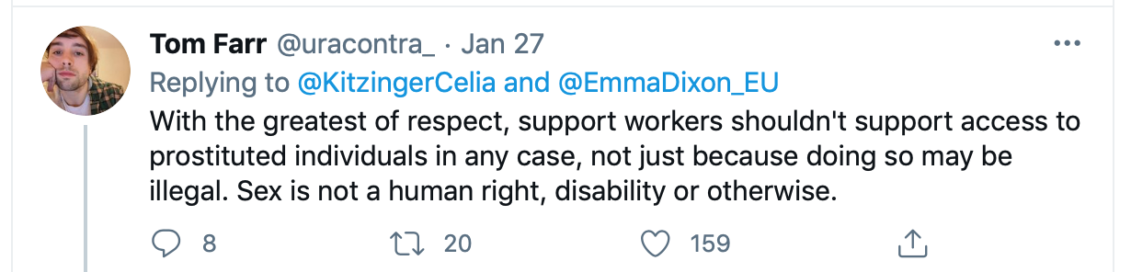
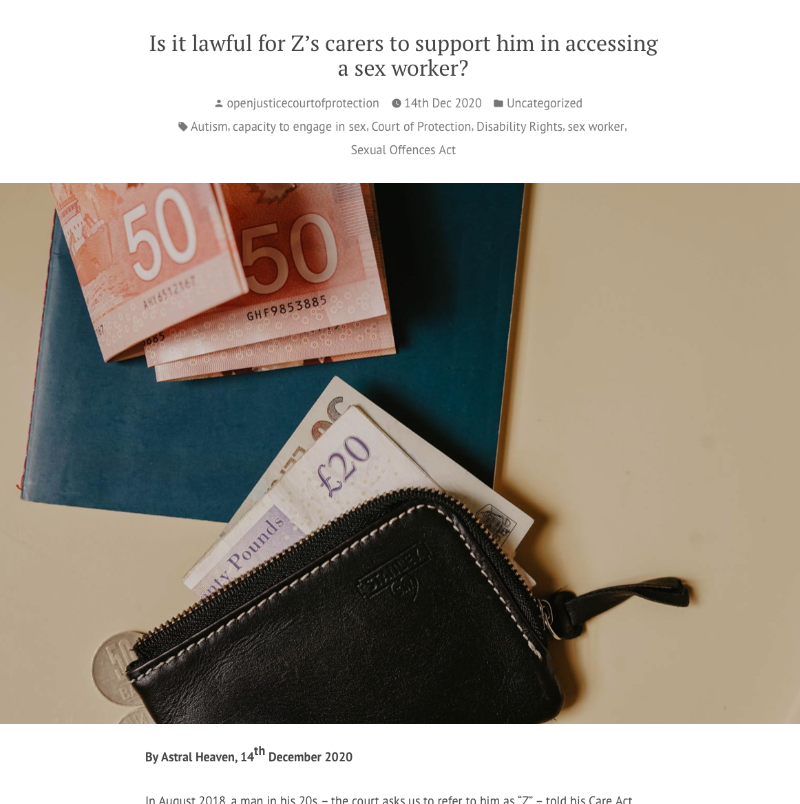
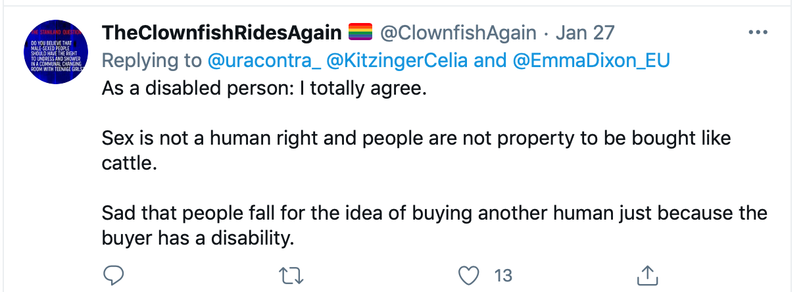
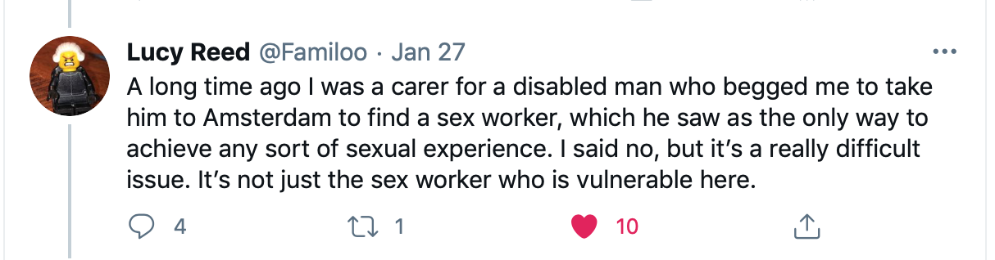
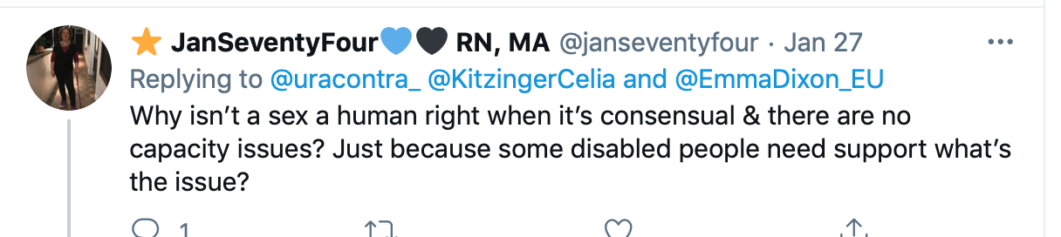
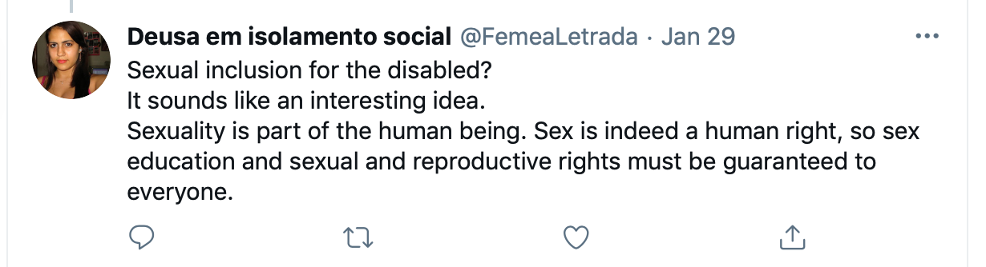
Supporting P’s use of sex workers
RR
Respectful debate

Slide 32
Costs and benefits of public observation

Slide 33
Costs:
Court staff time
Judicial time – both set up (phone) + in court,
Risks (so far not materialized) of Transparency Order being breached and confidential information made public
Possible discomfort at being scrutinized by the public for P, lay participants, lawyers + judiciary (and possibility of criticism)
Exposing (occasional) bad practice in court (also a benefit) – see Celia Kitzinger’s account of lay participants’ experience of A Clinical Commissioning Group v AF & Ors [2020] EWCOP 16

Slide 34
Benefits:
“Open Justice is a principle at the heart of our system of justice and vital to the rule of law”
Intro summary, clarifying + highlighting key legal principles + “on best behaviour’” (see: “How being watched changes how justice is done”
Increases public confidence in the courts – including P’s family + disability rights activists (e.g. 8x approached by P’s family and asked to observe hearings)
Supports development of legal literacy + rule of law in a democracy

Slide 35
Benefits continued…
Continuing professional development for health and social care staff (improving implementation of MCA and engagement with the Court)
Experience for (aspiring) lawyers
Supports development of a more informed public discussion about issues relevant to law, policy and ethics
Puts an end to the myth of the ‘secret’ court! (#NotSecretCourt is our Twitter hashtag)

Slide 36
Thank you!
Celia Kitzinger
KitzingerC@Cardiff.ac.uk
@kitzingercelia

