Slide 1
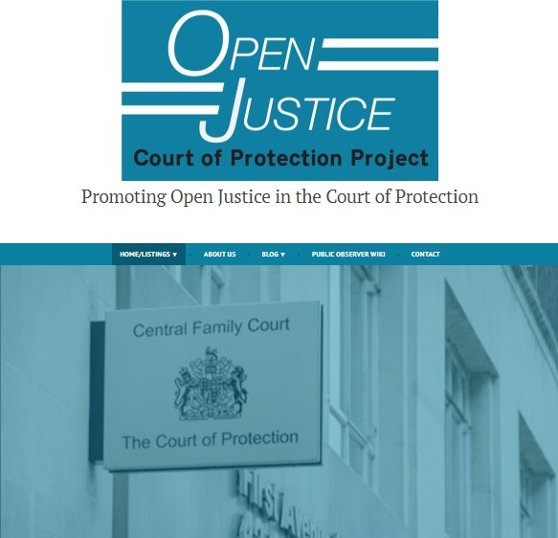
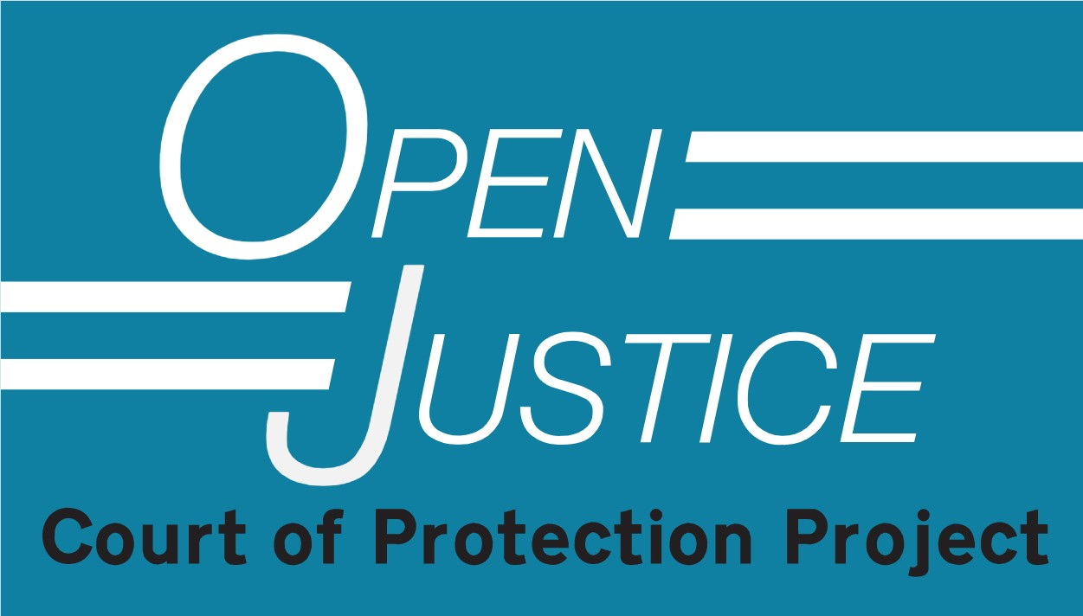

USING SOCIO-LEGAL SCHOLARSHIP TO PROTECT DISABILITY RIGHTS DURING THE PANDEMIC:
THE OPEN JUSTICE COURT OF PROTECTION PROJECT
Gillian loomes-Quinn
SLSA CONFERENCE – 30TH MARCH 2021

Slide 2
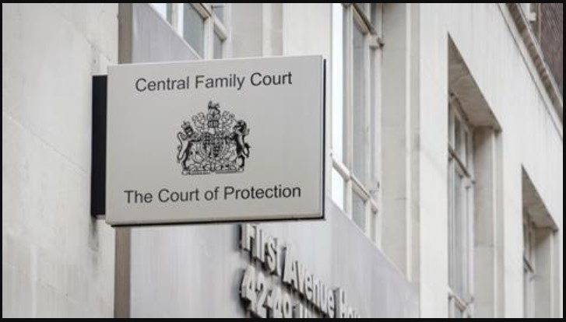
Disability Rights in the Court of Protection: Statistical Outline
Total numbers of applications before the Court:
in 2018: 32.029
in 2019: 34,445
in Q3 2020: 8937
in Q2 2020: 5754
in Q1 2020: 8267
in Q3 2019: 9407
in Q3 2018: 7900
Source: Family Courts Quarterly Statistics –
https://www.gov.uk/government/statistics/family-court-statistics-quarterly-july-to-september-2020
Notes:
As the specialist court with responsibility for issues relating to people who lack the capacity to make specific decisions, the Court of Protection is a key location of legal and political impact for disabled people. In terms of bare numbers, we can see here that the numbers of applications made to the court each year were in the tens of thousands – with 32,029 applications being made in 2018 and 34,445 in 2019. In the most recent quarterly breakdown, we find that between June and September 2020 8937 applications were made to the court. This compares with 9407 in the same quarter of 2019 and 7900 in the same quarter of 2018, so the numbers seem relatively steady despite the impact of the Pandemic.

Slide 3
Disability Rights in the Court of Protection: Statistical Outline
Types of application before the Court in 2020 (and compared with 2019)
2020/2019
Property and Affairs deputyship – 3386/4249
One-off Property and Affairs orders – 1790/1703
Personal Welfare deputyship – 266/314
One-off Personal Welfare orders – 87/95
Source: Family Courts Quarterly Statistics –
https://www.gov.uk/government/statistics/family-court-statistics-quarterly-july-to-september-2020
Notes:
In terms of the type of work being done by the court, in 2020, 3386 applications were made for property and affairs deputyship (compared with 4249 in 2019); 1790 applications were for one-off property and affairs orders (compared with 1703 in 2019); 266 applications for personal welfare deputyships were made in 2020 (with 314 being made in 2019); 87 applications for one-off personal welfare orders were made in 2020 (compared with 95 in 2019) and 1744 applications were made under the Deprivation of Liberty Safeguards in 2020 (with 1347 DoLS applications being made in 2019). So the majority of the court’s work across the most recent two years has been concerned with making decisions in the best interests of disabled people concerning their property and affairs – though deprivation of libe rty is also a significant area of focus for the court.

Slide 4
Disability Rights in the Court of Protection: Statistical Outline
Number of judgments published by the Court:
2020: 65
2019: 60
2018: 38
Source: British and Irish Legal Information Institute (BAILII) –
https://www.bailii.org/ew/cases/EWCOP/
Notes:
So the Court of Protection makes potentially life-changing decisions relating to thousands of people who lack, or may lack the mental capacity to make those decisions for themselves. The breadth of the range of issues dealt with by the Court means that there is very little in life that does not potentially fall within its scope – issues of health, care, privacy and family life, sexuality, personal finance, property – there is virtually nothing in the life of an individual that cannot fall under the Court’s purview if the impact of their impairment means they are deemed to lack capacity.
But the number of disabled people impacted by the Court of Protection, and the range of decisions with which it deals are, in my view, not the only factors meaning it is an important focus for people concerned with disability rights – The Mental Capacity Act 2005 influences legal and socio-political domains outside of the Court of Protection, with only a fraction of mental capacity assessments or decisions in the best interests of people deemed to lack capacity coming before the Court. The majority of such assessments and decisions take place in hospitals, homes, or offices and are necessarily private. However, in addition to its substantive influence in individual cases, the practice of the Court of Protection is instructive for the legal, health and social care, and other professionals whose work is shaped by mental capacity law. It therefore has considerable potential to impact the lives of disabled people both within its walls and beyond.
So how can those who want to understand how the Court of Protection implements mental capacity law find out about its work? And how can we scrutinise its impact (and the impact of mental capacity law more generally) on the lives of disabled people?
The Court of Protection is a busy court, but the number of judgments it publishes is relatively low. 65 judgments from the Court were placed on BAILII in 2020, compared with 60 in 2019 and only 38 in 2018. This, along with the nuance and inflection of court proceedings omitted from judgments that are published, means that for those who wish to understand the work of the court and the way it makes key decisions in the lives of disabled people, relying on published judgments can only be a small part of the strategy.

Slide 5


Transparency & COVID-19
Open justice. The words express a principle at the heart of our system of justice and vital to the rule of law. The rule of law is a fine concept, but fine words butter no parsnips. How is the rule of law itself to be policed? …. In a democracy, where power depends on the consent of the people governed, the answer must lie in the transparency of the legal process. Open justice lets in the light and allows the public to scrutinise the workings of the law, for better or for worse. Lord Justice Toulson R (Guardian News and Media Ltd) v City of Westminster Magistrates’ Court [2012] QB 618
"Publicity is the very soul of justice. It is the keenest spur to exertion and the surest of all guards against improbity. It keeps the judge himself while trying under trial.” (Jeremy Bentham quoted by Lord Shaw of Dunfermline in Scott v Scott [1913] AC 417, 477)
Notes:
So we’ve seen that the Court of Protection clearly has a profound impact on the lives of thousands of disabled people, but why does Open Justice matter in this Court? And how can public access to the Court benefit disabled people? In the next two slides, I consider why Open Justice is important, firstly as a general principle, and secondly from a disability rights perspective.
So, firstly the principle of Open Justice and its significance have been spelled out in case law [read quotes]

Slide 6
Transparency & COVID-19
Epistemic injustice refers to the ways in which social power operates to discredit, dismiss, and exclude the testimony (knowledge) of specific groups on the basis that such testimony is systematically unreliable.
Developed in the context of disability (e.g. Leach Scully, 2018; Barnes, 2016; Carel and Kidd, 2014; Fricker, 2007; Fricker, 2006)
Including in relation to austerity (Briant, Watson, and Philo, 2013; Cross, 2013; Williams-Findlay, 2011) healthcare and bioethics (Amundson, 2005; Asch and Wasserman, 2005; Carel and Kidd, 2014; Emery, Middleton and Turner, 2010, Fahmy, 2011; Middleton, Hewison, and Mueller, 1998, 2001) and education (Consortium for Research into Deaf Education, 2011; Moore, 2008)
“…ignorance about disabled lives is not inevitable but something that can and should be challenged.” (Leach Scully, 2019)
Notes:
From a perspective of disability rights, I think that one of the key reasons why Open Justice and public scrutiny of the Court of Protection are important comes from the potential of public observation of court proceedings to challenge the epistemic injustice experienced by disabled people by – to return to Lord Justice Toulson – letting in the light on the treatment of disabled people who deemed to lack decision-making capacity. [Read from slide].

Slide 7


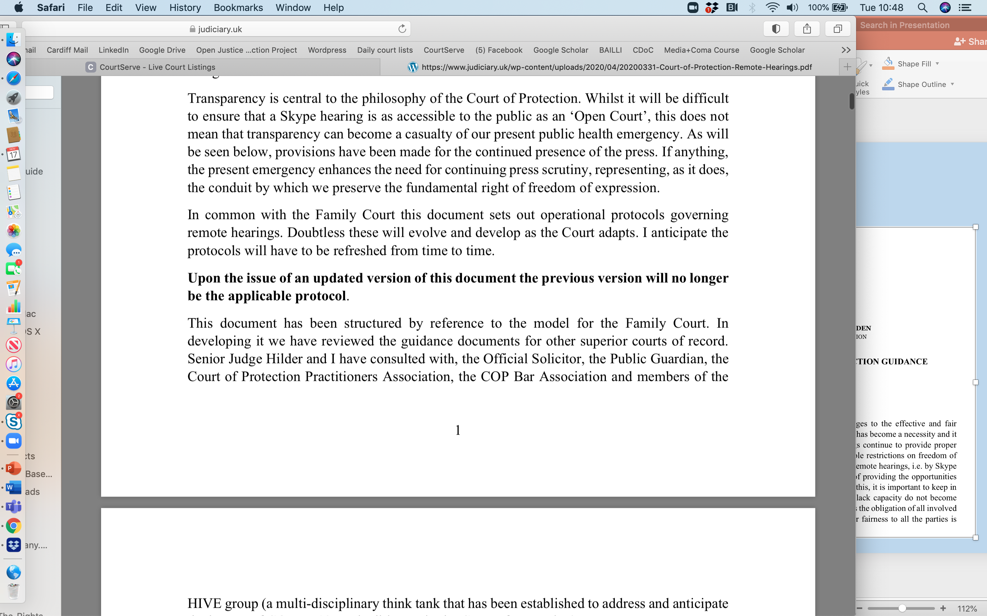



Transparency & COVID-19
Guidance from Mr Justice Hayden 31 March 2020
Created the HIVE Group (a multi-disciplinary thinktank established to address the impact of COVID-19 on litigants in the Court of Protection)
Notes:
Returning to the Court of Protection – obviously the Court has a history of concern with ‘transparency’ and with balancing competing interests of Open Justice with the right to privacy of those with whose lives it becomes involved. But the move the ‘remote hearings’ in March 2020 at the start of the first national lockdown in England and Wales triggered a need to revisit this issue.
A multi-disciplinary thinktank – the Hive Group – was established by the Vice President of the Court, Mr Justice Hayden, to address the impact of the pandemic on litigants in the Court of Protection. And as to ‘transparency’, he issued guidance reiterating that “Transparency is central to the philosophy of the Court of Protection” and must not “…become a casualty of [the] public health emergency…”

Slide 8

The Open Justice Court of Protection Project
Provides information and practical support to Public Observers
Reports on hearings we’ve observed
Shares updates on developments in the CoP
Launched 15th June 2020
Shares court listings
Provides links to published judgments
Uses our experiences to impact the development of Open Justice in the CoP
Notes:
However, despite express policy concern with Open Justice in the Court as it moved to predominantly remote working, it was far from clear what this would look like in practice. It was against this backdrop on 15th June last year that Celia Kitzinger and I co-founded the Open Justice Court of Protection Project. We both separately had prior experience of observing and researching in the Court of Protection, and share a commitment to the principles of Open Justice, and we saw a need to ensure that scrutiny of the Court’s work, and what it revealed about how disabled people lacking capacity are being treated, did not suffer as a result of the impact of the pandemic.
Since we launched we have supported hundreds of people (including lawyers, health and social care professionals, students, and family members themselves involved in other Court of Protection proceedings) to observe the Court in action, and to write about what they have observed and the impact their observations have had on them. We have published nearly 100 blogs, our website has had over 70,000 hits, and our most-read blog has been read nearly 5000 times.
Specifically, some of the things the Project does include… [read slide].

Slide 9
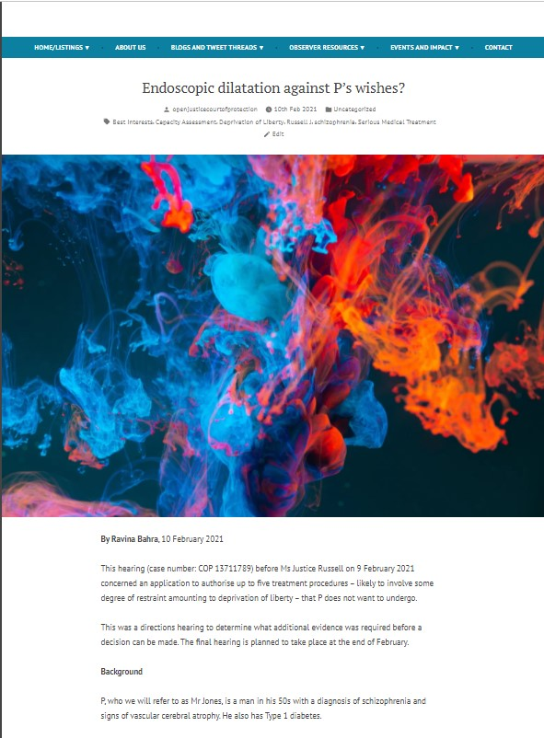
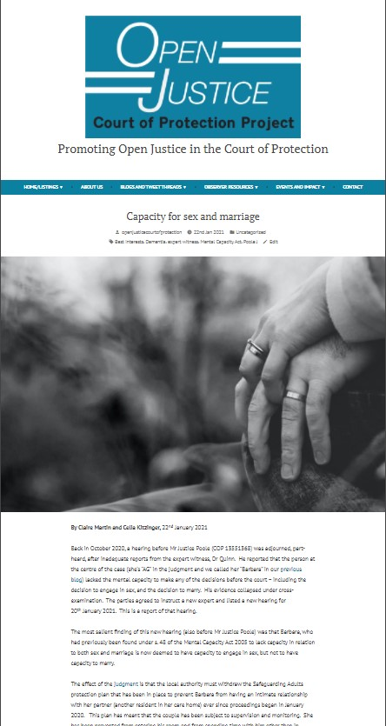
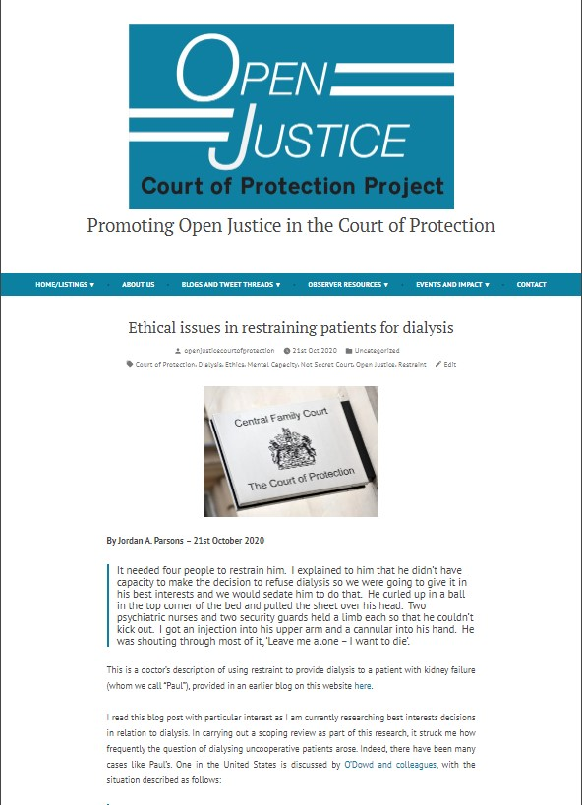
Observations of Law in Action
Notes:
Cases we have covered on our blog include decisions concerning the administering of medical procedures against a person’s wishes, the assessment of a disabled person’s capacity to consent to sex and marriage (and the impact of delays in proceedings on their right to family life), and ethical issues around restraint. Many of the observers we have supported – especially health and social care professionals – have told us how their understanding of mental capacity law and its impact on disabled people have increased through watching the Court in action.

Slide 10


Summary
Public scrutiny of law in action
Challenging epistemic injustices faced by disabled people
Pushing against an open door
Notes:
So, to summarise, Open Justice in the Court of Protection protects and advances disability rights by enabling public scrutiny of the law in action, and challenging epistemic injustice faced by disabled people through increasing public awareness of the impact of mental capacity law on disabled people, and unlike so much for which we as disabled activists are striving – here, we are pushing against an open door.

Slide 11
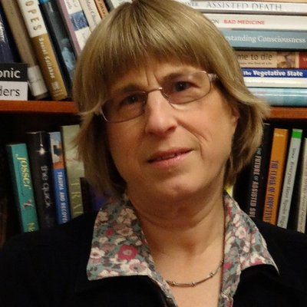

Further Details and Contact
Website:
openjusticecourtofprotection.org
Twitter:
@OpenJusticeCoP
The Open Justice Court of Protection Project is co-directed by Celia Kitzinger and Gill Loomes-Quinn.
Email:
OpenJustice@yahoo.com
Notes:
Thank you so much for listening, and I now look forward to answering any questions you might have.

