Slide 1


Observing the Court of Protection in action
Celia Kitzinger
Co-Director of the Open Justice Court of Protection Project
openjustice@yahoo.com
@kitzingercelia
Queen Mary University of London Law Students
15th February 2022

Slide 2
Celia Kitzinger: ”member of the public”
282 hearings in the Court of Protection since 1 May 2020 (plus c.20+ LST cases before then) – initially because I was very concerned about conduct + outcome of some hearings.
All but 2 “remote” or “hybrid” - i.e. via video-platform or telephone
District + Circuit judges in regional hubs across England and Wales + High Court (Tier 3) judges sitting in the Royal Courts of Justice
Founded the Open Justice Court of Protection Project (with Gill Loomes-Quinn), 15 June 2020 to keep an eye on justice
We’ve supported 100s of people to observe court hearings – and published more than 200 blog posts.

Slide 3
“Publicity is the very soul of justice. It is the keenest spur to exertion and the surest of all guards against improbity. It keeps the judge himself while trying under trial.”
(Jeremy Bentham: DRART FOR THE ORGANIZATION OF JUDICIAL ESTABLISHMENTS, COMPARED WITH THAT OF THE NATIONAL ASSEMBLY, WITH A COMMENTARY ON THE SAME (1790) )

Slide 4
  “Transparency is central to the philosophy of the Court of Protection […] The Vice President and the Hive group are particularly keen to ensure that the considerable efforts made to achieve a properly transparent Court of Protection are not undermined by the exigencies of the social distancing imperatives. (Mr Justice Hayden, 4th May 2020)
The Open Justice Court of Protection Project was created to support the judiciary’s commitment to transparency and open justice.
Totally independent of the Court of Protection – concerned citizens
Health and social care professionals (largest single category)
(Aspiring) Lawyers
Families of ‘vulnerable’ people – some involved in COP hearings themselves

Slide 5
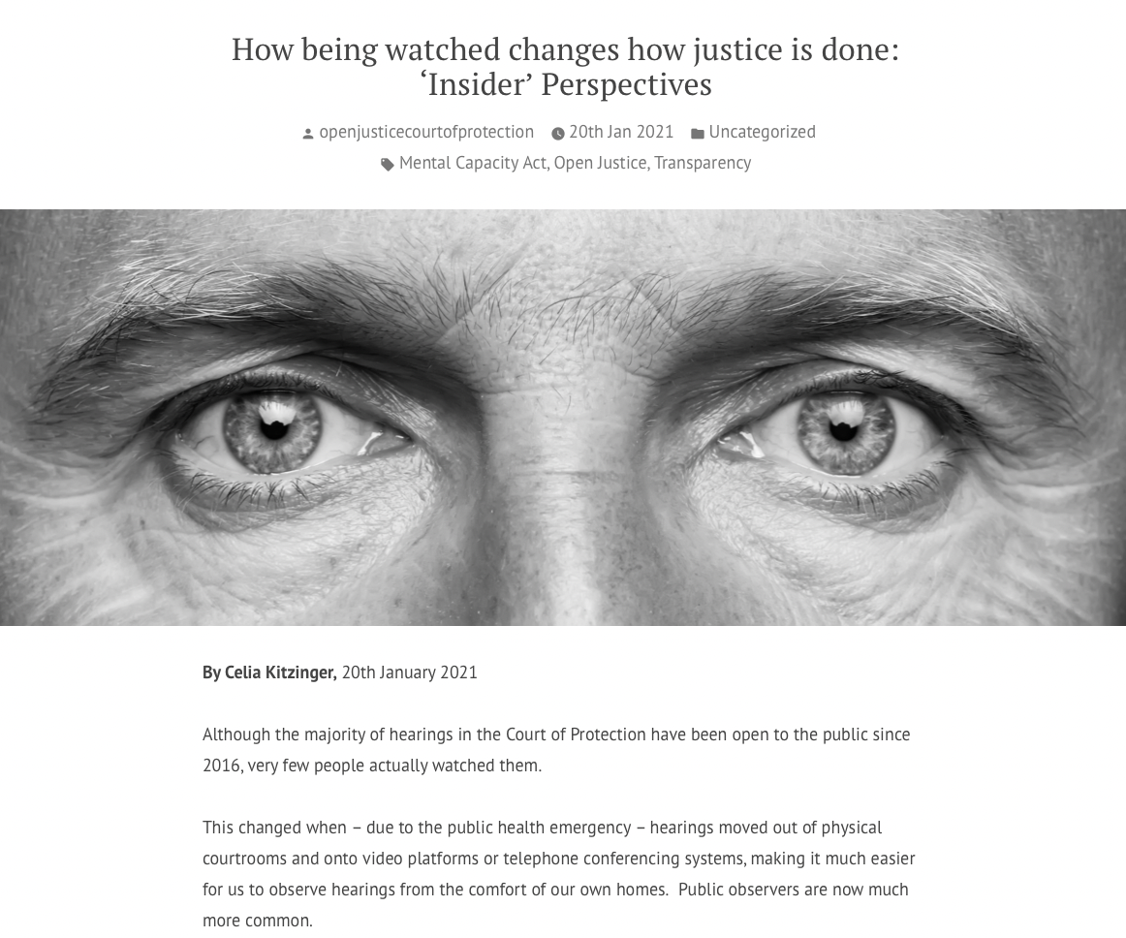

Slide 6
Who has observed a hearing in the Court of Protection?
Remote or in a court building (“attended”)
What was it like?
What are the 2 key issues before the COP in every case?
What is meant by ‘capacity’?
What is meant by ‘best interests’?

Slide 7
Check out our “Observer Feedback Form”
Intro summary
Parties (+ advocates)
Issues before the court – capacity + best interests
Opening statements
Evidence + cross examination
Closing statements
Judgment
Involvement of P (+ P’s family)

Slide 8

https://openjusticecourtofprotection.org

Slide 9
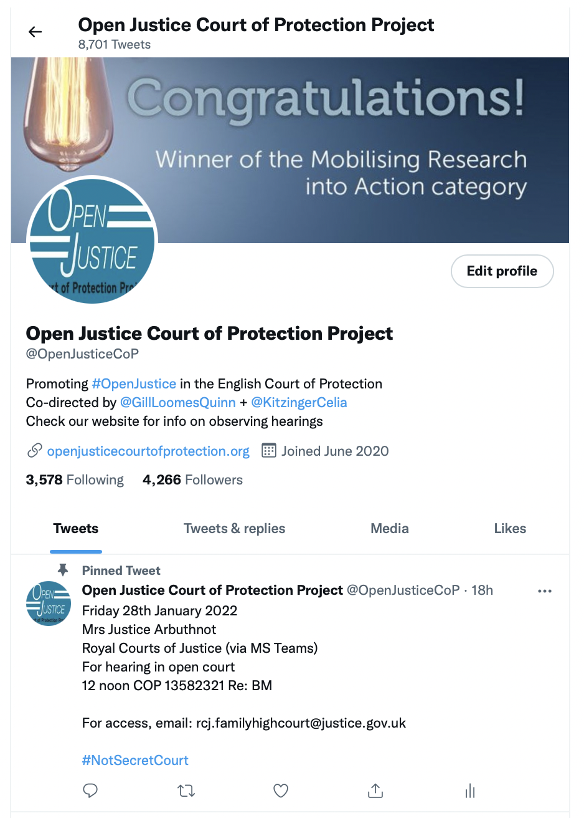
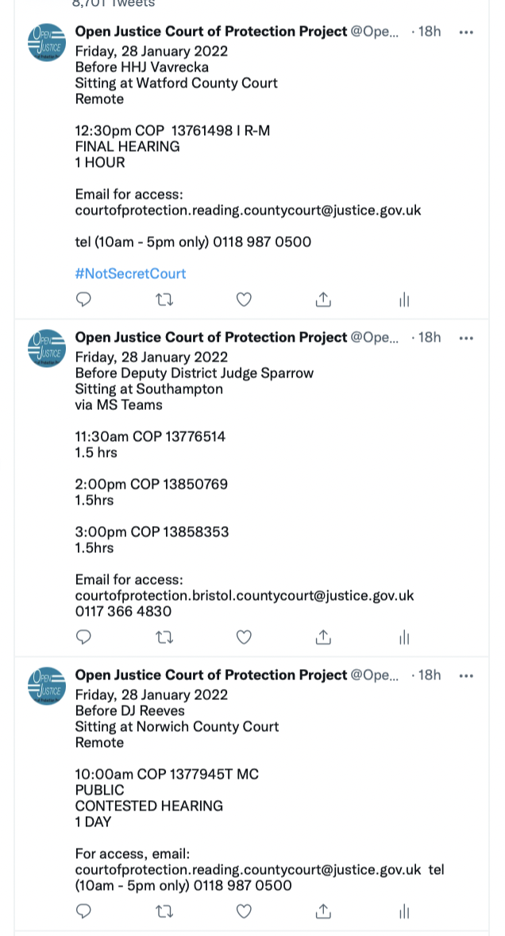
@OpenJusticeCOP

Slide 10
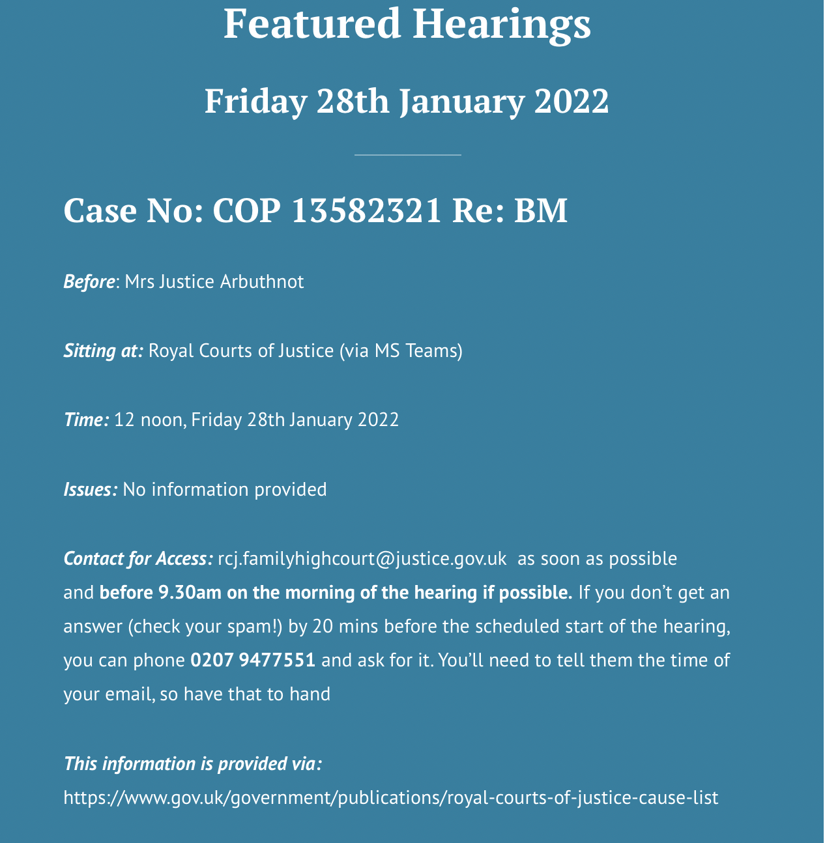
List of ”Featured Hearings” on the home page of our website
Provides correct contact info
Decodes T/E, BTMM, CMH, Dirs, etc
Omit the word “private”
Selects those to which we think access is most likely

Slide 11
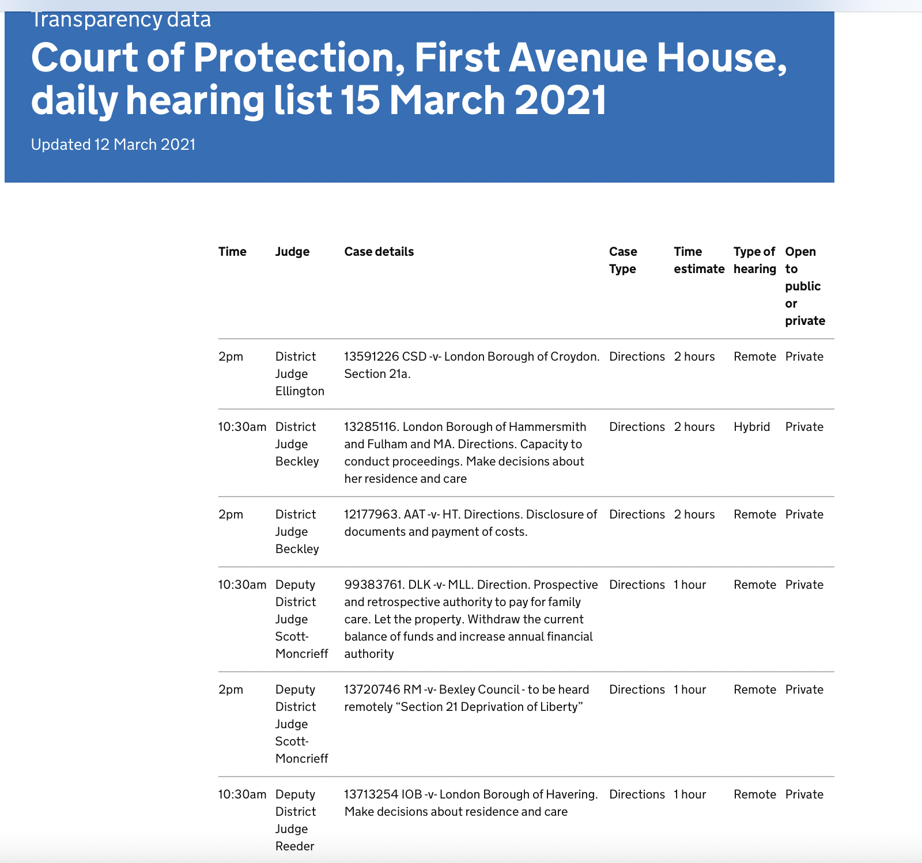

1. First Avenue House listings click here

Slide 12
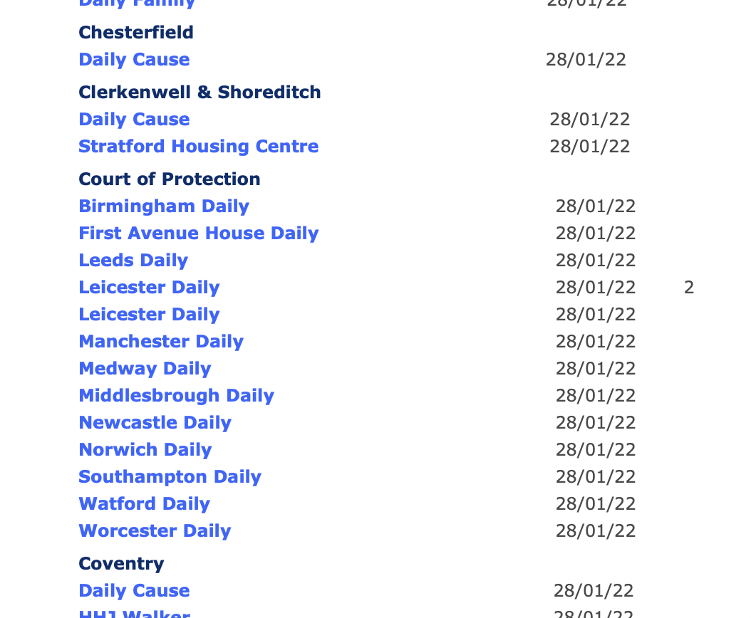
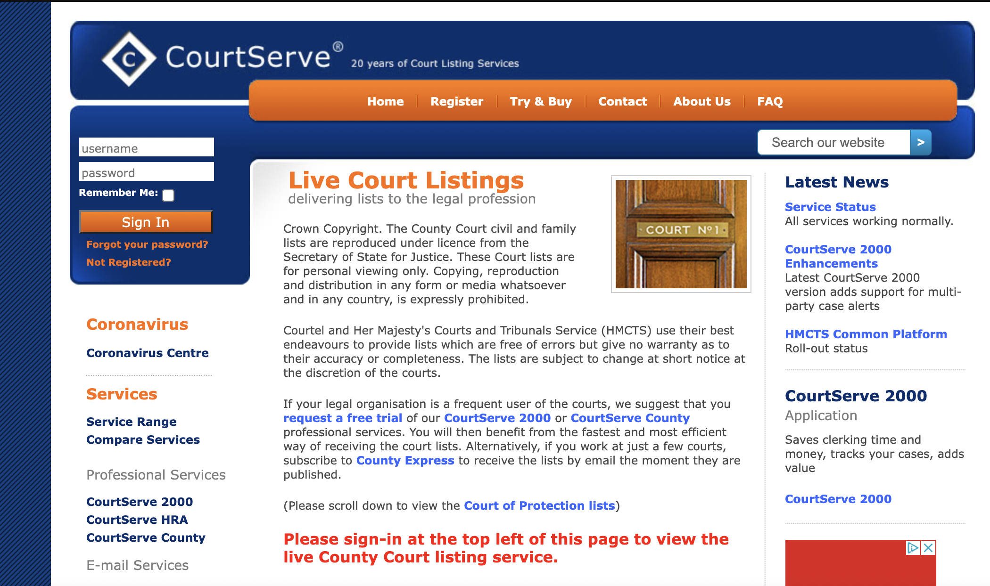
2. CourtServe (free but registration required)

Slide 13
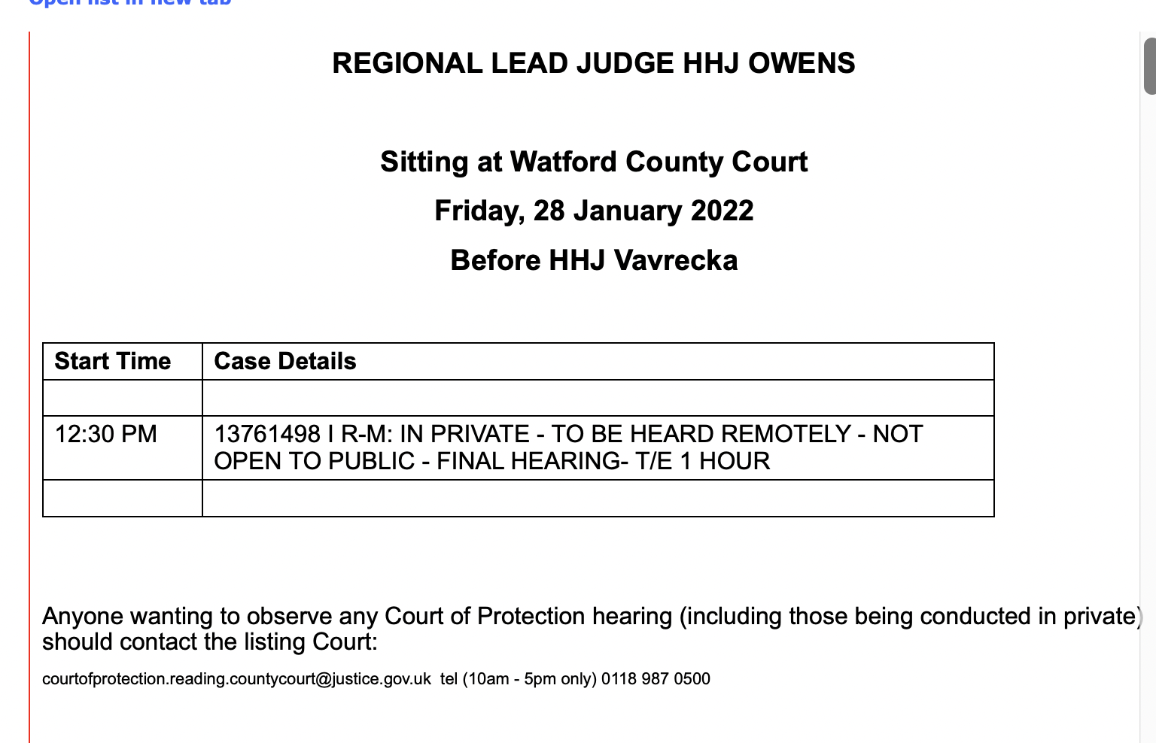
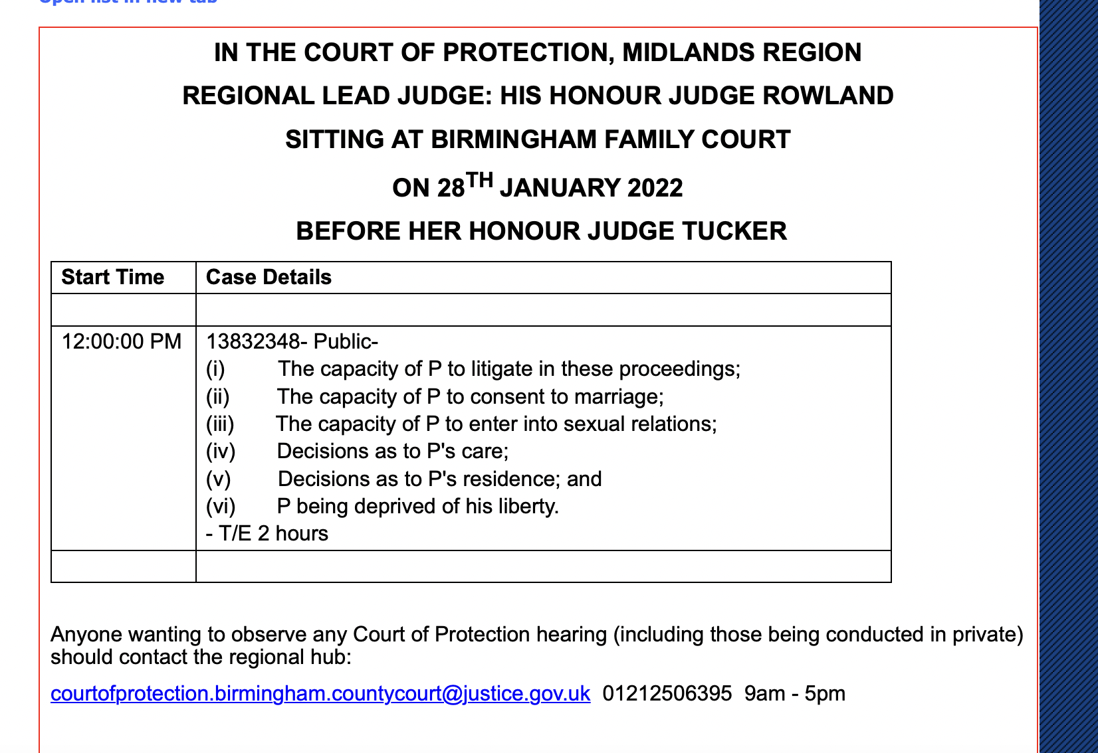
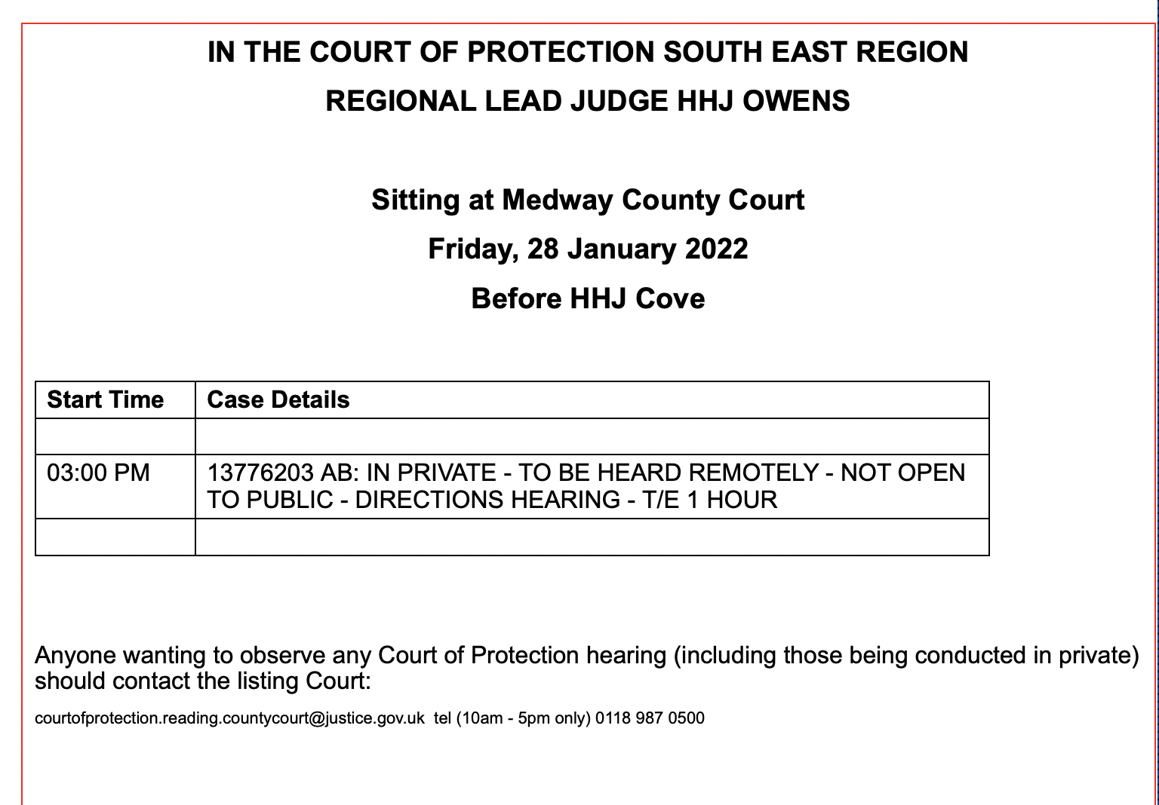
CourtServe

Slide 14
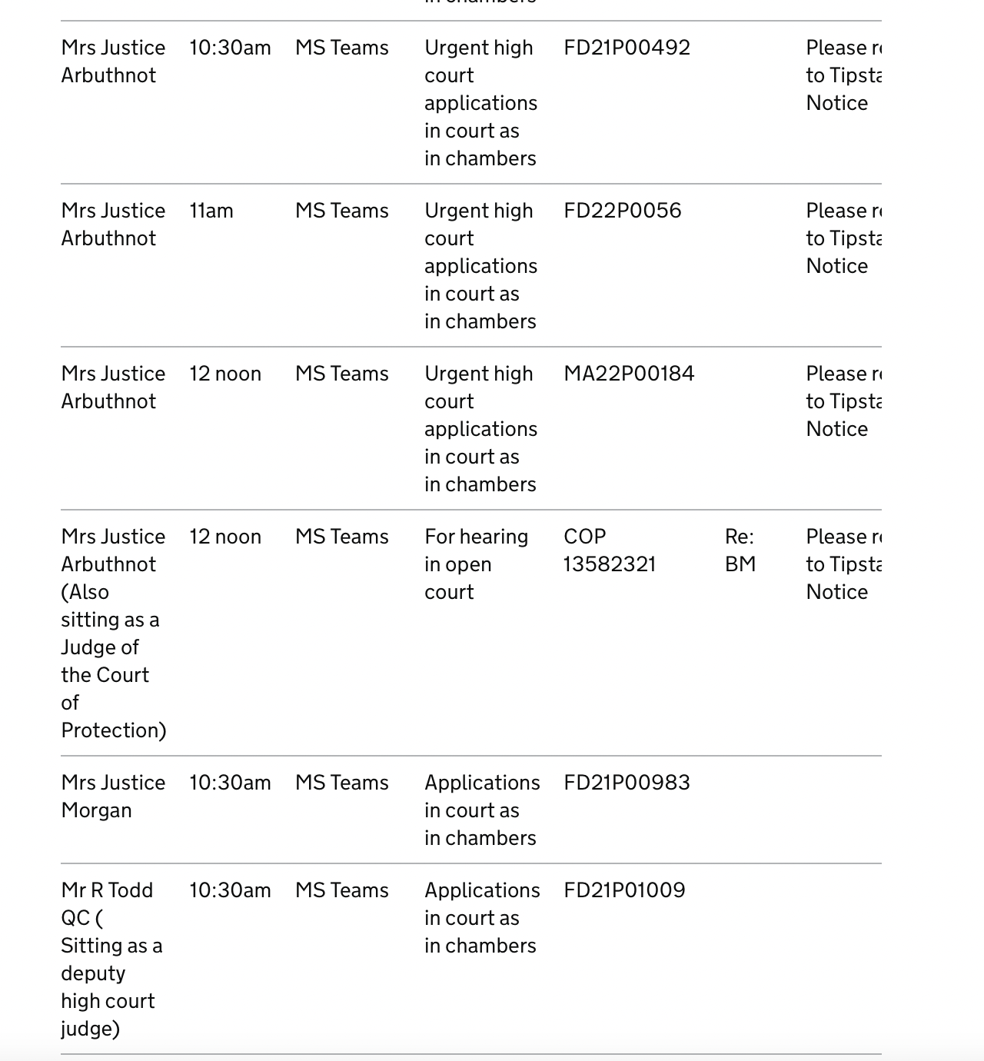
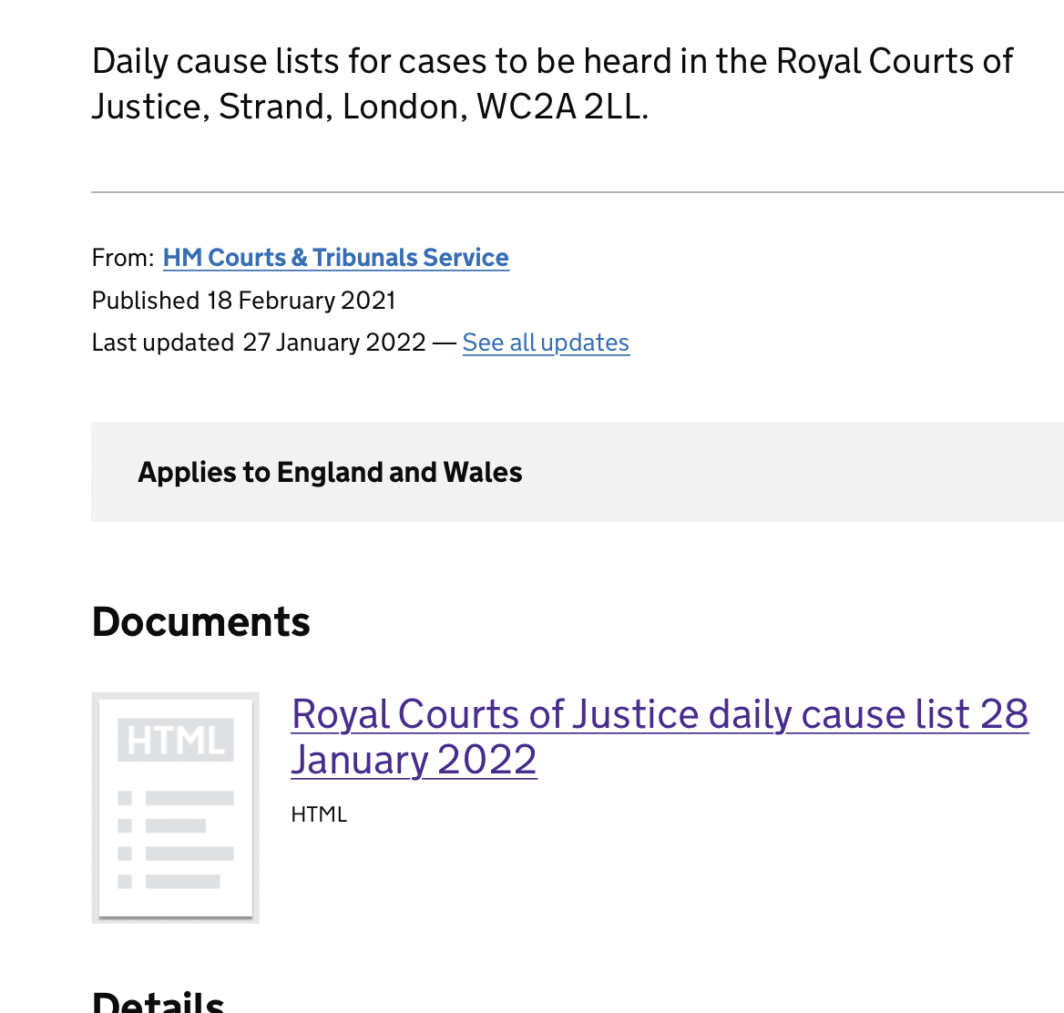
3. Royal Courts of Justice

Slide 15
Observing hearings
Almost all are open to the public (not “Dispute Resolution Hearings” DRH)
You send an email (with your phone no. if it doesn’t say hearing will be video platform) asking to observe. (Template letter on our home page)
For video-hearings you should receive email with MS Teams or Cloud Video Platform (CVP) link.
For phone hearings you are (mostly) phoned by the judge – sometimes you are asked to call in to a conference line
You must be in a quiet place where you cannot be overheard + you may not record the hearing
You must comply with the Transparency Order (Reporting Restrictions Order)
Hearing should begin with a summary of the case

Slide 16
Benefits
Watching justice in action – supporting fundamental principle of ‘open justice’
Understanding Mental Capacity Act 2005 in practice
Watching advocates make submissions, question expert witnesses incl. cross-questioning, engage with litigants in person
Observing how P and P’s family engage with court
Understanding how a judgment emerges from facts + law (including ‘dead ends’ and rejected arguments). Very different from seeing final judgment
Frustrations – inadequate advance info about issues in listings, many are adjourned + vacated, failure to respond to emails, forgetting to do introductory summary, we don’t get position statements!

Slide 18
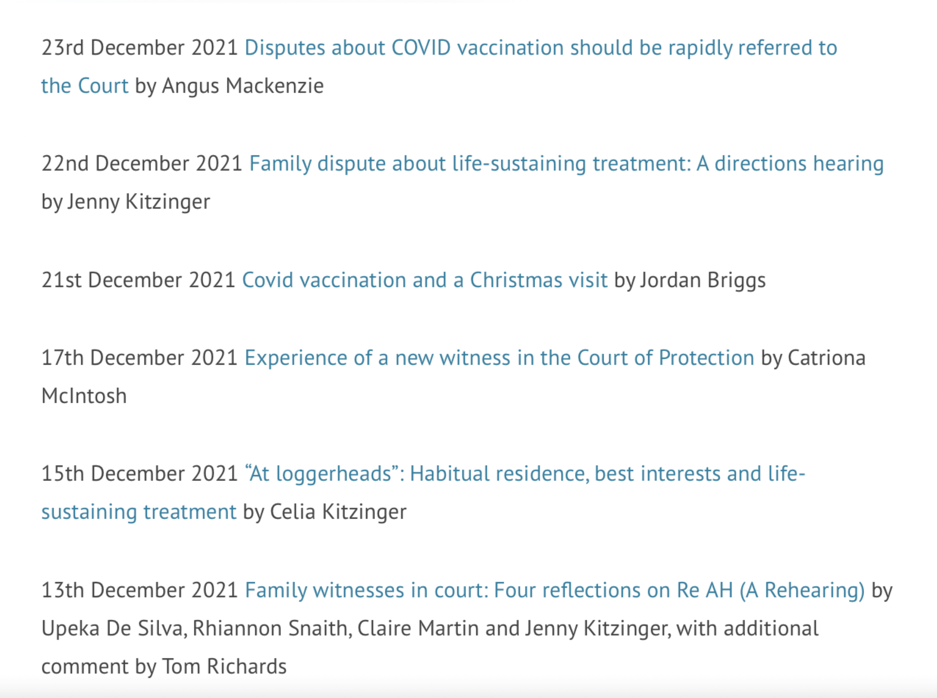
Blog index

Slide 19


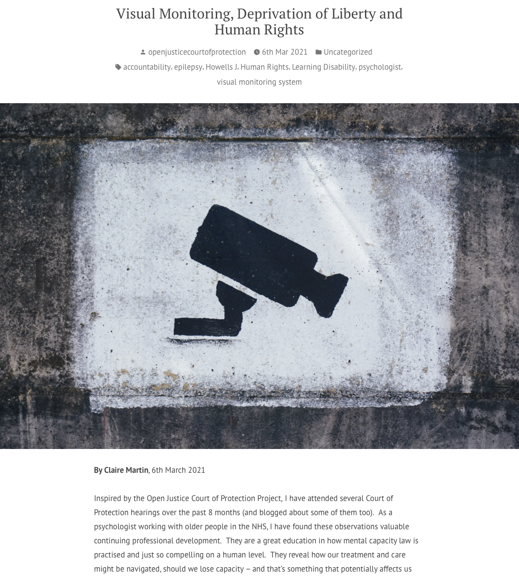
Click here for Authorising restraint blog
Click here for covert medication blog
Sample blog posts
Click here for Visual monitoring blog

Slide 20
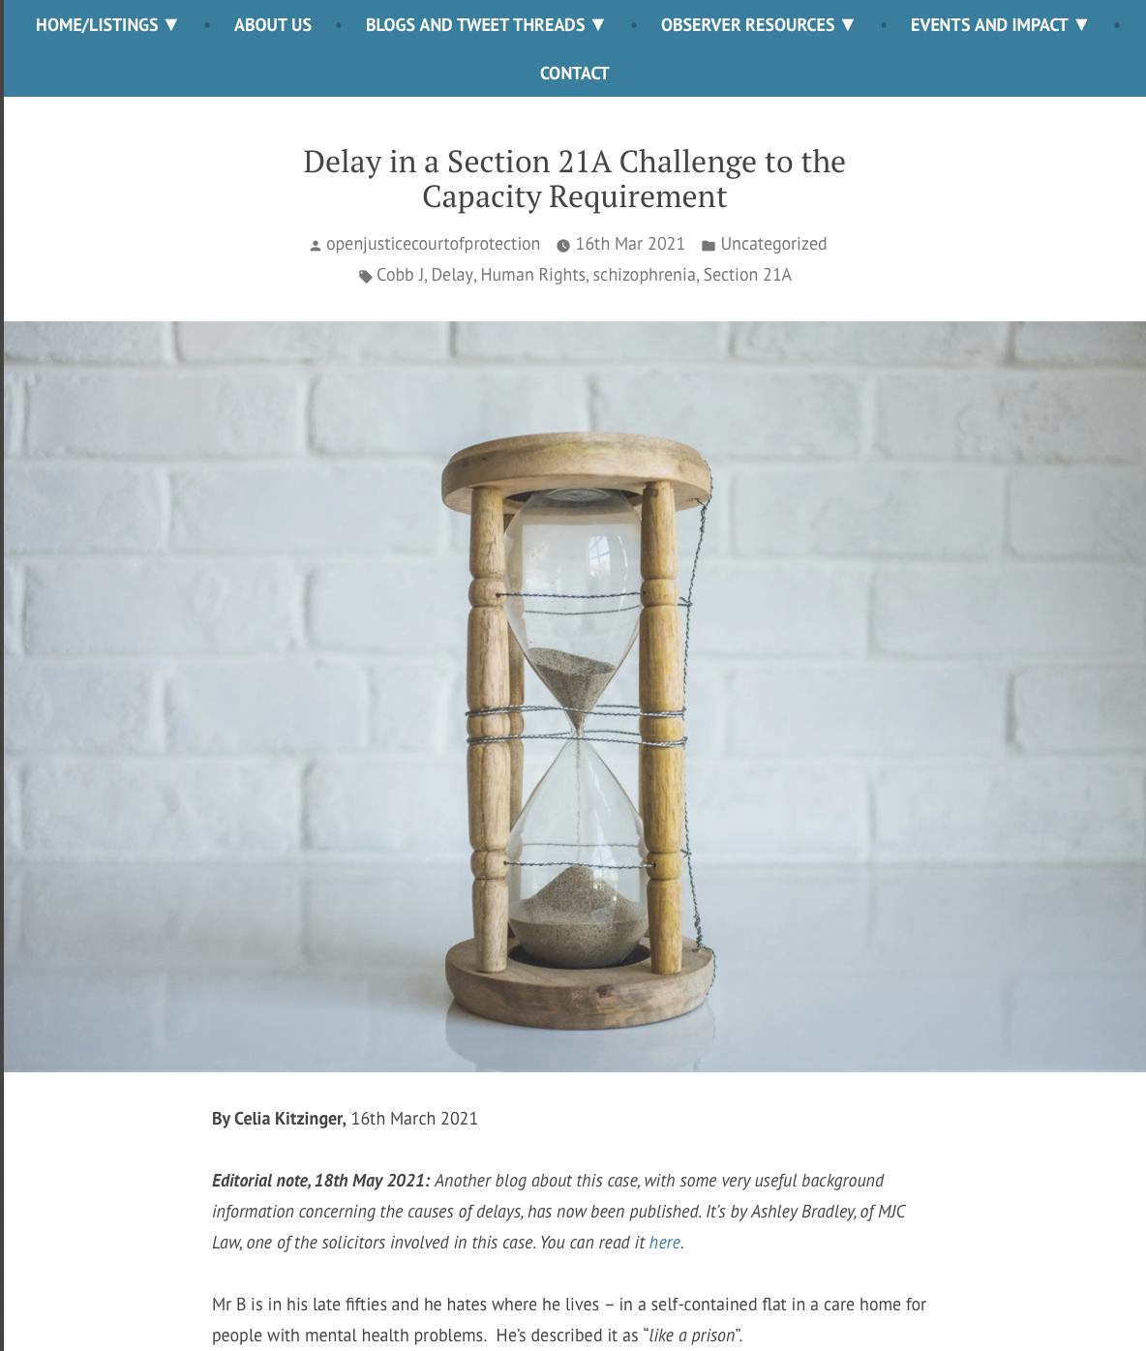
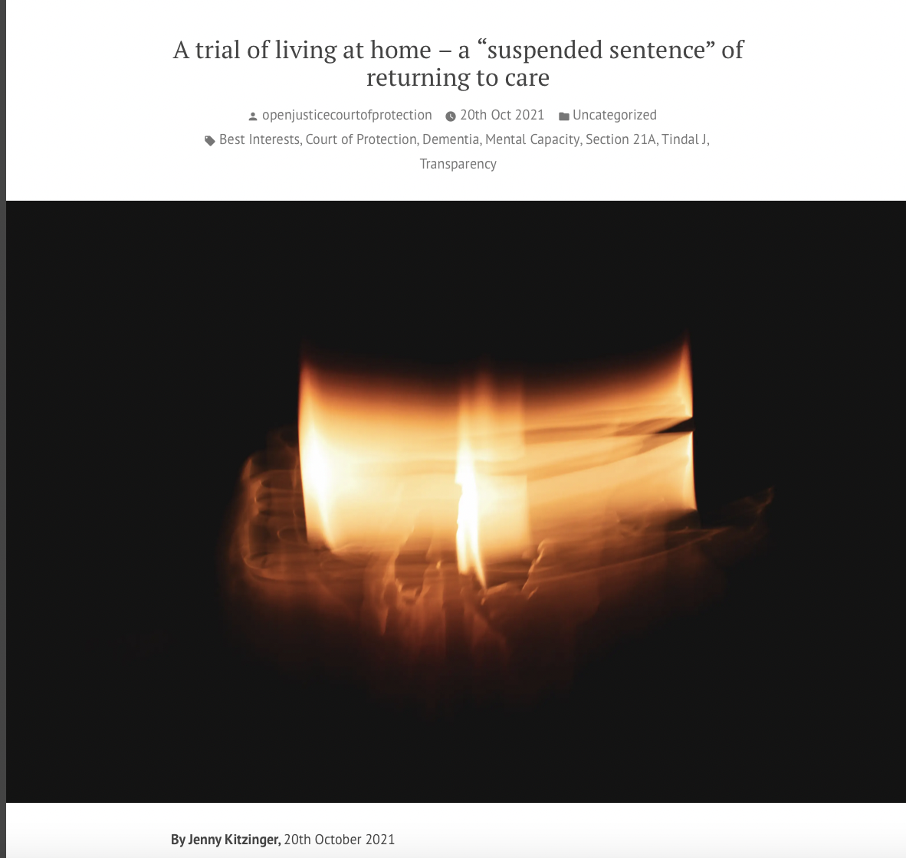
Section 21A

Slide 21

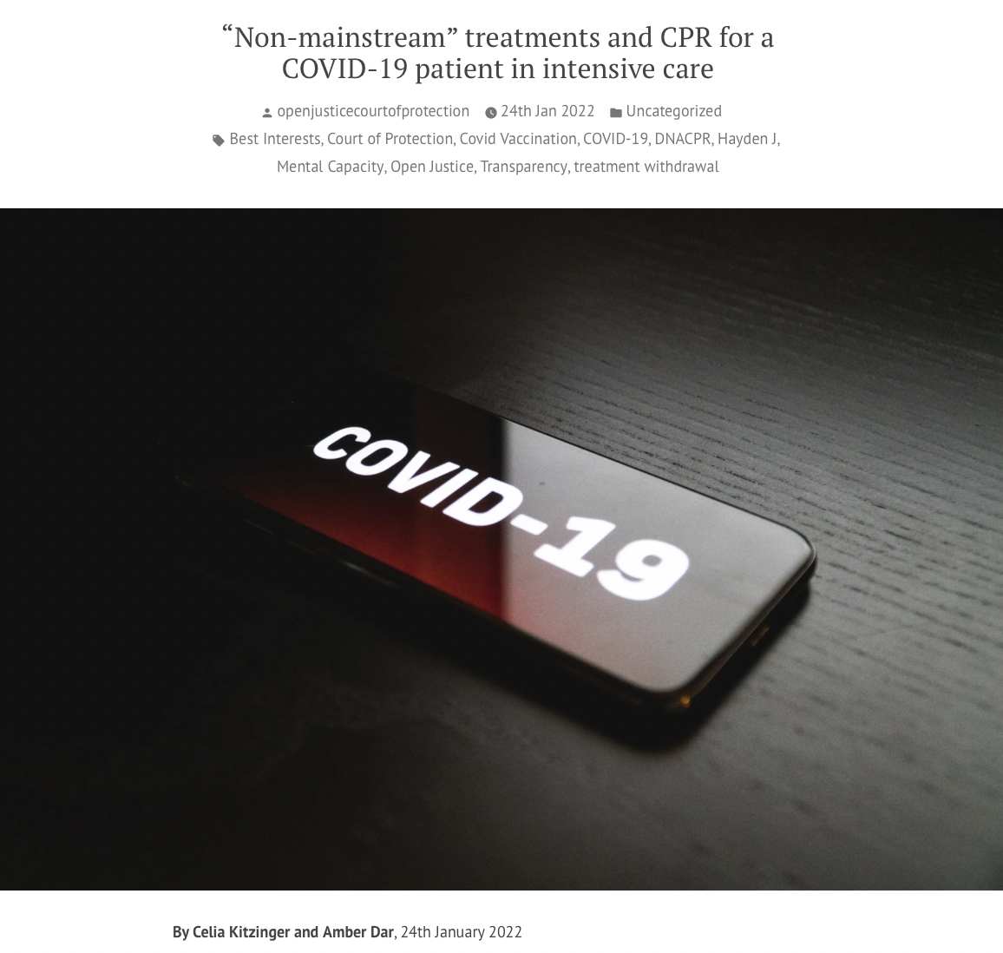
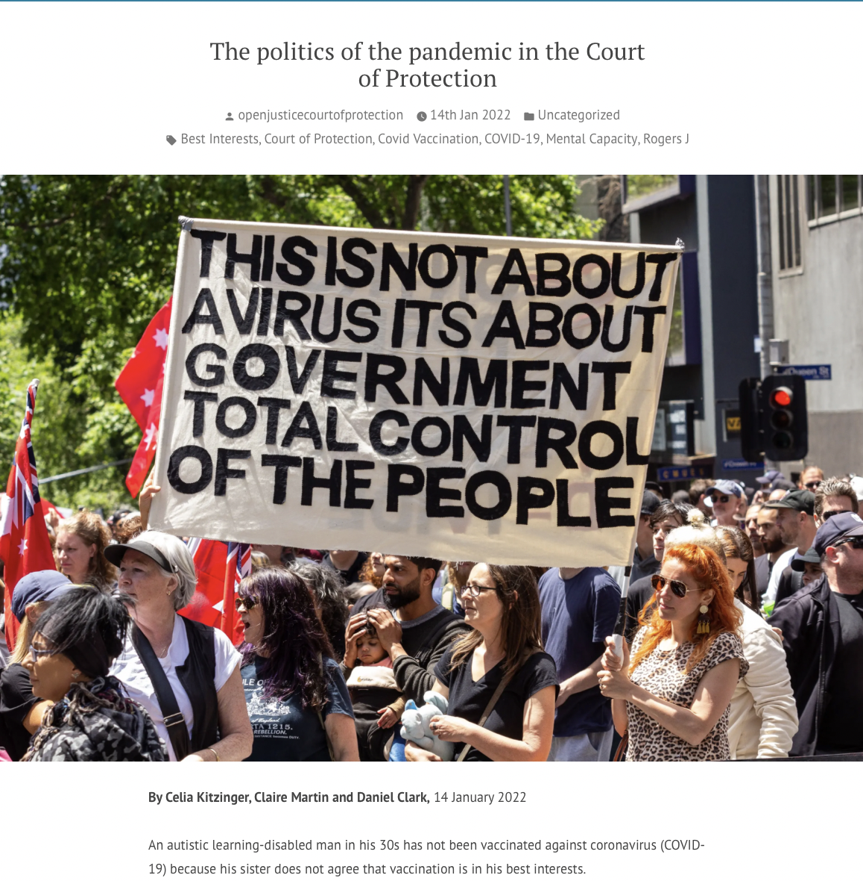
January 2022
Covid-related

Slide 22
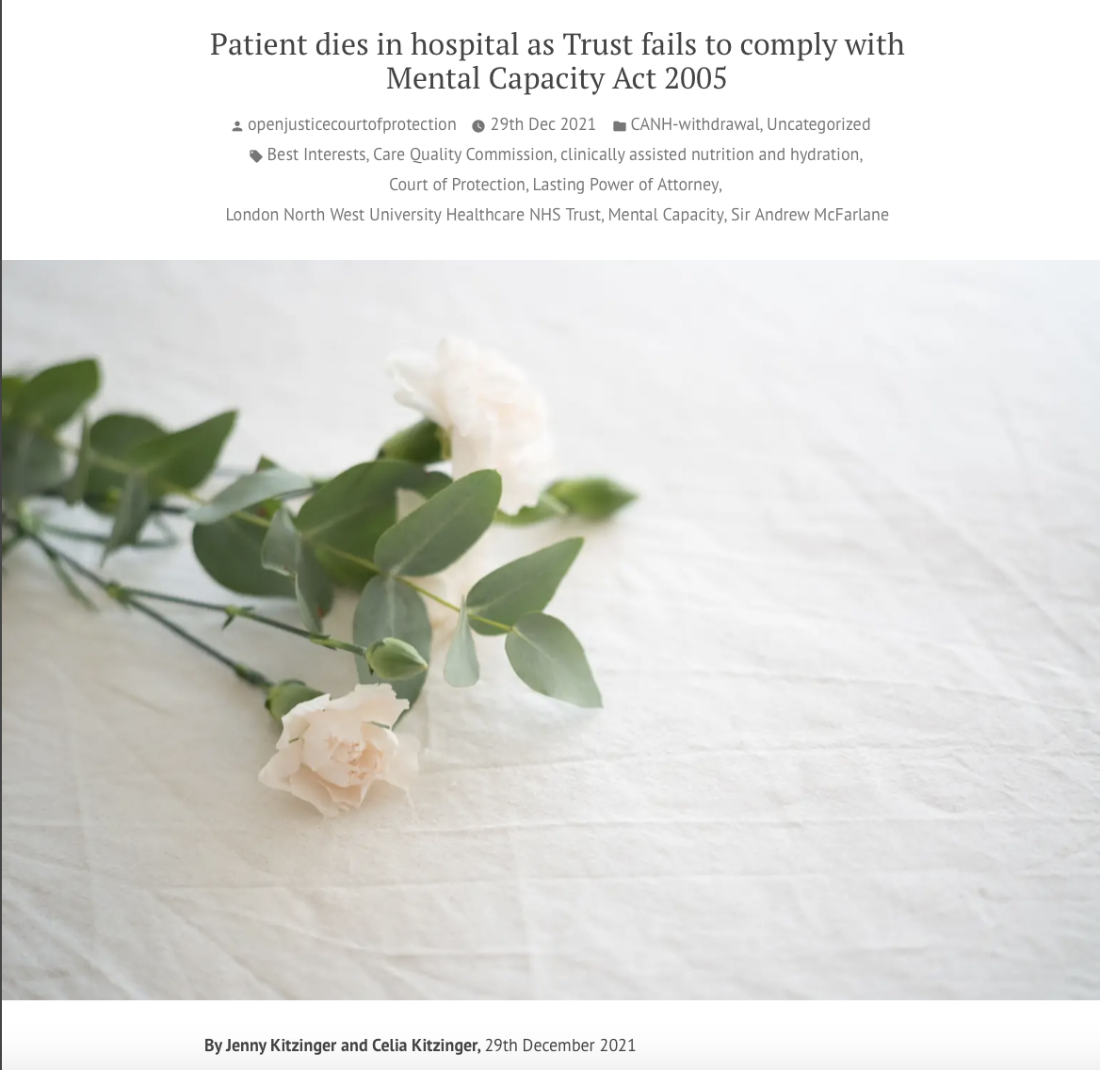
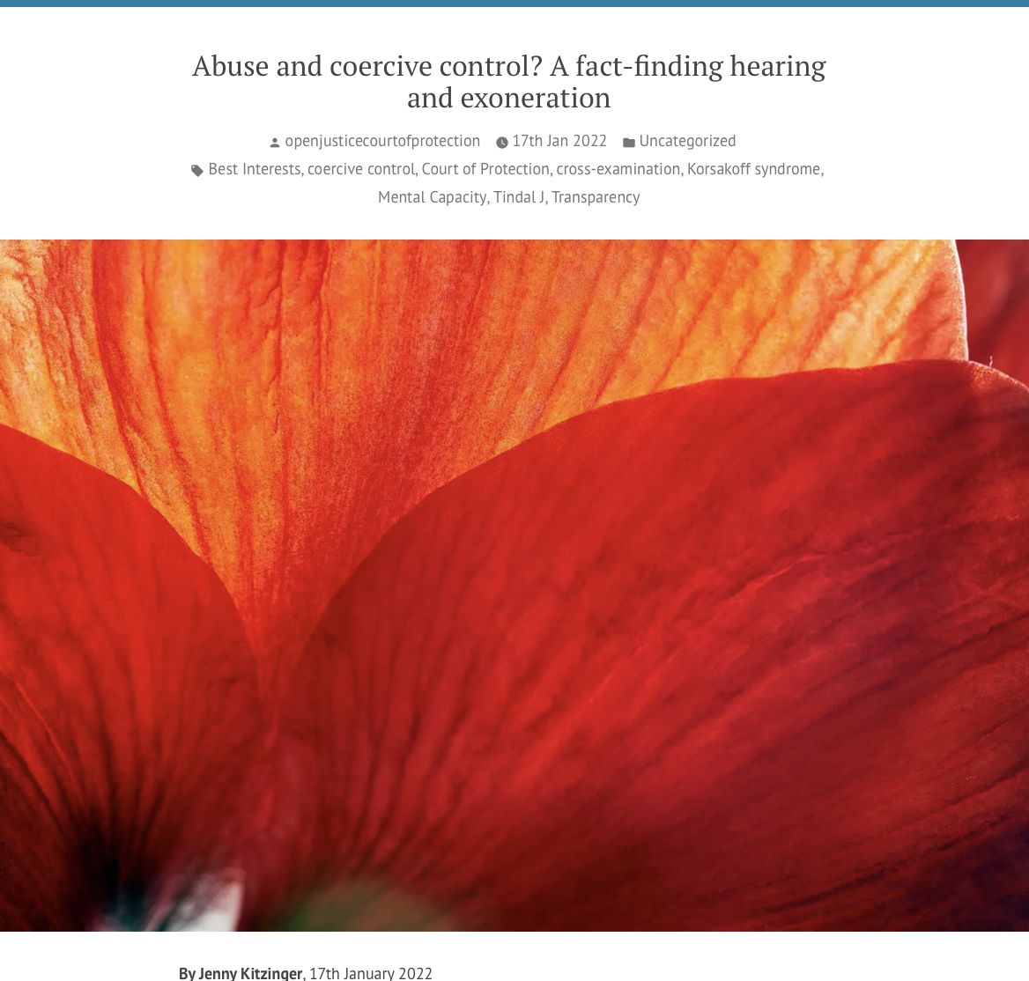

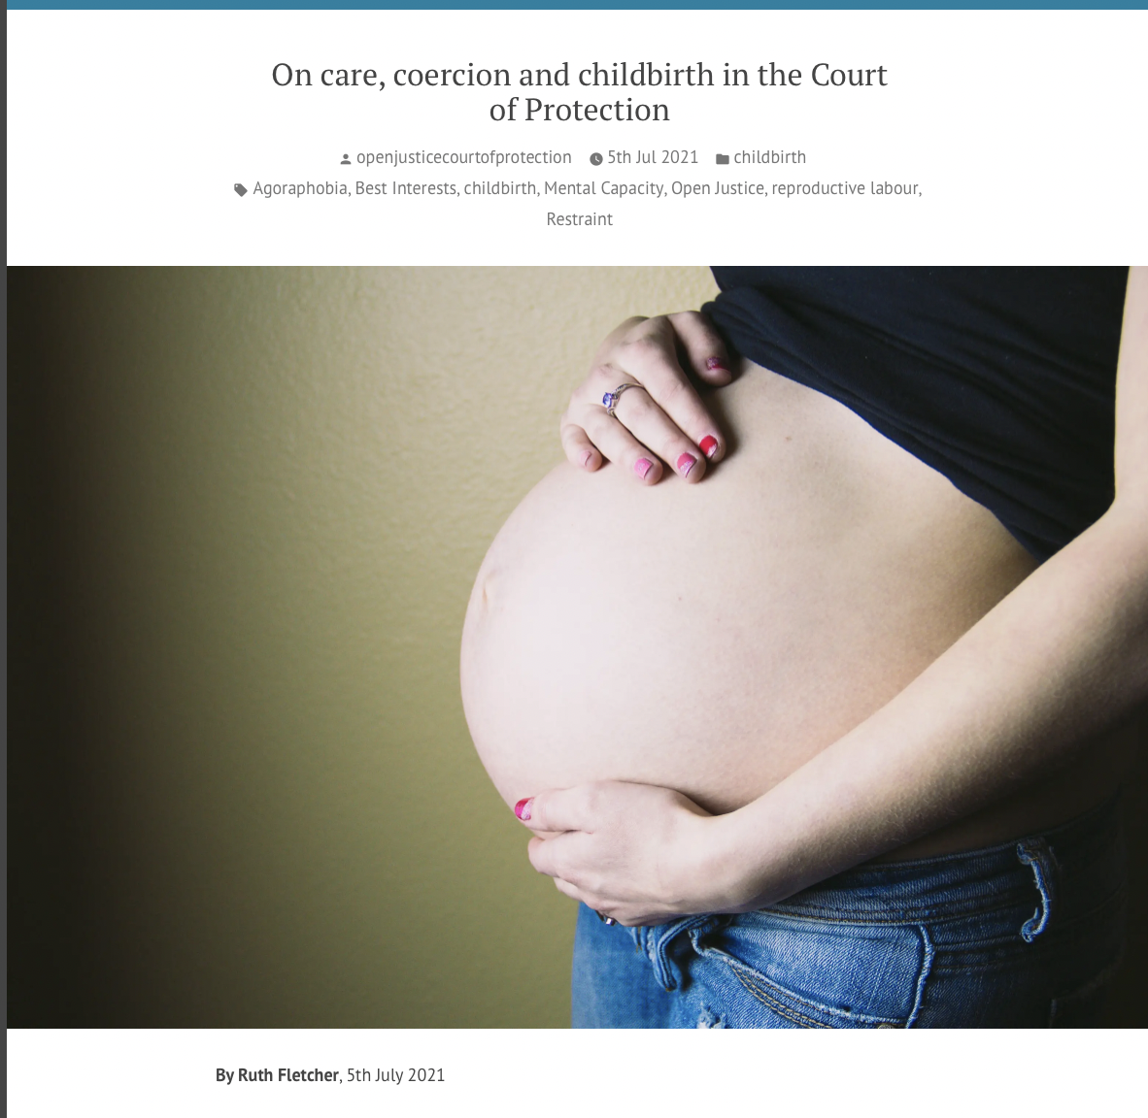
January 2022

Slide 23

Explainer blogs
By Alex Ruck Keene
39 Essex Chambers

Slide 24

By Victoria Butler Cole QC
39 Essex Chambers

Slide 25

By Kyle Squire
5 Pump Court Chambers

Slide 26

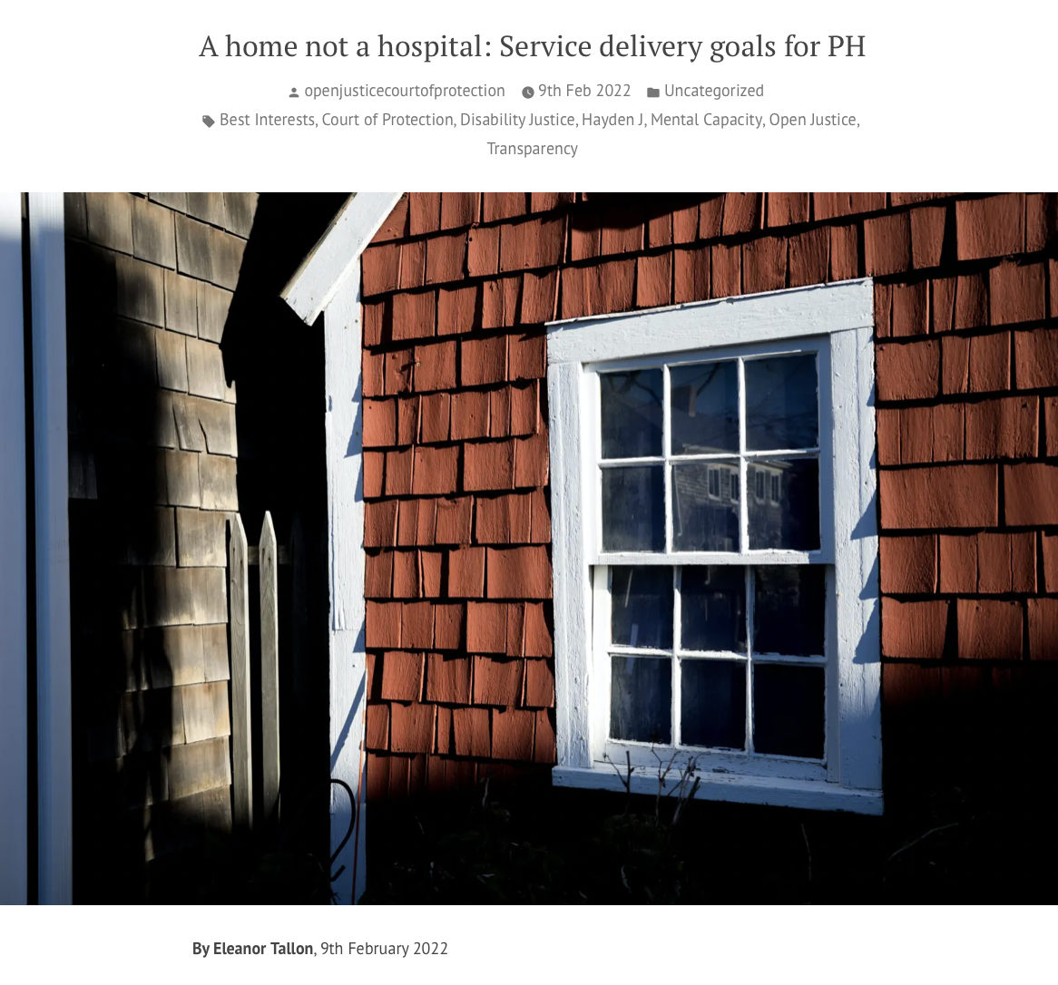
If at first you don’t succeed….

Slide 27
Hearing Feedback Form
Info about observer
How hearing was listed
Access to hearing + Transparency Order
Technology issues (it’s almost always fine – an occasional glitch)
Was there an introductory summary?
Who was there (by role)? (applicant, respondents, P, P’s family, witnesses etc)
How were P’s wishes and feelings represented and by whom?
What order was being sought + what were areas of disagreement?
What did the court decide?
What is going to happen next?

Slide 28
Thank you!
Celia Kitzinger
openjustice@yahoo.com
@kitzingercelia
@OpenJusticeCOP
Get involved! Observe hearings + write us a blog!

