Slide 1



Open Justice: the perspective of public observers
Celia Kitzinger
Honorary Professor Cardiff University
Co-Director of the Open Justice Court of Protection Project
kitzingerc@Cardiff.ac.uk
@kitzingercelia

Slide 2

“Fine words butter no parsnips”
Open justice. The words express a principle at the heart of our system of justice and vital to the rule of law. The rule of law is a fine concept but fine words butter no parsnips. How is the rule of law itself to be policed? It is an age old question. Quis custodiet ipsos custodes - who will guard the guards themselves? In a democracy, where power depends on the consent of the people governed, the answer must lie in the transparency of the legal process. Open justice lets in the light and allows the public to scrutinise the workings of the law, for better or for worse. Jeremy Bentham said in a well known passage quoted by Lord Shaw of Dunfermline in Scott v Scott [1913] AC 417, 477:
    "Publicity is the very soul of justice. It is the keenest spur to exertion and the surest of all guards against improbity. It keeps the judge himself while trying under trial."
Lord Justice Toulson R (Guardian News and Media Ltd) v City of Westminster Magistrates’ Court [2012] QB 618

Slide 3
  “Transparency is central to the philosophy of the Court of Protection […] The Vice President and the Hive group are particularly keen to ensure that the considerable efforts made to achieve a properly transparent Court of Protection are not undermined by the exigencies of the social distancing imperatives. (Mr Justice Hayden)
But most hearings have NO external observers (including no journalists) and most judgments are not published – both before and since the current public health emergency
How to fulfil judicial commitment to transparency and open justice when public don’t attend?
The Open Justice Court of Protection Project is committed to overcoming barriers and highlighting incentives to support public observation of court hearings.

Slide 4
Our experience
In physical courtrooms
Celia Kitzinger: 23 hearings between March 2012 and 1 May 2020 (all concerning serious medical treatment – feeding tubes for VS/MCS patients – see Coma and Disorders of Consciousness Research Centre)
Gill Loomes-Quinn: 14 hearings in February 2017 (here and here)
Remote Hearings
Celia Kitzinger – 1st post-pandemic-restrictions all-remote COP hearing, 17 March 2020 (here) - followed by 19 remote hearings in May 2020. I’ve observed 81 remote hearings in total (to 30 Sept 2020)
We jointly launched the Open Justice Court of Protection Project on 15 June 2020 (leading to many more observations and observers)

Slide 5


Slide 6
Structure of talk
Introduction
Who is observing in the Court of Protection (and why)?
Which hearings are they observing (and why)?
What do observers ‘see’ – and not ‘see’?
Building legal literacy via OJCOP
Cost and Benefits of public observation
How to support public observers

Slide 7
2. Who is observing in the Court of Protection (and why)?

Slide 8
Health and social care professionals
Social workers, case managers, IMCAs, clinical psychologists, speech and language therapists, nurses, care home managers….
  “My interest in wanting to observe a case is really one of professional development and wanting to learn more, so that I can better represent the clients I work with. I also want to be able to enhance my ability to support the team in understanding how the court works and what to expect if we’re called to court or asked to provide information, such as a statement for a hearing.” (Jackie Waggott, Case Manager, Social Return Case Management – blog post for OJCOP)

Slide 9
As an Adults Social Worker, I consider people’s mental capacity on a daily basis and complete formal documented mental capacity assessments probably once or twice a week. When financial management is involved this often results in paperwork for a Court of Protection (COP) application. I know the COP is there in the background to my work but once my paperwork is sent in, I have never given it much further consideration. When the opportunity to observe a COP hearing arose I was very keen to see “what happens next”.
(Louise Burrell, social worker)

Slide 10
On 29 June I started a job as a 2-day per week trainee Independent Mental Capacity Advocate (IMCA) and Relevant Person’s Representative (RPR) for an advocacy provider in Yorkshire. I am currently doing my induction and lots of training. I have never worked with the Court of Protection and am likely to be involved in cases in my job, so I thought that observing a hearing would enable me to gain some insight into how cases are dealt with by the Court. (Hilary Paxton, trainee IMCA)

Slide 11
(Aspiring) Lawyers
U/g, p/g, Graduate Law Diploma, Bar Practice Course, pupils etc, academics, newly qualified solicitor preparing for first COP hearing, lawyers with no COP experience)
  I am a solicitor working for NWSSP Legal & Risk Services. I started working for Legal & Risk Services on 9th March 2020 (so just before lockdown was imposed). I represent Health Boards across Wales…. As I am new to my role, I thought it would be helpful to attend this hearing as part of my training. …my role involves drafting the witness statements of clinicians like the doctor who gave evidence in this hearing. In my short time at the NHS, whilst I have attended Directions hearings, I have not attended a final hearing and therefore, I am yet to see a clinician give evidence in this way. Mr Justice Hayden challenged the doctor and he was not frightened to question him thoroughly. When it is time for me to attend a final hearing with an NHS Health Board, this experience will be invaluable in preparing them for what is to come. (Natalie Matthews, Solicitor Complex Patient Team of NWSSP Legal & Risk Services)

Slide 12
Family members of ‘vulnerable’ people
Some currently involved in COP hearings of their own.
  “I am in a Court of Protection hearing myself at the moment. And I find the whole process extremely intimidating. So it was very nice to see a hearing that I’m not involved in! I recognised one of the barristers from my own case. He seemed nicer than when he comes up against me…. And I thought that the judge in this case was absolutely brilliant. She was clearly concentrating on what was happening and she was concerned that the right thing be done for P. ” (Observer D)

Slide 13
Others
For example….
MCA trainer (David Thornicroft)
representatives of third sector organisations e.g. charities and campaigning organizations concerned with disability rights and end-of-life rights (e.g. Upeka de Silva, Compassion in Dying)
representative for bereaved families in death investigations (George Julian)
Creative Director of Dead Earnest Theatre (Charlie Barnes)

Slide 14
3. Which hearings are they observing (and why)?

Slide 15
People often make specific requests for issue-based hearings: “one about DOLS”, “something concerning dentistry for people who can’t consent”, “an ICU one”, ”decisions about kidney-dialysis”.
Sometimes people request hearings concerning Ps with specific impairments: autism, learning disability, schizophrenia, bipolar
Often people want to know how long a hearing will last so they can observe the whole thing
Occasionally a ‘local’ hearing (e.g. Wales) or a particular judge (e.g. Hayden, Hilder)
Most important issue is actually getting into a hearing at all – there’s not much scope for selecting between alternatives!

Slide 16
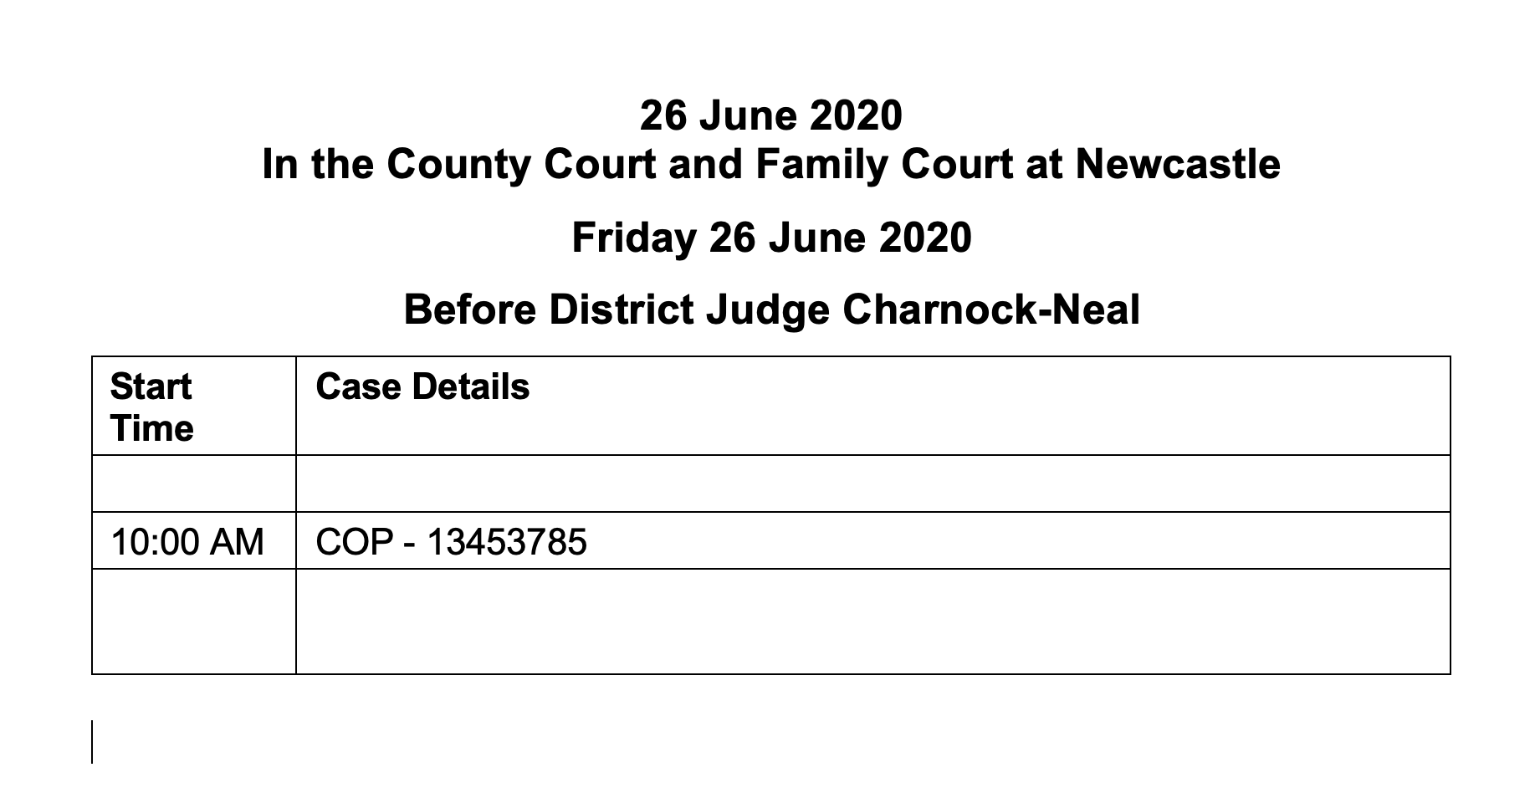
Typical example from CourtServe in June 2020

Slide 17
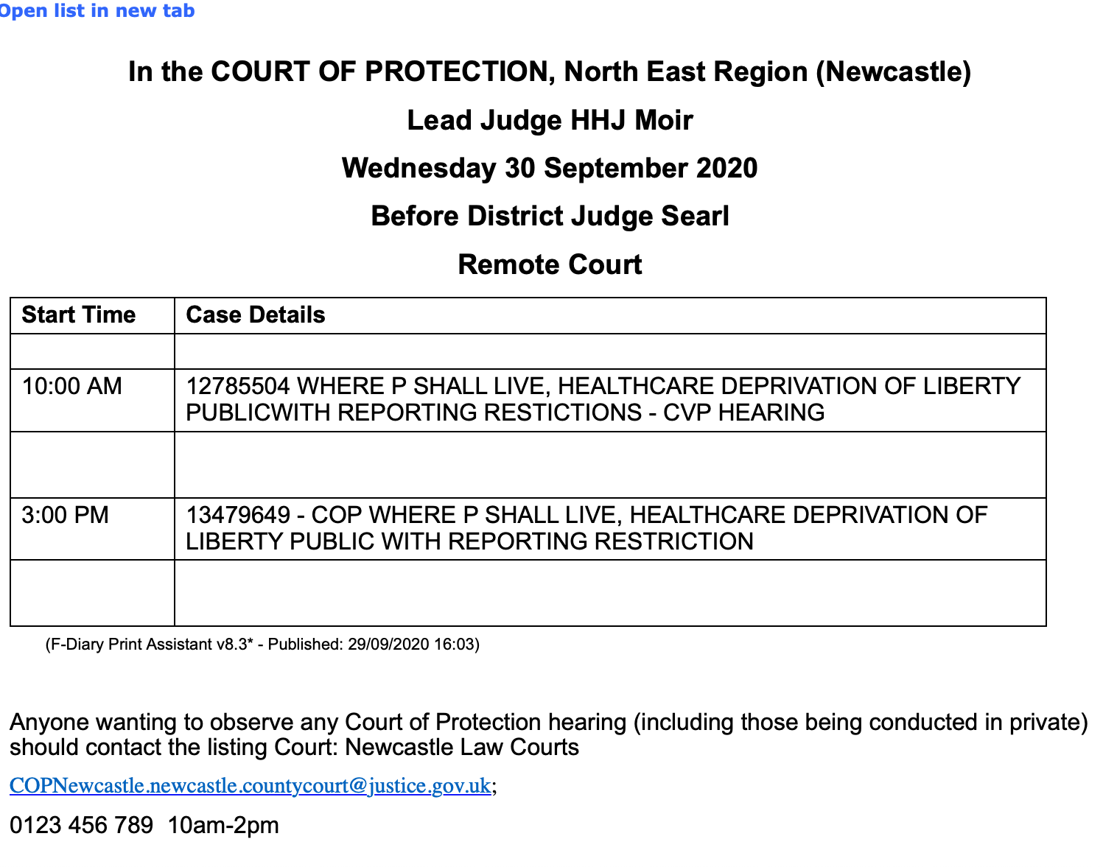
Issues to be addressed
”Public”
“CVP hearing”
Accurate contact information
Exemplary – but not yet typical – from CourtServe in September 2020

Slide 18

Time estimate given
Remote hearing (by telephone)
“Directions”
No info about issues to be addressed
No contact information (and it’s NOT Truro County Court!)

Slide 19
Hearings listed before Tier 3 judges (sitting in the Family Division of the RCJ here) are the easiest to access – i.e. most likely to get (timely) responses to emails and be sent a link.
Remote hearings are video-platform (not telephone) + much easier to follow.
They seem least likely to be vacated/adjourned
They concern matters of high public importance – but there’s no info on lists as to what issues will be addressed (and there’s no indication of estimated duration)
Clerks are (now) accustomed to dealing with requests to observe from members of the public + procedures are in place.
Very likely that judge will ask for introductory summary of the case for members of the public.

Slide 20

Hearings listed in First Avenue House (here) are relatively accessible – with the huge benefit of including info about issues to be addressed (and a time estimate). (But mostly phone hearings)

Slide 21
Hearings listed only in CourtServe – i.e. most hearings across England and Wales – are hard to access.
Frequently vacated or adjourned
Frequently little information about the hearing – no info re. issues, DRH not indicated, remote/attended not indicated, sometimes no contact information - or incorrect contact information
Often no replies to emails; telephones aren’t answered.
Judges often receive requests minutes before hearing starts + struggle to deal with them
Resource issues? Communication with administrative ‘hubs’?

Slide 22
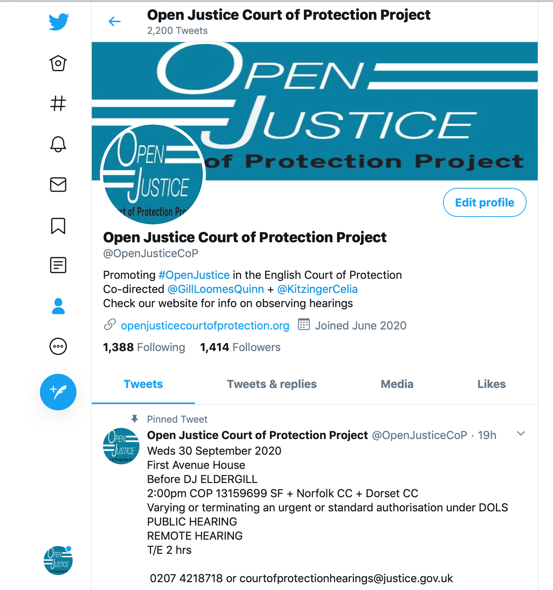

@OpenJusticeCOP

Slide 23
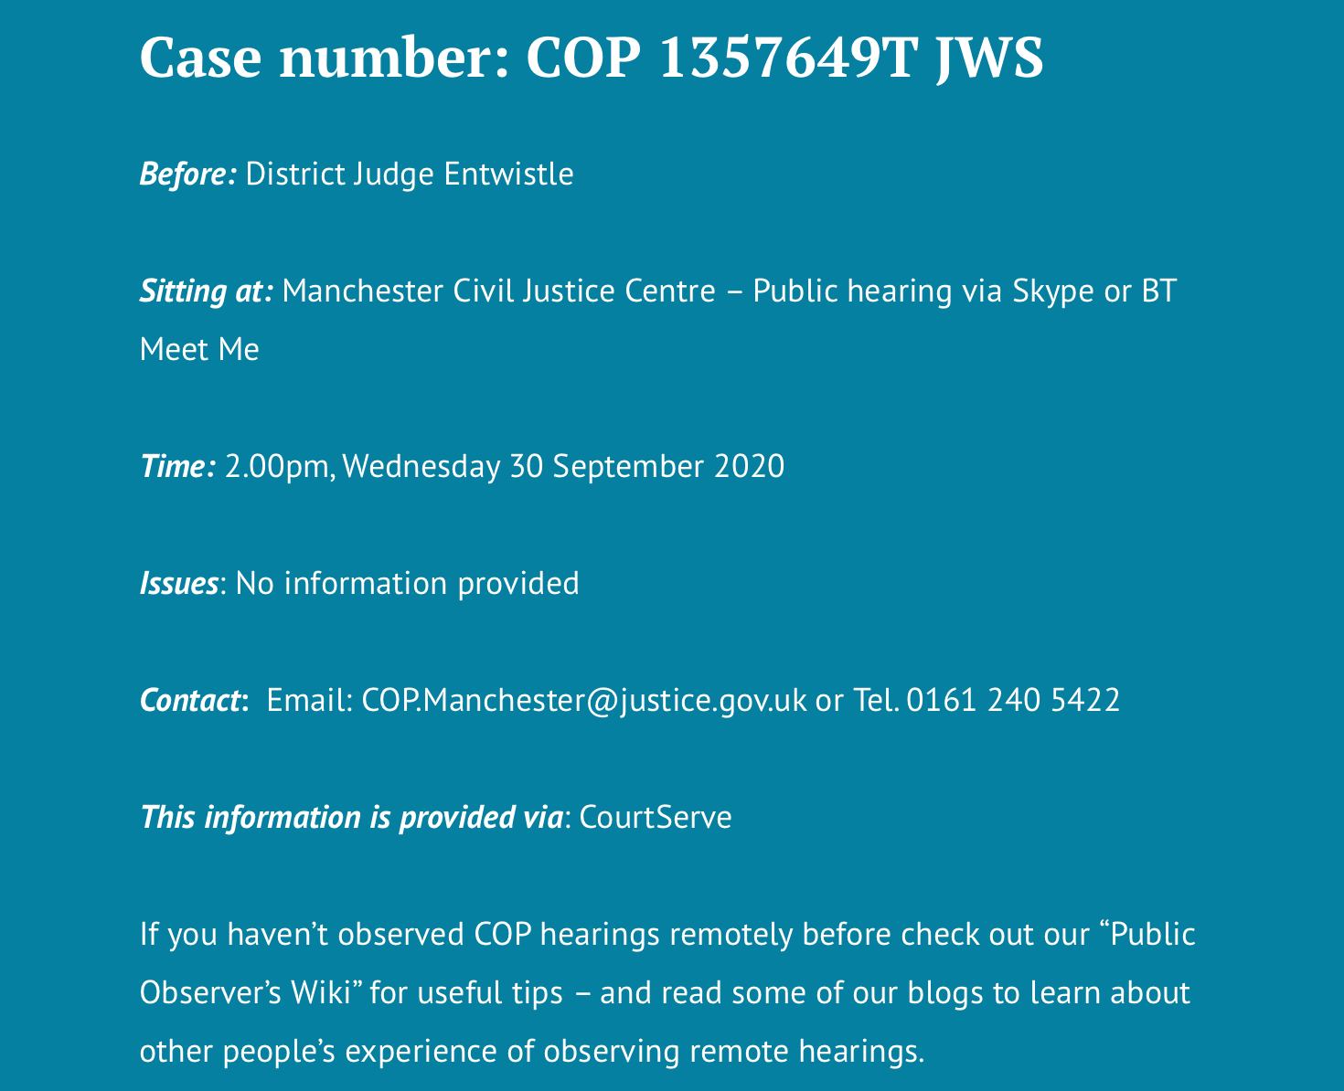
List of ”Featured Hearings” on the home page of our website
Provides correct contact info
Decodes T/E, BTMM, CMH, Dirs, etc
Selects those to which we think access is most likely

Slide 24
Hearings with public observers…
In practice they are most likely to be before Tier 3 judges sitting in the Family Division of the RCJ as COP judges, or judges in First Avenue House.
We are working to improve access to hearings across England and Wales (as I believe is HIVE)
Improvements in CourtServe listings have really helped
Resource issues continue to make it hard for courts to respond to requests for access.

Slide 25
4. What do observers ‘see’ - and not ‘see’

Slide 26
”Person-centred decision-making”
Overwhelmingly, ‘person-centred’ decision-making – to an extent that surprises and delights
  As a nurse my main focus is that the person remains at the centre of everything. It was so reassuring to see that this also was the primary focus within a formal court hearing for Mr Justice Hayden. The person-centred approach to this hearing epitomises and reflects exactly what I believe the Mental Capacity Act is all about.” (Sara Shorten)
  “Mr Justice Williams maintained unwavering focus on what is right for P and preventing him being exposed to a toxic atmosphere … I left feeling reassured that person-centred decision-making, an issue I feel strongly about, prevailed” (Upeka de Silva)

Slide 27
  “Human Rights has become real and applied. I can see more clearly that down at the coal face, we have real opportunity to empower our service users. And based on what I have observed, I have confidence that if the situation of our service users should ever require consideration by the Court of Protection, the judge will ensure their right to participate is facilitated and their right to self-determination, if at all possible, is respected.” (Louise Burrell, social worker)
  “In this virtual courtroom with Mr Justice Hayden the law enabled a person with a learning disability to access the same rights and healthcare as any other citizen. This give me a huge sense of relief that my family member will be safe and listened to with these structures in place, and free to live the life he chooses.” (NB)

Slide 28
… and what do observers NOT ‘see’?
Many observers struggle to make sense of the details of what is going on especially without:
An introductory summary
Position statements and draft orders (sometimes read out by judge)
A working knowledge of the ‘structure’ of hearings and the different ‘roles’ participants play (e.g. the applicant, the OS)
Sufficient knowledge of the principles of the MCA (esp. capacity and best interests) and relevant case law
Sufficient knowledge of details of the MCA (e.g. what’s a s.49 report)
Acronyms and initialisations (what’s an “aylar”?)

Slide 29
“ I think the best way of me explaining my experience of the hearing is by way of analogy. When I was a teenager I fell ill with some sort of wretched bug and I missed 10 days of school. Upon return to chemistry class I found that I’d missed the whole week covering the basics of titrations and I sat in the class trying to apply context and my existing knowledge to quickly get to grips with this new topic. … I could see justice being done. I could hear justice being done. But, hand on heart, I can’t say I fully understood the justice being done.”
(Olwyn Cockell, Speech and Language Therapist)

Slide 30
5. Building legal literacy via OJCOP

Slide 31

By Alex Ruck Keene
39 Essex Chambers

Slide 32

By Victoria Butler Cole QC
39 Essex Chambers

Slide 33

By Kyle Squire
5 Pump Court Chambers

Slide 34
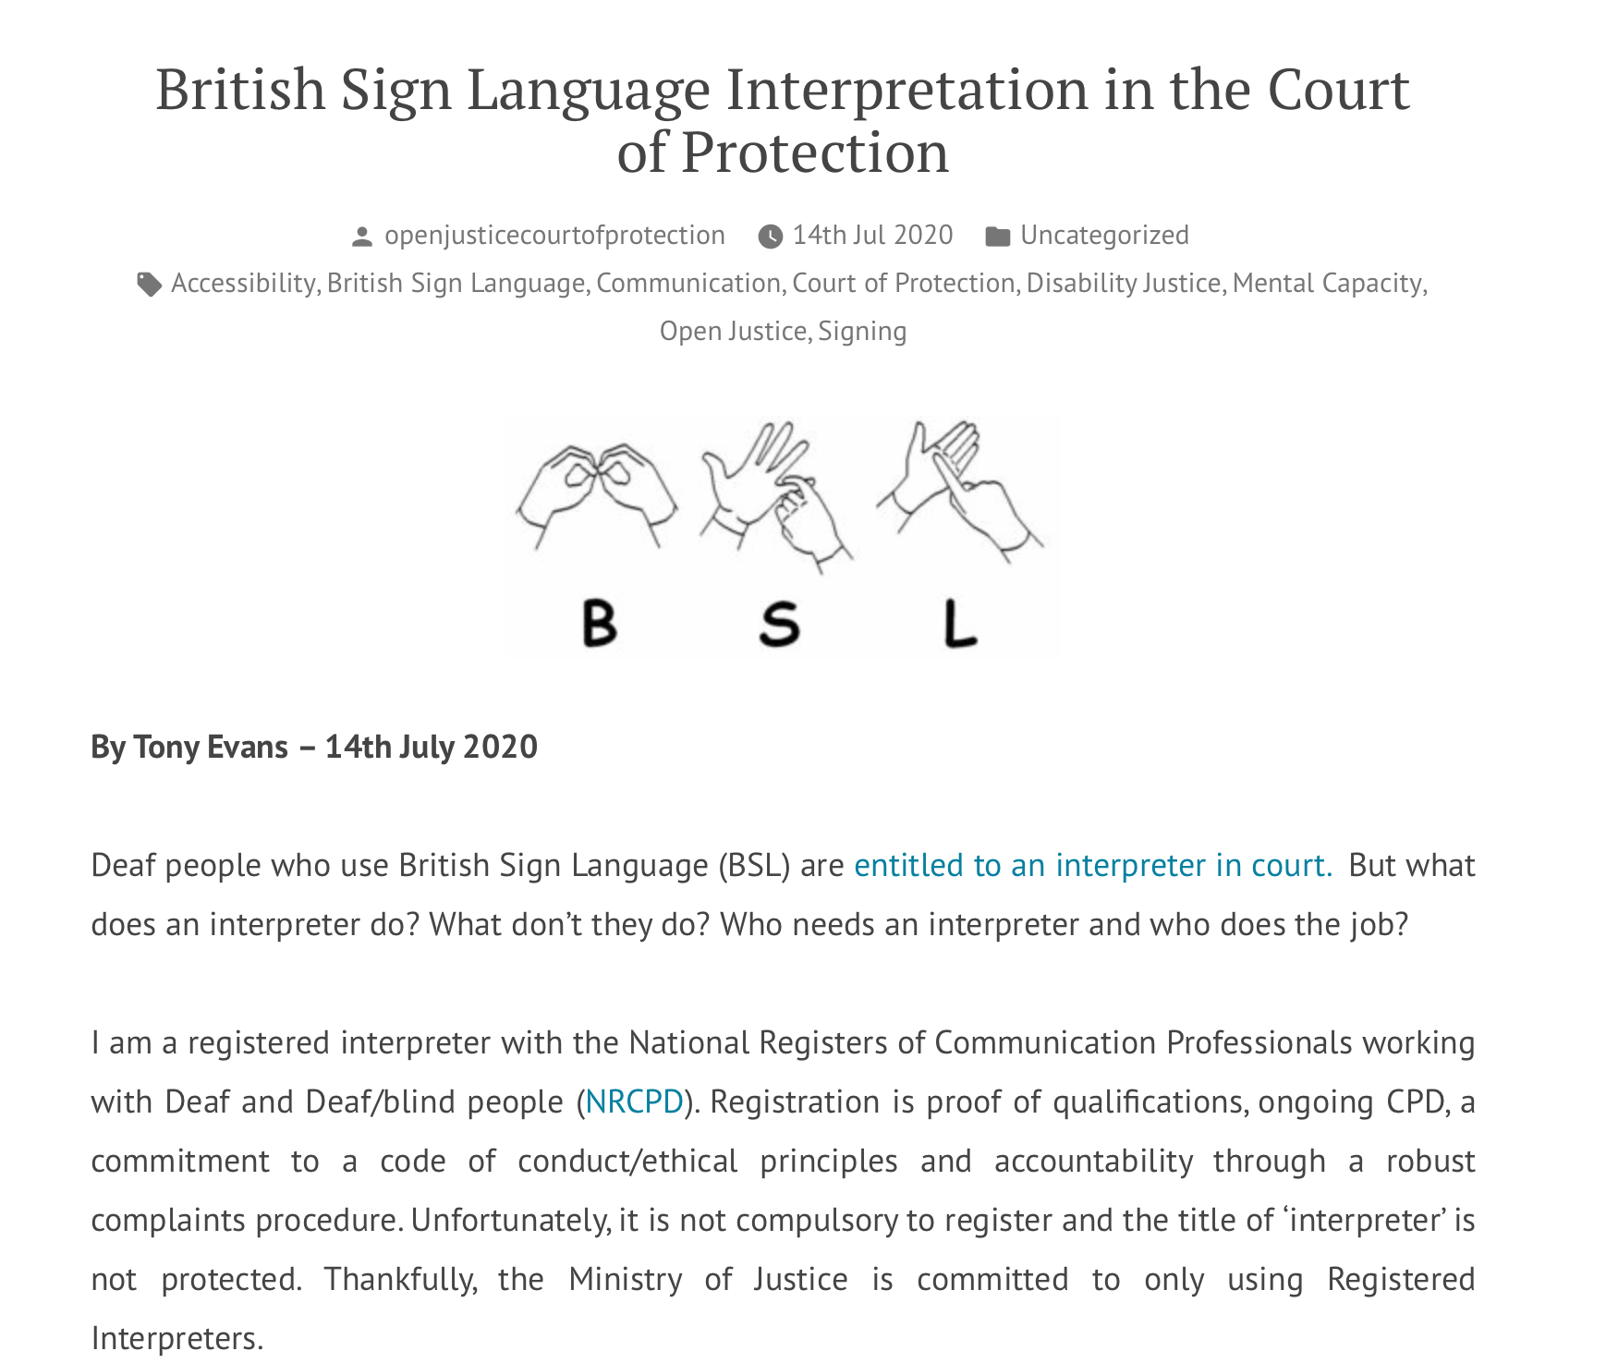
By Tony Evans

Slide 35
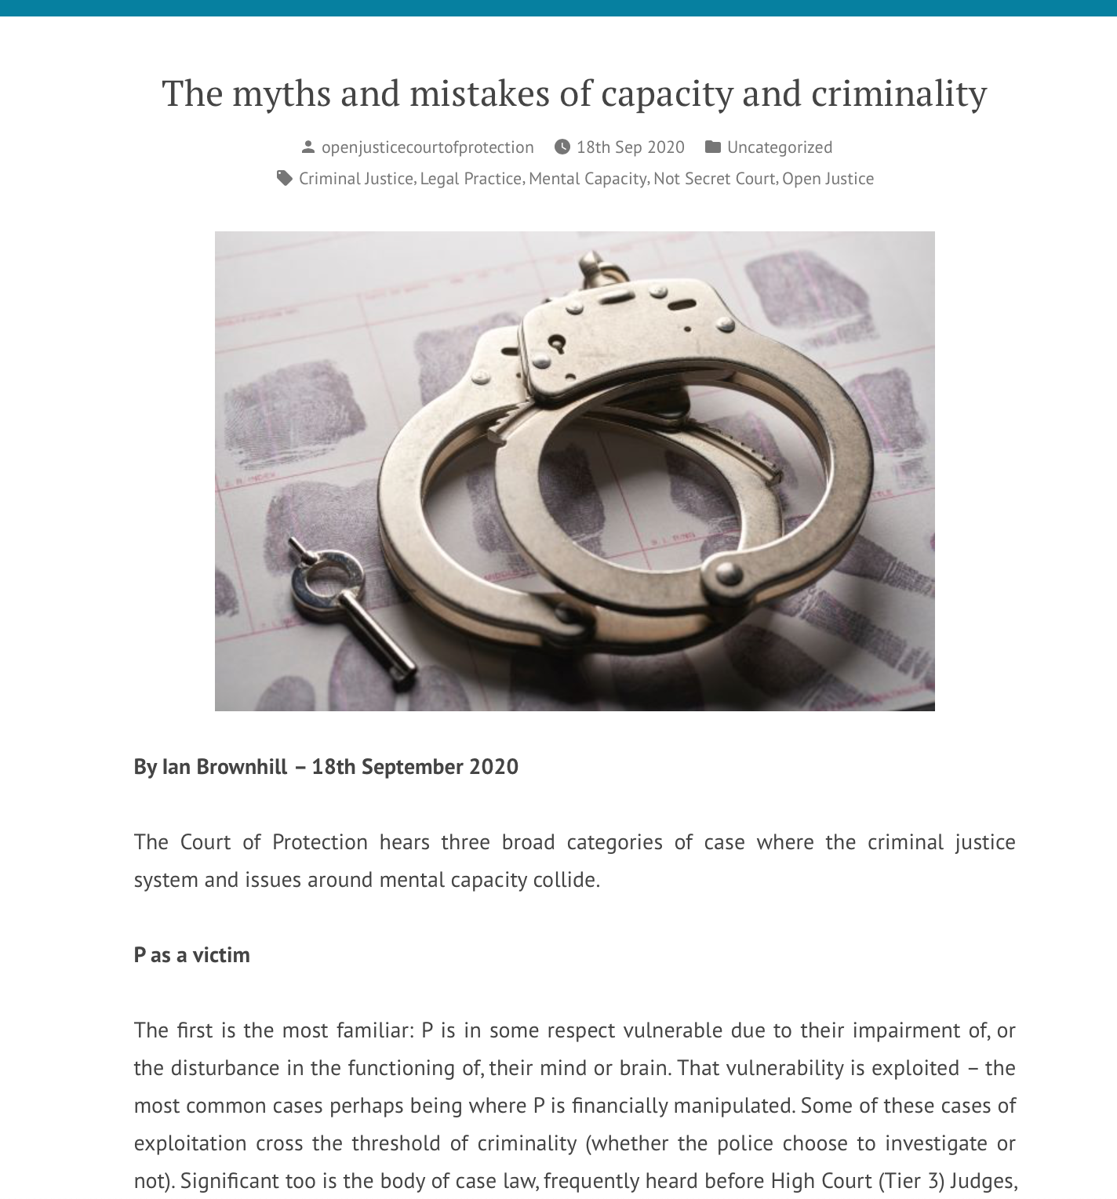
By Ian Brownhill
39 Essex Chambers

Slide 36
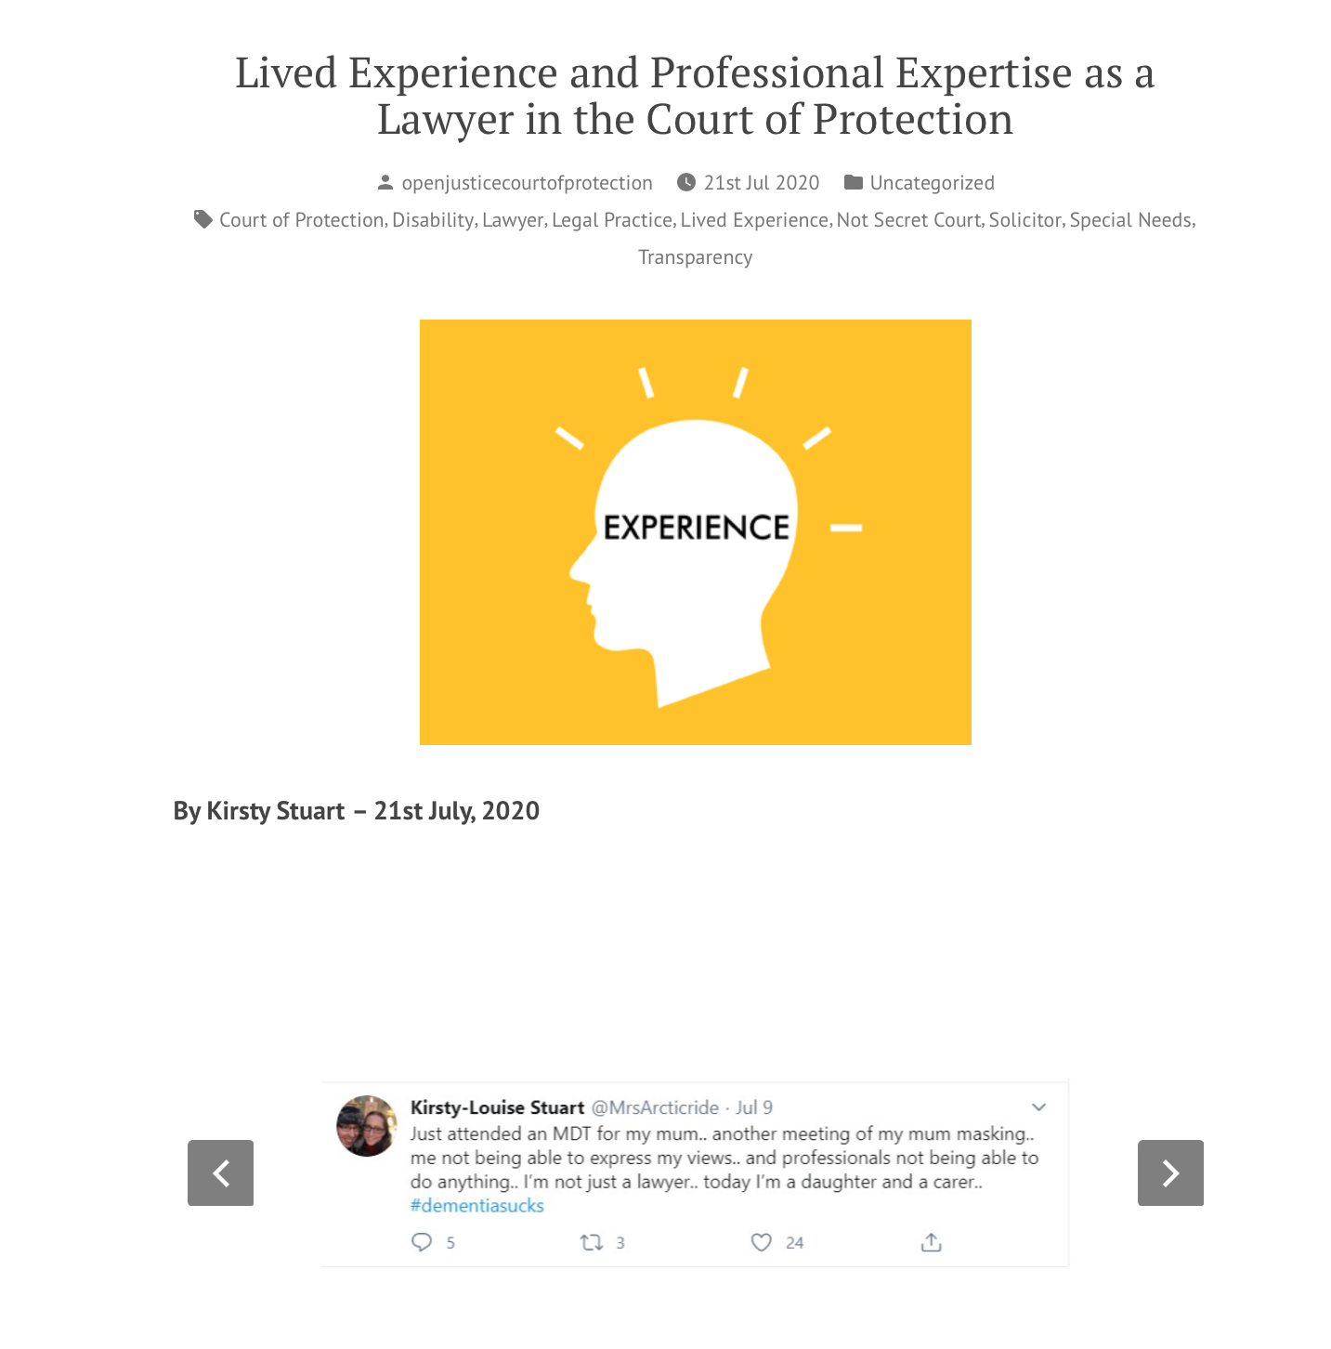
By Kirsty Stuart
Irwin Mitchell

Slide 37
Hearing Feedback Form
Info about observer
How hearing was listed
Access to hearing + Transparency Order
Was there an introductory summary?
Who was there (by role)? (applicant, respondents, P, P’s family, witnesses etc)
How were P’s wishes and feelings represented and by whom?
What order was being sought + what were areas of disagreement?
What did the court decide?
What is going to happen next?

Slide 38
Developing legal literacy through observation
I have found the whole observation experience very beneficial. The googling, looking up of legislation, reading up of quoted case law – both during and after the court attendance – has given me a crash course in legislation, that I now realise, I only thought I understood. Listening to a talk about how the Mental Capacity Act is implemented in the courts is one thing – actually observing it as it happens is very different! (Louise Burrell, social worker)

Slide 39
Observing the hearing was interesting and made me reflect on my own experience of conducting capacity assessments and the extent to which they would hold up in court. I do wish, though, that the judge or the applicant had done a proper introduction to the issues to be covered in court so that I would have been better placed to understand what was happening and use the experience more effectively for professional development. (Jacqui Bond, social worker)

Slide 40
Developing legal literacy via public discussion and informed critique
The Court of Protection makes decisions that observers (and other members of the public) can find distressing:
ordering that P must remain in a place they don’t want to live
separating a husband and wife against their wishes, by placing one in a care home
prohibiting contact for 6 months between a mother and her adult daughter
declining a family member’s request to act as a deputy for P
preventing P from having sexual relations
compelling P to have medical treatment against their wishes

Slide 41
These issues are often poorly reported in the media (e.g. Hayden’s alleged comment about a man’s ‘right’ to have sex with his wife) and leads to perception of COP as a secret court making arbitrary and draconian decisions
Observing a hearing permits understand of context, multi-disciplinary perspectives, concrete ethical dilemmas, real-world contingencies, ‘least worst’ options – texture and nuance
Court judgments and processes can still be criticized and debated but in a more informed way

Slide 42
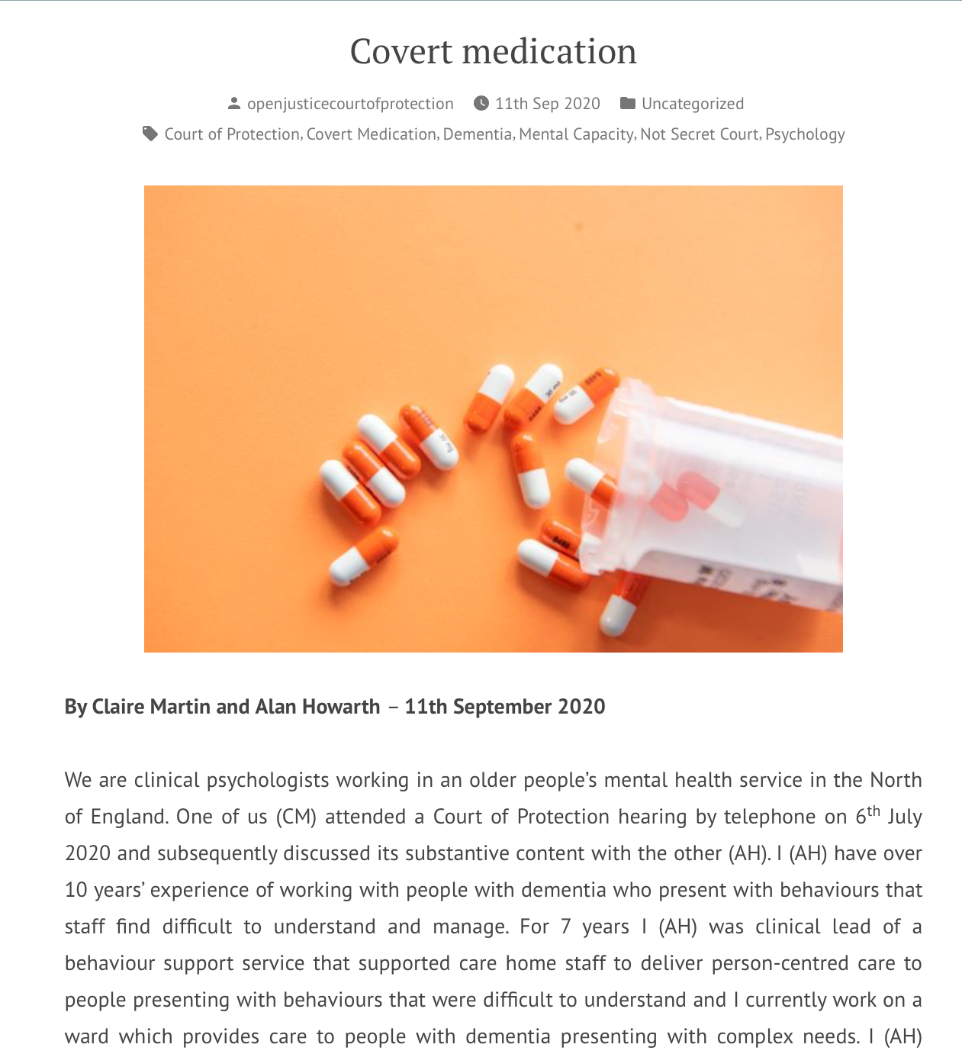
Covert Medication
Two clinical psychologists, Claire Martin and Alan Howarth, criticized a judge for authorizing covert medication for a dementia patient
…without apparently adequate exploration of less restrictive alternatives
… without discussion of P’s wishes and feelings (previous or current)
And included anti-psychotics (side effects, strokes + death)
Is dishonest + means staff have to lie.
Not clear that decision complies with best practice e.g. in British Psychological Society Guidance re. alternatives to antipsychotic medication for people with dementia.

Slide 43
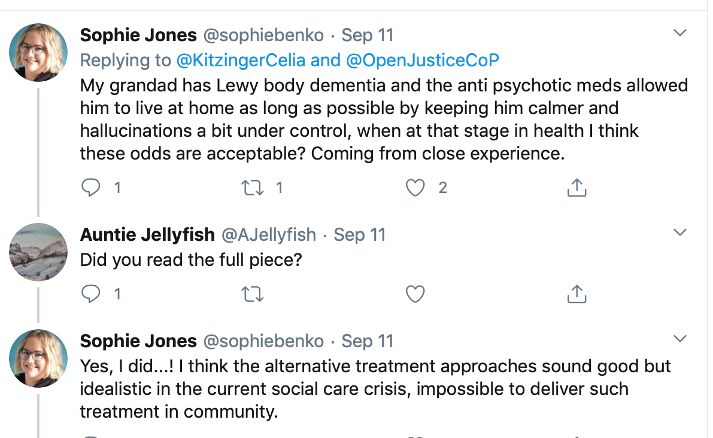
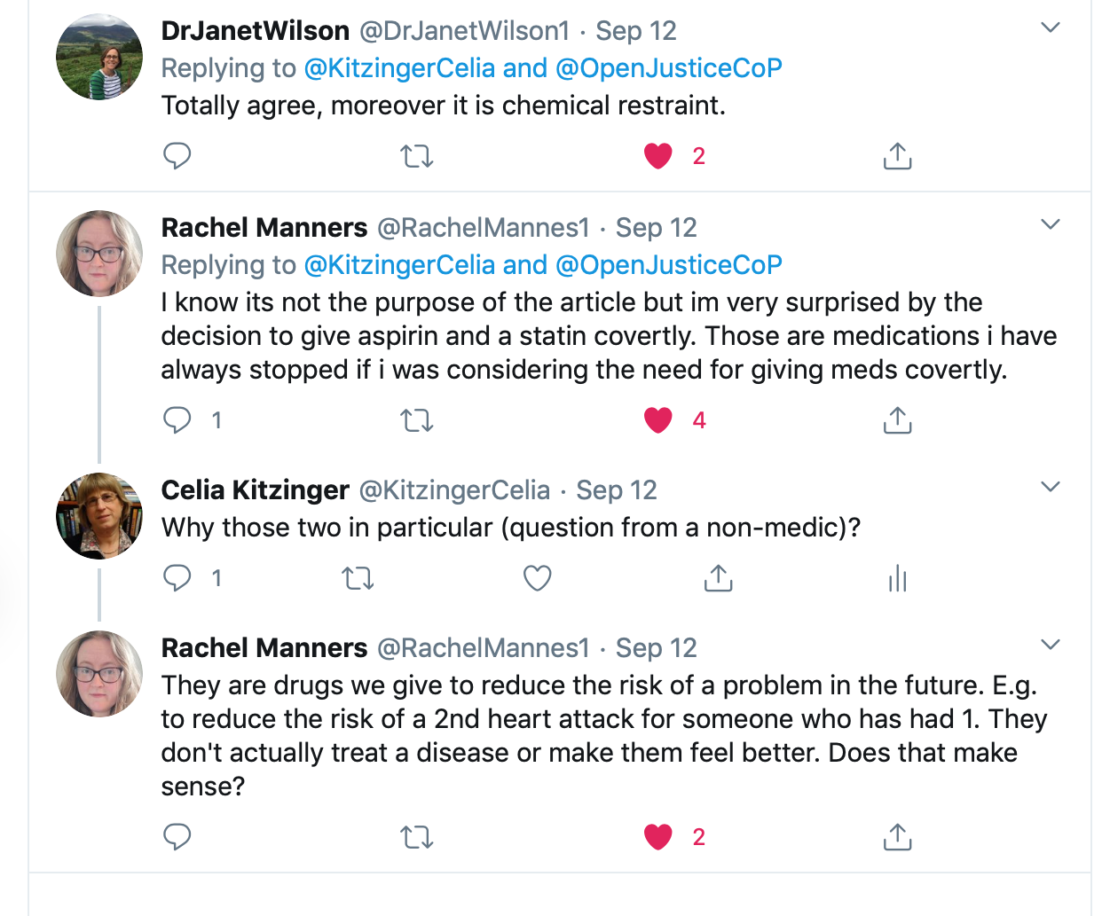
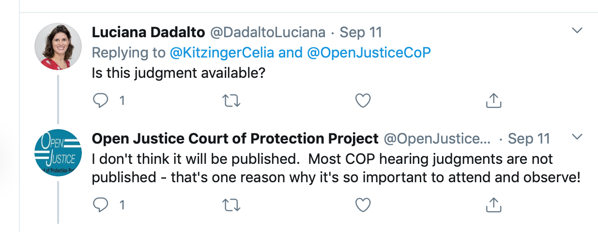

Slide 44
Covert meds blog post replies… from a hospice
Val Stangoe (CEO, St Mary’s Hospice Ulverston)
13th Sep 2020 at 9:19 am
I trained 30 years ago and this was common then. As students we struggled with the dissonance between what the School of Nursing taught us and actual practice. But having worked in many Care Homes there are other factors to consider other than unfair use of power. I think few people understand what it is like to work in a unit of up to 30 people with very advanced dementia. Often it is impossible to identify refusal from an inability to process what taking a tablet entails. Swallow reflex goes too. Staff work 12 hour shifts often. These are exhausting but necessary because of low salaries. But most care home staff care for their patients. They don’t want them to suffer any problem from not taking necessary meds. So they will do what they see as necessary to get meds into a person. Aggression is very common. I’ve worked in the community, with teenagers, on acute wards and in care of the elderly. I’ve only been hit working on care of the elderly. And when I say hit I’ve been bitten, scratched, kicked and punched. When the GP offers neoroleptic medicine to calm people it’s not an unpopular idea. To challenge poor norms we need to listen to care staff and consider how the environment for working and living can be made better. Smaller homes, more staff, better salaries, more useful tech to take the weight?

Slide 45

Covert meds blog post replies….
A geriatrician
Veda Adhiyamam, Glan Clwyd Hospital, Rhyl
13th Sep 2020 at 9:39 pm
This is a difficult situation. I am a geriatrician and my experience is limited to acute care settings. In the last six months, I personally recommended this only once (there are few forms to complete – capacity assessment, best interest assessment, DoLs assessment and a separate form for why we want to consider this option). This was for a person with dementia admitted with an acute medical problem. P was very agitated and hit a few people with a stick and bit a staff nurse (who had to go off sick for her own safety). I spoke to P’s daughter who was petrified with the events and said P had never harmed anyone in P’s lifetime and would have been very ashamed with the behavior.
The only non-pharmacological intervention was to request the family to come and sit with P, but it only made matters worse as P though the family had come to take P home. The medication did work briefly before P contracted an infection and was kept comfortable.
In acute settings, we have one nurse to look after 6-8 patients during the daytime and around 12 at nighttime with the support of an assistant.
Non-pharmacological steps are rarely available and when there are no correctable factors, we just do not have any other option. And one should remember that it takes longer to administer medications covertly so no one is very pleased to do this.

Slide 46

Covert meds blog post replies….
A speech + language therapist
Jennifer Benson, Grimsby Hospital
13th Sep 2020 at 10:00 pm
I am an adult Speech and Language Therapist working predominantly in neurology, and this was a fascinating read. Very often we recommend taking tablets with a spoonful of porridge, yoghurt, etc – not as a covert administration- but to use a carrier bolus to assist someone to swallow a tablet. This is often really successful, as it can mean that the tablet is swallowed much more effectively and reaches its intended destination- ie the stomach, where it can reach optimum therapeutic benefit, rather than remaining in the mouth or pharynx, or the lungs. I’ve been been accused in the past of suggesting covert medication in this scenario, whereas actually I’m making a swallowing recommendation. The two do not have to be mutually exclusive, and this mode of administration can be covert if that has been deemed to be in the person’s best interests and documented as such. Sometimes as SLTs we may contribute to that decision making process as part of the MDT. I believe it’s crucial to assess the swallowing of a patient with dementia- they may be refusing their meds because they find them uncomfortable to swallow and get stuck, or they cough and choke and don’t like that. It may not be the answer, but worth ruling out.
Using a carrier bolus with good reason does not have to be covert, and good communication with a person who cannot consent can be as simple as showing them the tablet before putting into the carrier item.
I think it’s critical to make that distinction to ensure that we can continue to make swallowing recommendations as part of a care plan that is in the person’s best interests.

Slide 47
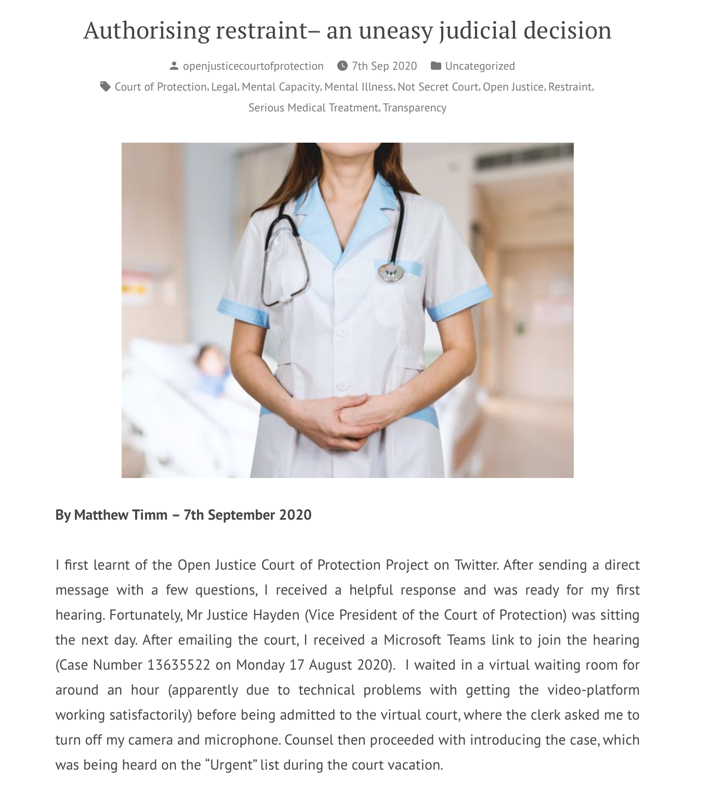
Restraint
Judicial authorization of restraint to administer dialysis – observed by Matthew Timm (BTC student)
“The wishes of F were clear – and expressed in two handwritten letters to the court … She does not want dialysis. She does not accept that it is life-saving.”
I have sympathy for those responsible for determining best interests in circumstances as difficult as these. Each competing factor pulled me in a new direction and proved illuminating to witness. In conclusion, and with all things considered, my discomfort with the authorisation of restraint in this case is ultimately lessened considering that no other means exist for ensuring she gets treatment…

Slide 48
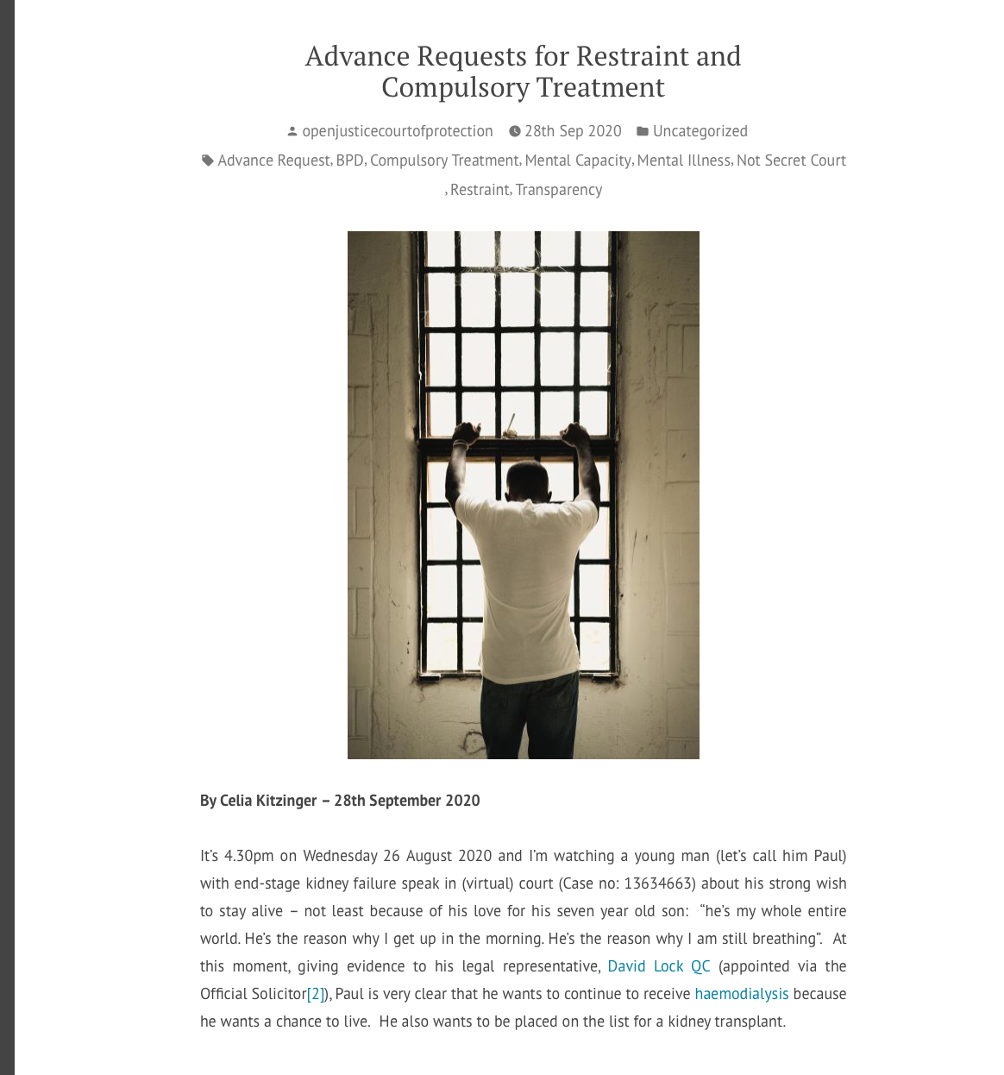
A patient with fluctuating capacity who (when he had capacity to decide) consented to dialysis + wanted to be restrained and compelled to have it when, in periods of mental crisis, he refused it. (Observed by Celia Kitzinger)
Has provoked lots of discussion re. diagnosis (“emotionally unstable personality disorder”), need for support for clinicians + advance planning (‘self-binding directives’).
Blog posts by professionals on restraint and ‘personality disorder’ on their way.

Slide 49
6. Costs and benefits of public observation

Slide 50
Costs:
Court staff time
Judicial time – both set up + in court
Risks (so far not materialized) of Transparency Order being breached and confidential information made public
Possible discomfort at being scrutinized by the public (and possibility of unfair criticism)
Exposing (occasional) bad practice in court (perhaps also a benefit?) – see Celia Kitzinger’s account of lay participants’ experience of A Clinical Commissioning Group v AF & Ors [2020] EWCOP 16

Slide 51
Benefits:
“a principle at the heart of our system of justice and vital to the rule of law”
"Publicity is the very soul of justice. It is the keenest spur to exertion and the surest of all guards against improbity. It keeps the judge himself while trying under trial.”
Increases public confidence in the courts – including P’s family + disability rights activists (e.g. 4x approached by P’s family to observe cases)
Supports development of legal literacy in a democracy

Slide 52
Continuing professional development for health and social care staff (improving implementation of MCA and engagement with the Court)
Experience for (aspiring) lawyers
Supports development of a more informed public discussion
Puts an end to the myth of the ‘secret’ court! (#NotSecretCourt is our Twitter hashtag)

Slide 53
7. How to support public observers

Slide 54
Let court staff know that you would welcome public observers + how to handle requests to observe.
Find out how your hearings are listed + do your best to ensure useful information is included: e.g. the words “public”, “remote/in person”, issues to be addressed, accurate contact information
At the beginning of hearings, ask the applicant to provide an introductory summary of the case (many judges do this now)
If there is going to be a long discussion of para. 37 of an Order, ask for it to be read out, or put on screen, so we all know what is being discussed (Mr Justice Hayden does this) and consider sharing PSs and Orders (many judges do this, on request).

Slide 55
Ensure that Transparency Orders are sent out promptly (we struggle to get these and often have to ask multiple times: I only have them for about half of the 81 hearings I’ve observed)
Some judges (e.g. Mrs Justice Lieven) thank the observers at the end of the hearing, for taking the time to ensure open justice – people very much appreciate this!

Slide 56
Thank you!
Celia Kitzinger
KitzingerC@Cardiff.ac.uk
@kitzingercelia

