Slide 1
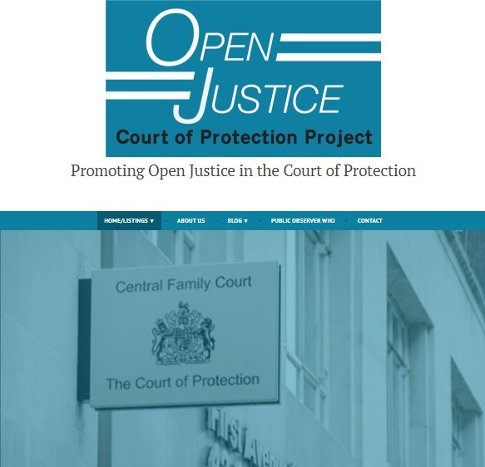

THE OPEN JUSTICE COURT OF PROTECTION PROJECT
GILLIAN LOOMES-QUINN & CLAIRE MARTIN
BABICM CONFERENCE – NOTTINGHAM
16TH JUNE 2022

Slide 2
Introduction - The Open Justice Court of Protection Project
Founded on 15th June 2020 (celebrated our 2nd birthday yesterday!) by Gill Loomes-Quinn (and Celia Kitzinger)
Both had experience of observing and supporting family members in the CoP (in person)
Concern at the start of the Pandemic about impact of ‘remote justice’ on transparency in the CoP
Guidance from Mr Justice Hayden 31 March 2020
Since then, over 300 hearings observed
Over 200 blogs published
Observers supported: Health and social care professional (largest group), (aspiring) lawyers, families of ‘vulnerable’ people
Awarded ‘Real Impact’ Prize in 2020 for Mobilising Research into Action
Totally independent of CoP – entirely voluntary and receive no funding. Kirsty Stuart and Claire Martin joined us in 2021 to form our Core Team

Slide 3
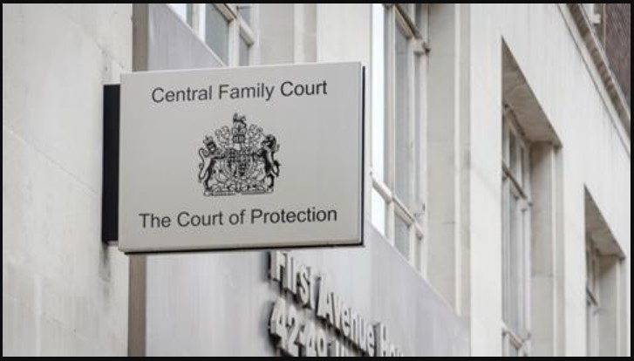
Work of the Court of Protection: Statistical Outline
Total numbers of applications before the Court:
in 2018: 32.029
in 2019: 34,445
in Q3 2020: 8937
in Q2 2020: 5754
in Q1 2020: 8267
in Q3 2019: 9407
in Q3 2018: 7900
Source: Family Courts Quarterly Statistics –
https://www.gov.uk/government/statistics/family-court-statistics-quarterly-july-to-september-2020
Notes:
Work of the CoP – determinations where mental capacity disputed, and best interests decision-making on behalf of adults deemed to lack mental capacity.
Health and welfare; property and affairs; mixed
Specific numbers here are not important – just to communicate in terms of orders of magnitude (thousands of applications for proceedings before the court each year – and increasing)
This compares with next slide.

Slide 4
Judgments of the Court of Protection: Statistical Outline
Number of judgments published by the Court:
2020: 65
2019: 60
2018: 38
Source: British and Irish Legal Information Institute (BAILII) –
https://www.bailii.org/ew/cases/EWCOP/
Notes:
Of the thousands of proceedings dealt with before the CoP each year, only a tiny handful result in a published judgment.
Not only the number of cases not recorded in a judgment, but lots of detail and nuance not included in a judgment. The judgment is intended to do a specific job – to record the legal reasoning behind the decision made by the judge. But this means other key information – such as arguments attempted and abandoned or unsuccessful can be missed.
These, and lots of other things, are details you can only experience by being present in court and watching law in action.
Point out that the court itself takes transparency seriously – Transparency Pilot from 2016. So our work has not been so much about arguing for policy or legislative change, but rather raising awareness – among the public and also among judiciary and court staff

Slide 5


Transparency & Open Justice
Open justice. The words express a principle at the heart of our system of justice and vital to the rule of law. The rule of law is a fine concept, but fine words butter no parsnips. How is the rule of law itself to be policed? …. In a democracy, where power depends on the consent of the people governed, the answer must lie in the transparency of the legal process. Open justice lets in the light and allows the public to scrutinise the workings of the law, for better or for worse. Lord Justice Toulson R (Guardian News and Media Ltd) v City of Westminster Magistrates’ Court [2012] QB 618
"Publicity is the very soul of justice. It is the keenest spur to exertion and the surest of all guards against improbity. It keeps the judge himself while trying under trial.” (Jeremy Bentham quoted by Lord Shaw of Dunfermline in Scott v Scott [1913] AC 417, 477)
Notes:
So we’ve seen that the Court of Protection clearly has a profound impact on the lives of thousands of disabled people, but why does Open Justice matter in this Court? And how can public access to the Court benefit disabled people? In the next two slides, I consider why Open Justice is important, firstly as a general principle, and secondly from a disability rights perspective.
So, firstly the principle of Open Justice and its significance have been spelled out in case law [read quotes]

Slide 6


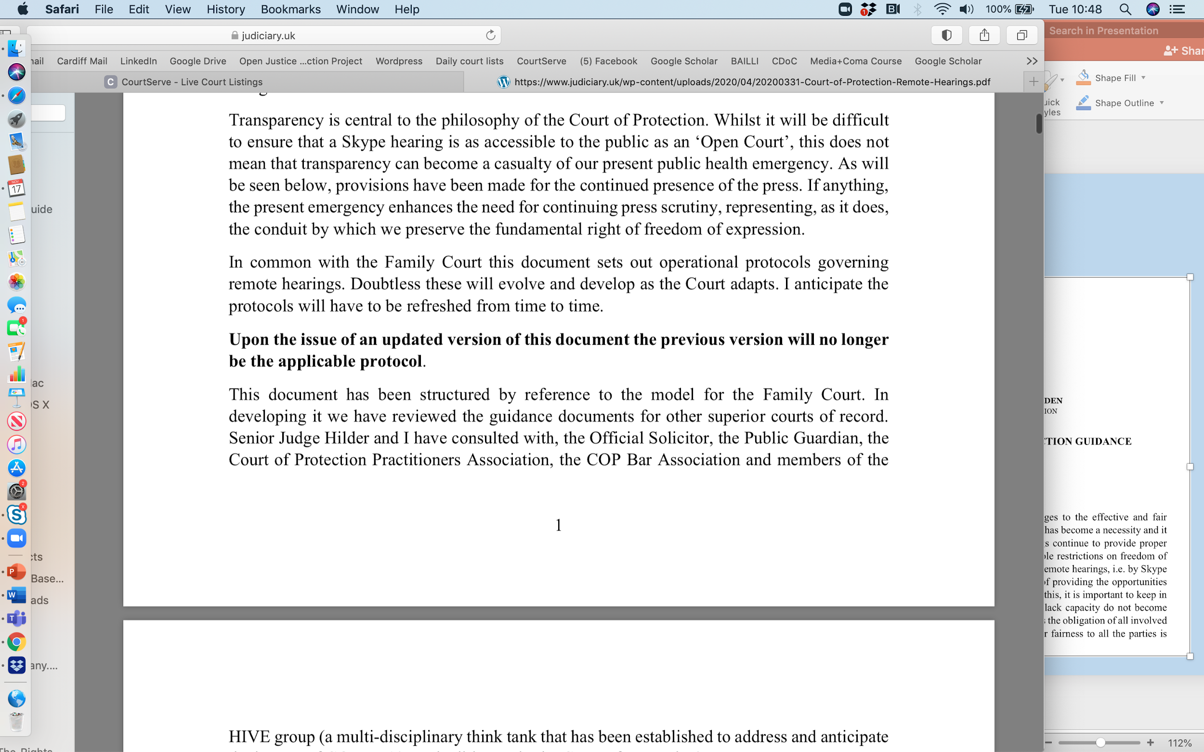



Transparency & Open Justice
Guidance from Mr Justice Hayden 31 March 2020
Created the HIVE Group (a multi-disciplinary thinktank established to address the impact of COVID-19 on litigants in the Court of Protection)
Notes:
Returning to the Court of Protection – obviously the Court has a history of concern with ‘transparency’ and with balancing competing interests of Open Justice with the right to privacy of those with whose lives it becomes involved. But the move to ‘remote hearings’ in March 2020 at the start of the first national lockdown in England and Wales triggered a need to revisit this issue.
A multi-disciplinary thinktank – the Hive Group – was established by the Vice President of the Court, Mr Justice Hayden, to address the impact of the pandemic on litigants in the Court of Protection. And as to ‘transparency’, he issued guidance reiterating that “Transparency is central to the philosophy of the Court of Protection” and must not “…become a casualty of [the] public health emergency…”

Slide 7
Benefits of Public Observing
Watching justice in action – supporting fundamental principle of ‘open justice’
Understanding Mental Capacity Act 2005 in practice
Watching advocates make submissions, question expert witnesses incl. cross-questioning, engage with litigants in person
Observing how P and P’s family engage with court
Understanding how a judgment emerges from facts + law (including ‘dead ends’ and rejected arguments). Very different from seeing final judgment
Frustrations – inadequate advance info about issues in listings, many are adjourned + vacated, failure to respond to emails, forgetting to do introductory summary, we don’t get position statements!
Note that ‘Public’ is more than ‘Press’
Notes:
As the specialist court with responsibility for issues relating to people who lack the capacity to make specific decisions, the Court of Protection is a key location of legal and political impact for disabled people. In terms of bare numbers, we can see here that the numbers of applications made to the court each year were in the tens of thousands – with 32,029 applications being made in 2018 and 34,445 in 2019. In the most recent quarterly breakdown, we find that between June and September 2020 8937 applications were made to the court. This compares with 9407 in the same quarter of 2019 and 7900 in the same quarter of 2018, so the numbers seem relatively steady despite the impact of the Pandemic.

Slide 8
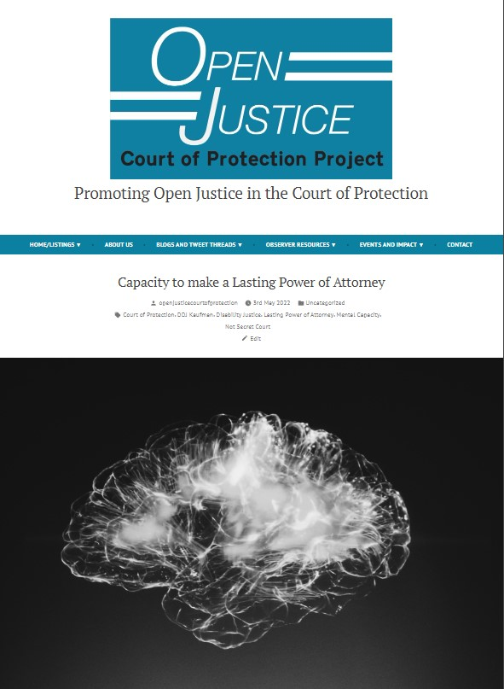
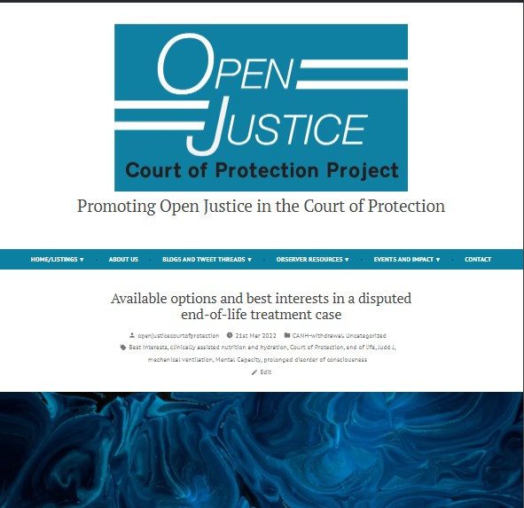

Observations of Law in Action
Blogs dealing with brain injury
Subscribe and Search bars at bottom of website – Keep updated and find what you need:
https://openjusticecourtofprotection.org/2022/05/03/capacity-to-make-a-lasting-power-of-attorney/
Clare Fuller, 2022
Celia Kitzinger, 2022

Slide 9
Hearing Feedback Form
Info about observer
How hearing was listed
Access to hearing + Transparency Order
Technology issues (it’s almost always fine – an occasional glitch)
Was there an introductory summary?
Who was there (by role)? (applicant, respondents, P, P’s family, witnesses etc)
How were P’s wishes and feelings represented and by whom?
What order was being sought + what were areas of disagreement?
What did the court decide?
What is going to happen next?
Available here or via ‘Observer Resources’ tab on our website.
Notes:
As the specialist court with responsibility for issues relating to people who lack the capacity to make specific decisions, the Court of Protection is a key location of legal and political impact for disabled people. In terms of bare numbers, we can see here that the numbers of applications made to the court each year were in the tens of thousands – with 32,029 applications being made in 2018 and 34,445 in 2019. In the most recent quarterly breakdown, we find that between June and September 2020 8937 applications were made to the court. This compares with 9407 in the same quarter of 2019 and 7900 in the same quarter of 2018, so the numbers seem relatively steady despite the impact of the Pandemic.

Slide 10
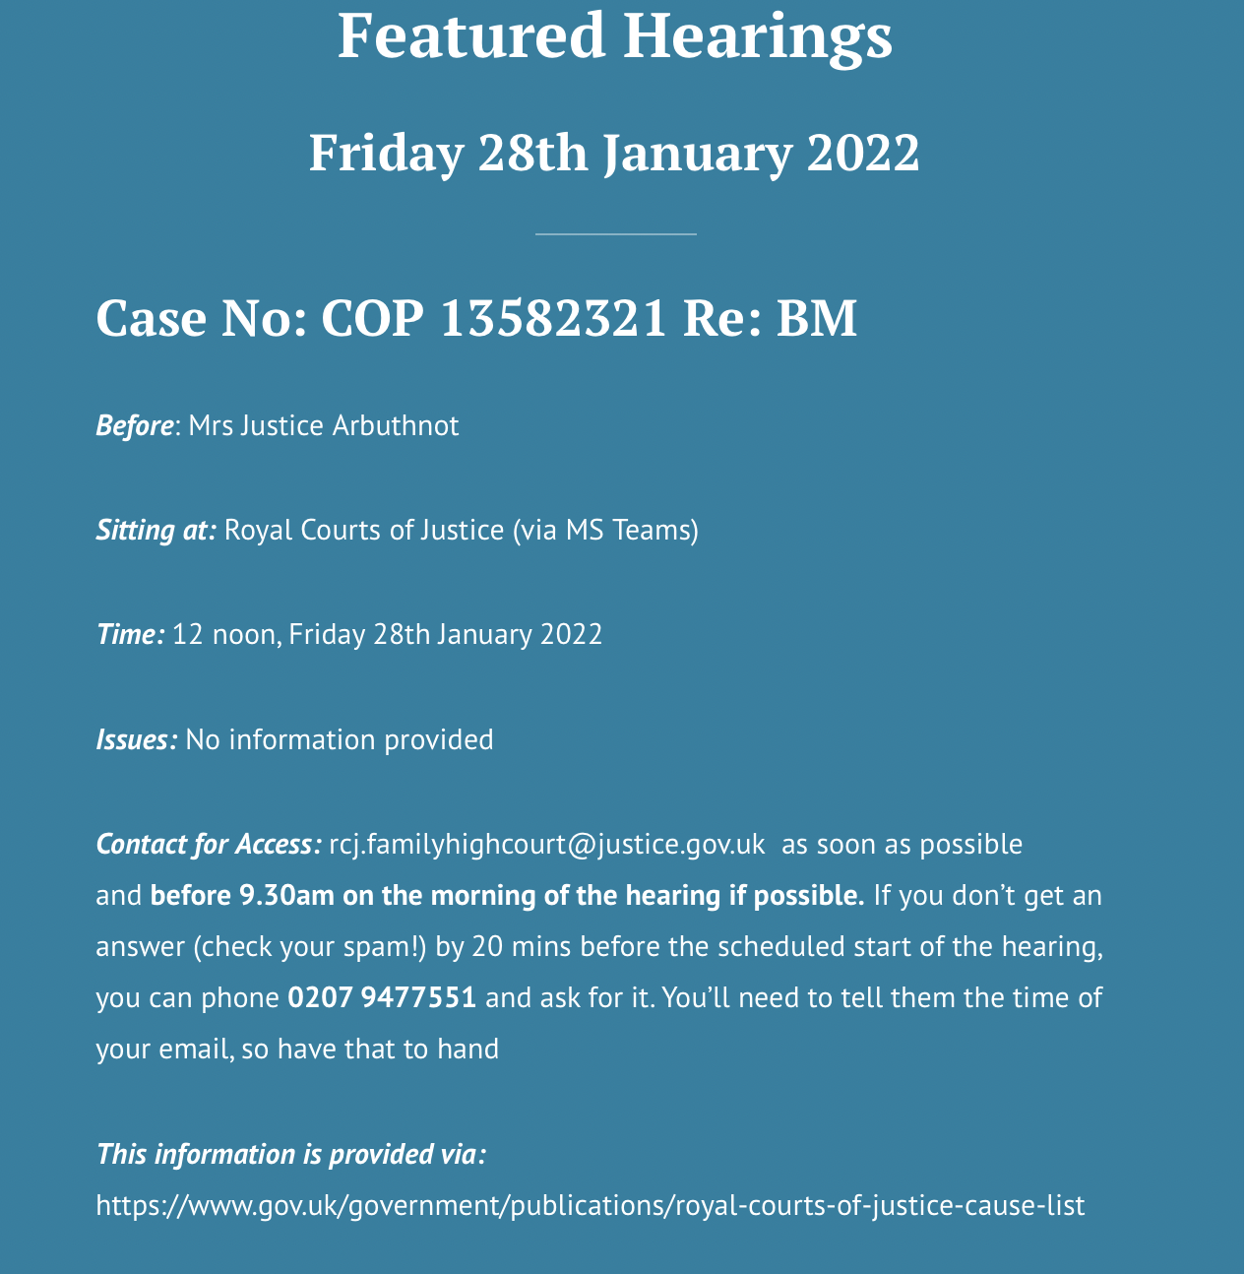
How to Observe the CoP in Action
Featured Hearings on OJCOP Website
Selection of most accessible hearings each day
Decode ‘jargon’ – T/E; DRH; BTMM etc
Remove ‘Private’
Probably best ‘first step’ for anyone interested in observing CoP in action
openjusticecourtofprotection.org
Notes:
As the specialist court with responsibility for issues relating to people who lack the capacity to make specific decisions, the Court of Protection is a key location of legal and political impact for disabled people. In terms of bare numbers, we can see here that the numbers of applications made to the court each year were in the tens of thousands – with 32,029 applications being made in 2018 and 34,445 in 2019. In the most recent quarterly breakdown, we find that between June and September 2020 8937 applications were made to the court. This compares with 9407 in the same quarter of 2019 and 7900 in the same quarter of 2018, so the numbers seem relatively steady despite the impact of the Pandemic.

Slide 11
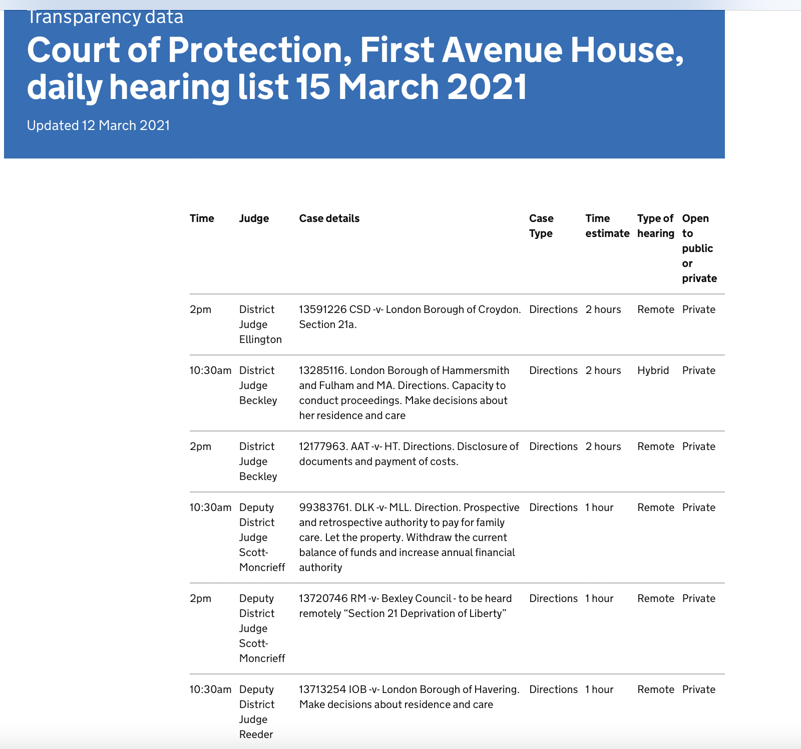
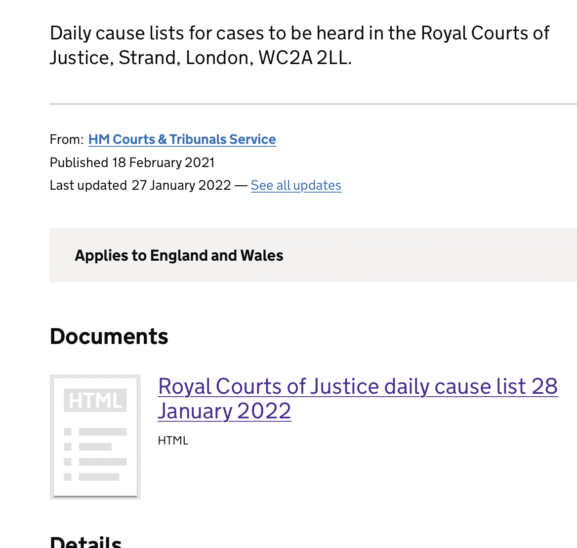
How to Observe the CoP in Action
First Avenue House listings click here
Royal Courts of Justice listings
Notes:
As the specialist court with responsibility for issues relating to people who lack the capacity to make specific decisions, the Court of Protection is a key location of legal and political impact for disabled people. In terms of bare numbers, we can see here that the numbers of applications made to the court each year were in the tens of thousands – with 32,029 applications being made in 2018 and 34,445 in 2019. In the most recent quarterly breakdown, we find that between June and September 2020 8937 applications were made to the court. This compares with 9407 in the same quarter of 2019 and 7900 in the same quarter of 2018, so the numbers seem relatively steady despite the impact of the Pandemic.

Slide 12
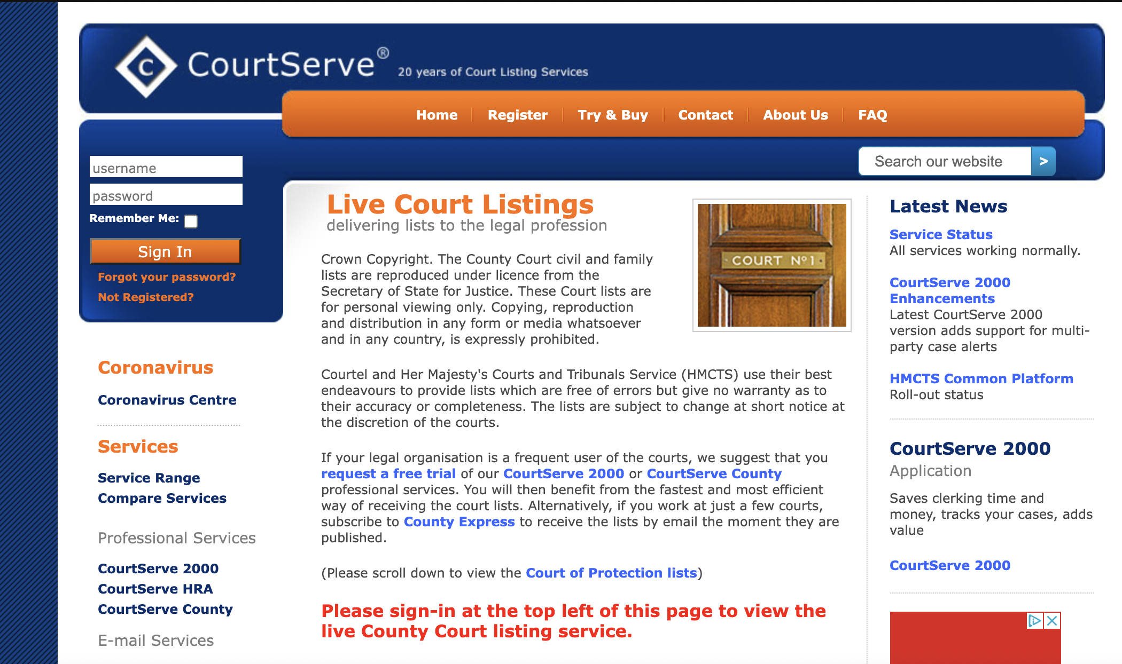
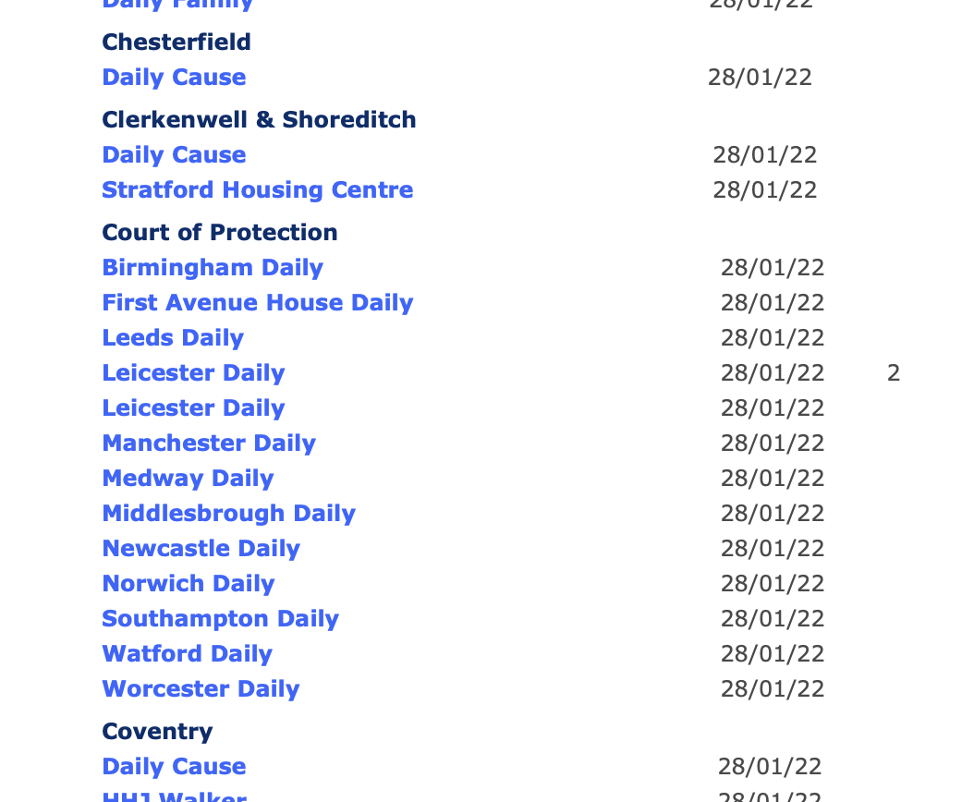
How to Observe the CoP in Action
CourtServe – free (but registration required) – courtserve.net
Aimed primarily at lawyers and other court users
Arranged geographically but also has CoP tab
Notes:
As the specialist court with responsibility for issues relating to people who lack the capacity to make specific decisions, the Court of Protection is a key location of legal and political impact for disabled people. In terms of bare numbers, we can see here that the numbers of applications made to the court each year were in the tens of thousands – with 32,029 applications being made in 2018 and 34,445 in 2019. In the most recent quarterly breakdown, we find that between June and September 2020 8937 applications were made to the court. This compares with 9407 in the same quarter of 2019 and 7900 in the same quarter of 2018, so the numbers seem relatively steady despite the impact of the Pandemic.

Slide 13
The experience of observing a hearing
Emailing to request access
Waiting, waiting ……
Being asked to put on the camera and speak to the judge
Making notes - no recording
Notes:
As the specialist court with responsibility for issues relating to people who lack the capacity to make specific decisions, the Court of Protection is a key location of legal and political impact for disabled people. In terms of bare numbers, we can see here that the numbers of applications made to the court each year were in the tens of thousands – with 32,029 applications being made in 2018 and 34,445 in 2019. In the most recent quarterly breakdown, we find that between June and September 2020 8937 applications were made to the court. This compares with 9407 in the same quarter of 2019 and 7900 in the same quarter of 2018, so the numbers seem relatively steady despite the impact of the Pandemic.

Slide 14
The experience of observing a hearing
Reflecting & gathering thoughts
Writing blogs – fear!
Professional benefits
Collegial experience
Insight into MCA application and the CoP truly trying to place P at the centre – often shocking treatment and failures by services who are meant to safeguard and promote the MCA values and principles
Notes:
As the specialist court with responsibility for issues relating to people who lack the capacity to make specific decisions, the Court of Protection is a key location of legal and political impact for disabled people. In terms of bare numbers, we can see here that the numbers of applications made to the court each year were in the tens of thousands – with 32,029 applications being made in 2018 and 34,445 in 2019. In the most recent quarterly breakdown, we find that between June and September 2020 8937 applications were made to the court. This compares with 9407 in the same quarter of 2019 and 7900 in the same quarter of 2018, so the numbers seem relatively steady despite the impact of the Pandemic.

Slide 15


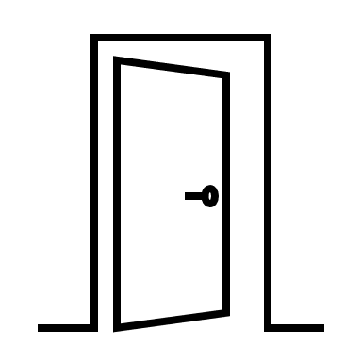
Summary
Have a look at our website for resources, blogs and upcoming hearings to observe
Get involved! Watch a hearing, write a blog
We can offer support to access hearings and with writing blogs
It’s excellent CPD - and free!
THANK YOU for inviting us - please get in touch
Notes:
So, to summarise, Open Justice in the Court of Protection protects and advances disability rights by enabling public scrutiny of the law in action, and challenging epistemic injustice faced by disabled people through increasing public awareness of the impact of mental capacity law on disabled people, and unlike so much for which we as disabled activists are striving – here, we are pushing against an open door.

Slide 16
Further Details and Contact
Website:
openjusticecourtofprotection.org
Twitter:
@OpenJusticeCoP
Email:
OpenJustice@yahoo.com
Notes:
Thank you so much for listening, and I now look forward to answering any questions you might have.

