Slide 1

Capacity, Empowerment and Transparency in the English (& Welsh) Court: Reflections from a public observer
Celia Kitzinger
Co-Director of the Open Justice Court of Protection Project
openjustice@yahoo.com
Thursday 8th December 15:00-17:00
Public talk (via Zoom)
Chaired by: Professor Amanda Phelan, Professor of Ageing and Community Nursing, School of Nursing & Midwifery, Trinity College Dublin

Slide 2
Celia Kitzinger
Observed 370+ hearings in the Court of Protection since 1 May 2020 – as a member of the public
Mostly via video-platform (some telephone; some in-person; some hybrid)
District + Circuit judges in regional hubs across England and Wales + High Court (Tier 3) judges sitting in the Royal Courts of Justice
Founded the Open Justice Court of Protection Project (with Gill Loomes-Quinn), 15 June 2020
We’ve supported 1000+ people to observe court hearings – and published more than 200 blog posts.

Slide 3
Value of observing hearings
Watching justice in action – supporting fundamental principle of ‘open justice’
Seeing how capacity assessments and best interests reports are used in the court
Watching expert witnesses give evidence and be cross-questioned
Observing how P and P’s family are questioned by judges (especially Hayden)
Understanding how a judgment emerges from facts + law (including ‘dead ends’ and rejected arguments). Very different from seeing final judgment
Frustrations – inadequate advance info about issues in listings, many are adjourned + vacated, failure to respond to emails, forgetting to do introductory summary, we don’t get position statements– and of course this is ‘front stage’ use of the MCA, not ‘behind the scenes’.

Slide 4

Structure of talk
1. Transparency
2. Capacity
3. “Best interests” (P’s wishes, will + preference)
4. Advance planning for loss of capacity

Slide 5
1. Transparency

Slide 6


Slide 7
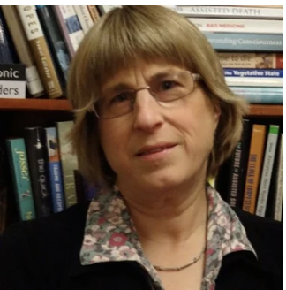
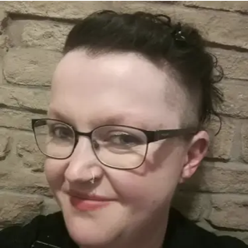
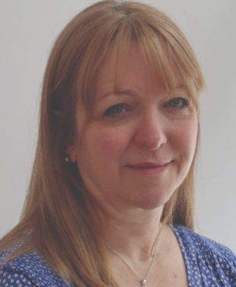
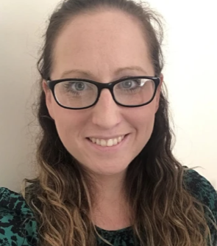
Who we are: Core group + ‘the public’
Celia Kitzinger – retired academic psychologist, expertise in coma and disorders of consciousness; co-authored BMA guidance on decision-making about clinically assisted nutrition and hydration
Gill Loomes-Quinn – socio-legal scholar and disability rights activist; convenor of Participatory Autism Research Collective
Kirsty Stuart – Associate Solicitor in the Public Law and Human Rights team at Irwin Mitchell and Chair of the Law Society's Mental Health and Disability Law Committee.
Claire Martin clinical psychologist working with older people in the NHS
No funding
No ‘permission’

Slide 8
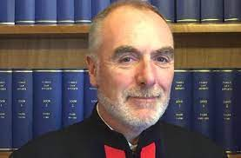
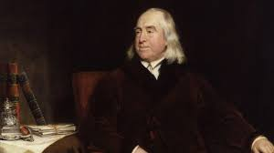
TRANSPARENCY – a fundamental value
“Transparency is central to the philosophy of the Court of Protection”
Mr Justice Hayden, Vice President of the Court of Protection, 4th May 2020
“Publicity is the very soul of justice. . . . It is the keenest spur to exertion, and the surest of all guards against improbity..”
Jeremy Bentham 1748–1832 English philosopher: Publicity in the Courts of Justice (1843)

Slide 9
Open Justice Court of Protection Project
Transparency Pilot 2016 – extended and incorporated into COP practice
Open Justice COP Project Founded 15 June 2020
Following negative experience of “first ever all-remote” hearing of the pandemic
Launched as “guard against improbity”, it soon became clear that it (also) offered a learning experience for people working in health and social care surprised at ‘person-centered’ + ‘less risk averse’ approach
And supports family members of P learning at first hand about the COP
Has massively increased observation in COP (as has remote hearings)
Thank you to observers + everyone who has supported observers
Has generally enhanced the reputation of the Court of Protection

Slide 10
Not all hearings are open to the public
Dispute Resolution Hearings ((§2.2 Practice Direction – Transparency Pilot) – judicial mediation
“Private” Hearings (2.4. Practice Direction - “The court may decide not to make an order [that hearing is public] if it appears to the court that there is good reason for not making the order … “ e.g.
  “the need to protect P or another person involved in the proceedings”,
  ”the nature of the evidence in the proceedings”,
  “whether earlier hearings in the proceedings have taken place in private”
  physical access
  risk of disruption.
More usually now an Art 8 Art 10 balancing exercise
3. ‘Closed’ hearings – from which a party is excluded.

Slide 11
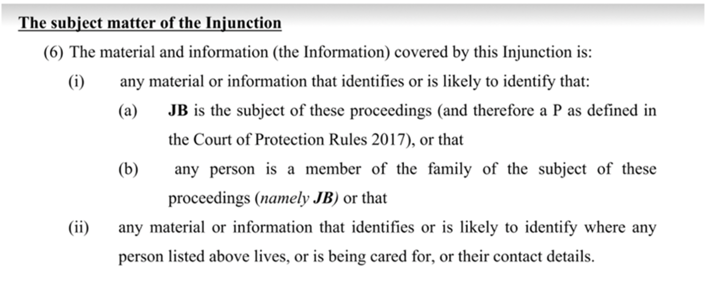
“Transparency orders” (reporting restrictions)

Slide 13
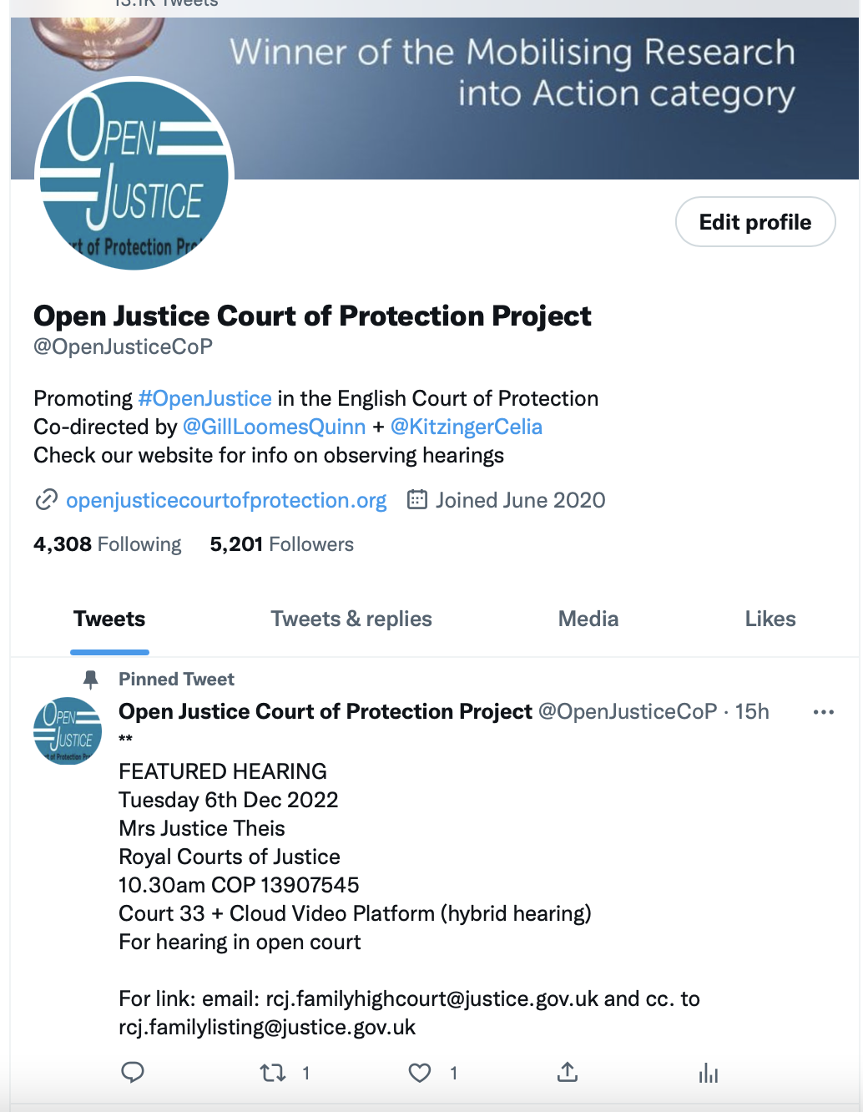
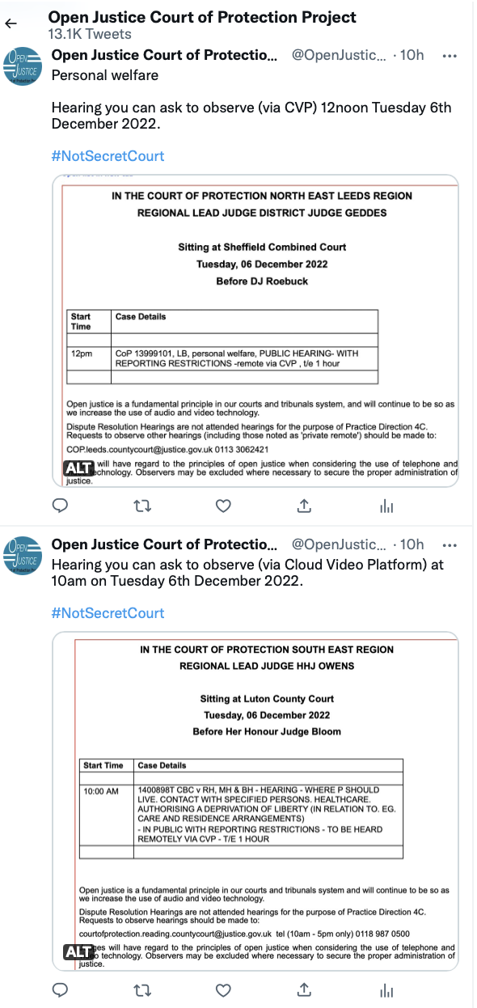
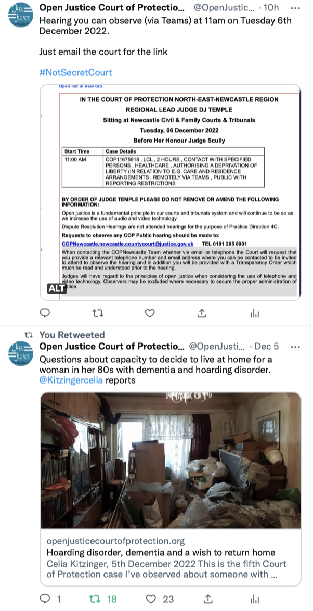
@OpenJusticeCOP

Slide 14
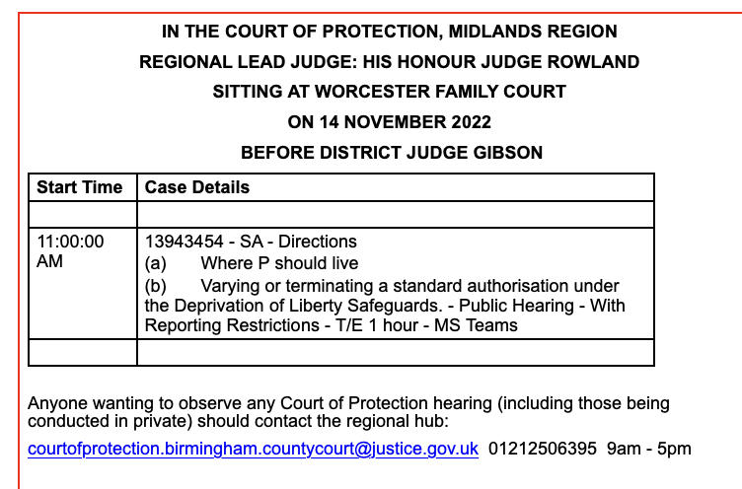
A good example of transparency in listing
1. This hearing is included in the Court of Protection list on Courtel CourtServe
2. It says “Public Hearing” – making clear that the public can observe
3. It says “MS Teams” – so we know we can observe it remotely.
4. Correct e-mail + phone number supplied
5. Tells us what hearing is about: “(i) Where P should live; (ii) Varying or terminating a standard authorisation under the Deprivation of Liberty Safeguards”
6. It says it’s a Directions hearing

Slide 15
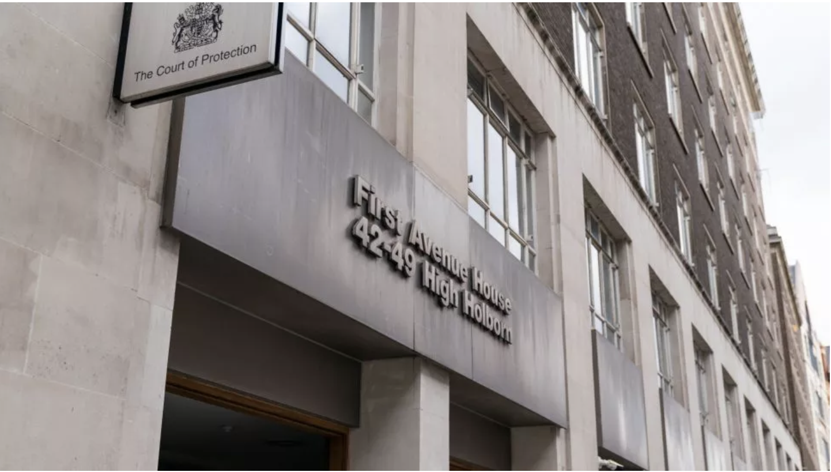

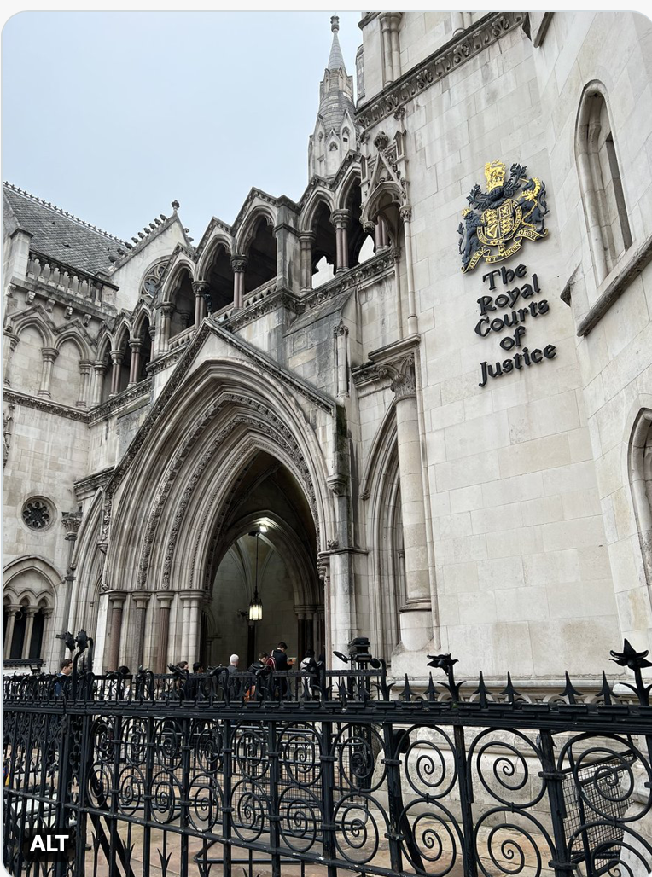
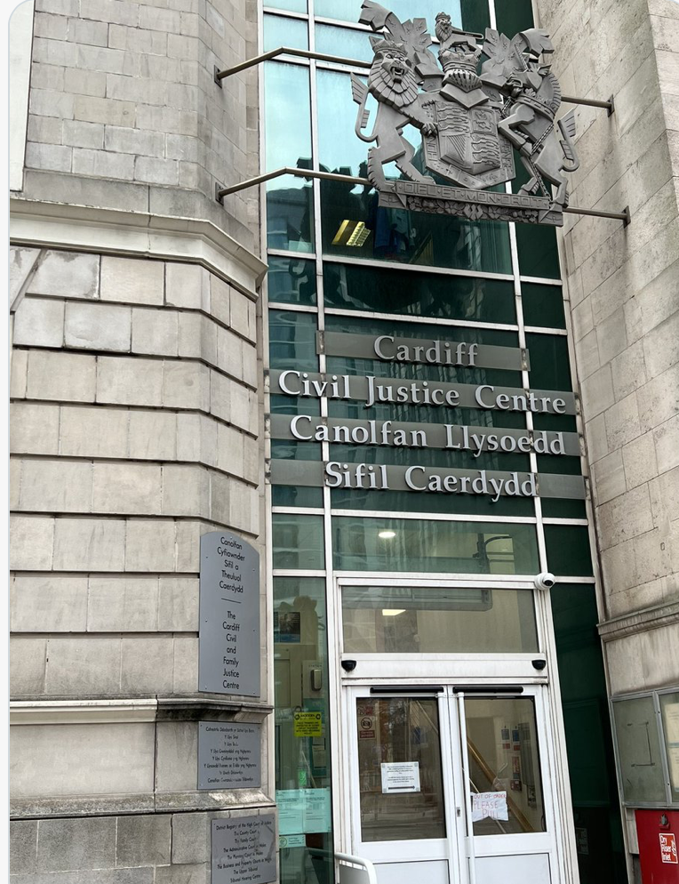
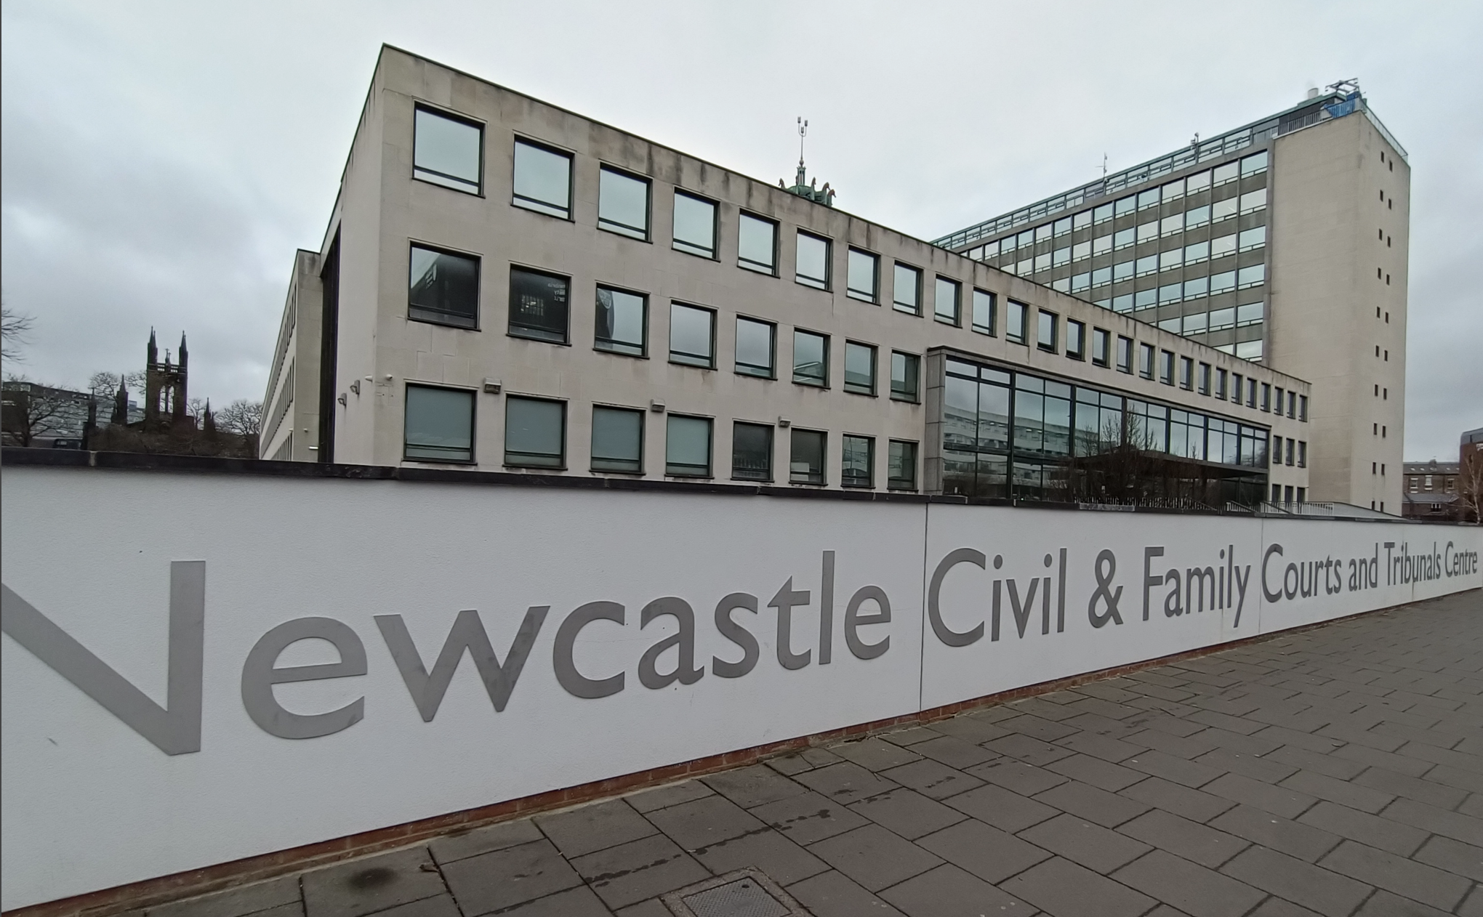
Where is the
Court of Protection?

Slide 16
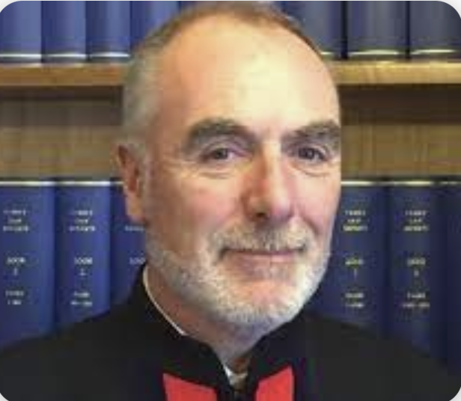
Regional COP Hubs – approx. 20-30 hearings every weekday
London HHJ Hilder
Leeds DJ Geddes
Newcastle DJ Temple
Manchester HHJ Butler
Reading HHJ Owens
Bristol HHJ Robertshaw
Birmingham HHJ Rowland
Cardiff HHJ Crowley
Vice-President of the COP:
Mr Justice Hayden
Tier 3 judges hear cases in the Royal Courts of Justice – and sometimes on circuit

Slide 17
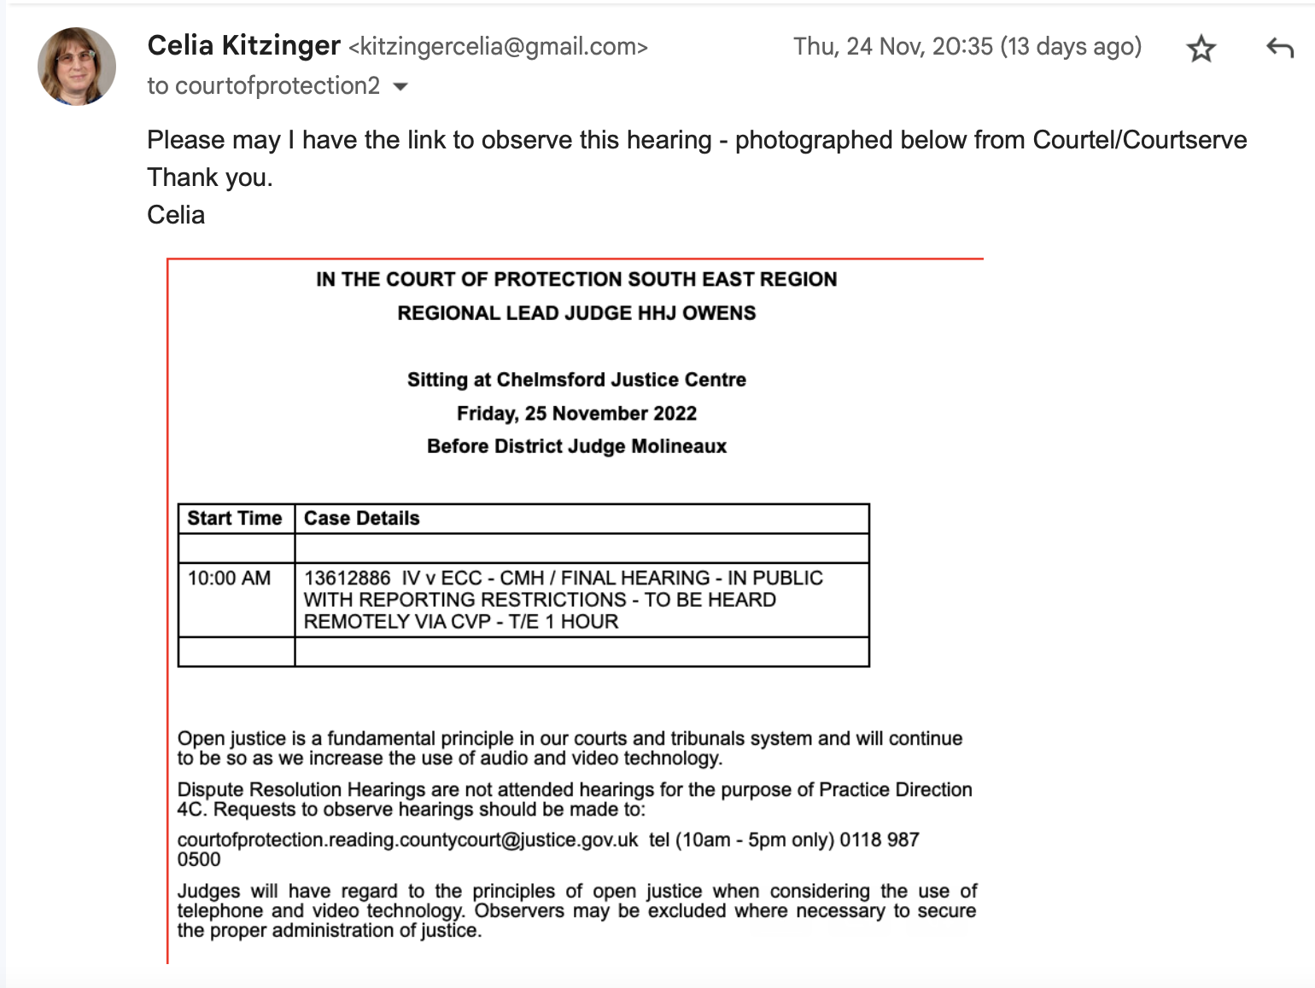
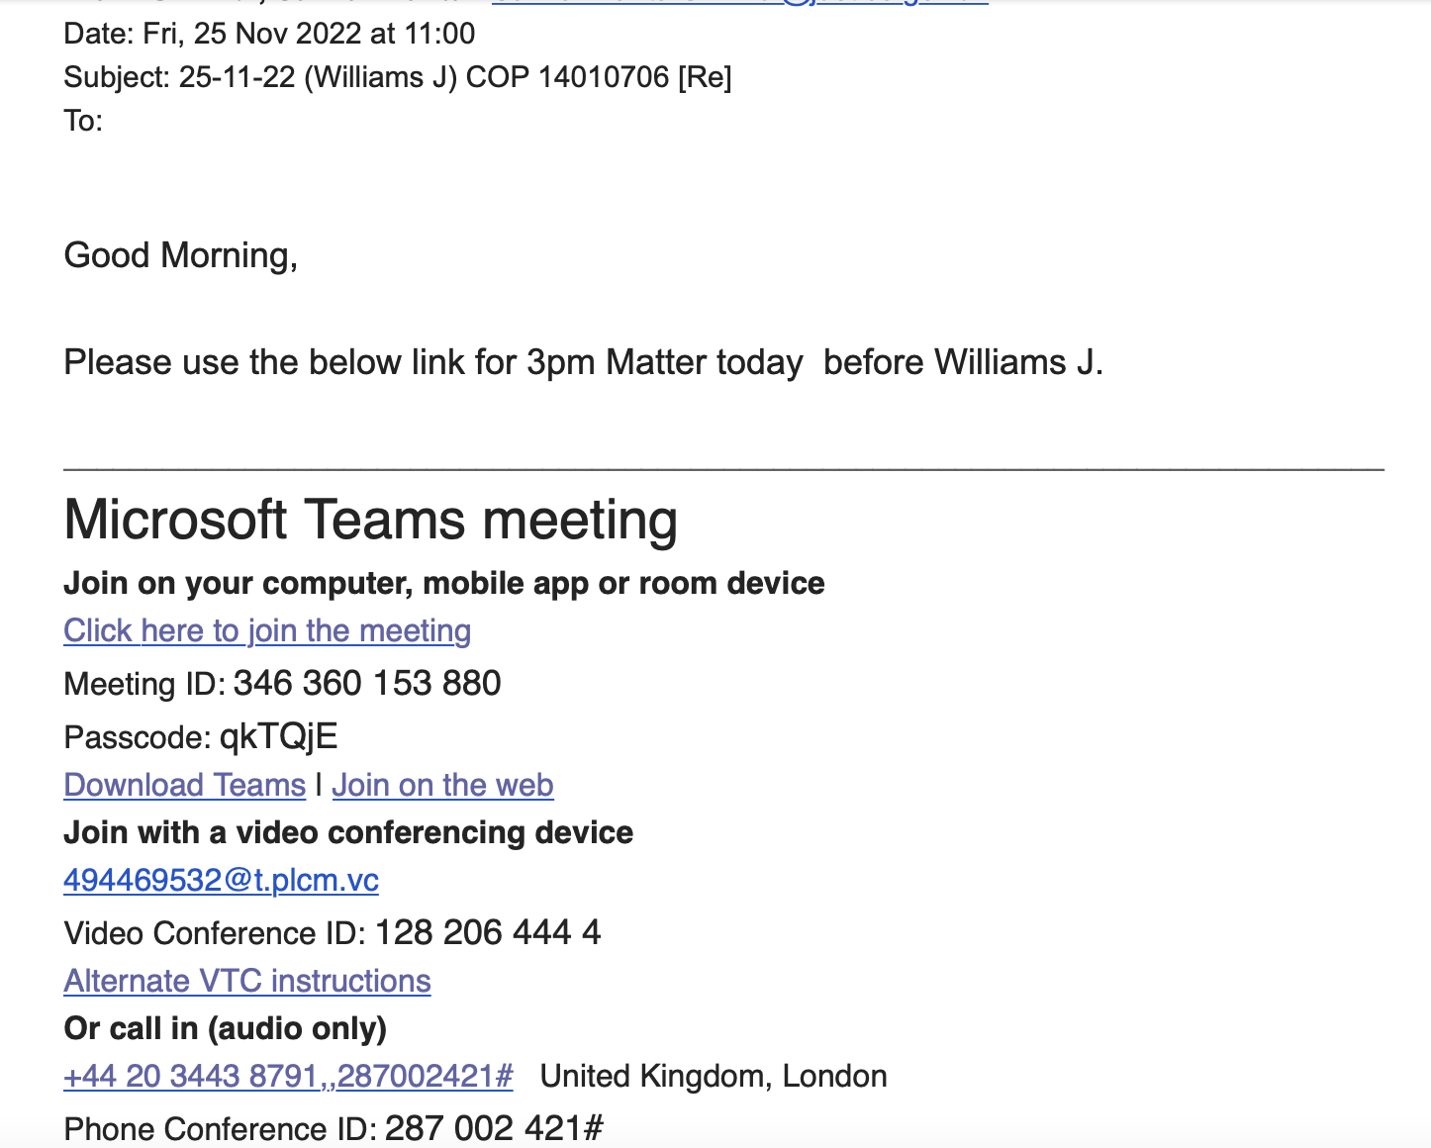
Requesting a hearing + getting the link
Join with video and microphone off to observe hearing

Slide 18
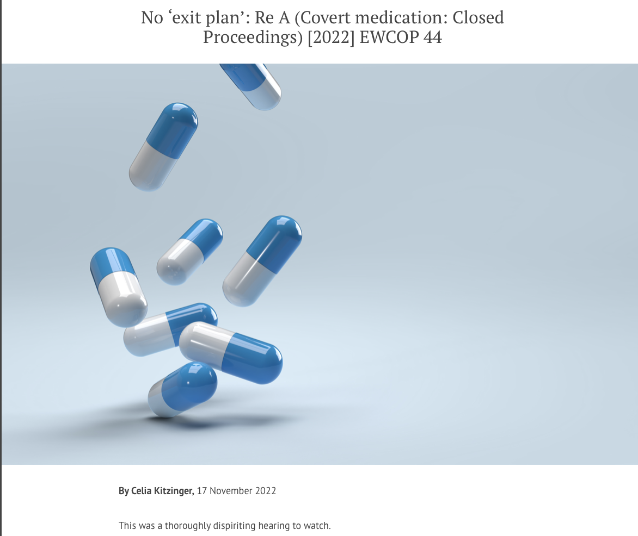

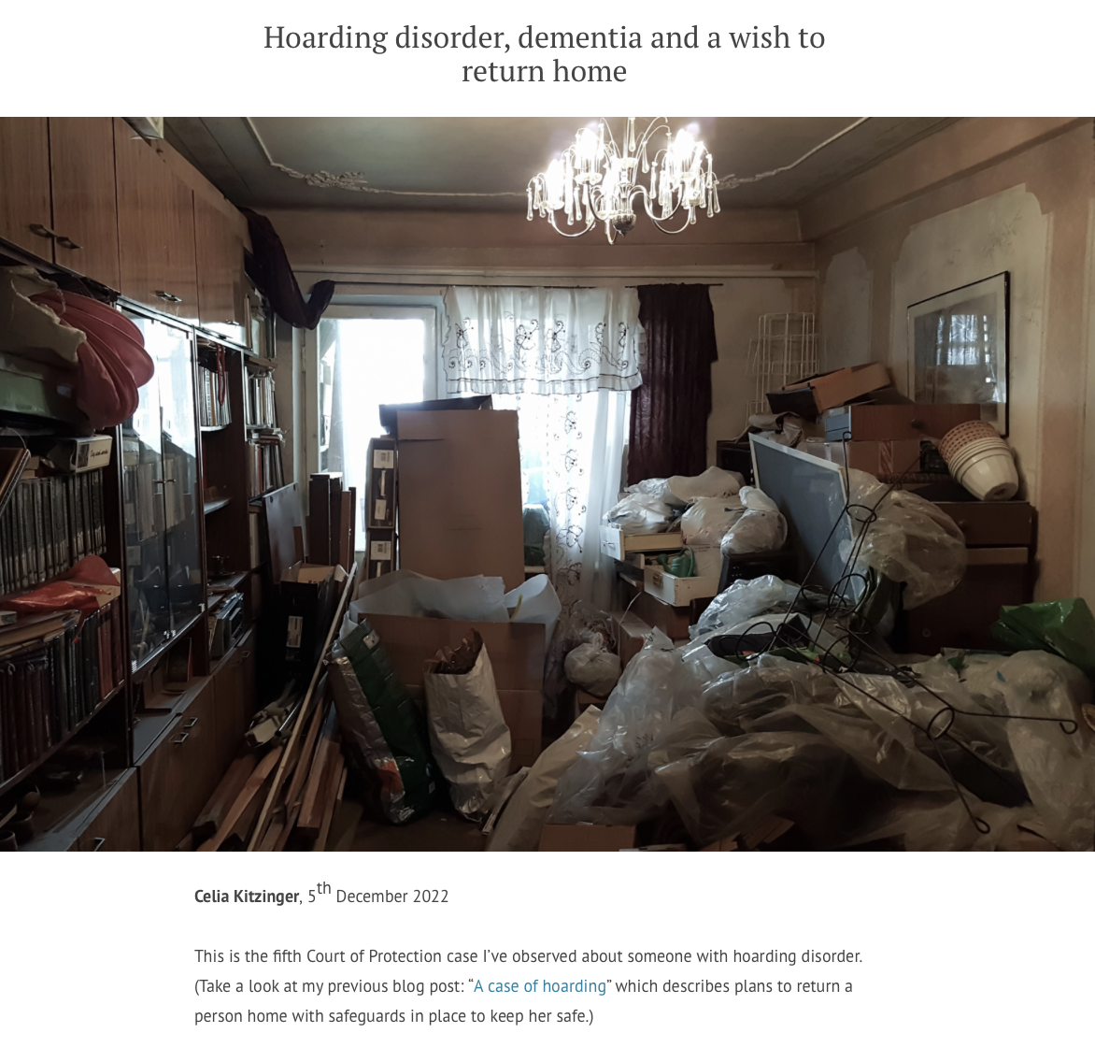
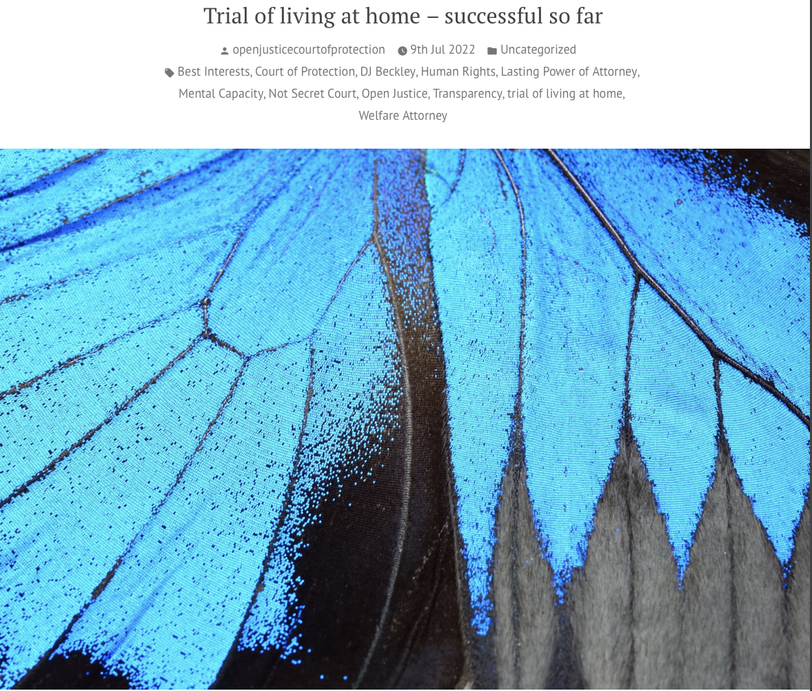
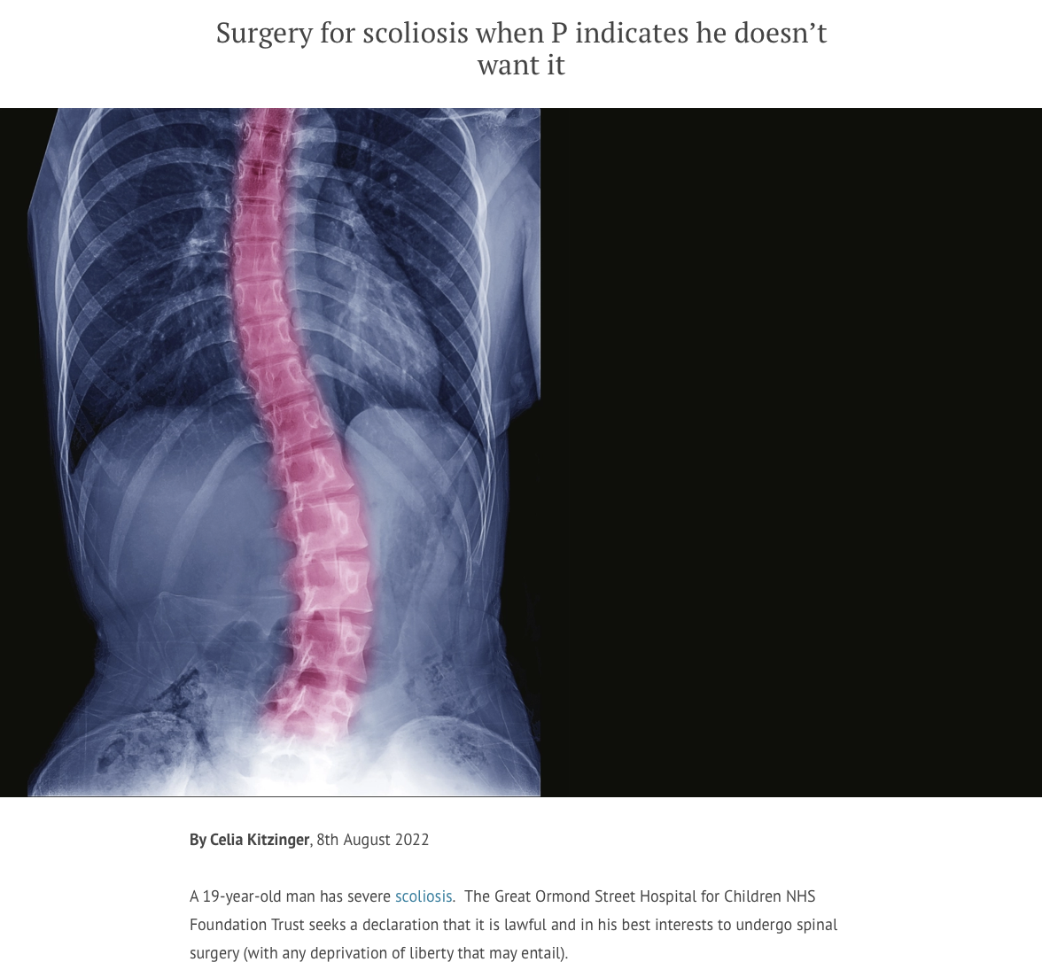
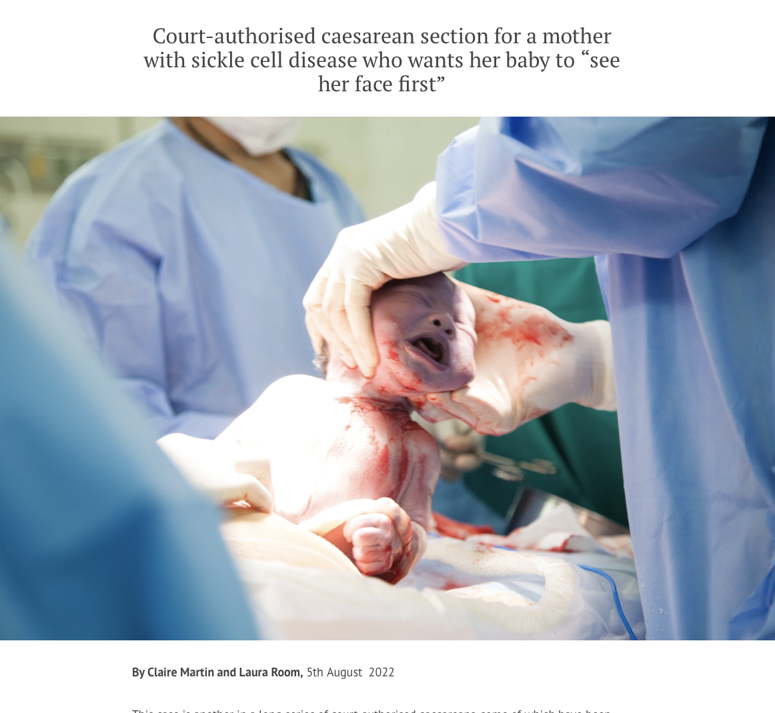
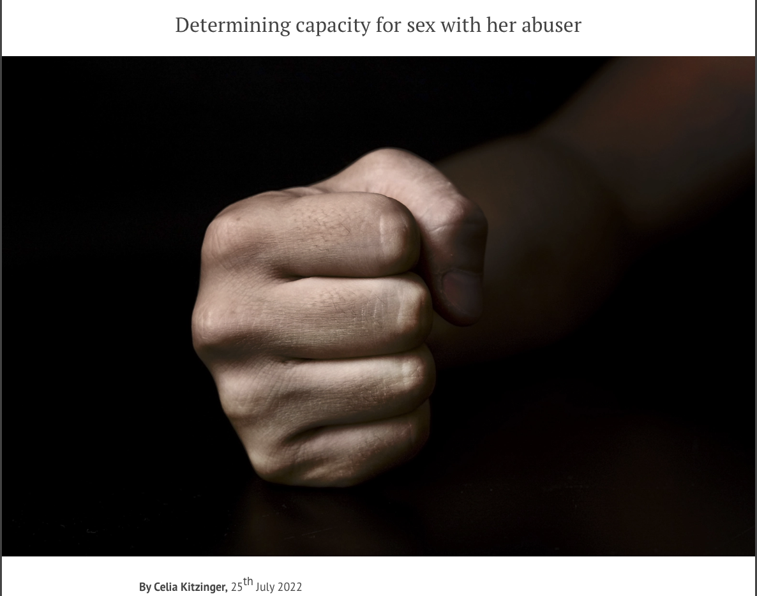
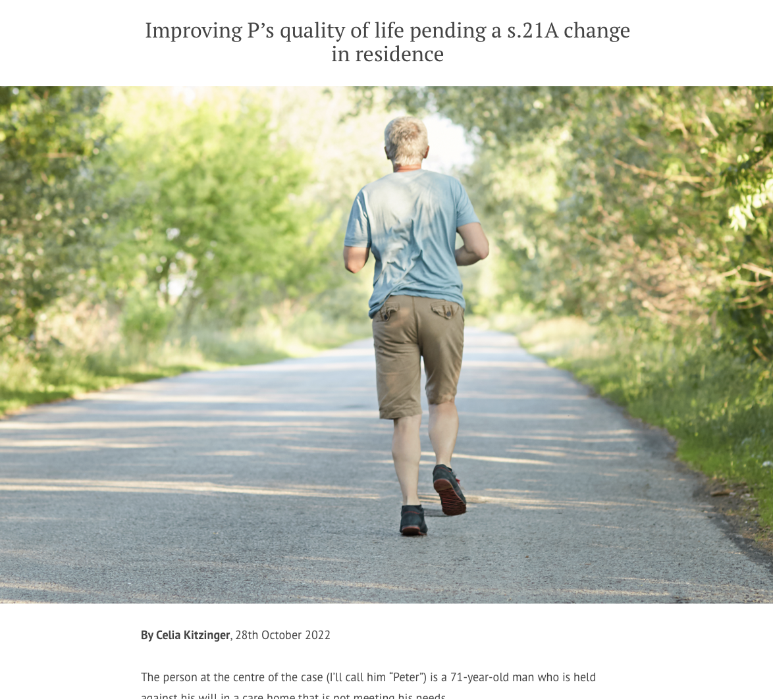
Sample blogs

Slide 20
2. Capacity

Slide 21
If the person has capacity to make a decision…
The Court of Protection has no jurisdiction over decisions a person has capacity to make
Very occasionally cases are heard under the “inherent jurisdiction” when a person’s will has been “overborne” (e.g. coercive control)
Court hearings where people have been found to have capacity to….
choose where to live for themselves
Have ‘risky’ sex
refuse tube feeding

Slide 22

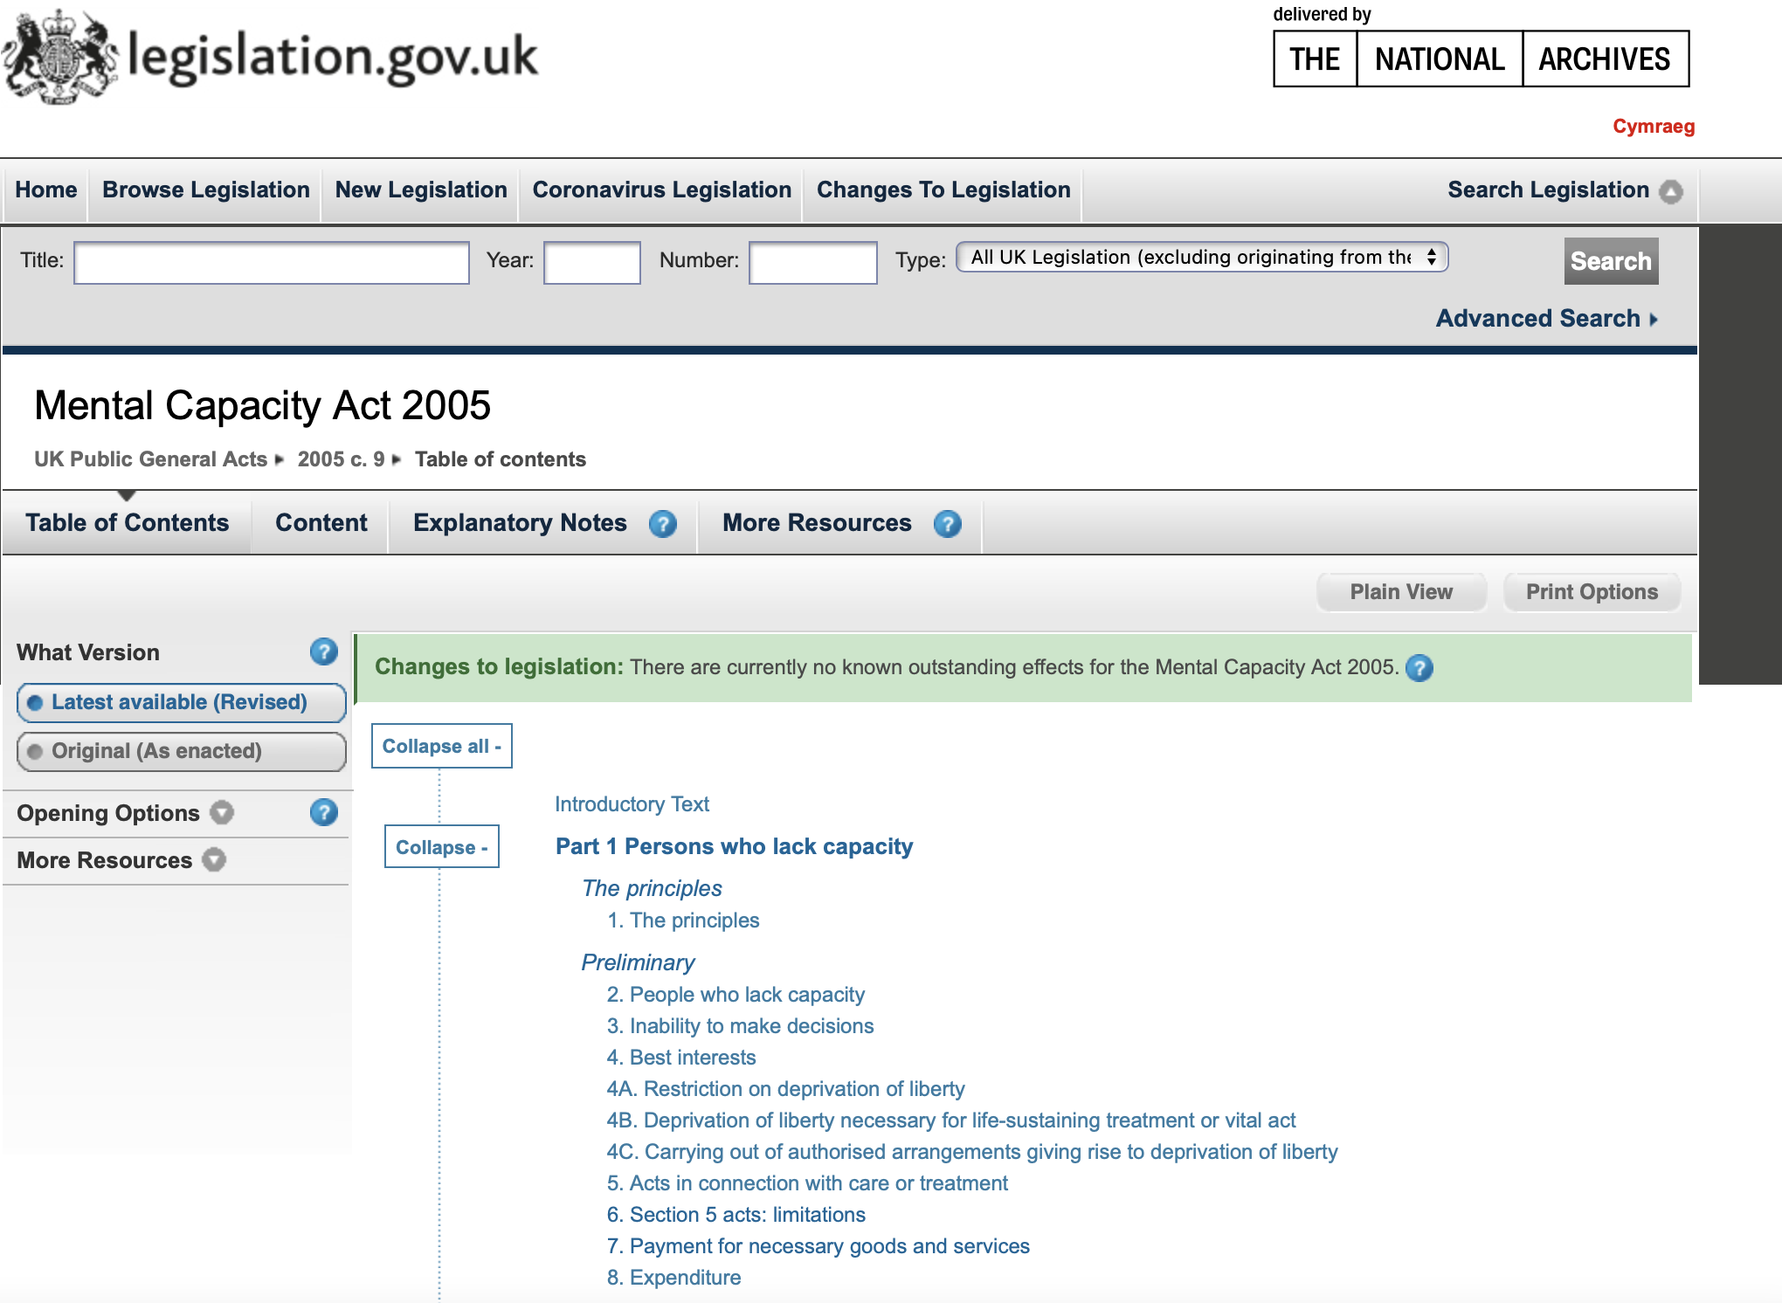
Mental Capacity Act 2005

Slide 23
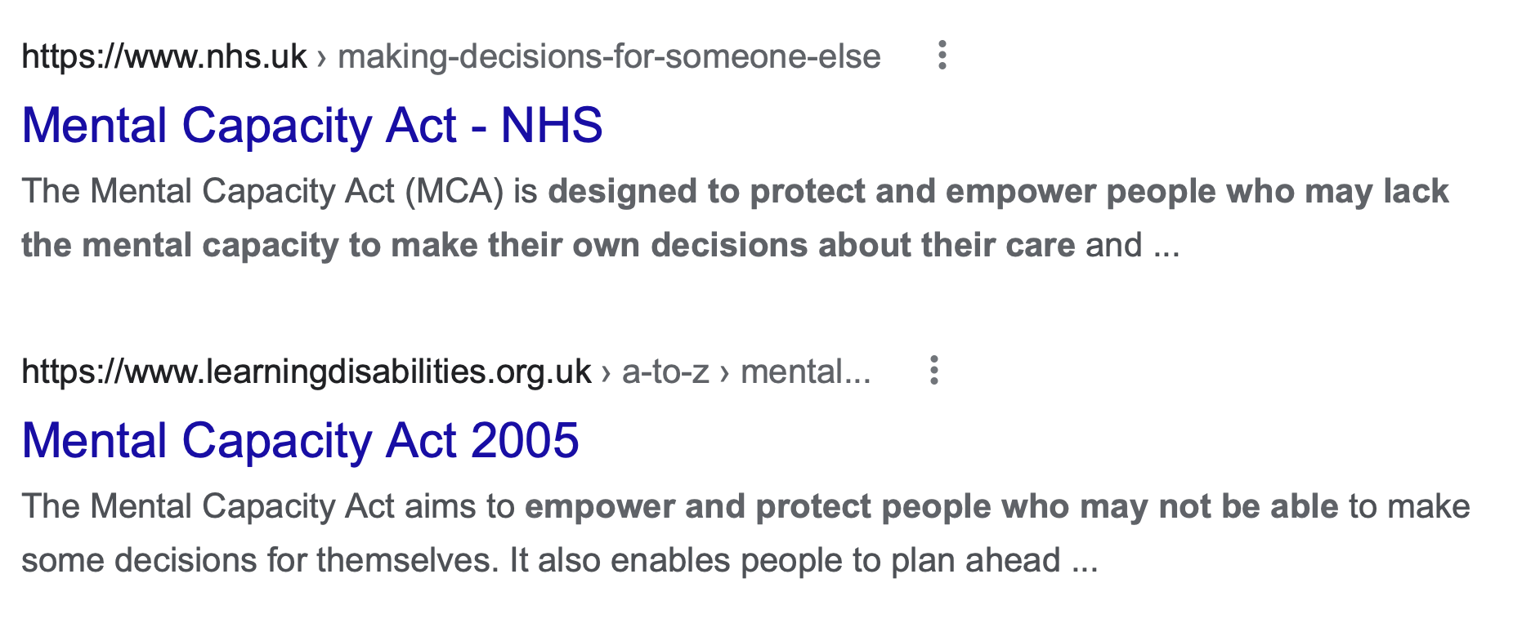

Mental Capacity Act 2005
Capacity
Best interests

Slide 24

From §1 “The Principles”
MCA 2005
A person must be assumed to have capacity unless it is established that he lacks capacity.
A person is not to be treated as unable to make a decision unless all practicable steps to help him to do so have been taken without success.
A person is not to be treated as unable to make a decision merely because he makes an unwise decision.

Slide 25
2(3) MCA
2(3) A lack of capacity cannot be established merely by reference to—
(a) a person's age or appearance, or
(b) a condition of his, or an aspect of his behaviour, which might lead others to make unjustified assumptions about his capacity.

Slide 26
“Functional” + “Diagnostic” test
“Functional”: Capacity means that P can understand, retain and use/weigh information relevant to the decision that needs to be made, + communicate their decision. (s 3)
“Diagnostic”: A person is deemed to lack capacity to make a decision if they cannot understand, retain, use/weigh that information – and their inability do to so is “because of an impairment of, or a disturbance in the functioning of, the mind or brain” (s 2(1) MCA)

Slide 27


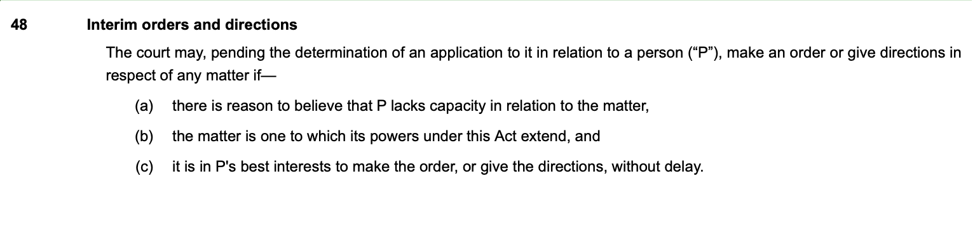
s. 48 orders and directions

Slide 28
Information relevant to making decisions about residence
The two (or more) options for living (how supported to live there; options available at property)
Broad information about the area
The difference between living somewhere and just visiting it
The activities that the person being assessed would be able to do if he lived in each place
Whether and how the person being assessed would be able to see friends and family if he lived in each place
Who they would be living with at each placement;
The sort of care they would receive in each placement

Slide 29
Information relevant to making decisions about belongings
Volume of belongings and impact on use of rooms
Safe access and use
Creation of hazards
Safety of building
Removal/disposal of hazardous levels of belongings
Taken from the judgment of HHJ Clayton in AC and GC (Capacity: Hoarding: Best Interests) [2022] EWCOP 39.

Slide 30
Information relevant to making decisions about care
With what areas the person under assessment needs support;
What sort of support they need;
Who will provide such support;
What would happen without support, or if support was refused.
That carers may not always treat the person being cared for properly, and the possibility and mechanics of making a complaint if they are not happy.
Theis J in LBX v K, L and M [2013] EWHC 3230 (Fam).

Slide 31
Information relevant to making decisions about contact
Who the contact would be with
Nature of relationship
What sort of contact (e.g. where, how long, supervised or not?)
Positive and negative aspects of having contact with each person
Risks posed by contact e.g. because of criminal convictions
Hedley J, approved in PC and NC v City of York Council [2013] EWCA Civ 478 at para 13.

Slide 32
Information relevant to making decisions about social media use
(a) That information and images (including videos) which you share on the internet or through social media could be shared more widely, including with people you don’t know , without you knowing or being able to stop it;
(b) That It is possible to limit the sharing of personal information or images (and videos) by using ‘privacy and location settings’ on some internet and social media sites. The precise details or mechanisms of the privacy settings do not need to be understood but P should be capable of understanding that they exist, and be able to decide (with support) whether to apply them;
(c) If you place material or images (including videos) on social media sites which are rude or offensive, or share those images, other people might be upset or offended.
(d) Some people you meet or communicate with (‘talk to’) online, who you don’t otherwise know, may not be who they say they are (‘they may disguise, or lie about, themselves’); someone who calls themselves a ‘friend’ on social media may not be friendly;
(e) Some people you meet or communicate with (‘talk to’) on the internet or through social media, who you don’t otherwise know, may pose a risk to you; they may lie to you, or exploit or take advantage of you sexually, financially, emotionally and/or physically; they may want to cause you harm;
(f) Ifyoulookatorshareextremelyrudeoroffensiveimages,messagesorvideosonlineyoumay get into trouble with the police, because you may have committed a crime.

Slide 33
Information relevant to making decisions about sex
the sexual nature and character of the act of sexual intercourse, including the mechanics of the act;
the fact that the other person must have the ability to consent to the sexual activity and must in fact consent before and throughout the sexual activity;
the fact that P can say yes or no to having sexual relations and is able to decide whether to give or withhold consent. The courts have held previously that person must understand that they can change their mind in relation to consent to sex at any time leading up to and during the sexual act.
that a reasonably foreseeable consequence of sexual intercourse between a man and woman is that the woman will become pregnant;
that there are health risks involved, particularly the acquisition of sexually transmitted and transmissible infections, and that the risk of sexually transmitted infection can be reduced by the taking of precautions such as the use of a condom.

Slide 34
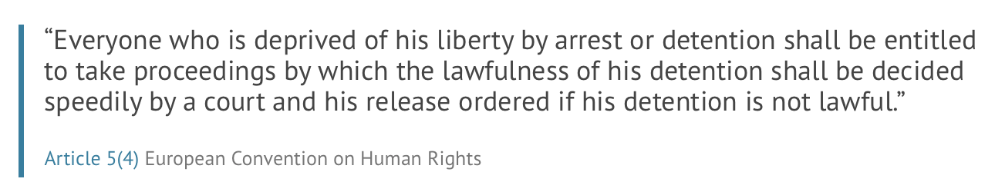
Section 21A challenges
The capacity requirement
The best interests requirement

Slide 35
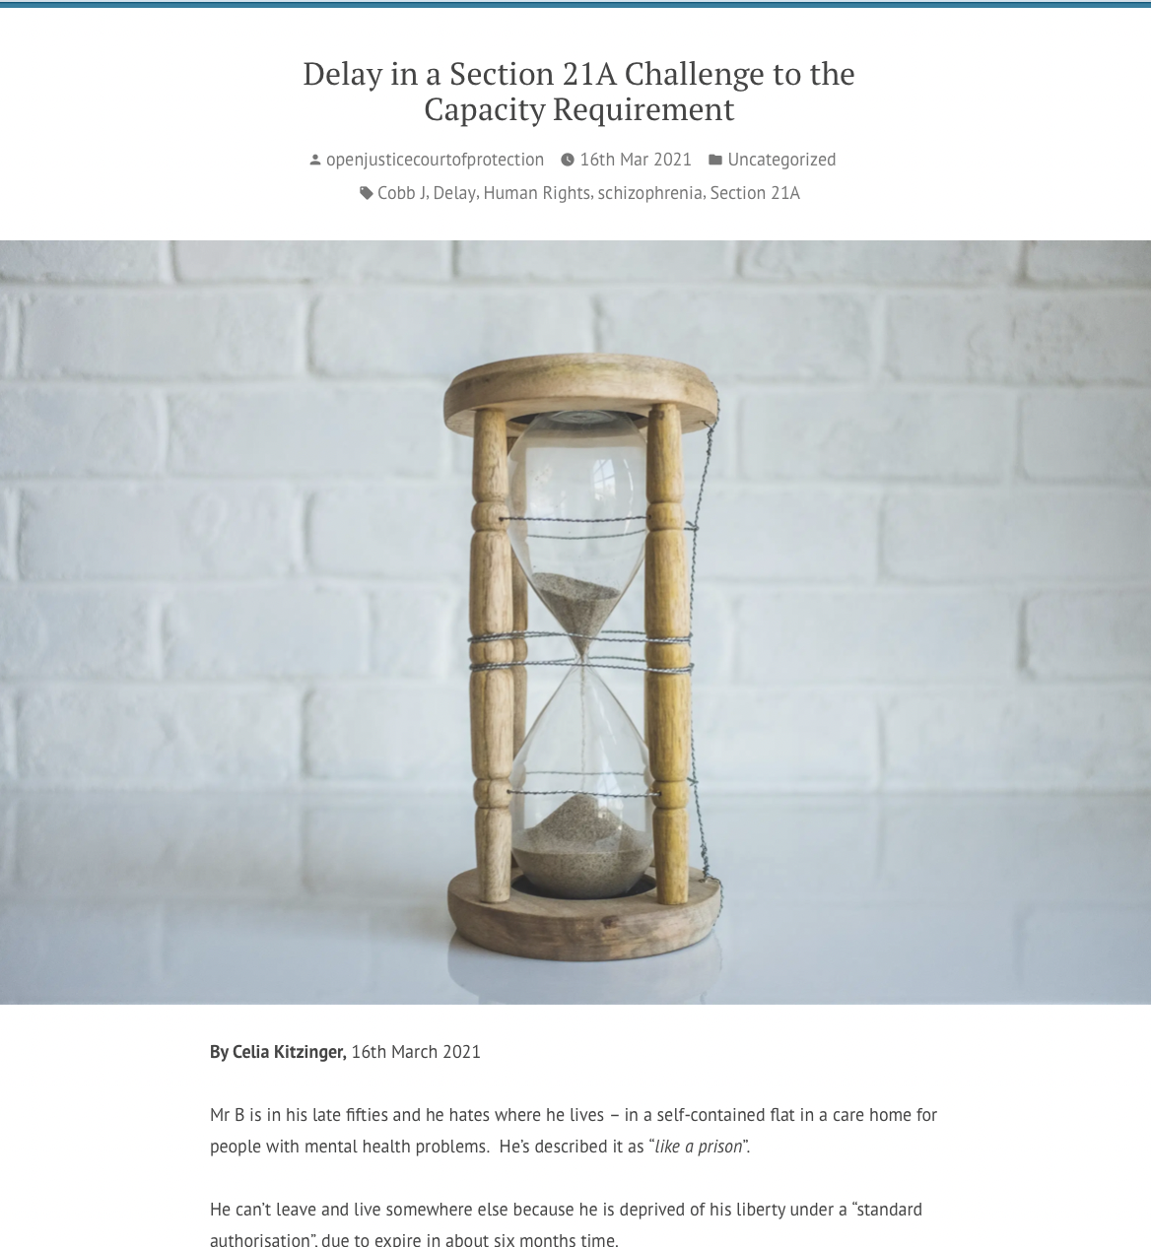
Section 21 A challenge to capacity requirement
Click here to read blog
Mr B is deprived of his liberty in a care home under a standard authorization
S.21A proceedings began in 2019
Final hearing scheduled for 27th April 2021 (16 months after first directions hearing)
Independent expert assessment finds P has capacity to make decisions about residence and care
But local authority disagrees….
Cobb J was giving them the opportunity to ask questions of the expert witness.
On 26th April 2021 LA withdrew its objections and DOL was ended

Slide 36
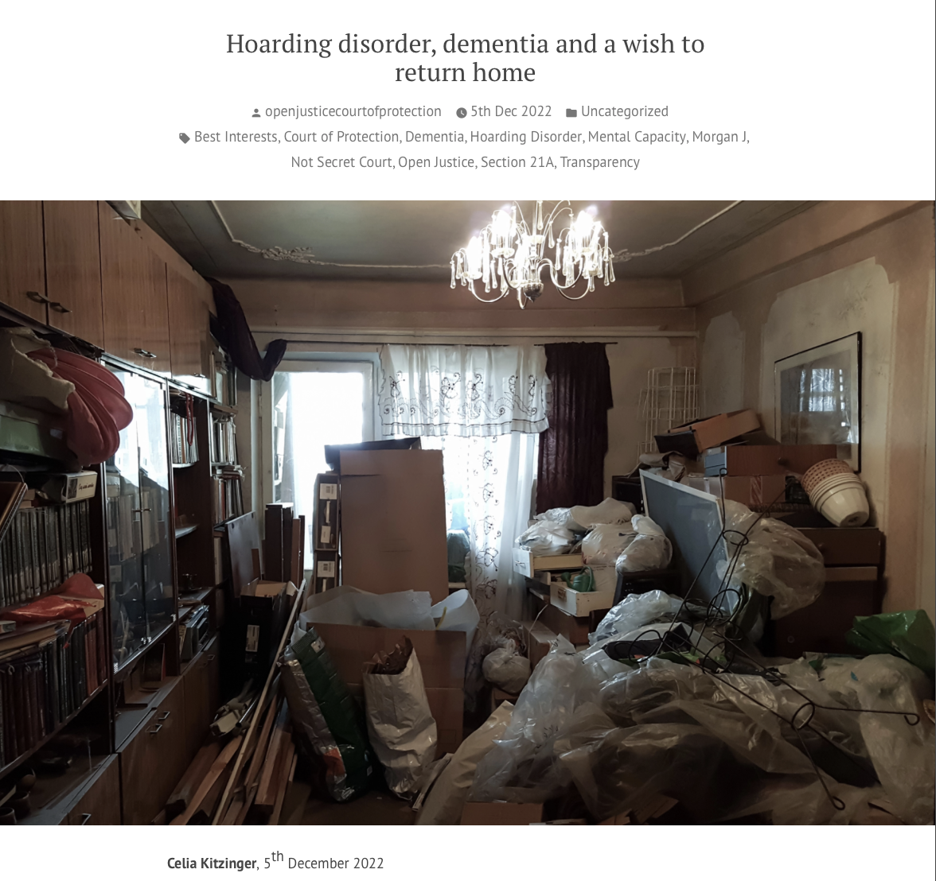
Click here to read blog
Lived in care home but wanted to return home - house “dilapidated” + in “dangerous state”
Assessed as having capacity to make decision – returned home with LA attempting to support her
Admitted to hospital after 3rd forced entry, gas poisoning (using butane gas cooking)
Back in care home – expert capacity assessment ordered – “very articulate” and “capacity not straightforward”

Slide 37
Ps in court contesting capacity determinations
Mr G (dementia, frontal lobe damage, Korsakoff’s, diabetes) – decision to return home
“I was taken into care erroneously. I believe that I have a small degree of impediment regarding my short-term memory. It does not ever interfere with my life, behaviour or quality of life.“
“I am perfectly capable of making decisions”
Distinguishes ‘chaotic’ period of his life when he lacked capacity and now.
Miss J “mixed personality disorder?” and other unverified diagnoses – decision to refuse feeding tube
““I am articulate and I have capacity spilling out of me. If I went to the shops with capacity, I’d be coming home with change.”
“This whole thing is just bullshit. People don’t listen. Surely, I should get to choose what happens to me.”
“I want to represent myself. Even Ted Bundy got to represent himself in court and he was a serial killer.”

Slide 38
Ps in court contesting capacity determinations
A heavily pregnant woman with religious objections to receiving blood products joined a hearing from her hospital bed to say: “I have capacity to represent myself and to instruct my very own solicitor”
P: I want to know why my capacity was questioned in the first place. I want to see the outcome of the two assessments. Two of them stated they believed I had capacity and 2 question it. Doctors had no reason to deny me my discharge papers and question my capacity and subject me to this treatment. (P has needle phobia)
P: I am in no way incapable of governing my own life, my finances, my own problems. (P has alcohol-related brain damage)

Slide 39
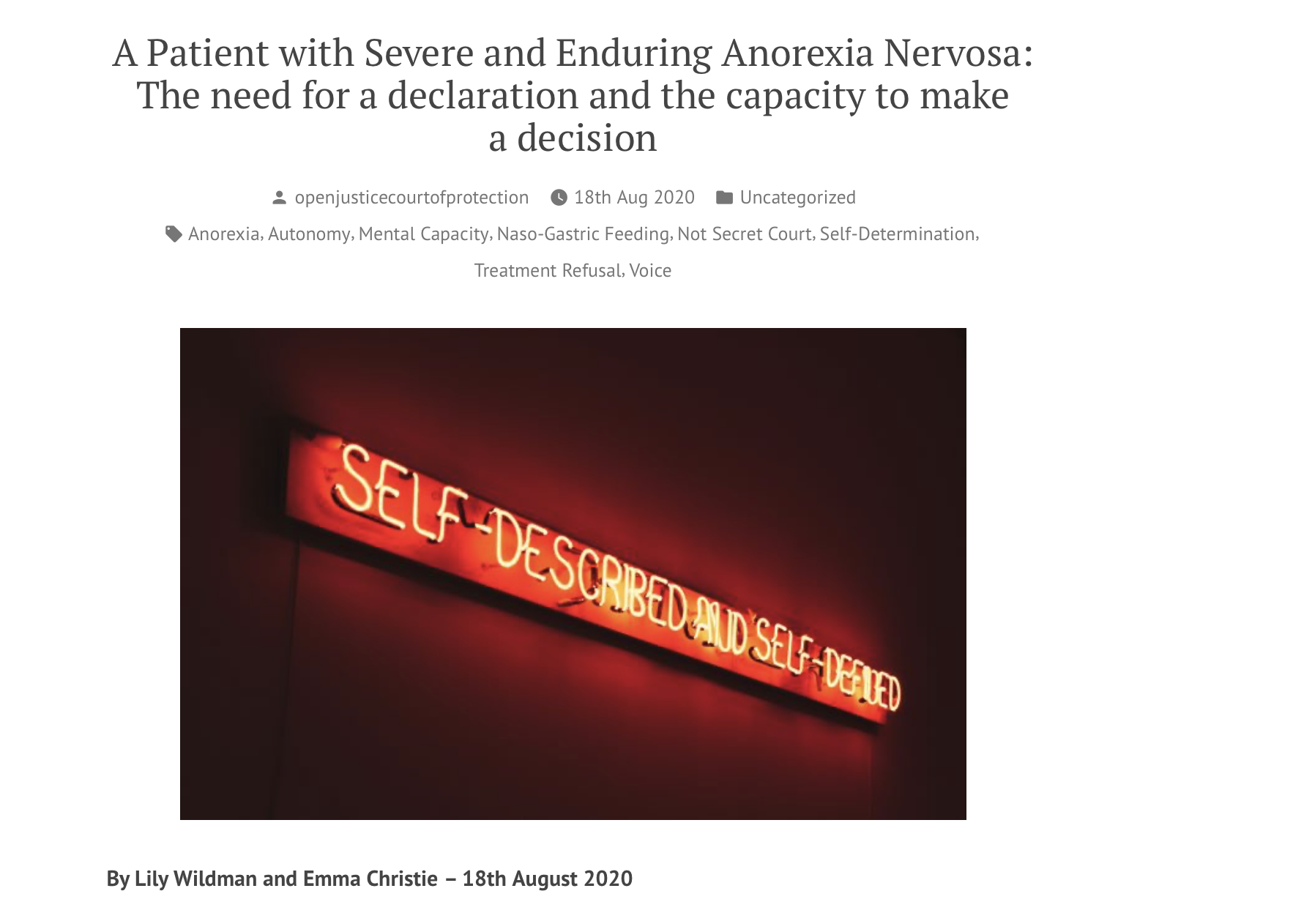
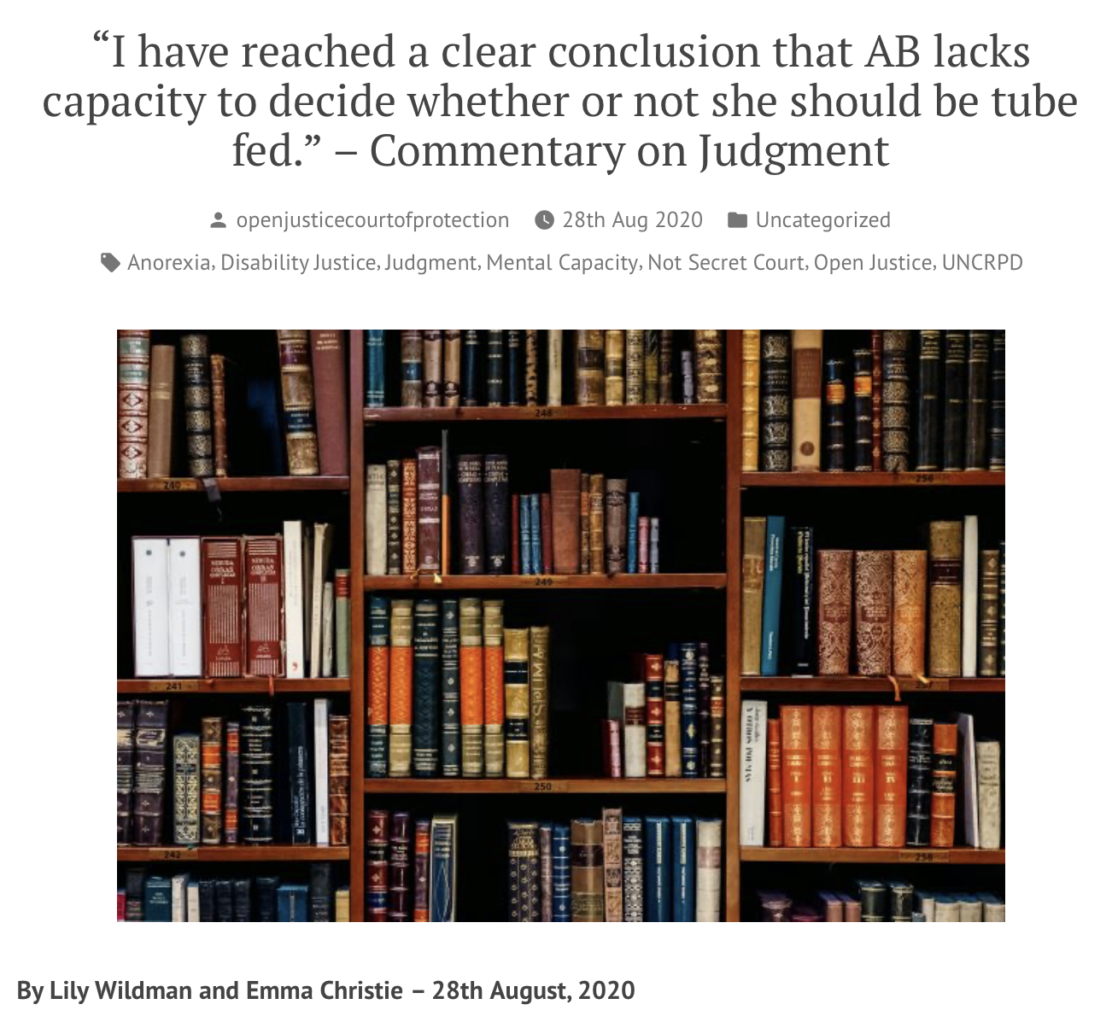
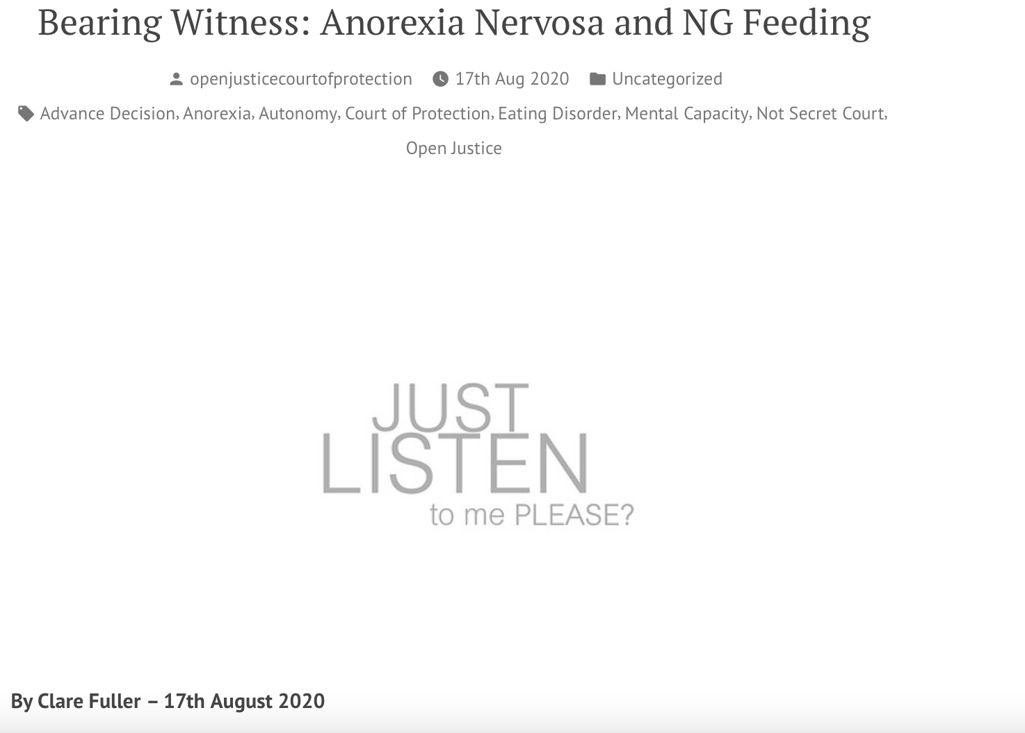
Capacity and anorexia

Slide 41
3. Best interests

Slide 42
A ‘best interests’ decision-maker must consider what person themselves would choose if they had capacity
Mental Capacity Act 2005
(a) the person’s past and present wishes and feelings ...
    (b) the beliefs and values that would be likely to influence his decision if he had capacity and
    (c) the other factors that he would be likely to consider if he were able to do so. [s4(6)] MCA 2005]
Consulting family & friends therefore key – “anyone engaged in caring for the person or interested in his welfare” [MCA 4(7(b)]
NB Next of kin are not decision-makers for adults

Slide 43
Ps meet the judge + attend court
P is always represented (usually by Official Solicitor)
Very common for P to have meetings with the judge (if they wish)
Around 10% attend court (often via video-link)
Express “wishes and feelings” or “will and preference”
Sometimes lengthy exchanges with judges (especially Hayden J)
Unclear to me whether or not this is “evidence” – it’s clearly taken into account in judgments
P’s wishes and feelings are not “determinative” – but part of best interests decision-making (compare "in good faith and for the benefit of the person” Assisted Decision-Making (Capacity) Act 2015)

Slide 44
P to the judge (s.21A hearing) – on wishes/ preferences
“I would like to congratulate that last lady speaker. What a fantastic presentation. That’s a very clear plan – the clearest I’ve ever heard put forward. I am capable of living on my own and feeding myself and going out on my own. I have a penchant nowadays for calling taxis even if it does cost a few bob. As for my appearance and dress, I can do a quick change in about ten minutes if I have to. If I’m not to go home, I’d be quite happy with the extra care accommodation at [Place] if you require it. I’m not incontinent. I don’t need spoon feeding or assistance in the bathroom. […] I would love to get back into the community.”

Slide 45
P wants to return to live with her abuser
P: (crying). All I want, please, is let me go back.
J: But he assaulted you badly on Thursday.
P: He didn’t. I was manipulated into saying that.
J: I take the view that if you were to go back, he would hit you again.
P: No he wouldn’t.
J: You understand he’s not allowed to live with a baby under any circumstances?
P: Yes I do. Please let me go back to him. PLEASE.
J: Yes. Thank you very much.

Slide 46

Click here to read blog
Ms Doe hates her current placement and has been saying for more than a year that it’s a “horrid place” and that she wants to go back to Poland to be with her family.
S.21A challenge on best interests
Big concerns – pension + social security entitlements, nationality, healthcare needs, travel during pandemic, etc
Hayden J ordered qualifying requirement of best interests not met + made order it’s in her best interests to return to Poland.

Slide 47
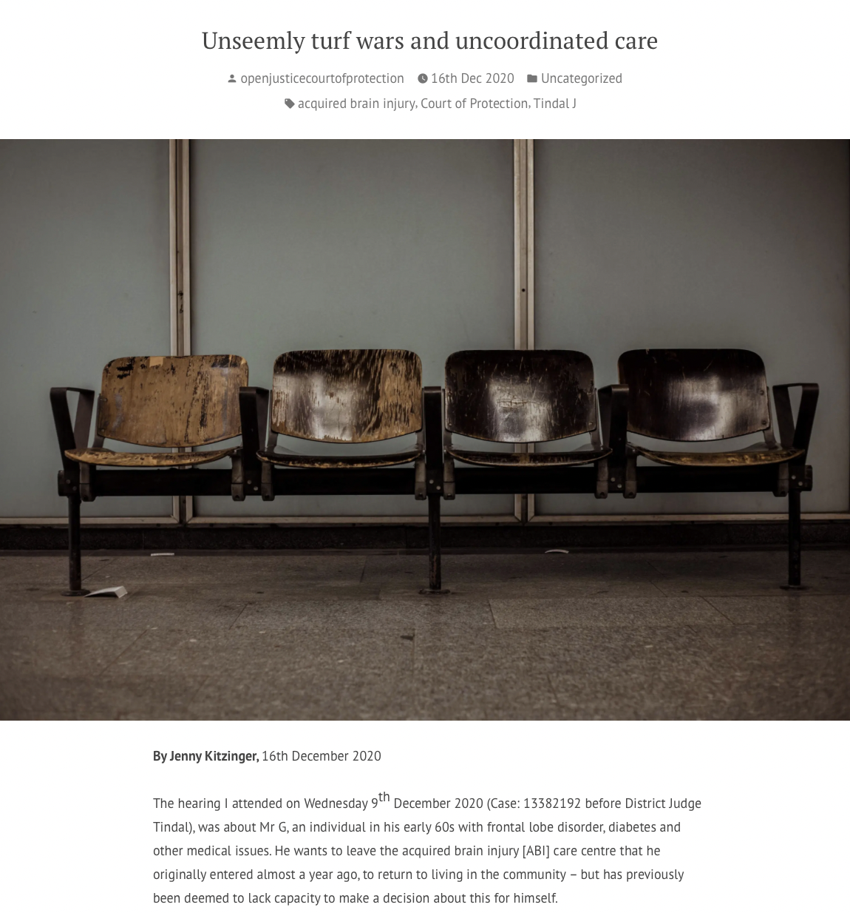
Click here to read blog
Mr G (64) has acquired brain injury, vascular dementia, Korsakoff’s, diabetes – wants to leave ABI centre + live in community.
Has been found to lack capacity to make this decision himself (he contests this, articulately)
Best interests requirement is now contested – is there a less restrictive option?
Delay of more than a year
December 2020 – info on alternative options not available to the court
Both Tindal J and Mr G expressed frustration at delay thus far
Median duration of 7 months (in 2017) for s.21A reviews (freedom of information from local authorities, Lucy Series et al. (click here)
Compare hearing within 8 weeks of application for Mental Health Tribunals

Slide 48
Mr G to the judge
“In the commentary you delivered you mention an ‘unseemly turf war’. That seems an apposite description of what’s going on here. The only people aside from my solicitor and barrister who’ve behaved with any dignity, any care – assets you might look for in a clinical setting – are the small but willing team in this place [ABI care centre] who’ve always treated me with dignity and respect. Everyone else has kicked me around like I’m an object. Which I am not. I am not going to give up. My life is ticking away in real time. I need action, by you, Your Honour, to return me to the life I’ve been deprived of”.
Note: The Official Solicitor was making the case for Mr G to remain in the care home in his best interests – i.e. the opposite case to what Mr G wanted

Slide 49
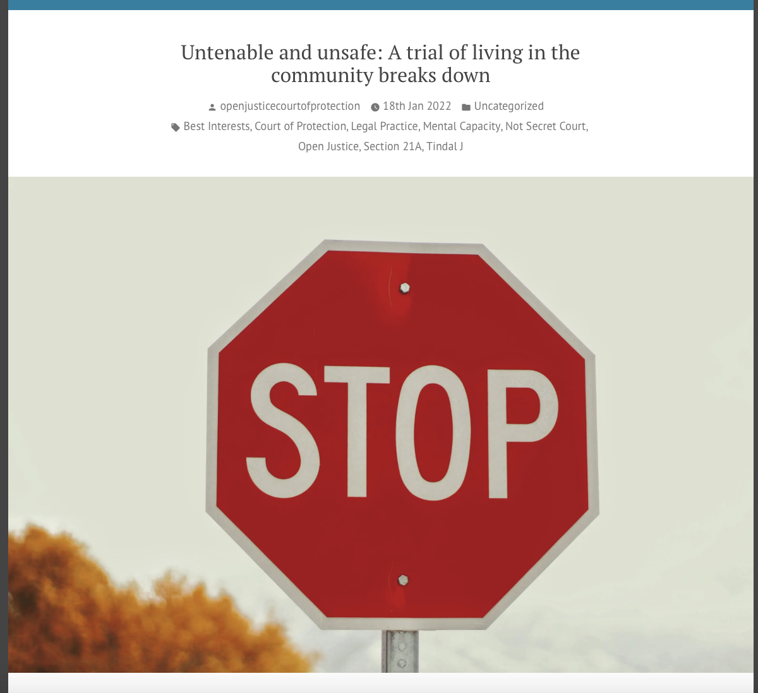
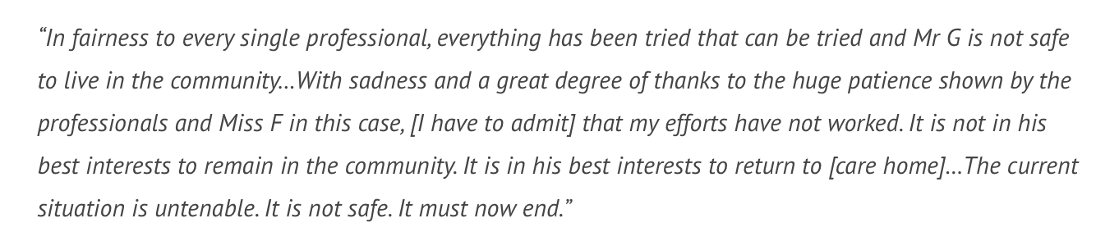
30th December 2021
What good is it making someone safer if it merely makes them miserable? (Munby J in §120 in Local Authority X v MM & Anor (No. 1) (2007).
“A gilded cage is still a cage”
Lady Hale

Slide 50
Concerns
Delays in carrying out robust capacity assessments (esp. in pandemic)
Lack of clarity about what the ‘relevant information’ is
Not explaining to P what the purpose of the assessment is
Conflating capacity and best interests
‘protection imperative’
Failure of RPR (or IMCA) to progress to s.21A application
Delays in making s.21A applications – and some are hard to understand (which qualifying requirement is contested?)
Delays in court process – not Art.5(4) compliant
Need for parallel work on BOTH ‘capacity’ + ‘BI’ requirements
Ethical challenges in making decisions directly counter to P’s wishes

Slide 51



Click here for Authorising restraint blog
Click here for covert medication blog
Other aspects of deprivation of liberty
Click here for Visual monitoring blog

Slide 53
4. Planning ahead for lack of capacity

Slide 54
Ways to influence future decisions
Have “the Conversation”
Make an Advance Statement
Appoint a Health and Welfare Attorney
Make an Advance Decision to Refuse Treatment If there are treatments you don’t want or states you wouldn’t want to be kept alive in.
Applies to all of us – not just terminally ill or very old people. Loss of capacity can strike at any time.

Slide 55
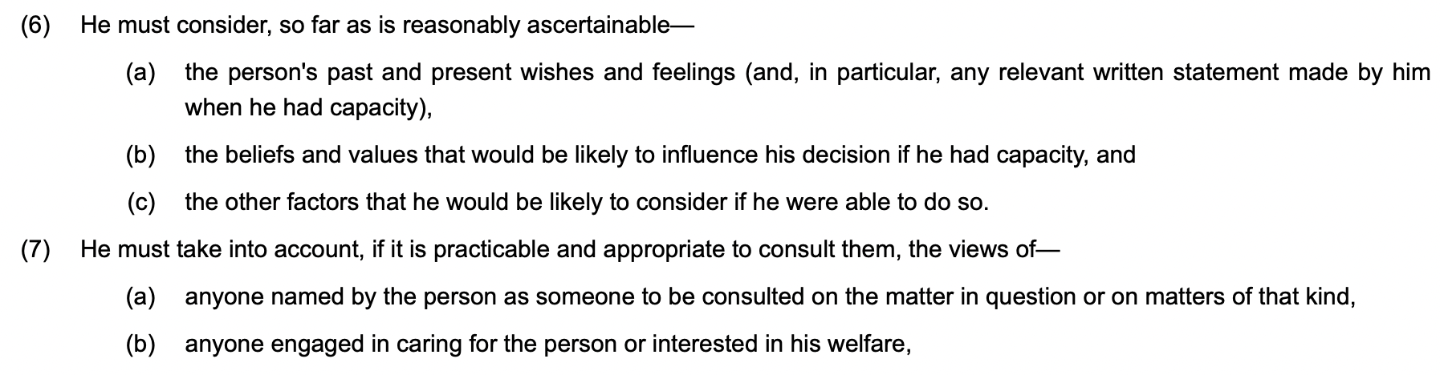
1. “The conversation” s. 4(6) + (7) MCA
He = ‘the decision-maker’
Family are usually included in those “engaged in caring for the person or interested in his welfare” so should be consulted about P’s “past and present wishes and feelings” + “beliefs + values”.
But family (or ‘next of kin’) are NOT ‘the decision-maker’

Slide 56
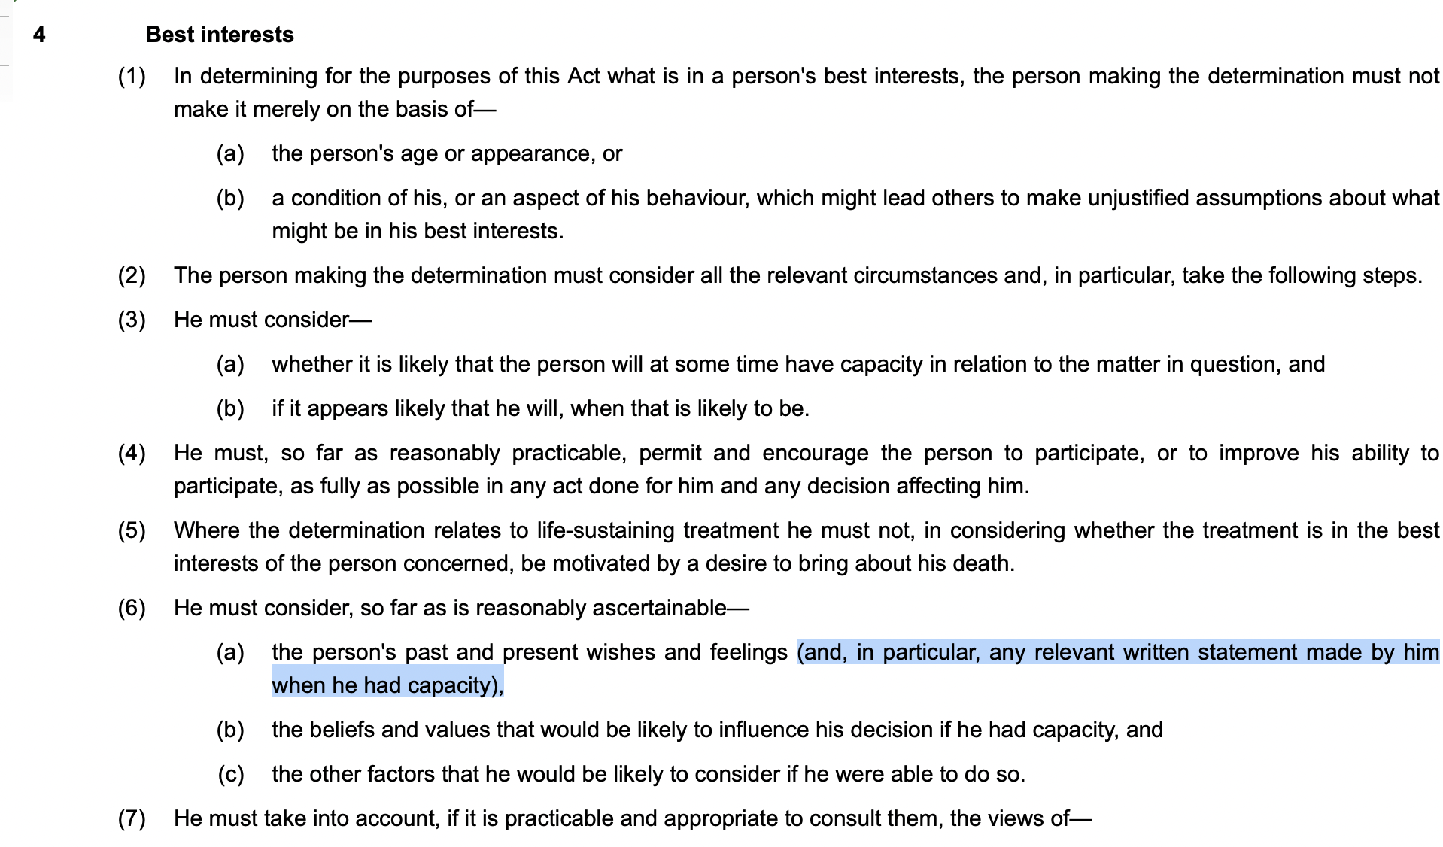
2. Written statement s.4(6)(a) MCA

Slide 57
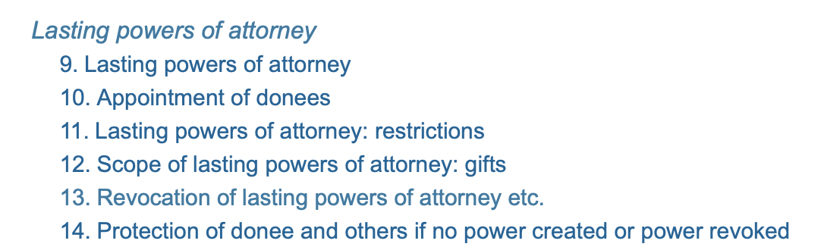
3. Lasting Power of Attorney ss. 9-14 MCA 2005
Two different kinds of LPA
Personal Welfare
Property and Affairs
Very often in court with validity challenges esp. relating to P’s capacity at the time they were made

Slide 58
4. Advance Decisions to Refuse Treatment ss. 24-26 MCA
Way of recording your decision to REFUSE MEDICAL TREATMENTS at a future time when you can no longer make or communicate such decisions
You can refuse ANY treatments you want under any circumstances you want.
This is NOT subject to best interests decision-making.
A valid and applicable ADRT is equivalent to a contemporaneous capacitous refusal.

Slide 59
Advance Decision 1 refusing just ONE treatment
“I refuse all blood products under all circumstances. I maintain this refusal even if my life is shortened as a result.”
Signed _______________
Witnessed _____________
Date:_______________
This is a valid Advance Decision – legally binding on paramedics, hospital staff + general public

Slide 60
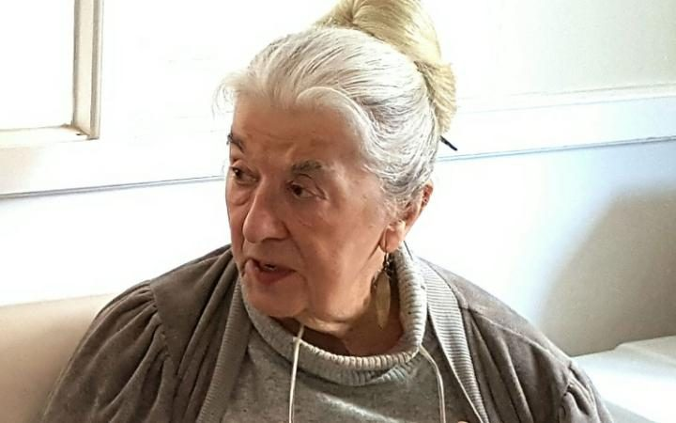
Advance Decision 2 refusing ALL life-sustaining treatments
“I refuse ALL medical treatment or procedures/interventions aimed at prolonging or artificially sustaining my life. I maintain this refusal of treatment in the hope that my life will be shortened as a result.”
(Extract from
Avril Henry’s
Advance Decision)

Slide 61
ADRTs in practice
Many work well – they are not seen by lawyers or the courts.
Many do not fulfil the requirements of s. 25 MCA 2005 e.g. no witness signature, no ‘magic sentence’ – but can be used as ‘advance statements’ in BI decision-making
Many are vague or muddled and it’s hard to know what treatments person wants/doesn’t want (including those written by solicitors)

Slide 62
Even when ADRT is valid + applicable…
Many HCPs (and paramedics, first responders etc) don’t understand they are legally binding treatment refusals. (Avril Henry’s lifeguard; conscientious objectors)
They get ‘lost’ in the system – In England and Wales there is no national repository for them

Slide 63
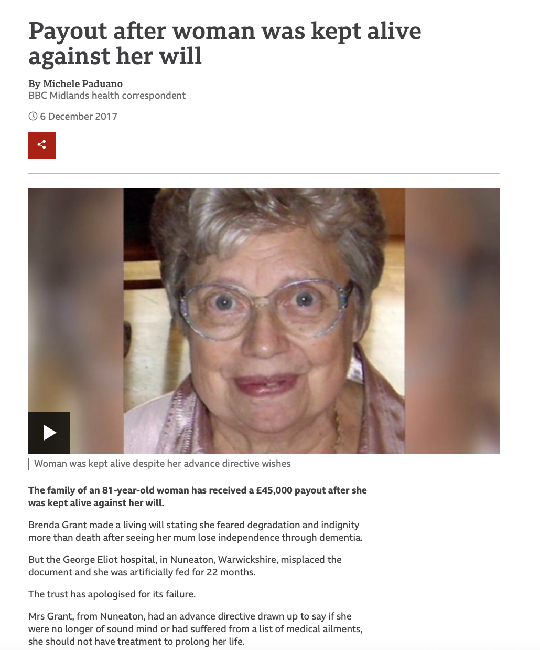
https://www.bbc.co.uk/news/uk-england-coventry-warwickshire-42240148
Devastating stroke + PEG fed for 22 months
Hadn’t told her children.
Hospital had ADRT in notes but ‘misplaced’ it

Slide 64
NHS Cumbria v Jillian Rushton + Ors. [2018] EWCOP 41
Head injury in her 80s, December 2015 –in vegetative state for 3 years
GP mis-reported content of ADRT in 2016 (as only about CPR)
Children didn’t know about ADRT. One son wanted CANH continued, others did not
News report here (https://www.newsandstar.co.uk/news/17533962.cumbrian-woman-right-to-die-legal-battle-passes-away/)
Discovered ADRT actually said: “I am refusing all treatment. Even if my life is at risk as a result,” and “in all circumstances of collapse that put my life at risk, this direction is to be applied.”
Hayden J gives guidance as to proper approach to ADRTs.

Slide 65
PW (Jehovah's Witness: Validity of Advance Decision), Re [2021] EWCOP 52 (22 September 2021)
Jehovah’s witness with dementia + ulcerated gastric tumour
ADRT complying with requirements of Act refusing blood transfusion
Signed 20 years ago (could no longer remember doing so + now inconsistent about refusing blood transfusion)
An ADRT is not valid if P “has done anything else clearly inconsistent with the advance decision remaining his fixed decision” S.25(2)(c)
Argued that she’d acted inconsistently by appointing her children as LPAs + not telling them she’d refused blood products, so ADRT not valid
Court approved blood transfusion in her BI

Slide 66
Thank you!
Celia Kitzinger
openjustice@yahoo.com
@kitzingercelia
@OpenJusticeCOP
Get involved! Check out our website and follow us on Twitter

