Slide 1

Transparency Matters in the Court of Protection
Celia Kitzinger
19th January 2023
Park Square Barristers
At Iberica, Hepper House,
17a E Parade, Leeds LS1 2BH

Slide 2
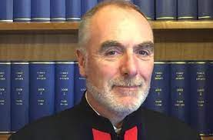
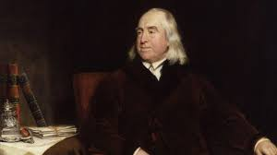
TRANSPARENCY – a fundamental value
“Transparency is central to the philosophy of the Court of Protection”
Mr Justice Hayden, Vice President of the Court of Protection, 4th May 2020
“Publicity is the very soul of justice. . . . It is the keenest spur to exertion, and the surest of all guards against improbity..”
Jeremy Bentham 1748–1832 English philosopher: Publicity in the Courts of Justice (1843)

Slide 3
Open Justice Court of Protection Project
Transparency Pilot 2016 – extended and incorporated into COP practice
Open Justice COP Project Founded 15 June 2020
Following negative experience of “first ever all-remote” hearing of the pandemic
Launched as “guard against improbity”, it soon became clear that it (also) offered a learning experience for people working in health and social care surprised at ‘person-centred’ + ‘less risk averse’ approach
And supports family members of P learning at first hand about the COP
Has massively increased observation in COP (as has remote hearings)
Thank you to everyone who has supported observers
Has generally enhanced the reputation of the Court of Protection

Slide 4
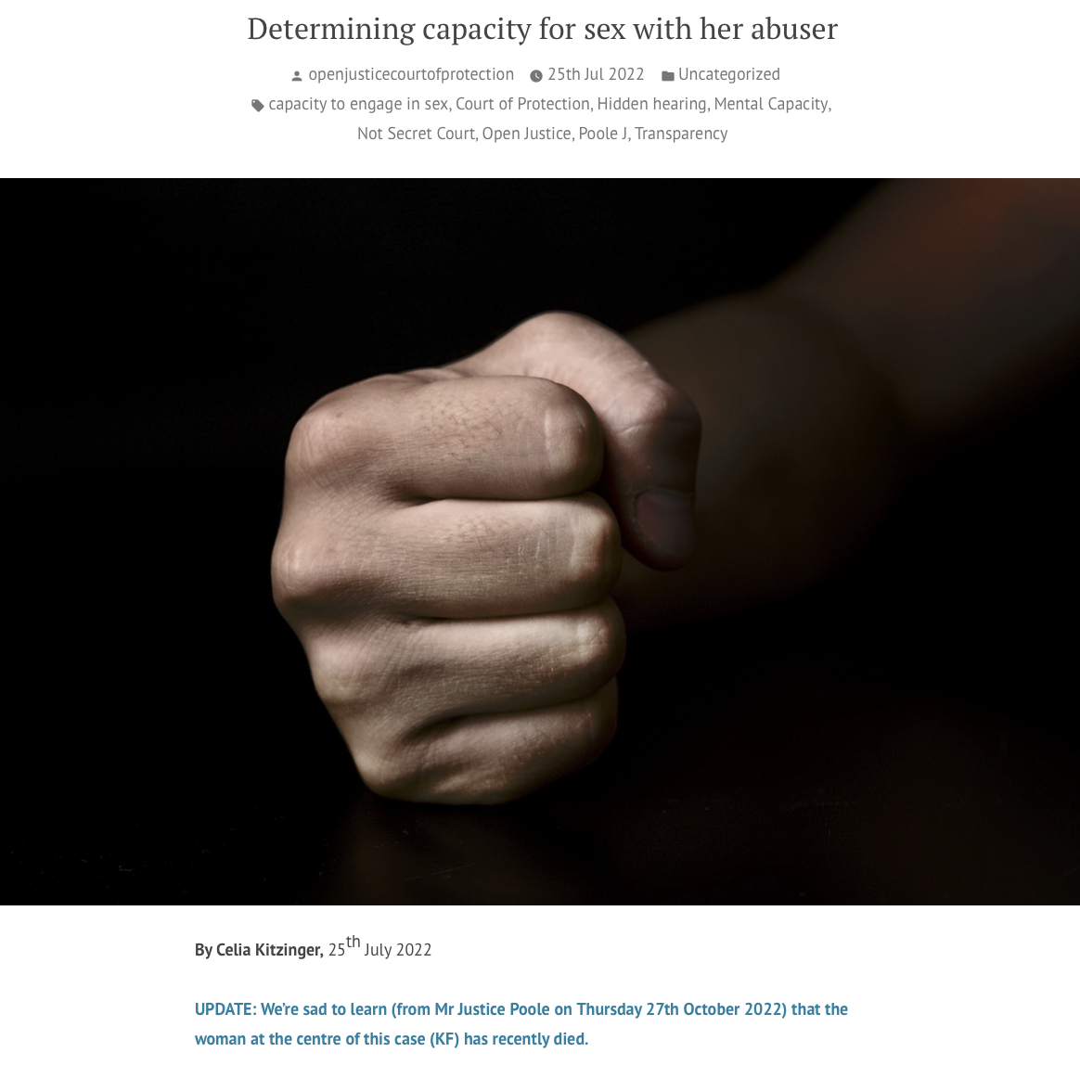
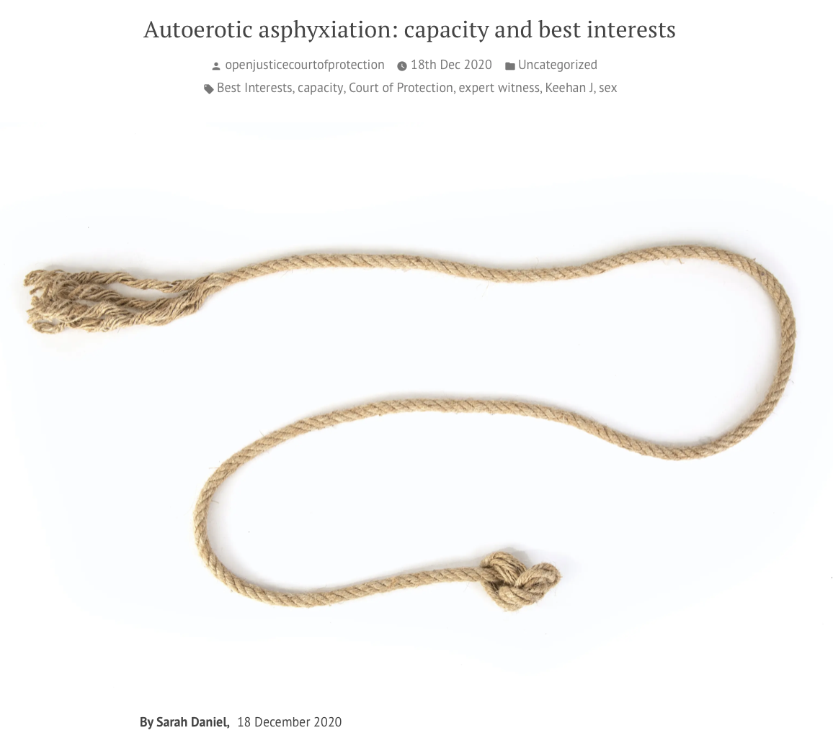
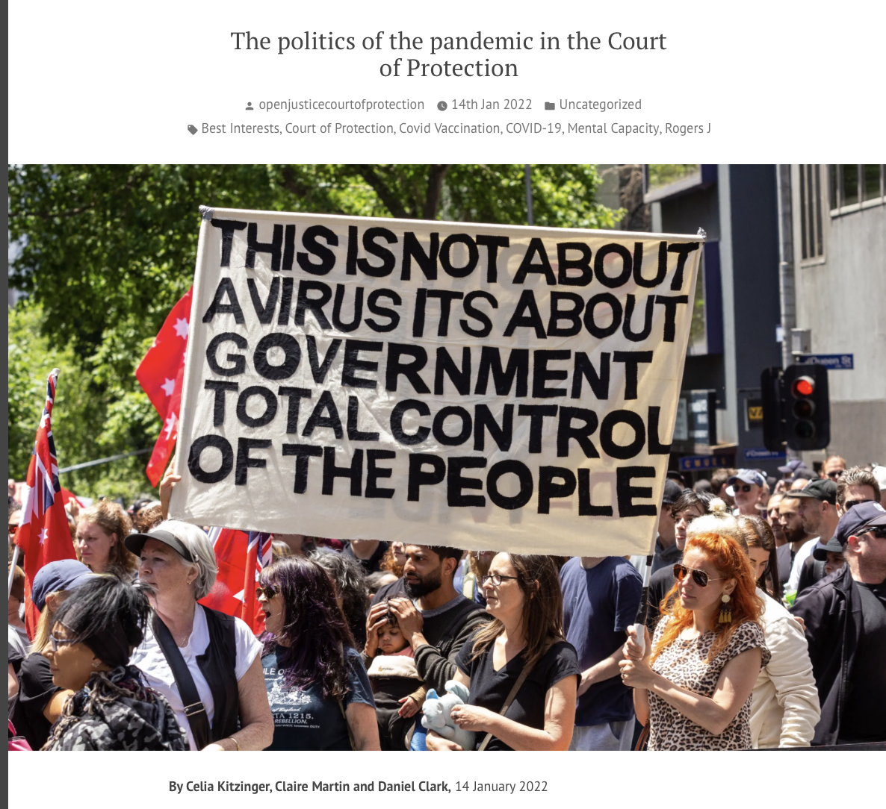
Open Justice Court of Protection Blogs
Determining capacity for sex with
her abuser
Autoerotic asphyxiation
Politics of the Pandemic
Search on ‘covid’ in our blog index

Slide 5



Open Justice Court of Protection Blogs
Search on ‘covid’ in our blog index

Slide 6
Today’s talk
‘Extraordinary’ hearings
Committal Hearings
Closed hearings - especially Re A (Covert Medication: Closed Proceedings) [2022] EWCOP 44
2. ’Ordinary’ hearings

Slide 7
‘Extraordinary’ hearings
Committal Hearings

Slide 8
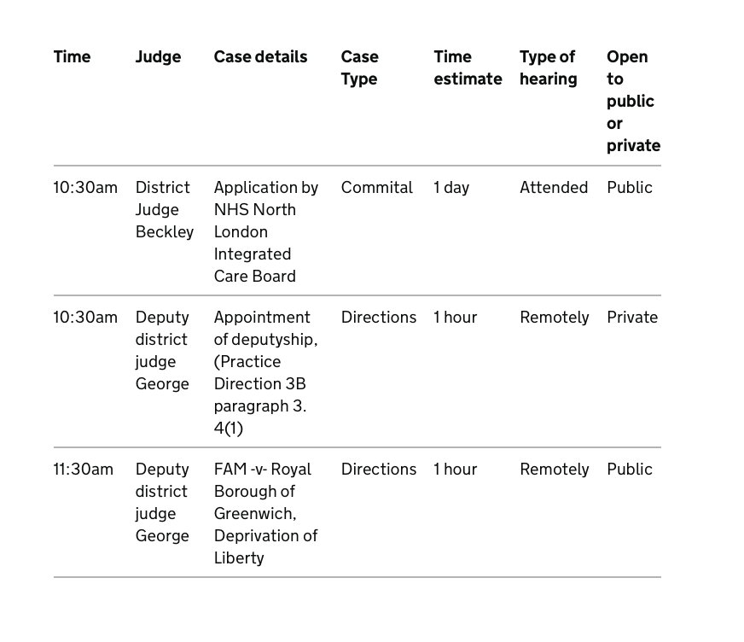
Committal hearing (1): What’s wrong with this listing for today’s hearing?

Slide 9
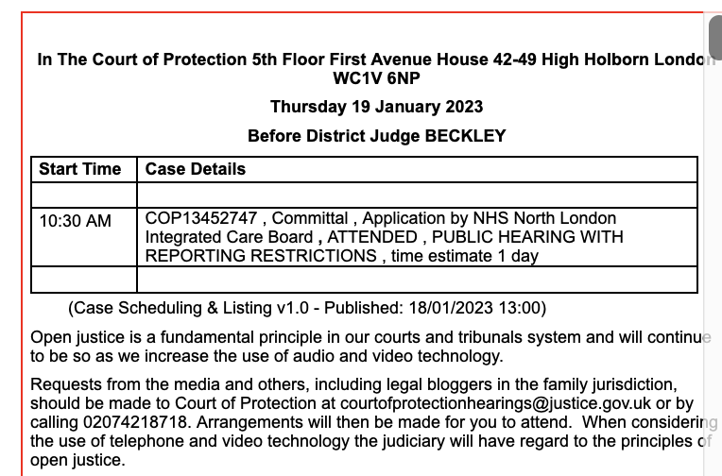
What’s wrong with this listing?

Slide 10
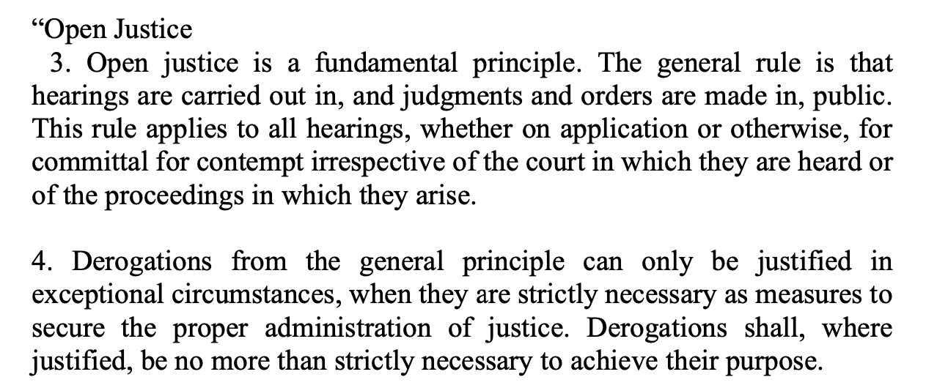
Practice Direction Committal for Contempt of Court
- Open Court, March 2015

Slide 11
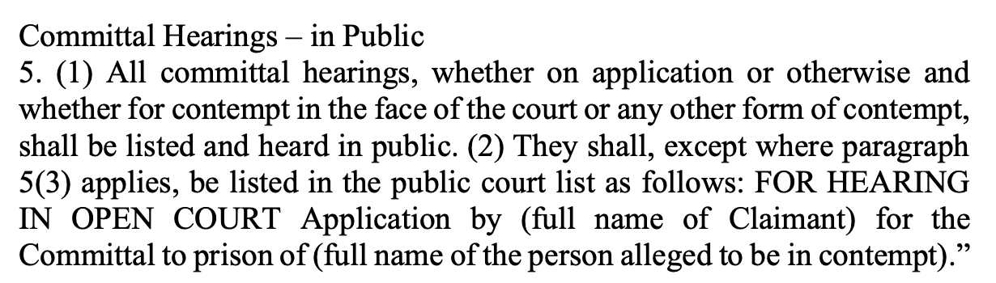
Practice Direction Committal for Contempt of Court
- Open Court, March 2015
PD plus amendments 4th January 2023

Slide 12
Committal hearing (2): Sunderland City Council v. Lioubov Macpherson [2023] EWCOP 3
Judgment just published (today)
Does name defendant but did not do so in listing either of the two committal hearings
They were held in public because I was aware of them and alerted a journalist to attend the first, and was able to attend the second myself (with a journalist)
Read the judgment!

Slide 13
‘Extraordinary’ hearings
Closed hearings - especially Re A (Covert Medication: Closed Proceedings) [2022] EWCOP 44

Slide 14
Closed hearings – can they be held in public?
Closed hearings - one party + legal representatives is excluded by court order from the hearing. Closed material hearings where some of the evidence before the court is withheld from one party.
“In retrospect it might have been possible to list the case without a case number or with a new case number created for the specific hearing, without any identifying names or initials to enable the listing to be linked to any previous open proceedings, and to make a reporting restrictions order at the hearing to prevent any communication or publication about the hearing (at least not until further order)” (§9 Re A (Covert Medication: Closed Proceedings) [2022] EWCOP 44 (Poole J)
Observers to “guard against improbity” may be MORE important at closed hearings!

Slide 15
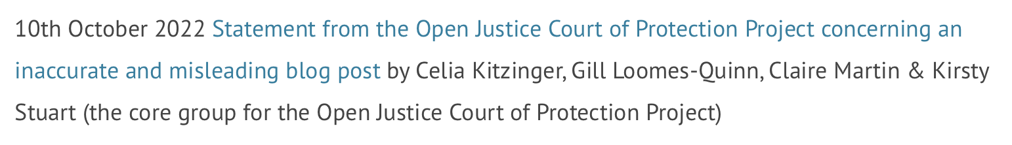
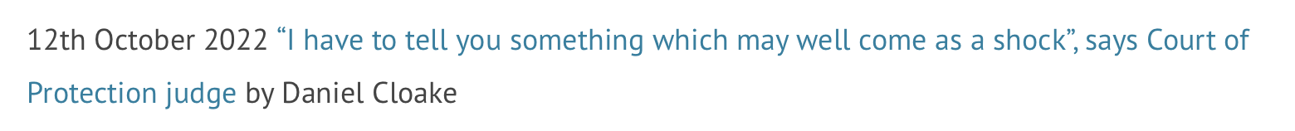
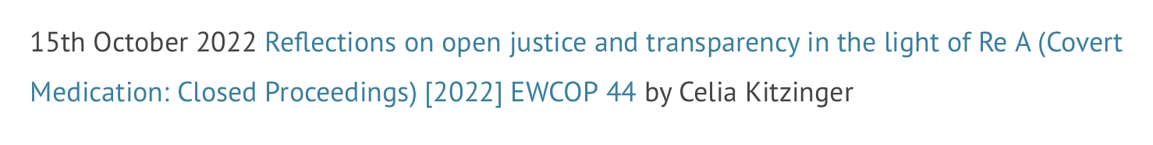
The Open Justice COP project & Re A

Slide 16
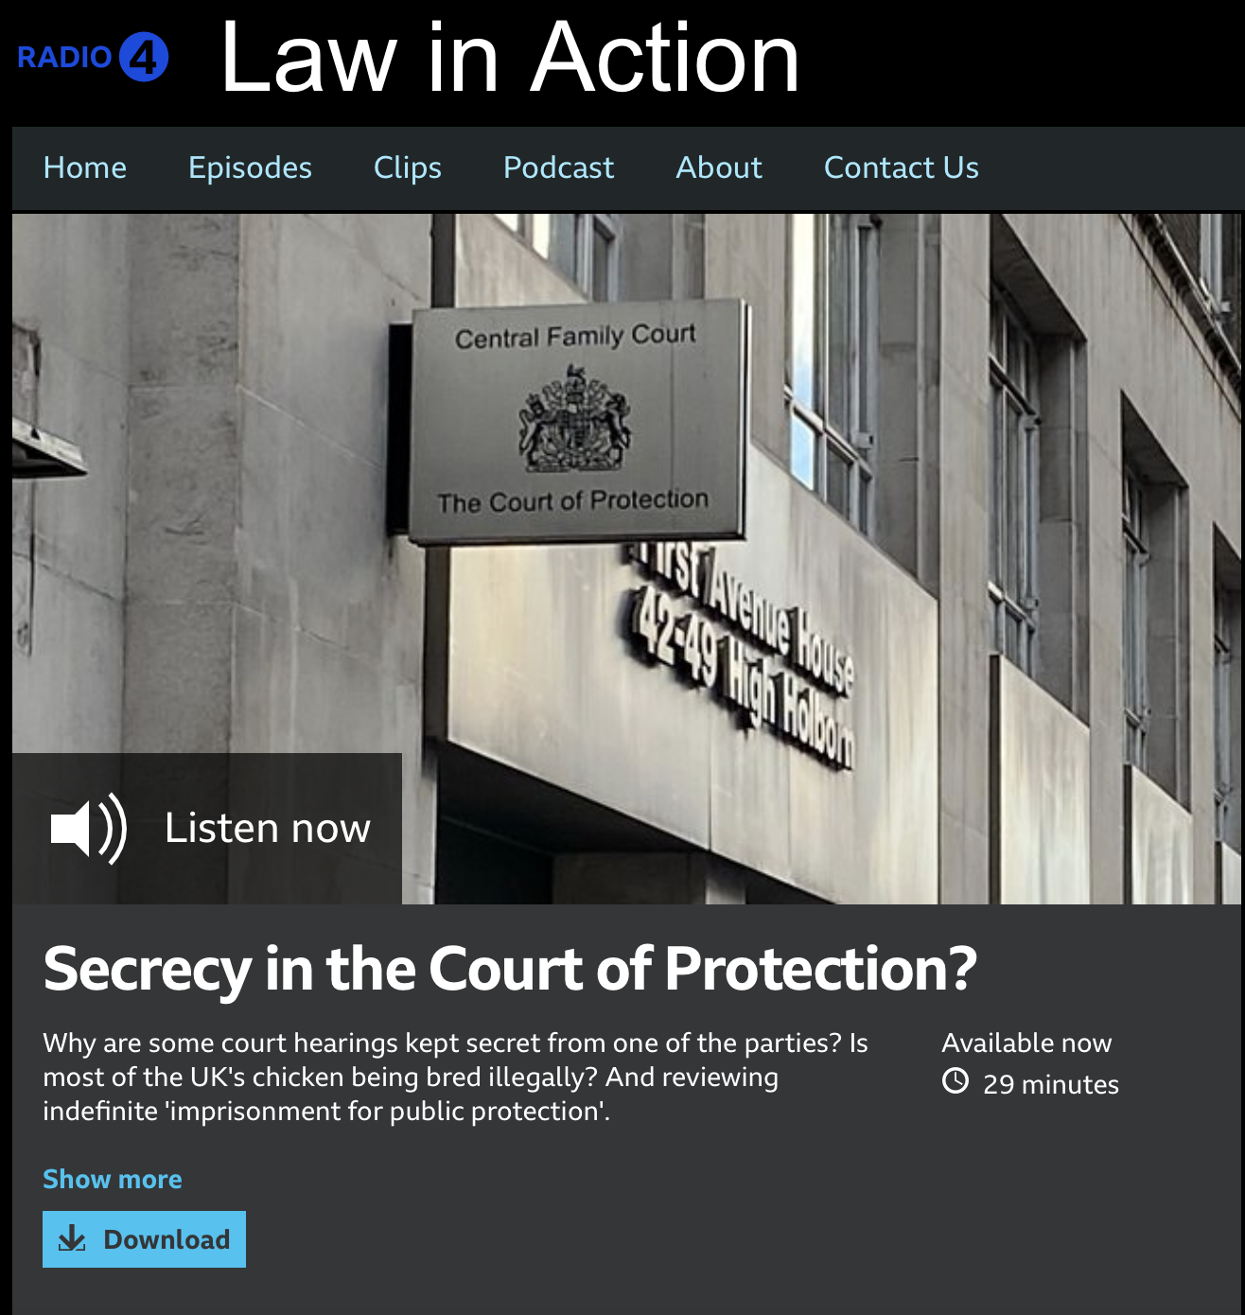
The Open Justice COP project & Re A
Law in Action:
Celia Kitzinger interviewed by Joshua Rozenberg

Slide 17
2. ‘Ordinary’ hearings

Slide 18
Key Performance Indicators for Open Justice
1. List the hearing in the Court of Protection list on @CourtServe so we know about it.
2. Make it clear public can attend
3. Tell us how we can attend (remote/in person)
4. Supply correct contact info (for both remote and in person hearings)
5. Tell us what the hearing is about
6. Tell us the type of hearing (e.g. directions, case management, final)

Slide 19
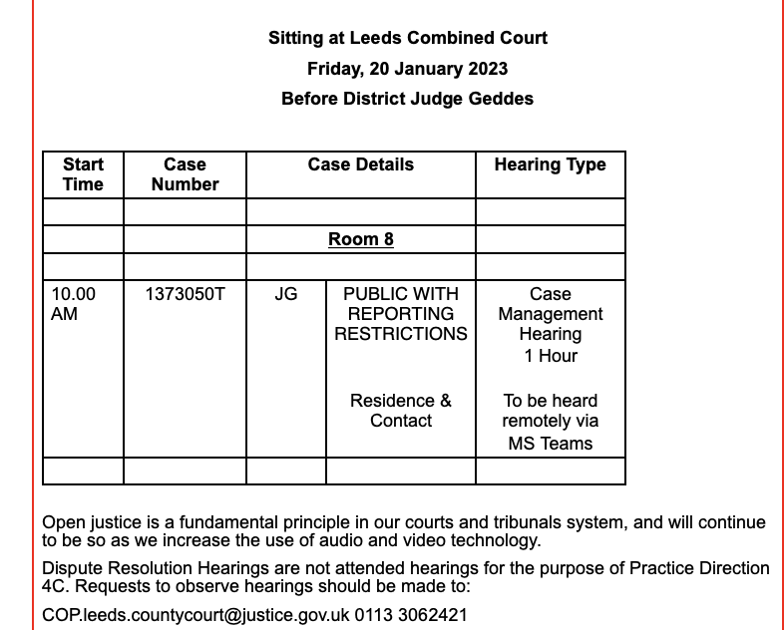
A good example from Leeds

Slide 20
1. List the hearing in the Court of Protection list

Slide 21
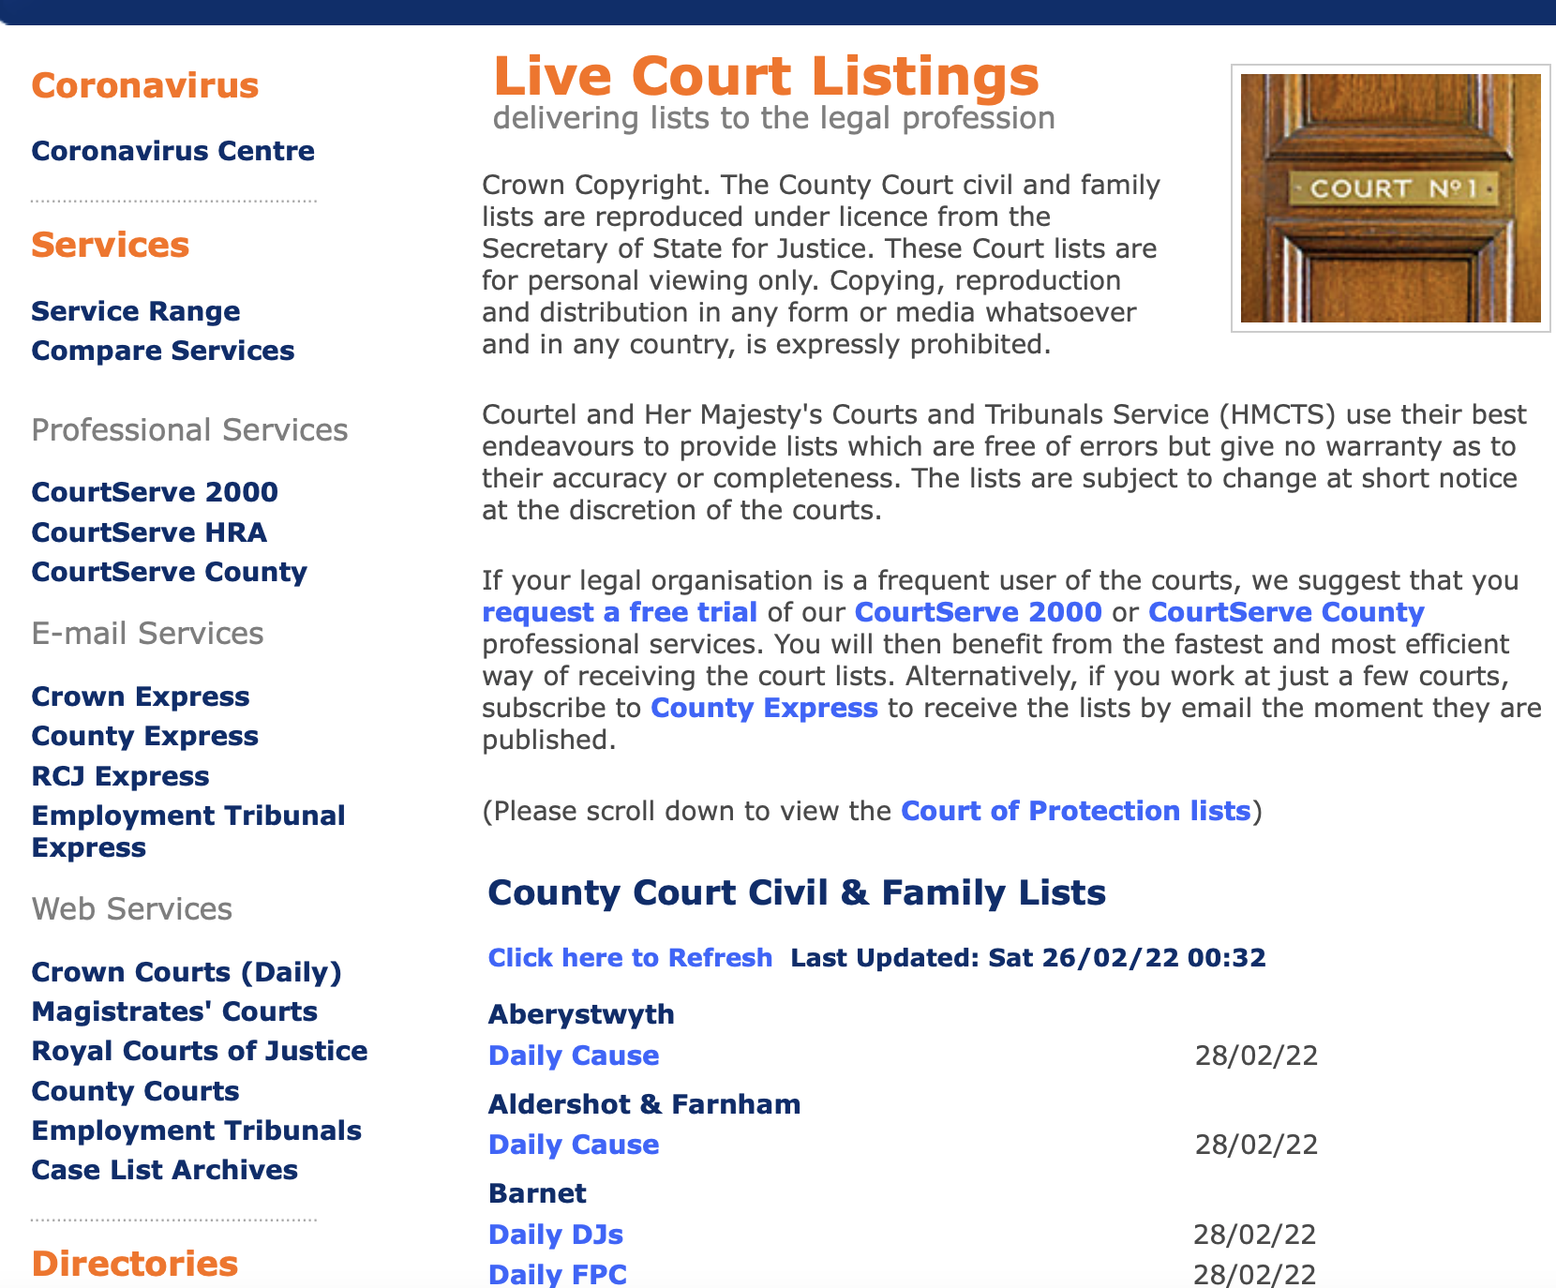
All Court of Protection hearings are supposed to be listed in CourtServe
All hearings (except in Royal Courts of Justice) should be under the
Court of Protection tab for the County Courts
(see the text the blue arrow points at)

Slide 22
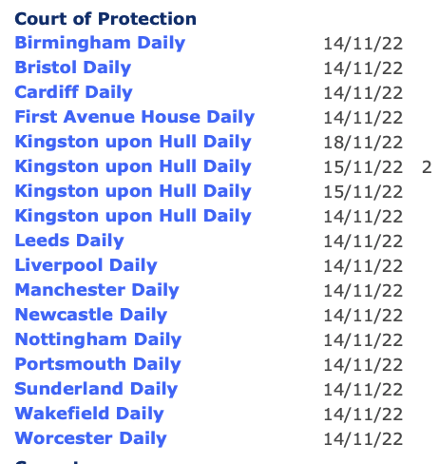
14th November 2022
Here’s the COP list in CourtServe.
There are 28 hearings listed for 14/11/22 (and some hearings listed for other dates too, which aren’t included in the analysis here)
When you click on a city/town name it opens to show you one or more COP hearing(s) listed.
There’s one hearing under each town/city name, except 2 for Cardiff, Hull, & Manchester; 3 for Leeds; 4 for Sunderland; and 7 for First Avenue House – making a total of 28 hearings.

Slide 23
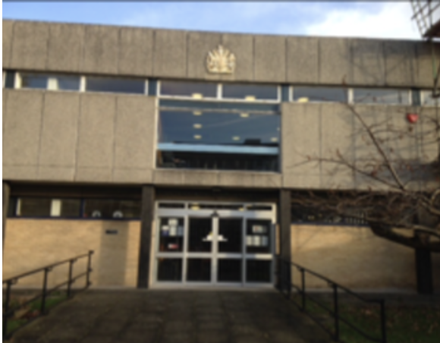
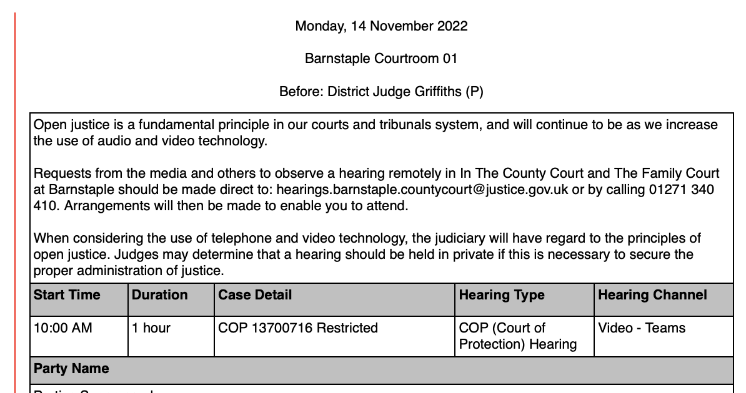
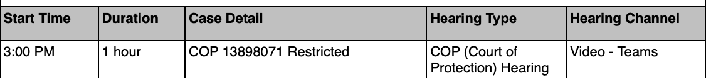
Two hidden hearings in Barnstable
Barnstable isn’t here
Plymouth isn’t here
All COP hearings should be in the COP list. There’s no hearing listed in Barnstable on the COP list. But look! There are TWO COP hearings listed in the Daily Cause List for Barnstable.
These are hidden hearings. This does not support open justice.

Slide 24
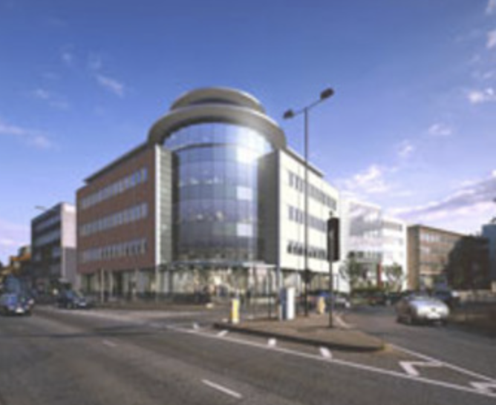
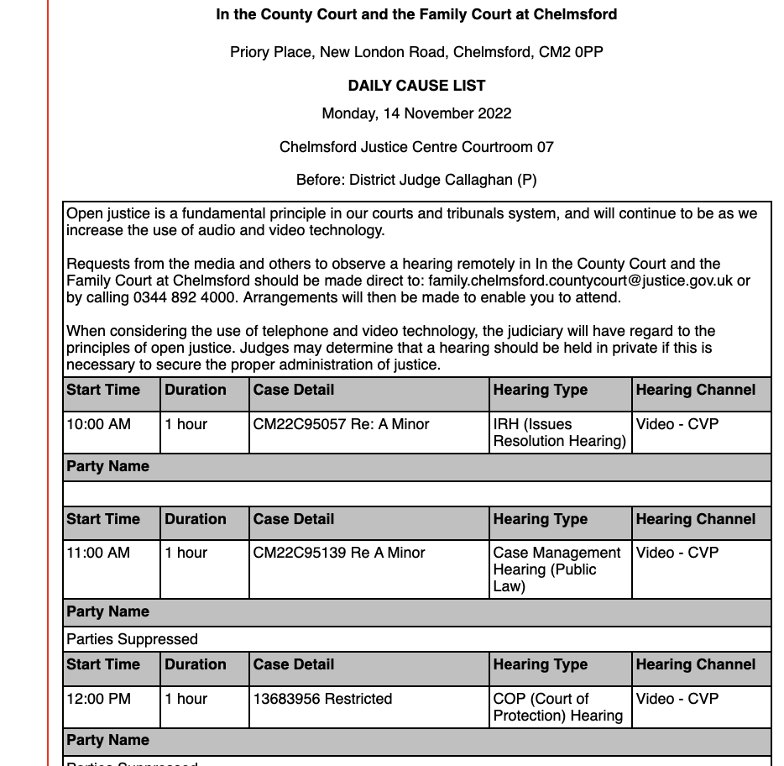
Hidden hearing in Chelmsford
Chelmsford isn’t here
Walsall isn’t here
All COP hearings should be in the COP list on CourtServe. There’s no hearing listed in Chelmsford on the COP list. But look! There’s a COP hearing listed in the Daily Cause List for Chelmsford. It’s a hidden hearing. This does not support open justice.

Slide 25
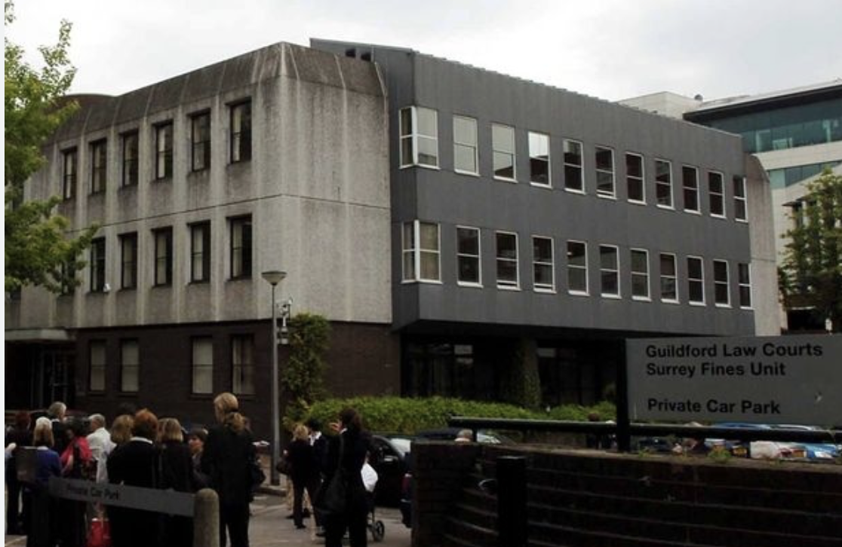
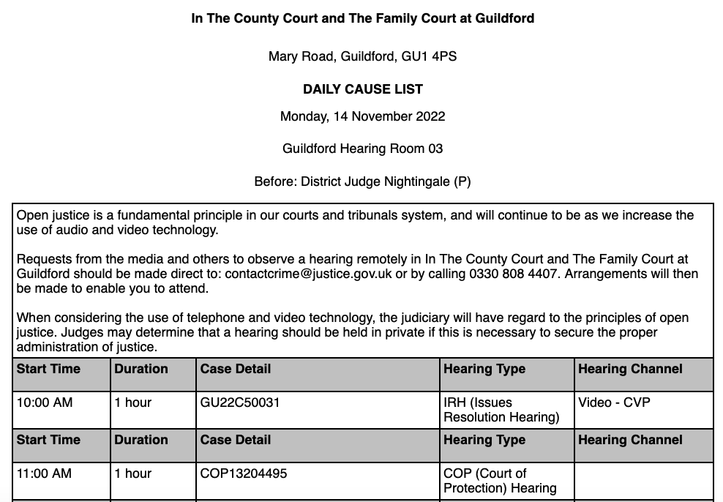
Hidden hearing in Guildford
Guildford isn’t here
Walsall isn’t here
All COP hearings should be in the COP list on CourtServe. There’s no hearing listed in Guildford on the COP list. But look! There’s a COP hearing listed in the Daily Cause List for Guildford. It’s a hidden hearing. This does not support open justice.

Slide 26
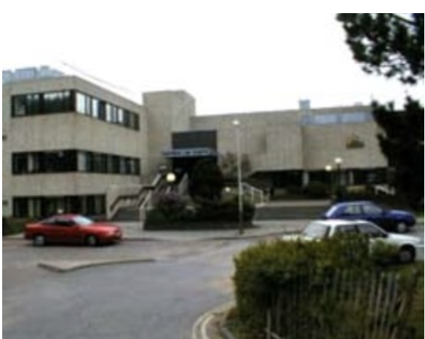
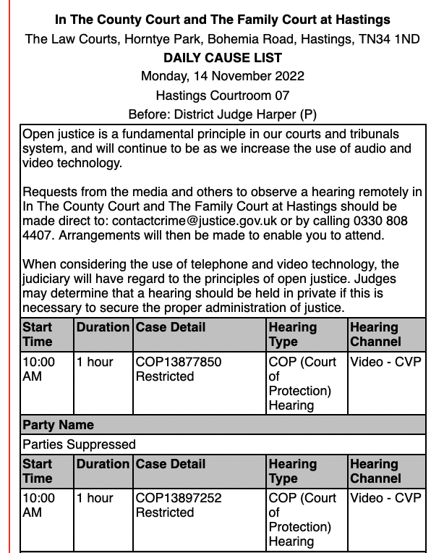
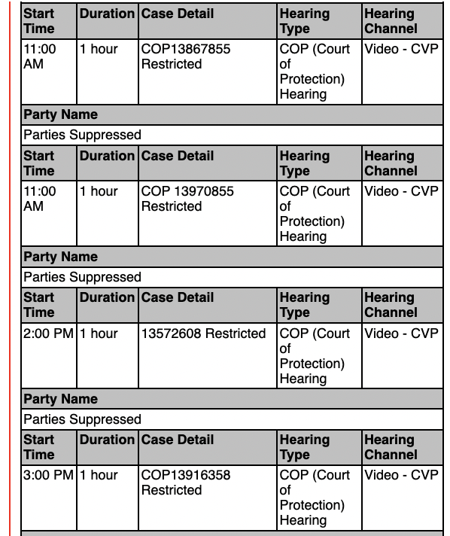
Six hidden hearings in Hastings
Hastings isn’t here
Walsall isn’t here
All COP hearings should be in the COP list on CourtServe. There’s no hearing listed in Hastings on the COP list. But look! There are six COP hearings listed in the Daily Cause List for Hastings. These are hidden hearings. This does not support open justice.

Slide 27
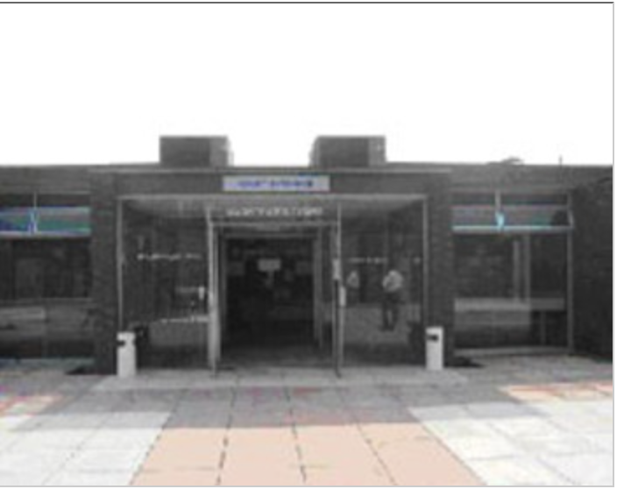
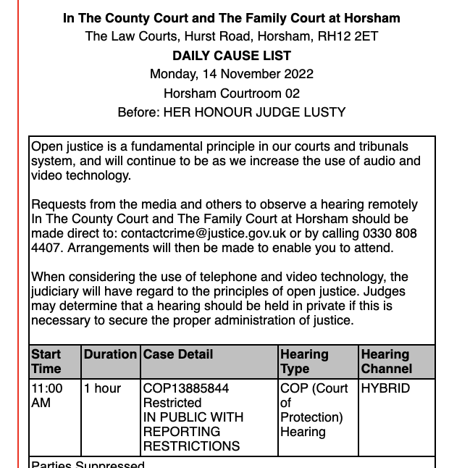
Hidden hearing in Horsham
Horsham isn’t here
Walsall isn’t here
All COP hearings should be in the COP list on CourtServe. There’s no hearing listed in Horsham on the COP list. But look! There’s a COP hearing listed in the Daily Cause List for Horsham. It’s a hidden hearing. This does not support open justice.

Slide 28
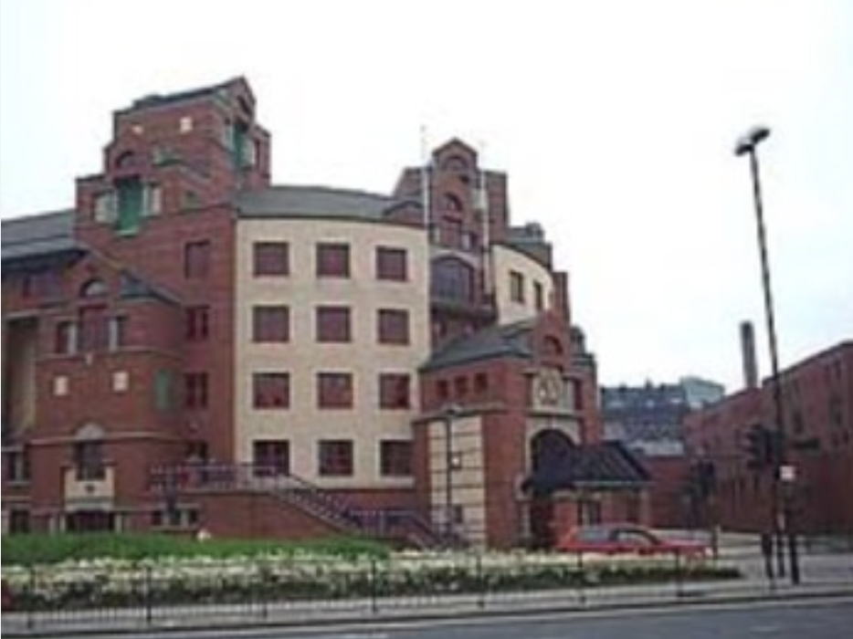
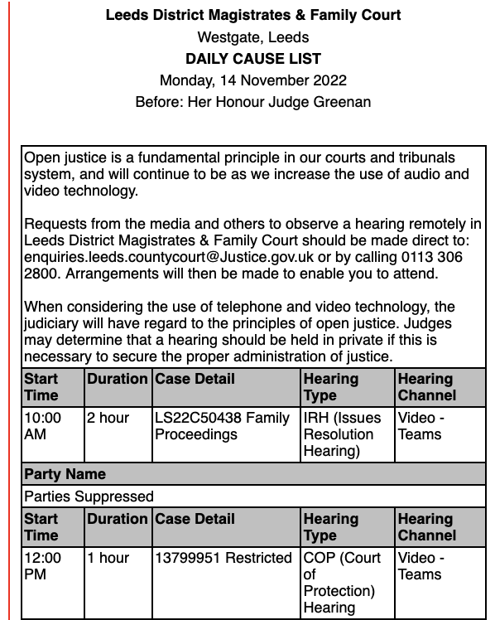
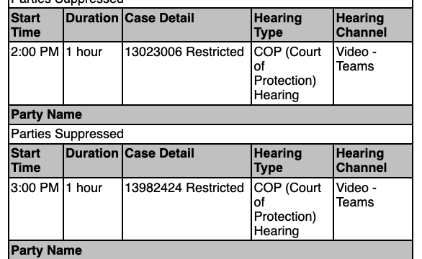
Three hidden hearings in Leeds
Leeds is here, but….
There are 3 hearings listed in Leeds in the COP list: case numbers are: 1378090T, 13996564 & 13790750 before DJ Bell and DJ Troy.
But the 3 hearings shown here (case nos. 13799951, 13023006 & 13982424) before HHJ Greenan are NOT listed. They appear in the Daily Cause list for Leeds.
These are hidden hearings. This does not support the judicial commitment to open justice.

Slide 29
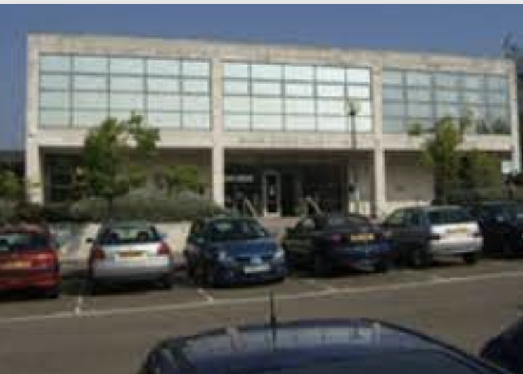
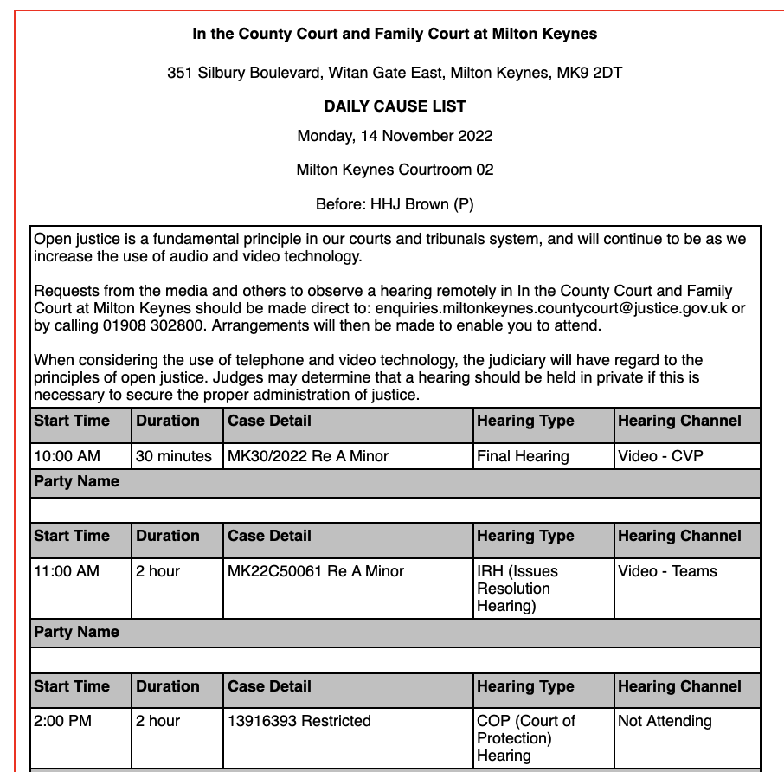
Hidden hearing in Milton Keynes
Milton Keynes isn’t here
Walsall isn’t here
All COP hearings should be in the COP list on CourtServe. There’s no hearing listed in Milton Keynes on the COP list. But look! There’s a COP hearing listed in the Daily Cause List for Milton Keynes. It’s a hidden hearing. This does not support open justice.

Slide 30
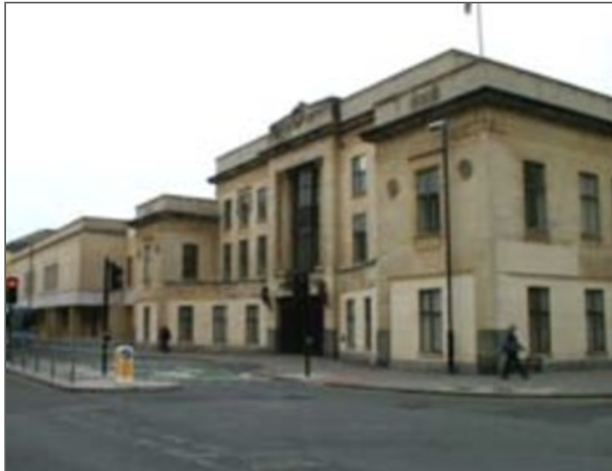
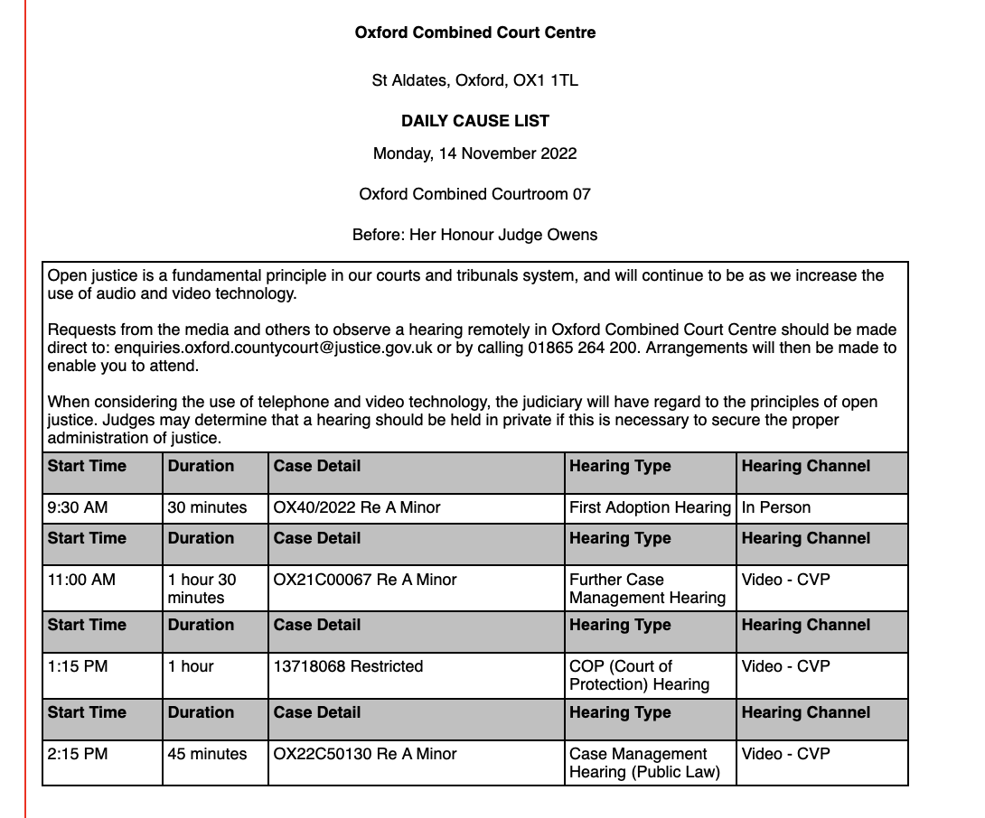
Hidden hearing in Oxford
Oxford isn’t here
Walsall isn’t here
All COP hearings should be in the COP list on CourtServe. There’s no hearing listed in Oxford on the COP list. But look! There’s a COP hearing listed in the Daily Cause List for Oxford.
It’s a hidden hearing. This does not support open justice.

Slide 31
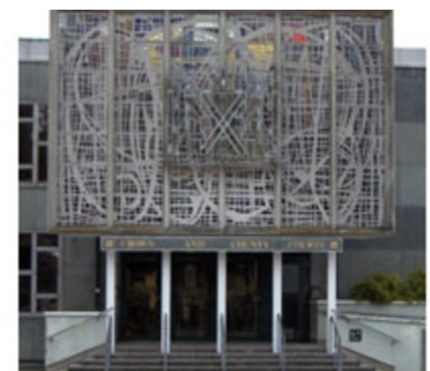
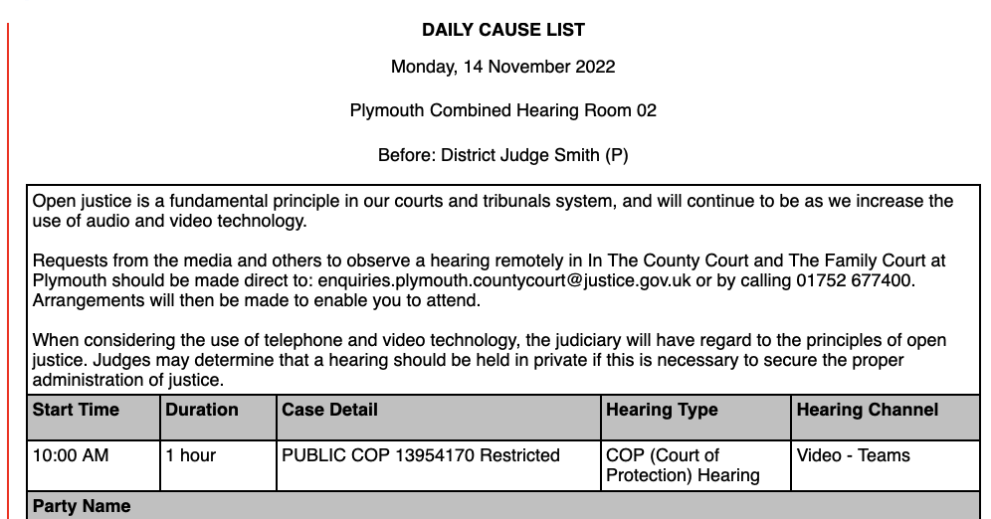
Hidden hearing in Plymouth
Plymouth isn’t here
Walsall isn’t here
All COP hearings should be in the COP list on CourtServe. There’s no hearing listed in Plymouth on the COP list. But look! There’s a COP hearing listed in the Daily Cause List for Plymouth. It’s a hidden hearing. This does not support open justice.

Slide 32
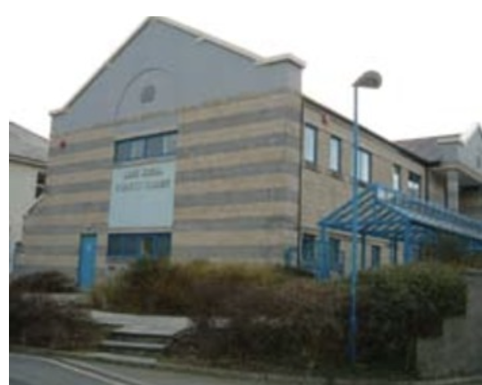
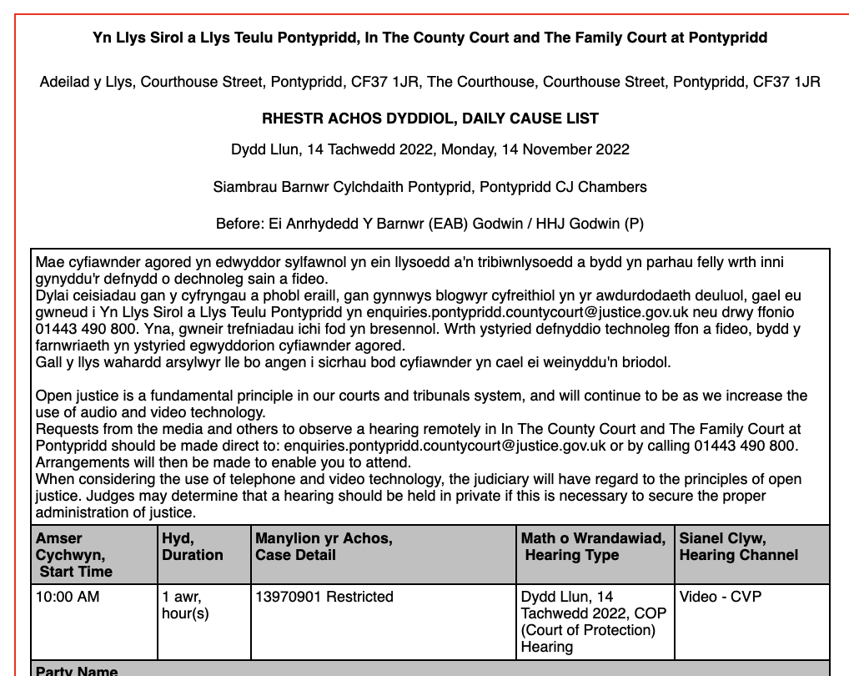
Hidden hearing in Pontypridd
Pontypridd isn’t here
Walsall isn’t here
All COP hearings should be in the COP list on CourtServe. There’s no hearing listed in Pontypridd on the COP list. But look! There’s a COP hearing listed in the Daily Cause List for Pontypridd. It’s a hidden hearing. This does not support open justice.

Slide 33
So how well does the COP meet the 1st KPI: “List the hearing in the COP list”?
Well over a third (39%) of COP hearings are not in the COP list.
This is very disappointing, not least because there had been a significant improvement on this KPI at the last appraisal in September (at that point, only 11% were not on the COP list).
With the exception of September 2022, the percentage of hearings that don’t appear in the COP list has fluctuated between about a quarter and about a half ever since I’ve been systematically monitoring it (i.e. over the last 2 years).
Rating: Poor

Slide 34
RCJ Hearings outside London – often secret – not listed anywhere
Sometimes there are hearings that aren’t listed in CourtServe at all – or anywhere else – “secret” hearings.
The only way I find out about these is when people directly involved in cases contact me and ask me to observe their hearings. I look for them on CourtServe and on other public websites such as the Daily Cause List for First Avenue House and for the Royal Courts of Justice and quite often I can’t find them anywhere.
This happens frequently when Tier 3 judges hear cases in regional courts.
Like Mrs Justice Lieven’s case in Northampton on 5th October 2022

Slide 35
Enquiring about a secret hearing
Letter to Northampton Court staff (copied to Mrs Justice Lieven’s clerk, because – unlike most members of the public – I have her email address)
I've been told there's a Court of Protection hearing before Mrs Justice Lieven at 10.30am in Northampton today, but I can't find it on lists. It's not on the RCJ listings (which is understandable since it's not being held in the RCJ) but it's also not in Courtel/CourtServe in the Court of Protection list either (Northampton doesn't appear in that list at all). I also double-checked the Daily Cause List for Northampton, but it's not there either - only the hearings before her at 12.00 and 2.00pm which don't look like COP hearings. Are you able to advise me as to whether this hearing is going ahead, and if so how I can observe it please.
I received the link from Mrs Justice Lieven’s clerk 8 minutes later. I checked the listings again once I had all the information about joining this case and still couldn’t find it on the listings. It was a secret hearing.
Secret hearings are a recurrent problem.

Slide 36
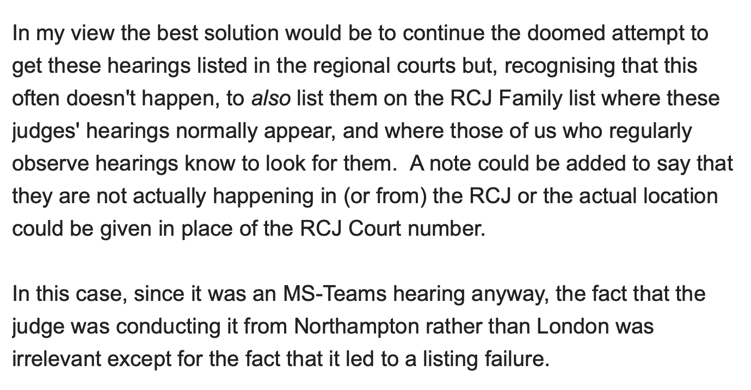
Extract from my email to HMCTS about this ’secret’ hearing - & how the problem could be solved
(5th October 2022)

Slide 37
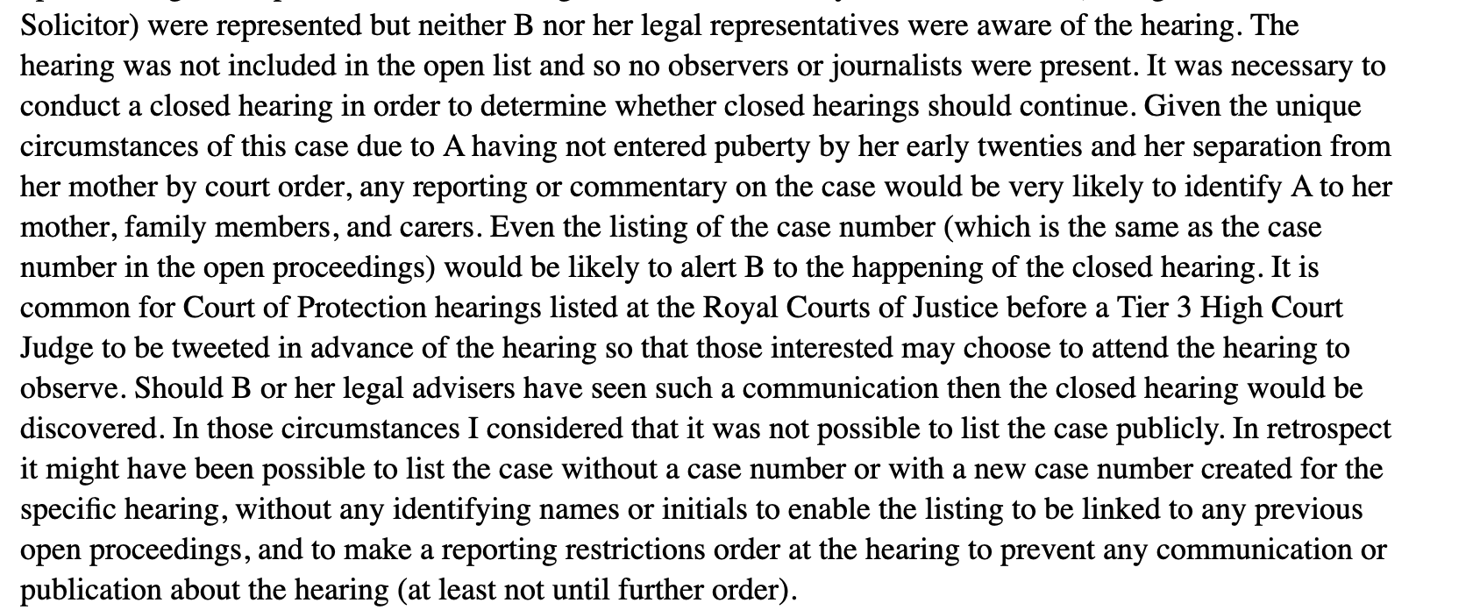
A deliberately secret hearing: closed proceedings before Poole J
Re A (Covert Medication: Closed Proceedings [2022] EWCOP 44

Slide 38
2. Make it clear the public can attend

Slide 39
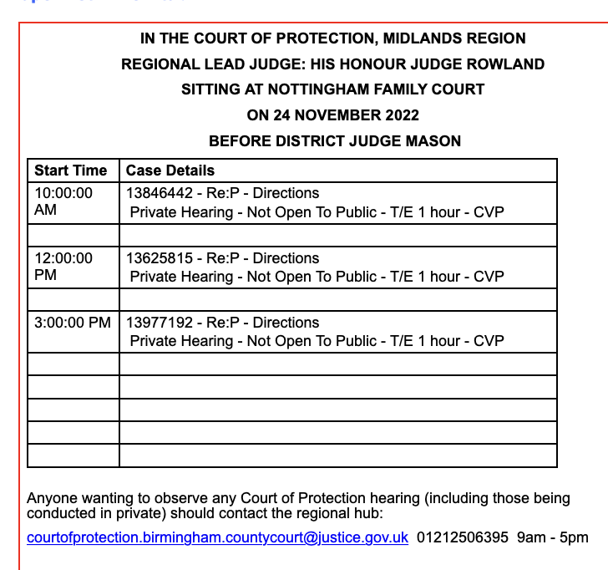
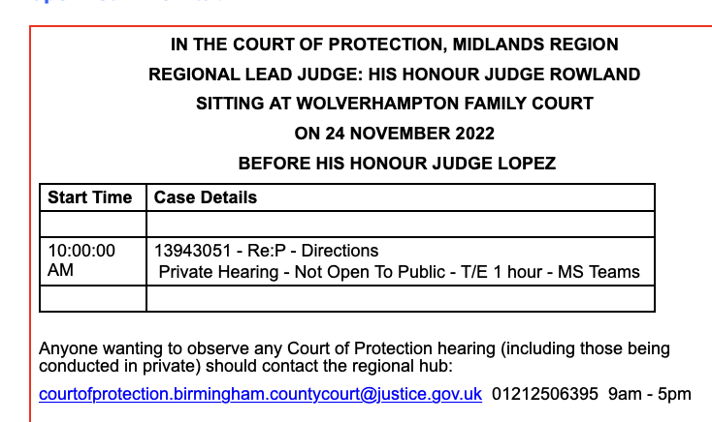
Today!
Also doesn’t say what they’re about

Slide 40
KPI 2 - Make it clear the public can observe
Of the 46 hearings listed for 14 November 2022, only 24 (52%) convey, unambiguously, that they are “PUBLIC” and open for observers to attend
Most in the COP list do (24/28)
Of the additional 18 hearings NOT included in the COP list (the “hidden” hearings) all but one say “RESTRICTED”

Slide 41
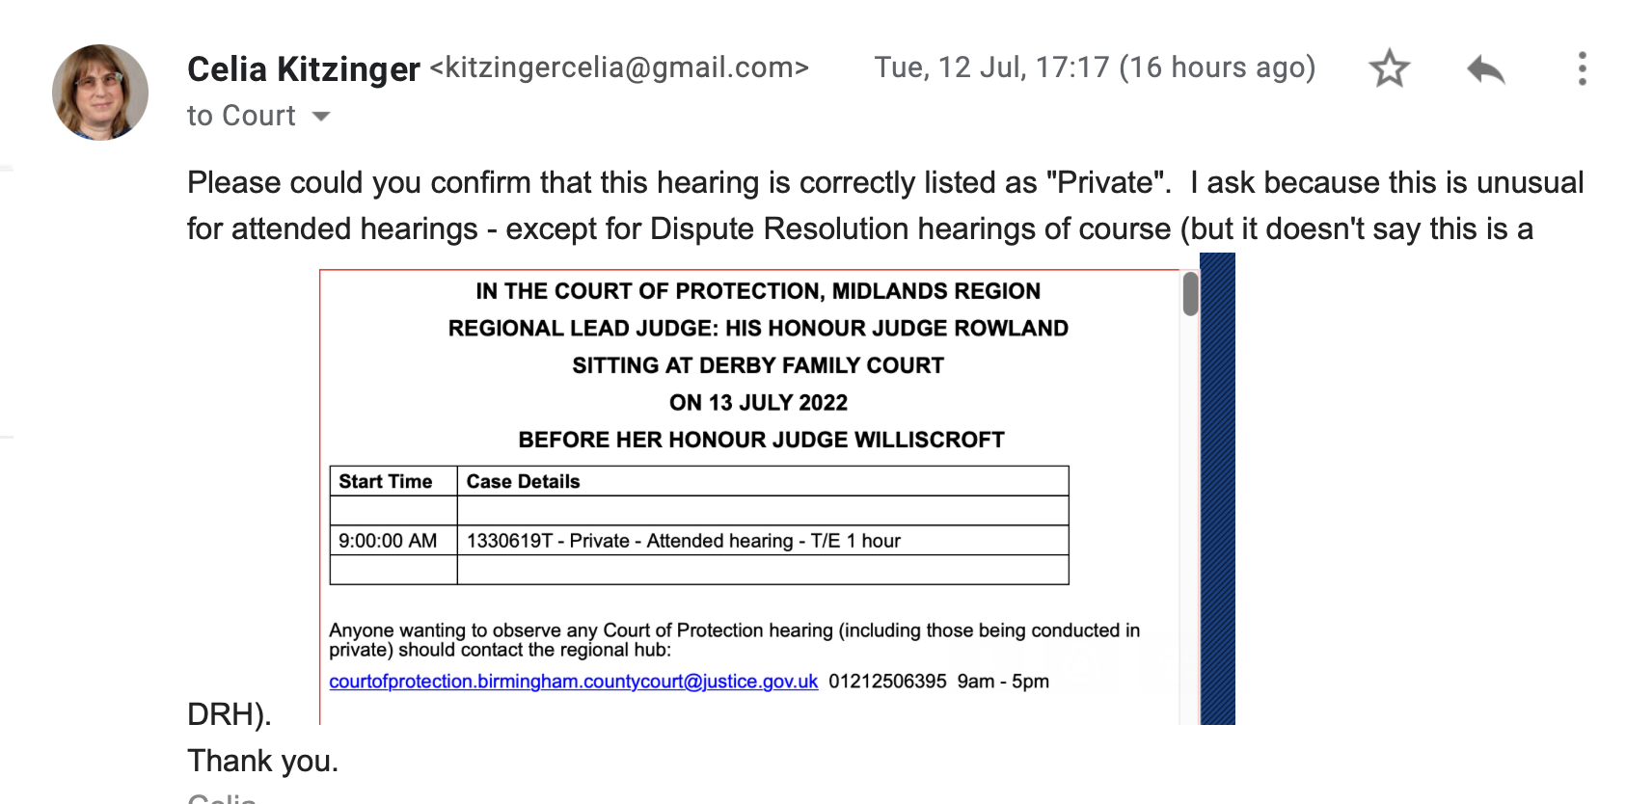
Recent trend to label “attended” hearings as “Private”

Slide 42
3. Tell us how to attend – remote or in person (phone or video)

Slide 43
3rd KPI: “Tell us if hearing is remote or in person”?
The COP performs well on this Key Performance Indicator for open justice.
Last time, 73% of CourtServe hearings provided clear and adequate information about “hearing channel”.
14 November 2022: 96% provide clear and adequate information about “hearing channel” - and the only two that didn’t were both ”hidden” hearings not in the COP list.
It looks as though ensuring that all COP hearings are in the COP list could bring this up to 100%
Rating: Very Good (a definite improvement)

Slide 44
4. Supply the correct contact information

Slide 45
KPI 4 – Supply correct contact information
41% give the wrong contact information
27/28 hearings in the COP list provide the correct email address and telephone number to contact for potential observers. But all 18 “hidden” hearings, listed outside the COP list, provided the WRONG email address (the address of the county court, instead of the address of the COP Regional Hub).
Emailing the wrong address usually means we don’t get to observe hearings. Court staff don’t know what to do with the request – and if they forward it to the correct address, it is often read too late.
Rating: Very Poor (It looks as though ensuring COP hearings are in the COP list would fix this.)

Slide 46
5. Tell us what the hearing is about

Slide 47
Plans to provide case descriptor for more than 6 years
Policy officials will also work with Her Majesty’s Courts and Tribunals Service to amend the way in which court lists are displayed, so that they provide a short descriptor of what the case is about, allowing the media to make an informed decision on whether to attend the hearing.” (from the Judiciary site, 29 January 2016)
It is recognised that it is important that cases are appropriately described when they are listed to provide information to the public at large of what they are about and when and where they will be heard. Comment on how this should be and is being done is welcomed. As is more general comment on how the public and the media can make themselves aware, or should be made aware, that certain types of case are due to be heard… (Mr Justice Charles, the Vice President of the COP, March 2017)

Slide 48
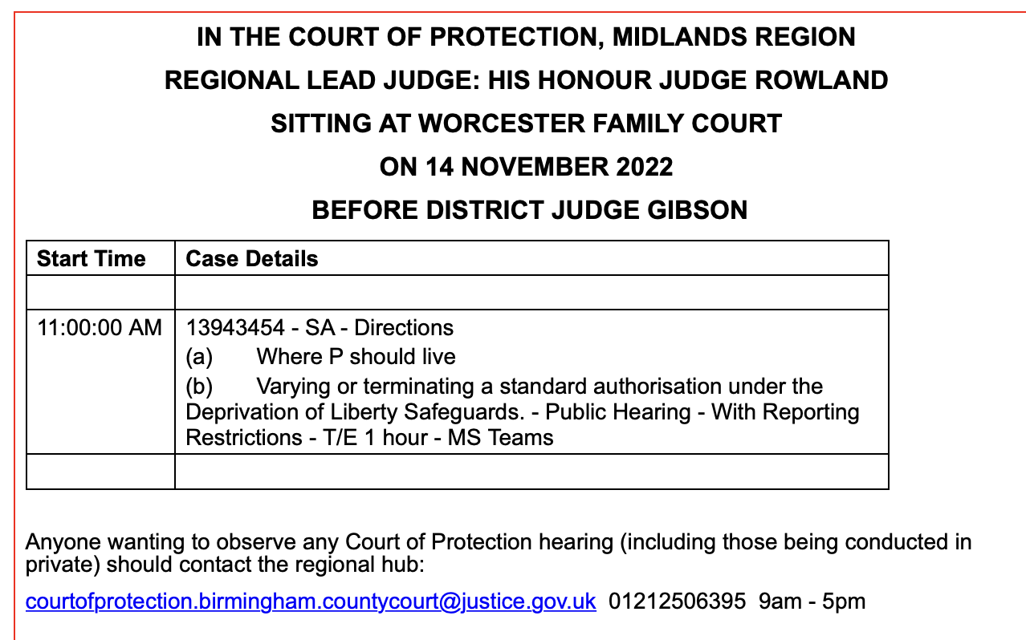
KPI 5 – Tell us what the hearing is about
Good listings tell us what the hearing is about e.g. “Decisions relating to deprivation of liberty”
This listing for Worcester tells us clearly what the hearing is about.
Overall, 23/46 (50%) hearings provide descriptors of what they’re about.

Slide 49
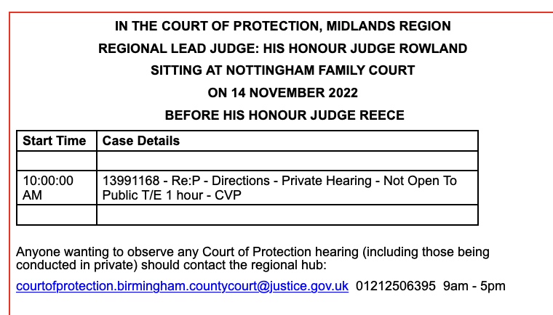
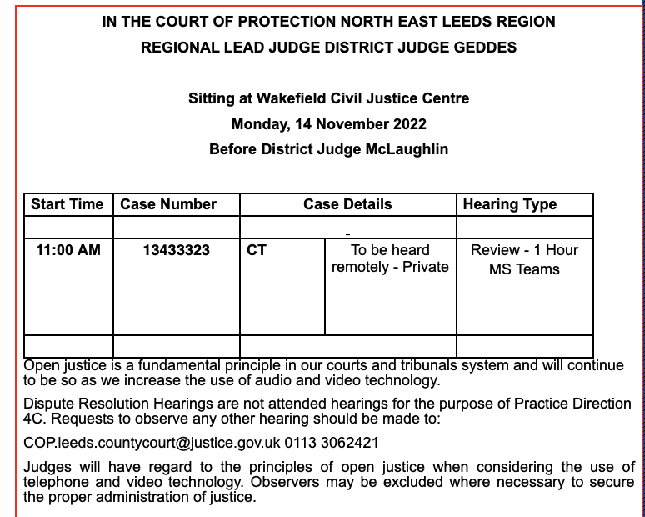
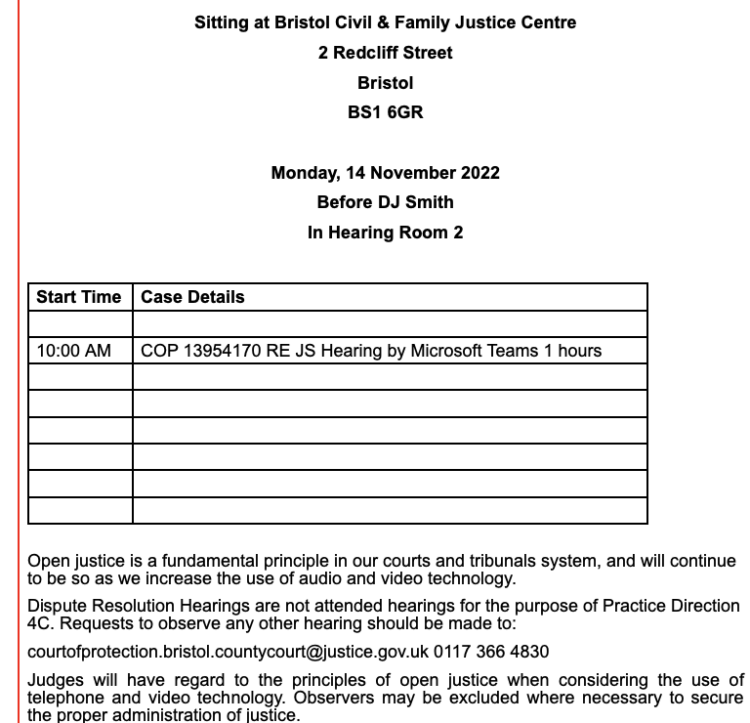
On 14th November 2022
23 of the 46 listings (50%) do NOT include information about the issues before the court.
These are hearings included in the COP list. It’s hard to see why anyone would ask to observe these hearings, as there’s no info as to what they’re about. It doesn’t help that 2 of them say “private” either.

Slide 50
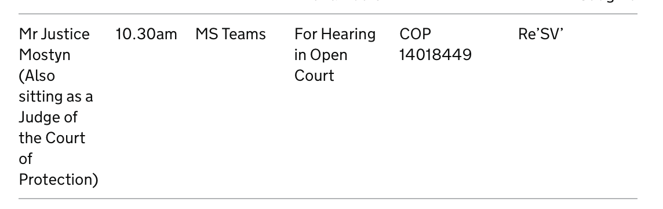
RCJ never tells us what hearing is about
RCJ

Slide 51
Why it matters to include info on what hearings are about
Members of the public are much more likely to ask to observe a hearing if they have some idea what it’s about.
People select hearings to watch for personal and professional reasons, e.g. someone facing a s.21A COP hearing about her mother asked us specifically for a s.21A hearing to observe; a best interests assessor asked for a hearing concerning contact arrangements; a special dentist asked for a hearing about dentistry….
It’s frustrating not to have the information necessary for people to choose hearings in their area of interest. There’s much less incentive for people to give up their time and energy to observe COP hearings.
Not knowing what hearings are about is a barrier to transparency and open justice in the Court of Protection.

Slide 52
So how well does the COP meet our 5th KPI: “Tell us what the hearing is about”?
The COP performs POORLY on this Key Performance Indicator for open justice.
Twenty-three of the 46 hearings (50%) provide no information as to what hearings are about (i.e. the issues before the court).
The likelihood of descriptors being included is much greater for hearings in the COP list (23/28 = 82%) compared with ‘hidden’ hearings in the Daily Cause lists (0%).
Also, COP hearings in the Royal Courts of Justice (not included in this analysis of county court hearings) NEVER tell us what they’re about.
Rating: Poor. As the judiciary recognizes, this is important for transparency – so this is a very disappointing outcome. This situation can be massively improved by ensuring that all COP hearings are in the COP list.

Slide 53
6. Tell us the type of hearing (directions, case management, final etc)

Slide 54
6th KPI: “Tell us the type of hearing”
Type of hearing was specified for only 39% of hearings overall.
But there was a significant difference between hearings in the COP list (where 64% of hearings specified type) and the ‘hidden’ hearings scattered though the Daily Cause lists (where 0% provided information about type of hearing).
Rating: Very Poor. The problem can be ameliorated in part by ensuring that all COP hearings are included in the COP list.

Slide 55
Key Performance Indicators for Open Justice
7. Admit us to public hearings when we ask for the link
8. Make it clear in terms the public can understand what can and cannot be reported
9. Provide a brief opening summary so that we can understand the hearing – including introducing the parties and who is representing whom
Be willing to provide Position Statements (anonymized if necessary) to help people understand the hearing and to maximise the chances of accurate reporting.
Most recent systematic evaluation on 14th November 2022
(+ sent to HMCTS)

Slide 56
7. Admit us to public hearings when we ask for the link

Slide 57
Arriving at a courtroom to find “PRIVATE” on the door (+ court staff declined to remove it)
No reply to emails
Replies after the hearing has started (or finished)
Making access conditional upon provision of home address, or ’screening’ observers – asking them who they are and why they want to observe a hearing.
Consulting with counsel in case they have objections + not admitting observer when no reply (it was listed as a ‘public’ hearing)

Slide 58
Solution?
If a hearing is listed as ‘public’, court staff could send us the link directly (letting the judge know they’ve done so) without waiting for the judge to “consider our request” – since really, in my view, there is nothing to consider.
If some consideration is, in fact, needed, it can happen at the beginning of the hearing and we can be asked to leave then, if necessary.

Slide 59
Final assessment (for 14th November 2022)
1. List the hearing in the Court of Protection list on @CourtServe. POOR
2. Make it clear the public can observe POOR
3. Tell us how we can observe VERY GOOD
4. Supply correct contact info FAIR
5. Tell us what hearing is about. POOR
6. Tell us the type of hearing. VERY POOR
7. Admit us to public hearings when we ask for the link - MANY CONTINUING PROBLEMS
Gap between judicial aspiration and reality

Slide 60
Other KPIs
8. Make it clear in terms the public can understand what can and cannot be reported (Submission to Rules Committee on TOs under way)
9. Provide a brief opening summary so that we can understand the hearing – including introducing the parties and who is representing whom
10. Be willing to provide Position Statements (anonymized if necessary) to help people understand the hearing and to maximise the chances of accurate reporting.

Slide 61
TRANSPARENCY – a fundamental value
“Transparency is central to the philosophy of the Court of Protection”
Mr Justice Hayden, Vice President of the Court of Protection, 4th May 2020
“Publicity is the very soul of justice. . . . It is the keenest spur to exertion, and the surest of all guards against improbity..”
Jeremy Bentham 1748–1832 English philosopher: Publicity in the Courts of Justice (1843)

Slide 62
Dialogue + consultation needed!
How to bridge the gap between aspiration and reality?
Active involvement of COP practitioners is essential
Requires a collaborative approach

Slide 63
Thank you!

