Slide 1


Open Justice in the Court of Protection
Celia Kitzinger
Co-Director of the Open Justice Court of Protection Project
openjustice@yahoo.com
@kitzingercelia
MHLA 24th Annual Conference 17th November 2023
Hallam Conference Centre London

Slide 2
What is the Court of Protection?
Modern court founded with the Mental Capacity Act 2005
20-30 public hearings every weekday
Protected party “P” – dementia, learning disabilities, or mental health problems (schizophrenia, ‘personality disorder’, phobia, etc)
Two key issues before the COP in every case
Does this person have capacity to make their own decision (about the matter in hand) – understand/retain/weigh info + communicate outcome?
If not, the judge makes a decision in their ‘best interests’
Serious/complex cases heard in Royal Courts of Justice. Others in First Avenue House and regional courts across England and Wales

Slide 3
Celia Kitzinger: ”member of the public”
Nearly 500 hearings in the Court of Protection since 1 May 2020 – initially because I was very concerned about conduct + outcome of some hearings.
Mostly “remote” or “hybrid” - i.e. via video-platform or telephone
Founded the Open Justice Court of Protection Project (with Gill Loomes-Quinn), 15 June 2020 to keep an eye on justice
We’ve supported 1000s of people to observe court hearings – and published more than 400 blog posts.

Slide 4
“Publicity is the very soul of justice. It is the keenest spur to exertion and the surest of all guards against improbity. It keeps the judge himself while trying under trial.”
(Jeremy Bentham: DRART FOR THE ORGANIZATION OF JUDICIAL ESTABLISHMENTS, COMPARED WITH THAT OF THE NATIONAL ASSEMBLY, WITH A COMMENTARY ON THE SAME (1790) )

Slide 5
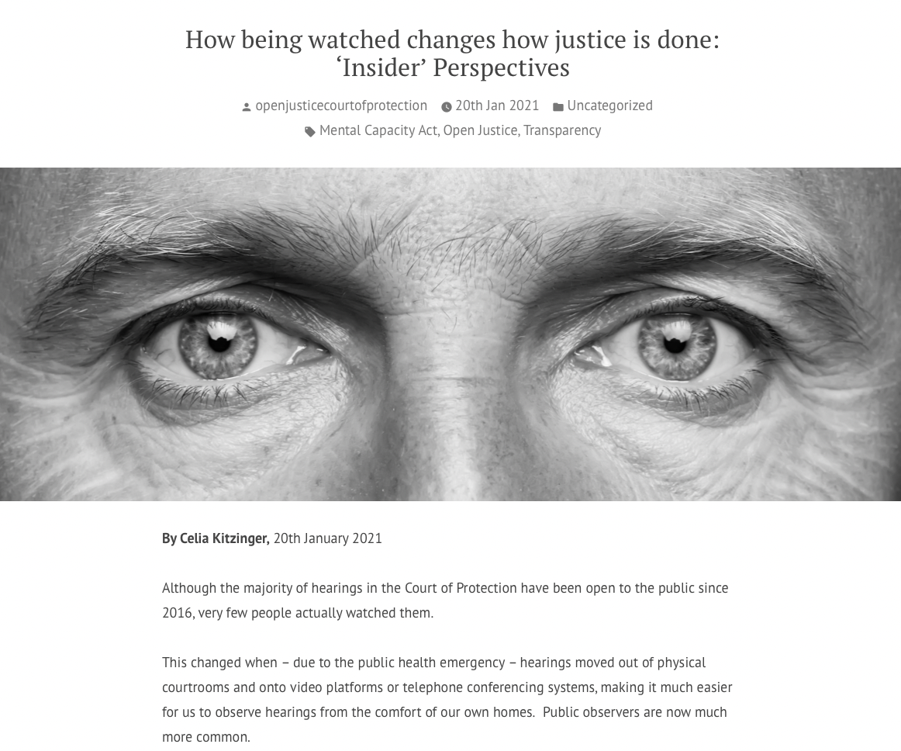

Slide 6

Openjusticecourtofprotection.org

Slide 7
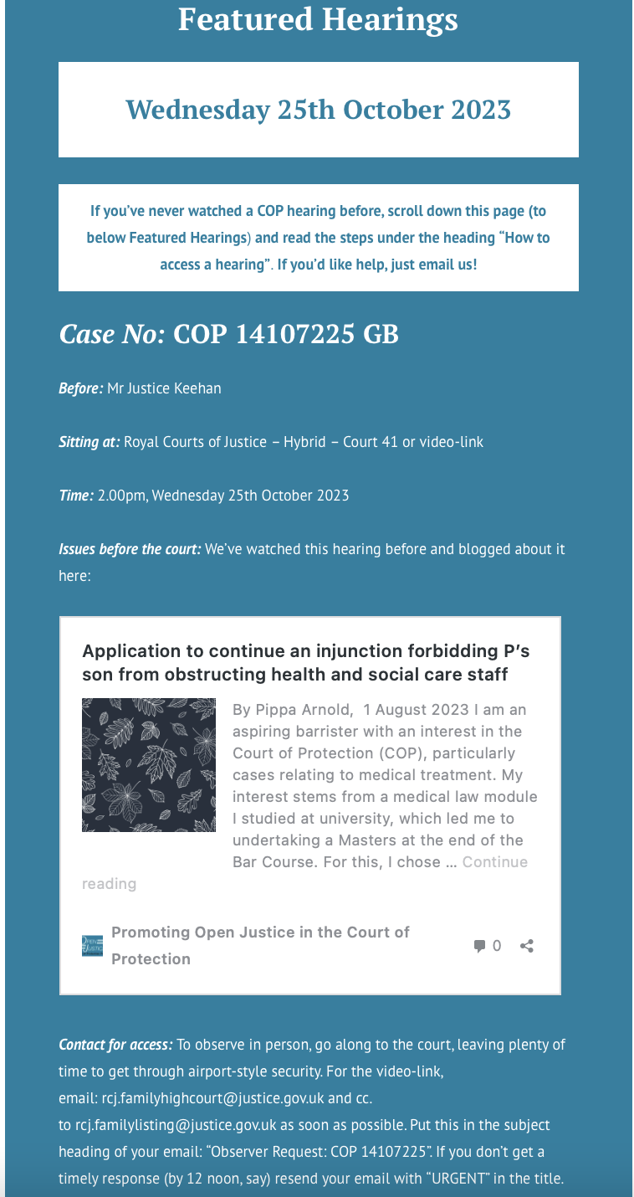

Slide 8
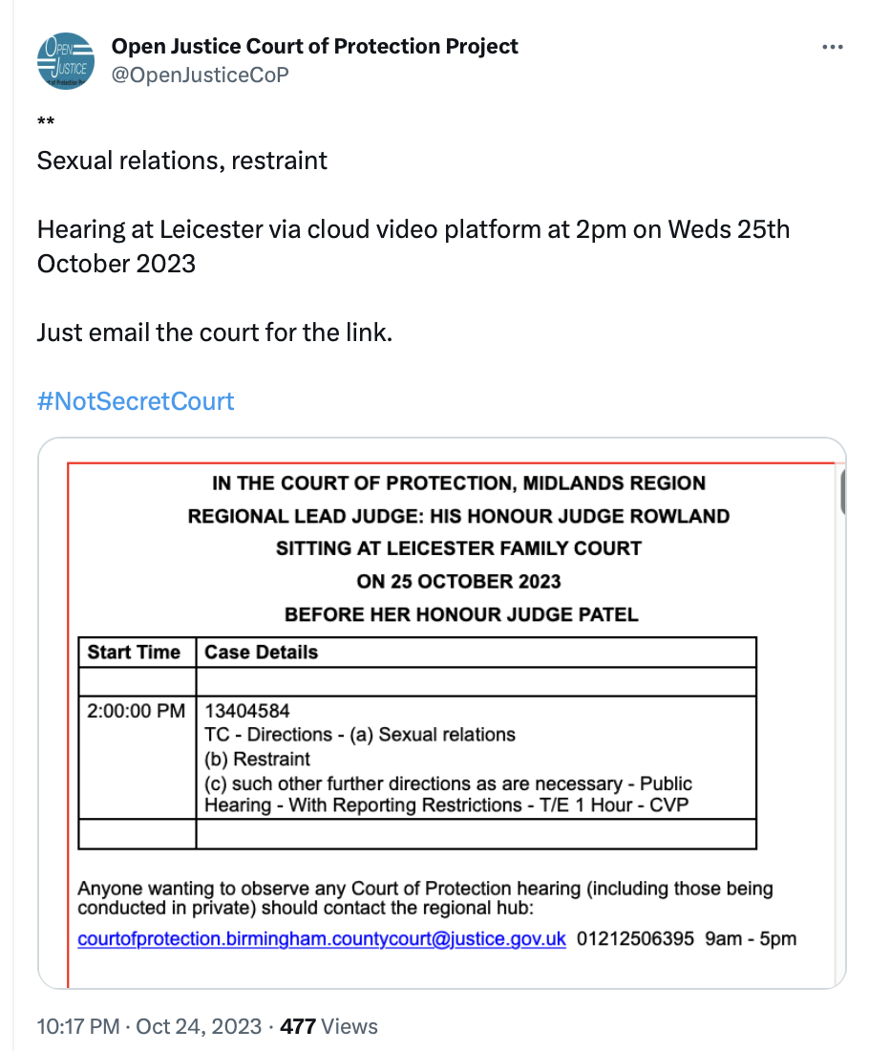
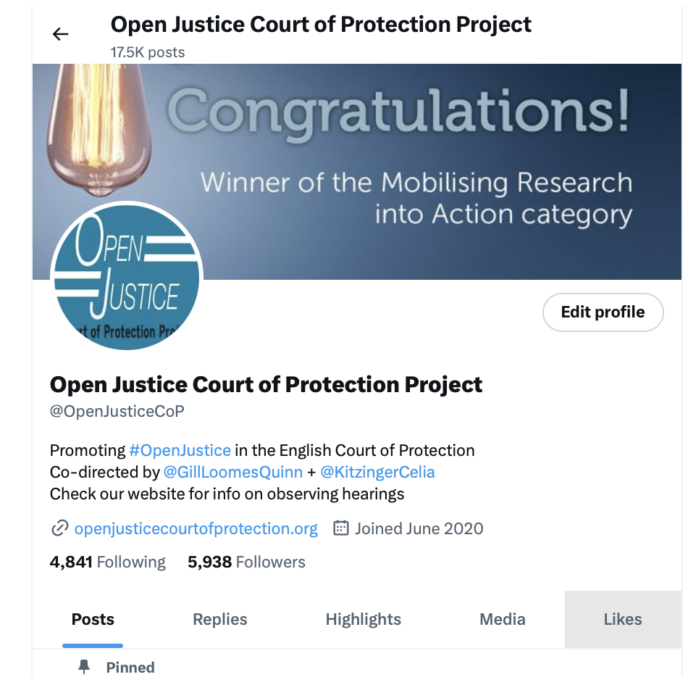
Twitter

Slide 9
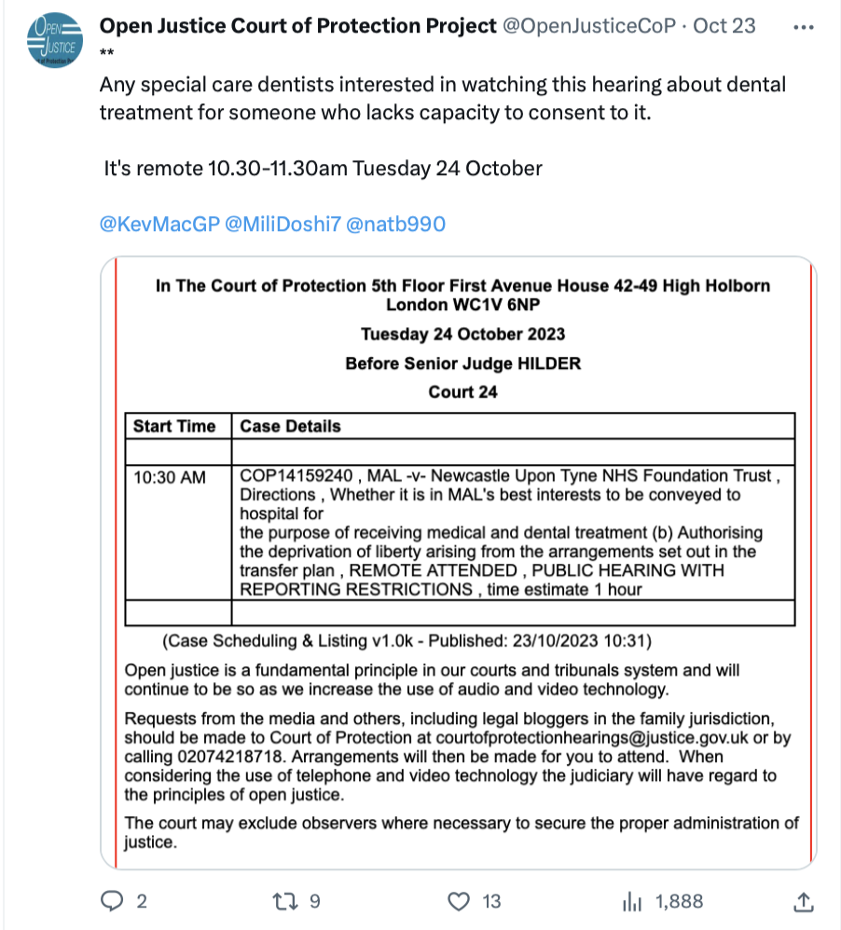
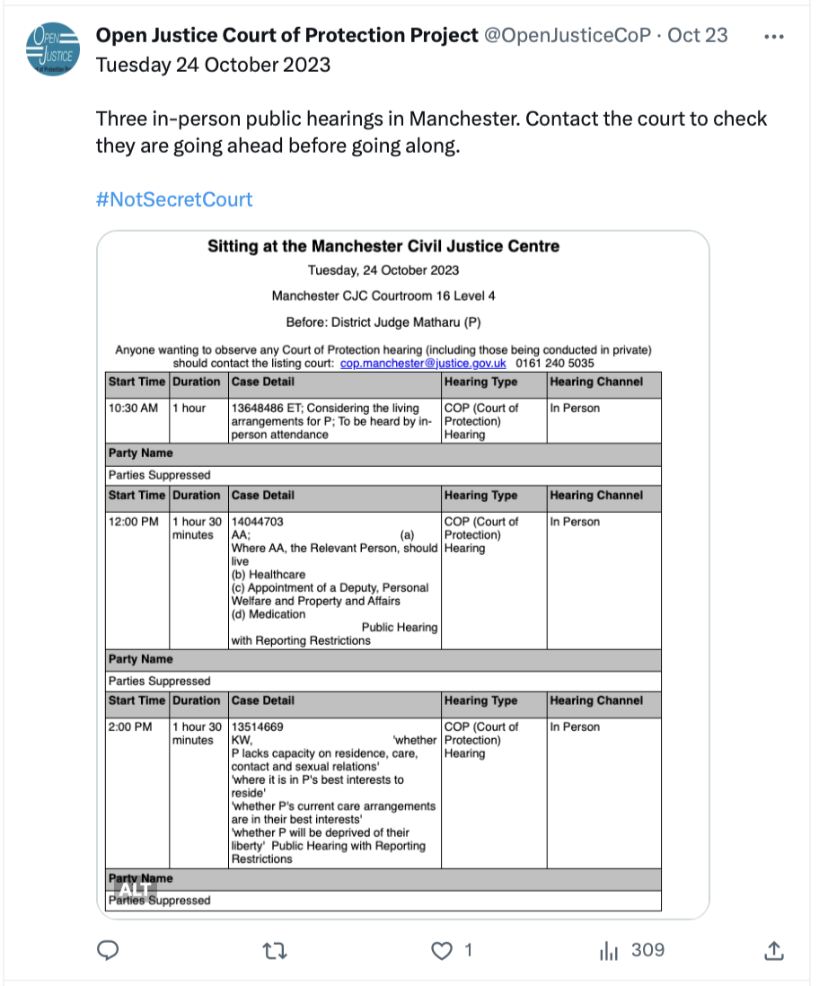
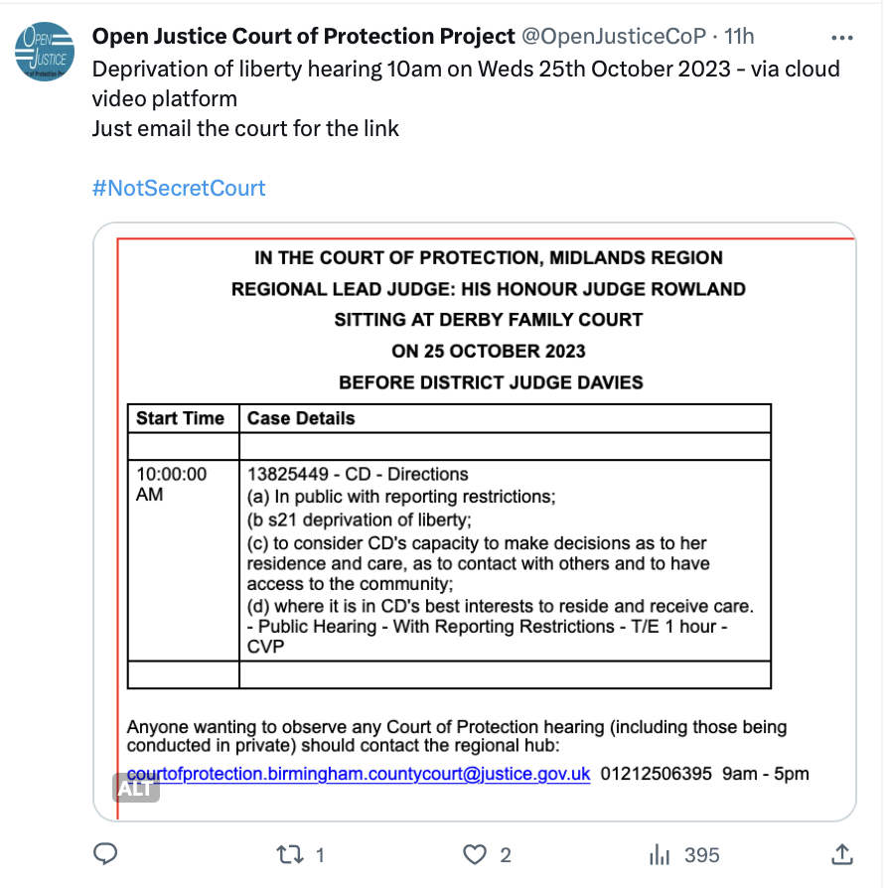
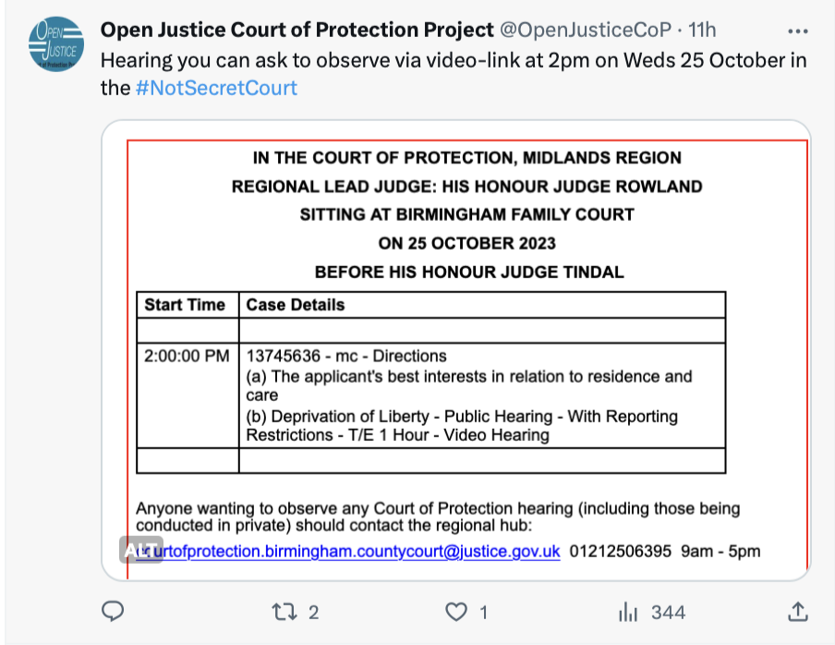

Slide 10
  “Transparency is central to the philosophy of the Court of Protection […] The Vice President and the Hive group are particularly keen to ensure that the considerable efforts made to achieve a properly transparent Court of Protection are not undermined by the exigencies of the social distancing imperatives. (Mr Justice Hayden, 4th May 2020)
The Open Justice Court of Protection Project was created to support the judiciary’s commitment to transparency and open justice.
Totally independent of the Court of Protection – concerned citizens
Health and social care professionals (largest single category)
(Aspiring) Lawyers
Families of ‘vulnerable’ people – some involved in COP hearings themselves

Slide 11
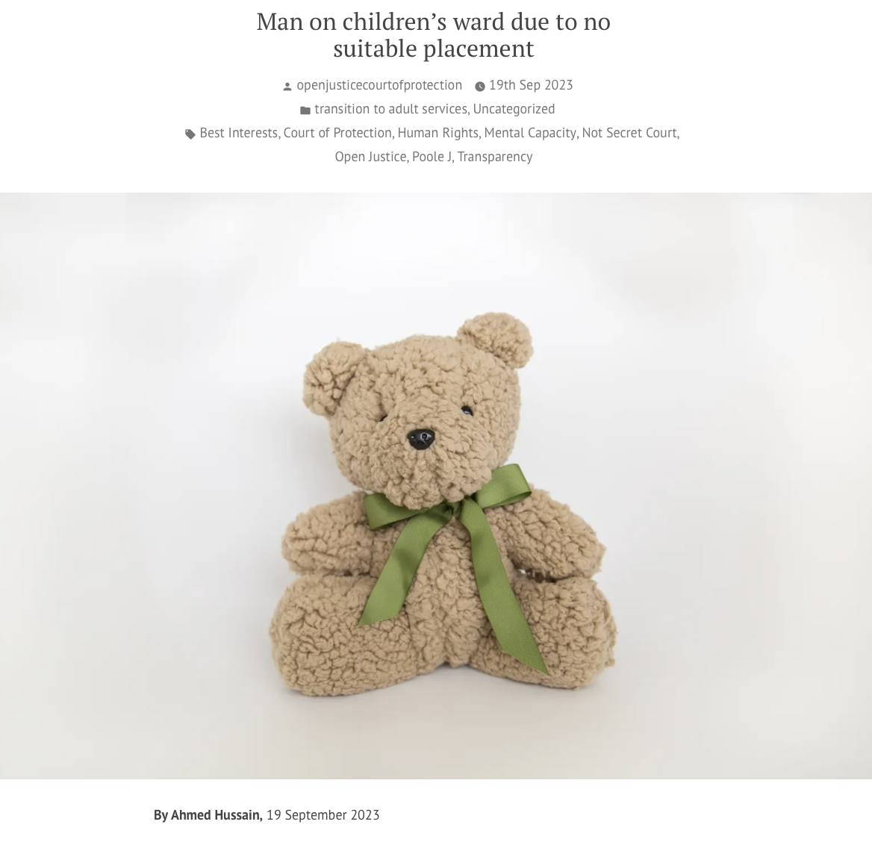
As a law student at King’s College London, much of my time is spent reading about the law in books and articles. Observing a Court of Protection hearing has ‘brought the law to life’ because I am effectively following people’s legal issues ‘in real time’ as they are decided before the court. I was also keen to watch practising barristers deliver their oral submissions in court as I could employ some of the techniques they use in my own advocacy, both in moots and in my future professional practice.
I would also encourage others to attend a hearing because the work done in the Court of Protection, which is based on the Mental Capacity Act 2005, overlaps with a range of legal practice areas such as human rights, family law and medical law so there is bound to be something of interest for everyone.
Ahmed Hussain is a final year Law student at King’s College London.
His LinkedIn profile is here: linkedin.com/in/ahmed-hussain-987b791b3
He tweets @ahmedhussainlaw

Slide 12
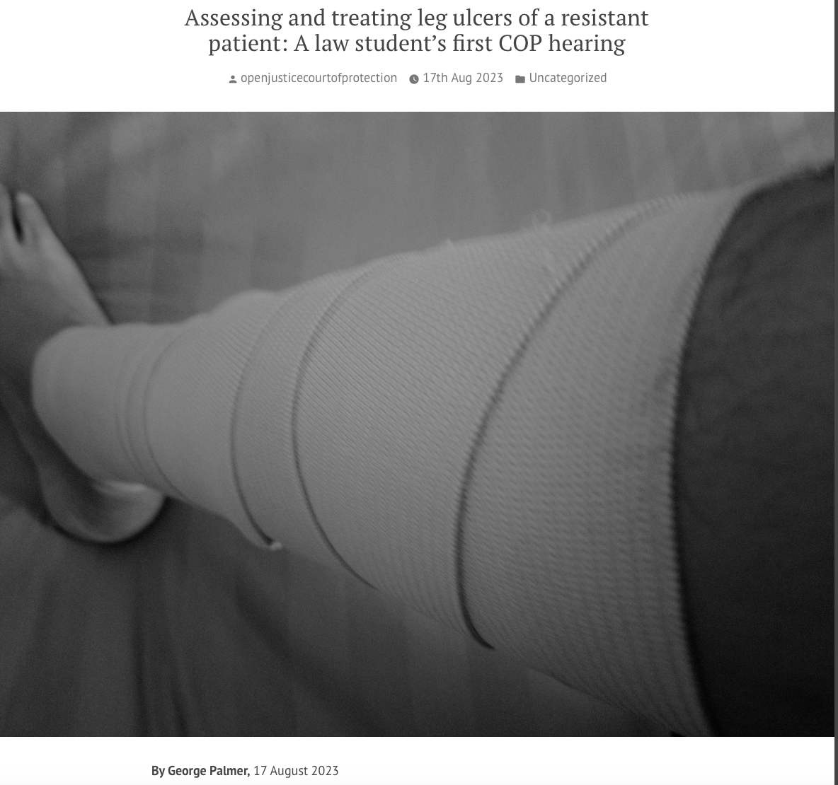
Watching the hearing, live, in real time, and being able to listen to the barristers talk about the issues concerned gave the final outcome in the judgment lots more meaning and understanding than I am accustomed to when studying law and reading judgments for research purposes.
Watching the advocacy skills of these established barristers and observing how a judge interacts with barristers, especially compared to my experience only with mooting which can be quite scary and harsh compared to this reality, was very insightful, and has given me more confidence that I will be able to go on and advocate in front of a judge with the same amount of skill and confidence as those within this case.
This experience has been incredibly useful in giving me insight into the court… To see how deeply decisions about mental capacity can impact a patient’s
life and the decisions that are made on their behalf was just eye-opening.
George Palmer is a third-year University of York Law student and aspiring
Clinical Negligence barrister. He hopes to commence Pupillage in 2025 and
one day become a leading barrister in his chosen field.

Slide 13
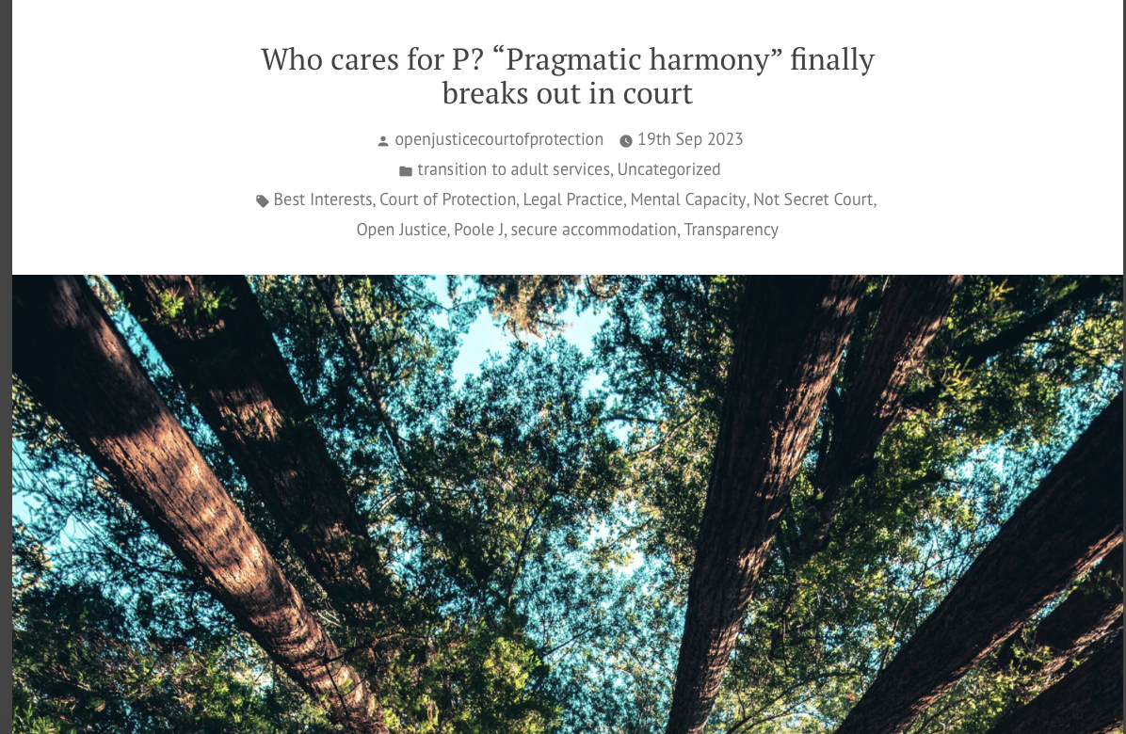
I would strongly advise other aspiring barristers … to observe
It is definitely worth noting that despite my anxieties throughout the hearing, observing was highly interesting, productive, and informative.
My anxieties can probably be put down to my relative inexperience observing CoP hearings and being thrown into the middle of a case with only a basic understanding of CoP law. So please don’t be put off if you want to observe!
I have gained a deeper respect for the court staff and CoP lawyers/judges, especially their patience and pragmatism.
Hartej Singh Saund-Matharu (he/him) is a Bar Course student at the Inns of Court
College of Advocacy, first-class Law (LLB Hons.) graduate. He hopes to commence
pupillage in 2024.

Slide 14
Benefits
Watching justice in action – supporting fundamental principle of ‘open justice’
Understanding Mental Capacity Act 2005 in practice
Watching advocates make submissions, question expert witnesses incl. cross-questioning, engage with litigants in person
Observing how P and P’s family engage with court
Understanding how a judgment emerges from facts + law (including ‘dead ends’ and rejected arguments). Very different from seeing final judgment
Frustrations – inadequate advance info about issues in listings, many are adjourned + vacated, failure to respond to emails, forgetting to do introductory summary, failure to send position statements!

Slide 15
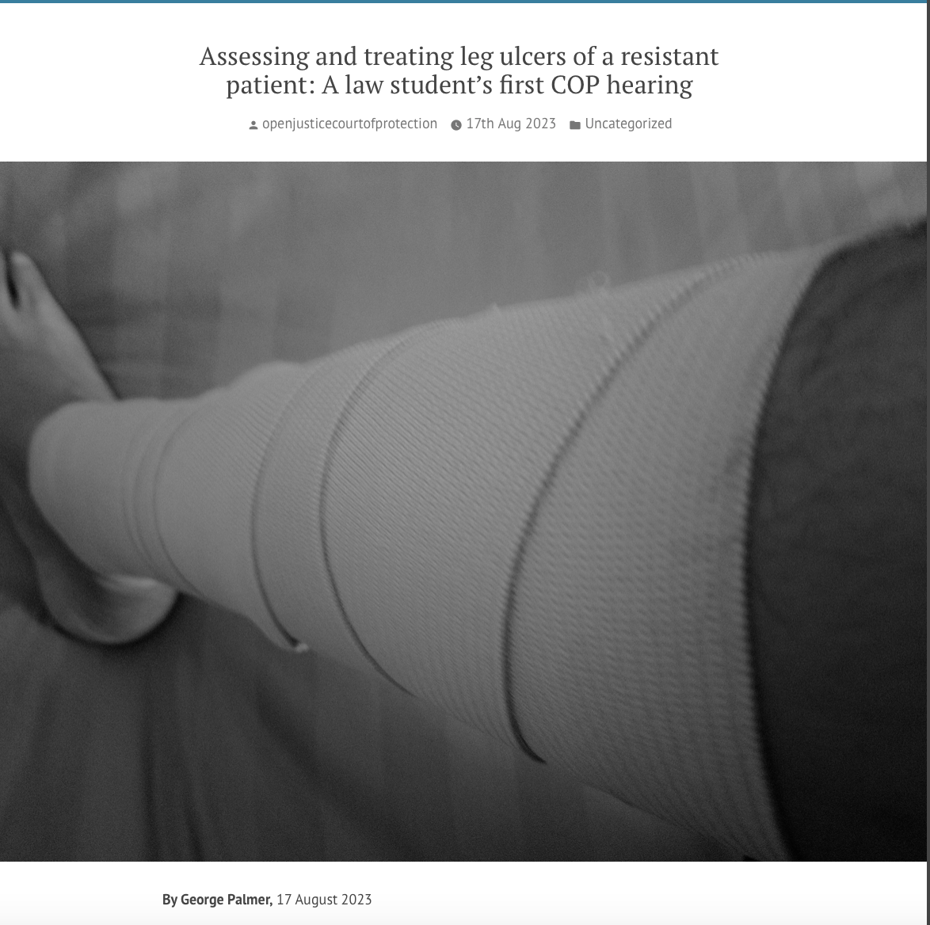
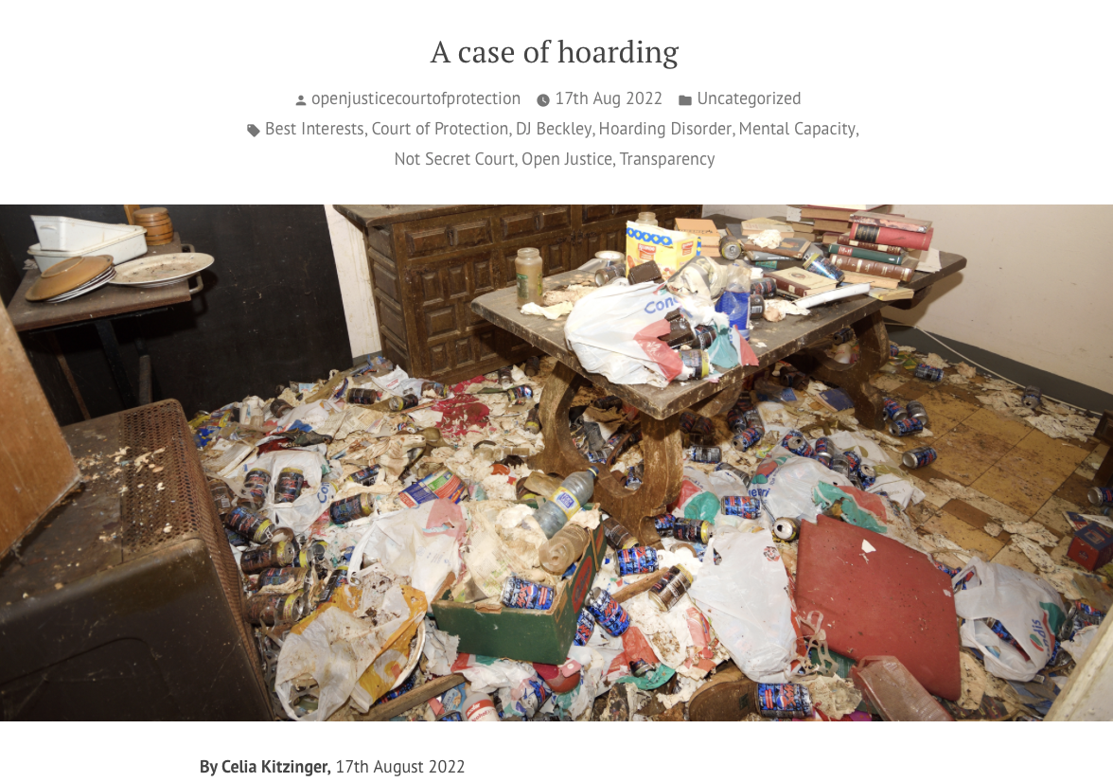

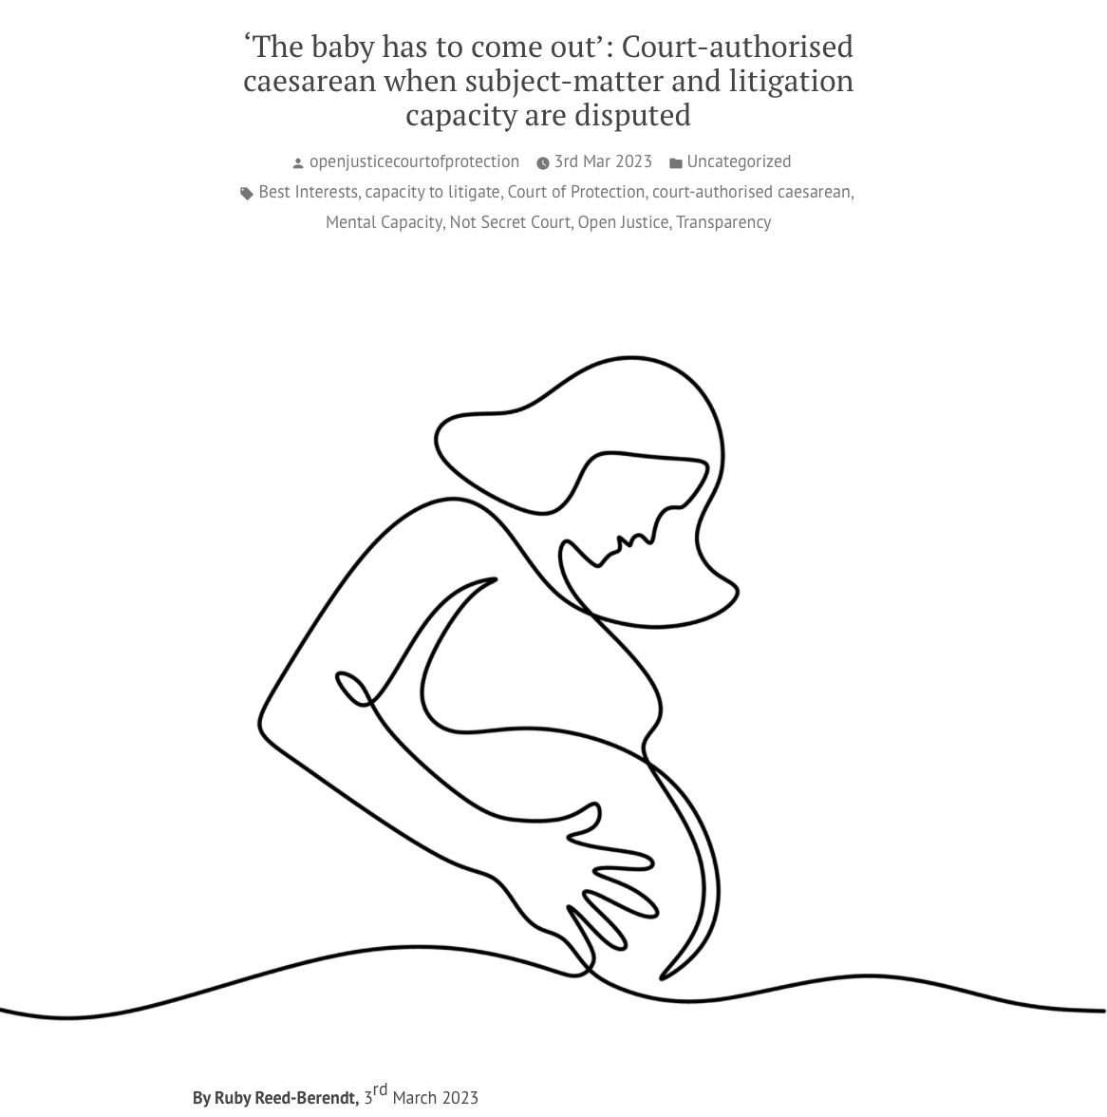

Blogs concerning people with mental health issues

Slide 16


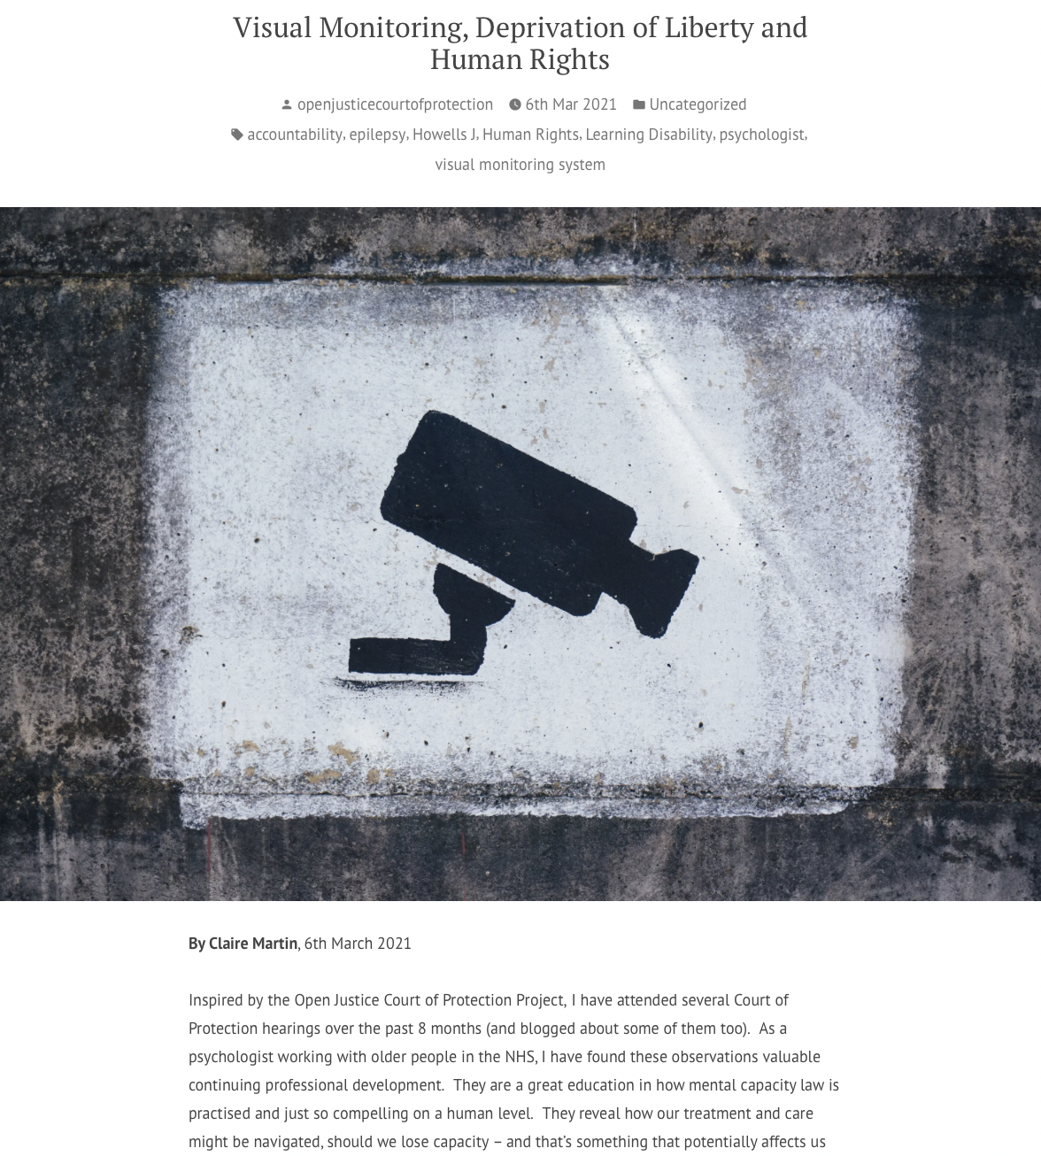
Click here for Authorising restraint blog
Click here for covert medication blog
Sample blog posts
Click here for Visual monitoring blog

Slide 17
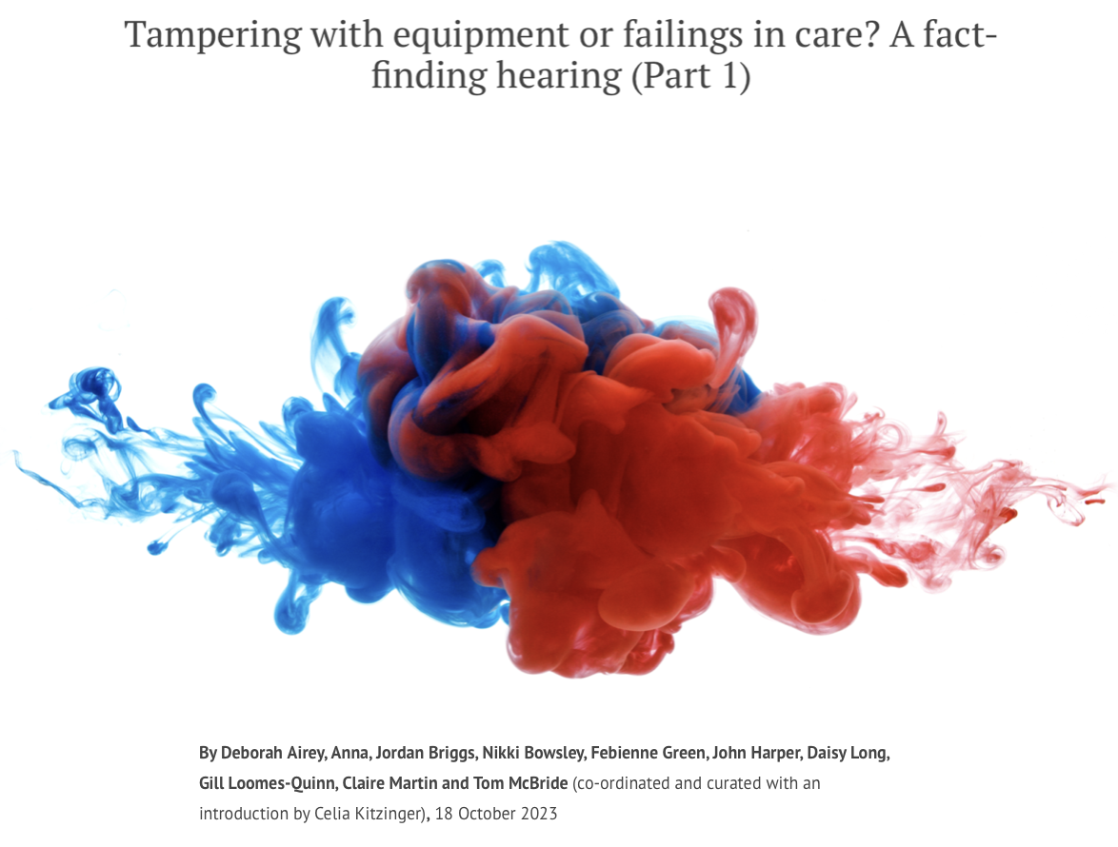
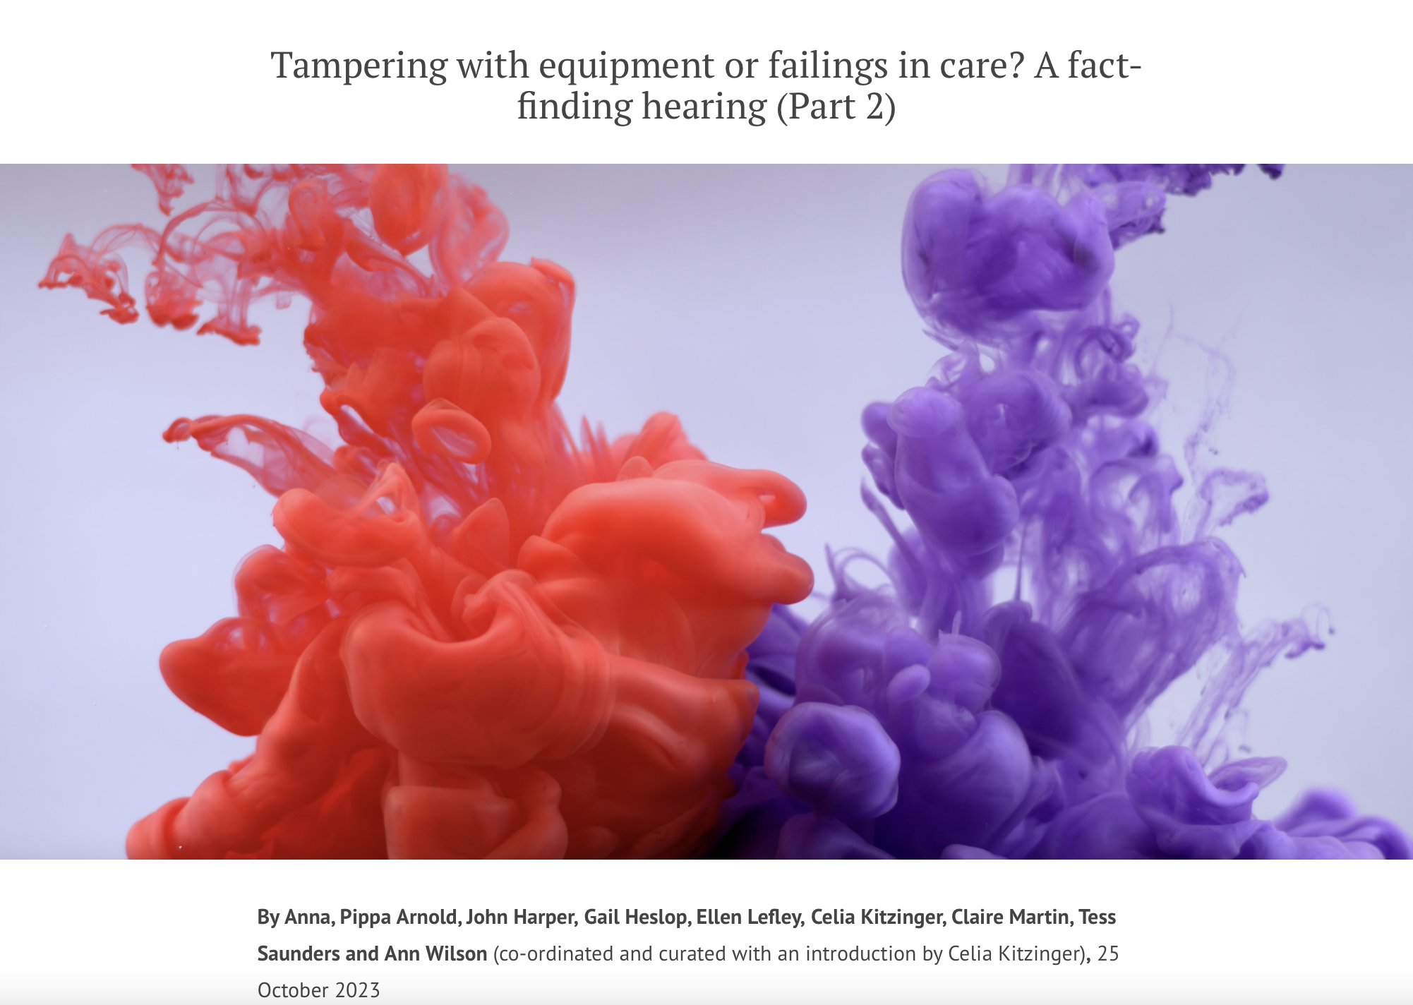
Collective blog posts
38 observers – 19 bloggers and more to come

Slide 18
Observing hearings
Almost all are open to the public (not “Dispute Resolution Hearings” DRH)
You send an email (with your phone no. if it doesn’t say hearing will be video platform) asking to observe. (Template letter on our home page)
For video-hearings you should receive email with MS Teams or Cloud Video Platform (CVP) link.
For phone hearings you are (mostly) phoned by the judge – sometimes you are asked to call in to a conference line
You must be in a quiet place where you cannot be overheard + you may not record the hearing
TURN YOUR MIKE AND VIDEO OFF
You must comply with the Transparency Order (Reporting Restrictions Order)
Hearing should begin with a summary of the case

Slide 19
Hearing Feedback Form
Info about observer
How hearing was listed
Access to hearing + Transparency Order
Technology issues (it’s almost always fine – an occasional glitch)
Was there an introductory summary?
Who was there (by role)? (applicant, respondents, P, P’s family, witnesses etc)
How were P’s wishes and feelings represented and by whom?
What order was being sought + what were areas of disagreement?
What did the court decide?
What is going to happen next?

Slide 20


Slide 21

Explainer blogs
By Alex Ruck Keene
39 Essex Chambers

Slide 22

By Victoria Butler Cole QC
39 Essex Chambers

Slide 23

By Kyle Squire
5 Pump Court Chambers

Slide 24
Thank you!
Celia Kitzinger
openjustice@yahoo.com
@kitzingercelia
@OpenJusticeCOP
Get involved! Observe hearings + write us a blog!

