Slide 1

OLDER PEOPLE AND MENTAL CAPACITY:
THE OPEN JUSTICE COURT OF PROTECTION PROJECT
Claire Martin
Consultant Older Adult Clinical Psychologist
Core team member OJCOP
Welsh branch of British Geriatric Society Conference
22nd September 2023

Slide 2
Structure of the talk
Open Justice COP Project: What Do We Do?
Older people in the Court of Protection – balancing autonomy, protection & human rights (case examples)
Context – Open Justice & Transparency
The Project! – Twitter, The Website, The Blog
Who Observes the Court of Protection?
Why Observe the CoP in Action?
How to get involved

Slide 3
Older people are the largest single demographic group among ‘Protected Parties’ in the Court of Protection.
What sorts of issues are addressed?
Experiences we might all anticipate – e.g., ADRT/LPA
(What Happens When Lasting Power of Attorney Goes Wrong?)
Court proceedings centring ‘P’s’ views and ‘everyday’ concerns
(‘Dementia, Cats, and Football’)
Court holds professionals to account to uphold ‘P’s’ rights
(Conflating Capacity and Best Interests? Cross-Examining a Neuropsychiatrist)
Court proceedings and giving ‘voice’ – Anna’s experience
(Deprived of her Liberty – My Experience of the Court Procedure for my Mum)
Older People in the Court of Protection

Slide 4
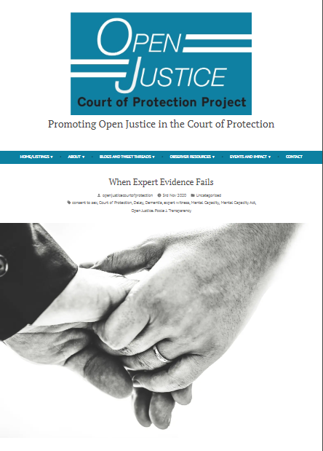
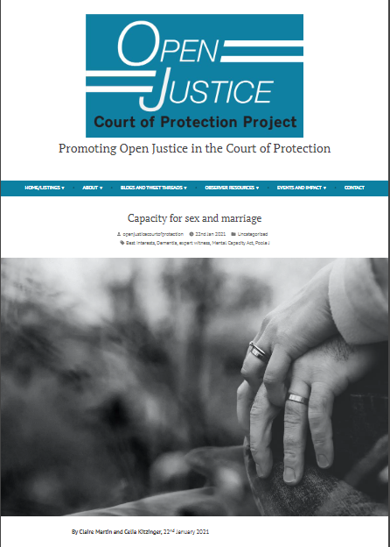
Expert Evidence Challenges in the COP
‘Barbara’: capacity to consent to sex and marriage
Older People in the Court of Protection
‘Barbara’ was living in a care home. She had a diagnosis of frontal lobe dementia.
She’d struck up a relationship with a man in the care home – ‘John’
This raised questions about capacity to consent to sex.
A Safeguarding Plan was put in place and Barbara &
John had been unable to be alone together for over a
year – an interference with their Article 8 rights to a
private and family life
The expert witness evidence was dismissed & a new
expert instructed

Slide 5


‘Barbara & John’ – their wait to be together
Older People in the Court of Protection
The expert witness called by the Local Authority said Barbara lacked capacity in all respects, including for sex and marriage.
Unfortunately, he did not provide an adequate capacity assessment and a new expert witness was instructed.
What went wrong?
  The judge said:
  “This case demonstrates how a thorough assessment and well-reasoned expert report on capacity can assist the resolution of difficult issues, saving time, resources, and anguish.”
  Assuming the diagnosis is sufficient to rebut capacity for a decision
  Not showing your working out!

Slide 6
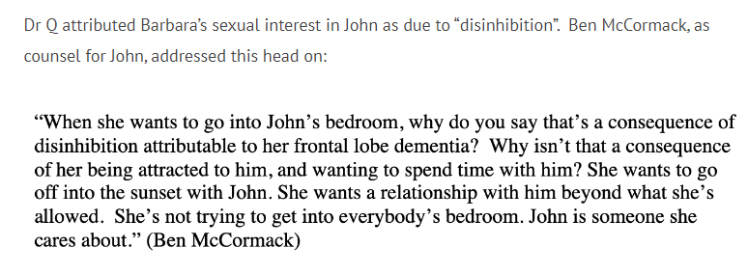
Cross-Examination in the COP
Older People in the Court of Protection
Here are some examples from Barbara’s case:

Slide 7
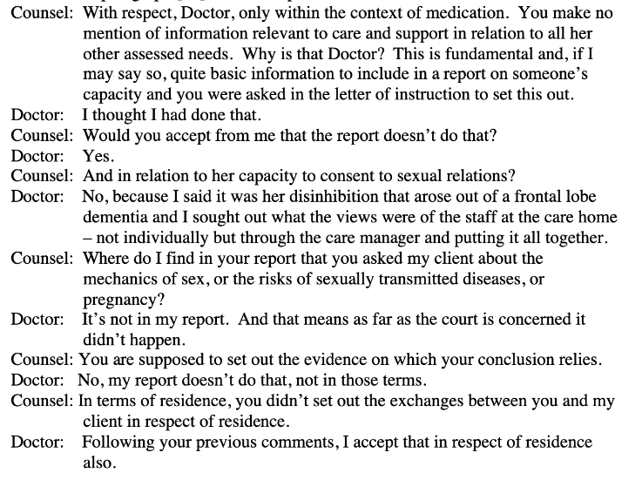
Older People in the Court of Protection
“Under deft cross-examination … the deficiencies in Dr Q’s evidence were fully exposed, as he was taken through each of the four reports in turn. The following exchange between Joseph O’Brien, counsel for Barbara, and Dr Q:”

Slide 8
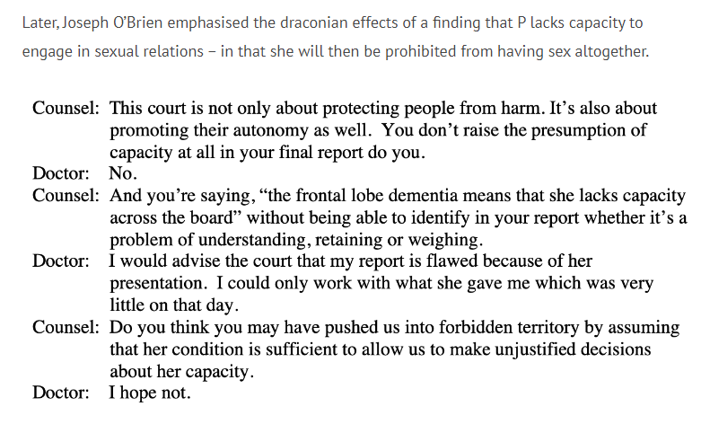
Older People in the Court of Protection
Protection versus Autonomy

Slide 9
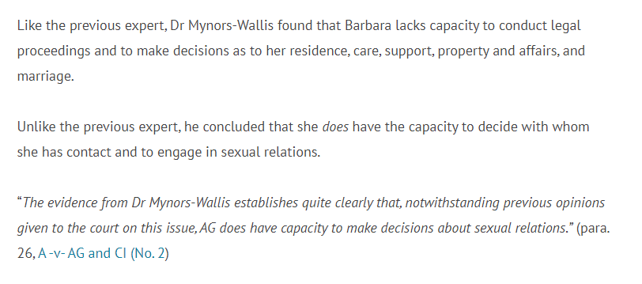
A Happy Ending for Barbara & John
Older People in the Court of Protection

Slide 10
Another case ……

Slide 11

The balance of autonomy, protection and Human Rights in practice
Cardiff County Council v Ross & Davies (2011)
This case concerned an 82-year-old woman with a diagnosis of dementia, who had decided with her partner of 20 years to go on a cruise ship holiday, something they had both done together on many previous occasions. Mrs Ross had moved to a care home a few months before the planned cruise following medical problems but spent weekends with her partner Mr Davies at his home.
The local authority formed the view that Mrs Ross lacked capacity to decide to go on the cruise, and that it was not in her best interests. The critical issue from the local authority’s perspective was that Mrs Ross was not able to appreciate the potential risks to her wellbeing of going on the cruise.
Older People in the Court of Protection
This Photo by Unknown Author is licensed under CC BY-ND

Slide 12

Continued
The judge went on to hold that even if Mrs Ross lacked capacity, it was not contrary to her best interests to go on the holiday. The judge felt that the Council's approach to the best interests decision was too risk averse and failed to take proper account of the potential benefits to Mrs Ross: it 'smacked of saying that her best interests were best served by taking every precaution to avoid any possible danger without carrying out the balancing exercise of considering the benefit to Mrs Ross of what, sadly, may be her last opportunity to enjoy such a holiday with Mr Davies’
Older People in the Court of Protection

Slide 13
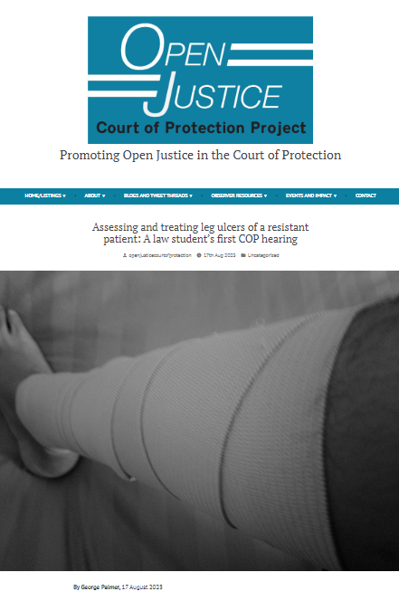
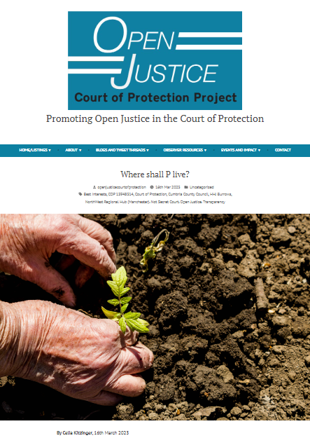
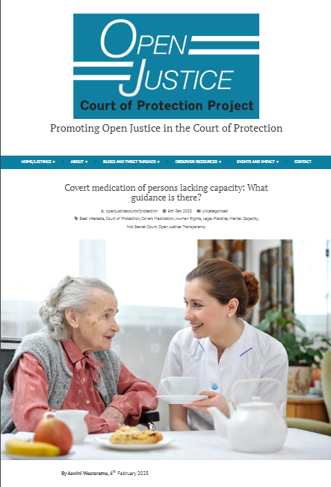

Lots more blogs about cases involving older people on our website ………
Treatment of leg ulcers in a resistant patient
Where shall
P live?
Covert medication – what guidance
is there?
Not authorising restraint for bowel surgery

Slide 14

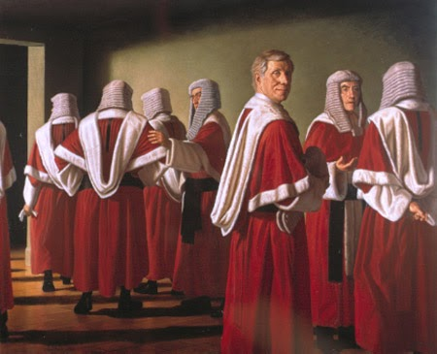
“Fine words butter no parsnips”
Open Justice. The words express a principle at the heart of our system of justice and vital to the rule of law.
“The rule of law is a fine concept but fine words butter no parsnips. How is the rule of law itself to be policed? It is an age-old question. Quis custodiet ipsos custodes - who will guard the guards themselves? In a democracy, where power depends on the consent of the people governed, the answer must lie in the transparency of the legal process. Open justice lets in the light and allows the public to scrutinise the workings of the law, for better or for worse. Jeremy Bentham said in a well-known passage quoted by Lord Shaw of Dunfermline in Scott v Scott [1913] AC 417, 477:
    "Publicity is the very soul of justice. It is the keenest spur to exertion and the surest of all guards against improbity. It keeps the judge himself while trying under trial.””
Lord Justice Toulson R (Guardian News and Media Ltd) v City of Westminster Magistrates’ Court [2012] QB 618
Context – open justice & Transparency

Slide 15
“Transparency is central to the philosophy of the Court of Protection” (Mr Justice Hayden)
But most hearings have NO external observers (including no journalists) and most judgments are not published – both before and since the current public health covid emergency
How to fulfil judicial commitment to transparency and open justice when the public doesn’t attend?
Context – open justice & Transparency

Slide 16


‘Secret’ court?
From 2007 most hearings were held in private (except Serious Medical Treatment and Committal).
From 2009 the press gained access (public access still prohibited – balance between public interest and maintaining dignity and privacy of P).
Court of Protection Transparency Pilot launched in 2016 and formalised in 2017.
Assumption that most hearings would be public with Reporting Restrictions (Transparency Order).
Low public attendance at hearings.
Access challenges (particularly publicising hearings).
Context – open justice & Transparency

Slide 17
When & why was the project launched?
Open Justice COP Project founded 15 June 2020
Following negative experience of “first ever all-remote” hearing of the pandemic
Launched as “guard against improbity”, it soon became clear that it (also) offered a learning experience for people working in health and social care surprised at ‘person-centred’ + ‘less risk averse’ approach
It supports family members of P learning at first hand about the COP
Has massively increased observation in COP (as have remote hearings)
Has generally enhanced the reputation of the Court of Protection
Open justice court of protection
Project

Slide 18
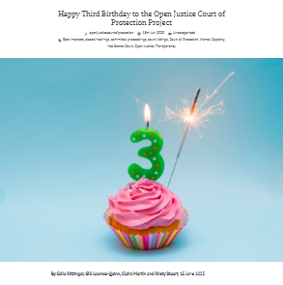
The Open Justice Court of Protection Project is committed to overcoming barriers and highlighting incentives to support public observation of court hearings.
Celia Kitzinger & Gill Loomes Quinn – directors
Jointly launched the project.
No funding or organisational backing. Just passion about open justice and legal literacy!
Since then the project has supported thousands of observers and attracted just over 100 different blog authors.
The project celebrated its 3rd birthday this year.
Core team, with directors, now includes:
Claire Martin, ‘Anna Jones Brown’ (more from Anna later!) and Daniel Clark
Legal Advisory Group:
Kirsty Stuart (Solicitor), Victoria Butler-Cole KC, Ian Brownhill
Open justice court of protection
project

Slide 19


TWITTER/’X’
Open justice court of protection project
@OpenJusticeCOP

Slide 20


The Website
www.openjusticecourtofprotection.org
Publicising CoP hearings
Featured Hearings
Complexities: Short notice, incoherent/inconsistent, lack of details (issues, impairments etc)
Open justice court of protection project
Providing support and information to Public Observers about what to expect during a CoP hearing.
Particularly how to access CoP hearings remotely.

Slide 21
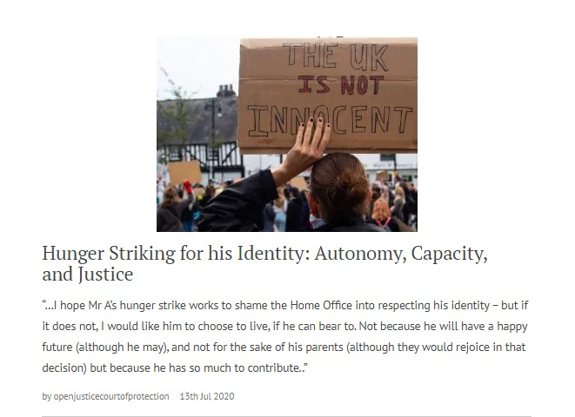
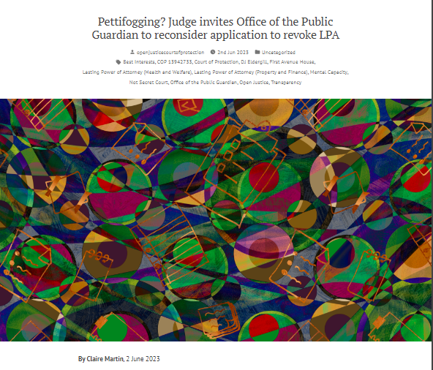
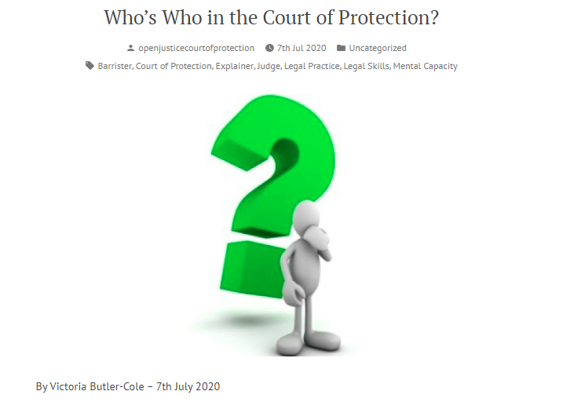
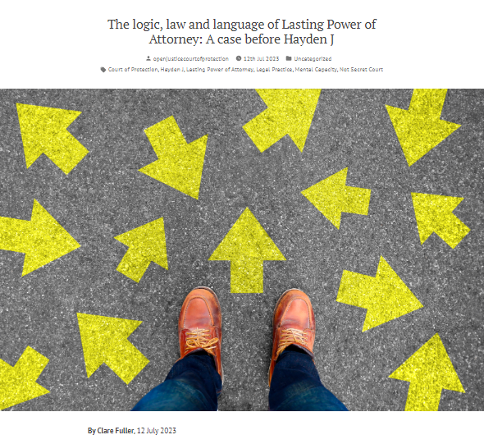
Public Observer reports
Nearly 400 blog posts published
since 15th June 2020
‘Explainers’ Commissioned on aspects of Court of Protection practice – explaining the work of the court and specific key roles (e.g., transparency orders, court bundles, how BSL interpreters work).
Project News – Including details of short-term collaborations with other organisations and projects.
THE BLOG
Open justice court of protection Project

Slide 22
Who observes the court of protection?
Social workers, case managers, IMCAs, clinical psychologists, medics, speech and language therapists, nurses, care home managers, law students, solicitors (this can count towards CPD), trainee lawyers, people who are involved in the CoP themselves ….
Example Volunteer observers: a Registered Intermediary who supports children in giving evidence in court, a clinical psychologist who works with people with learning disabilities, a speech and language therapist involved in capacity assessments, a palliative care nurse, an MCA trainer, the policy officer for an end-of-life charity, the mother of a daughter living with a brain injury after a road traffic accident, who now lacks capacity to make most decisions for herself.
‘Anna’, our colleague in the project, became involved during a CoP case for her mother ……

Slide 23

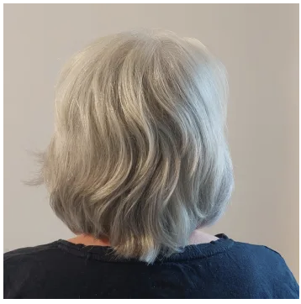
Observing and Blogging for the Open Justice COP Project
Who observes the Court of Protection?
I’m Anna, an ordinary middle-aged woman with no background in the law.
My mother, who has dementia, lives in a care home.
When I first heard that her case was going to the Court of Protection, I was angry and bewildered as I had no idea what that meant.
Discovering the Open Justice Court of Protection Project, and starting to observe Court of Protection cases, opened my eyes. I’m now passionate about transparency and committed to writing blogs to share what I learn with others.
Ironically, the Court has served an injunction on me meaning that I’m not allowed to write about my mother under my own name, in case it identifies her. So ”Anna” is a pseudonym. I’m applying to get the injunction lifted.

Slide 24

The story of how Anna became involved in the Open Justice Court of Protection Project
Who observes the Court of Protection?
Background
Anna’s elderly mother, who is living with dementia, was admitted to full time care in August 2021 with the agreement of her social worker and children, including her daughter (“Mary”), who had Lasting Power of Attorney for Health and Welfare.
Mary and Anna thought that their mother’s dementia had deteriorated to the extent that she had lost capacity to make decisions and so Mary could make decisions as to their mother’s care and residence.
But they hadn’t heard of the Deprivation of Liberty Safeguards (DoLS) framework which was employed, as is usual when someone is admitted to care.
When asked by professionals, such as the Best Interests Assessor, their mother said that she wanted to go home and did not want to be in the care home
After a few months, to Mary and Anna’s surprise, Mary was told that her mother’s case was going to the COP
Mary and Anna were told the case was between their mother and the Local Authority. Nobody clearly explained to them about DoLS and the COP. They felt completely excluded and did not know where to turn for help.

Slide 25
The story of how Anna became involved in the Open Justice Court of Protection Project
Who observes the Court of Protection?
What happened next
Anna searched the internet and by chance came across the Project website
She emailed via the contact page and Celia Kitzinger replied
This was the start of a number of conversations between Anna and Celia, to help Anna learn about DoLS and the COP
As part of this process, Anna started observing COP hearings and writing blogs
This helped her feel better prepared for her mother’s hearing in June 2022.
Supported by Celia, her confidence and knowledge increased to the extent that she became a Litigant in Person as a party in the case. This meant she played an active part in the process, including the COP hearing, and had access to all documents.

Slide 26
The story of how Anna became involved in the Open Justice Court of Protection Project
Who observes the Court of Protection?
The outcome
Anna’s attitude to the process completely changed from learning more about it through the Project
She and Mary worked collaboratively with all the care professionals and legal team to ensure that their mother’s best interests were identified and that adjustments were made to her care plan that took account of, for example, her cultural and religious wishes
Anna wrote a detailed blog about her story so that:
  other families could learn from what happened and
  to raise awareness for professionals, so that they can consider how to better involve and communicate with families, to improve the process
The blog has been read well over 4000 times (current count 4.3K!)
‘Deprived of her liberty’: My experience of the court procedure for my mum

Slide 27
Anna and the Open Justice Court of Protection Project today
Who observes the Court of Protection?
Key Learning Points
Anna found the Open Justice Court of Protection Project invaluable in the navigation of her mother’s case and has become passionate about open justice. She became a member of the core team in June 2023
As an “ordinary” family member and somebody with no professional background in social care or the law, she feels this brings a different perspective to observing and writing about COP cases.
She feels very strongly that communication with family members could be improved, to the benefit of all
Anna would encourage anybody, whatever their background, to observe COP hearings and contribute to open justice

Slide 28
Please get involved!
Here’s how ……. 1, 2, 3 ….

Slide 29
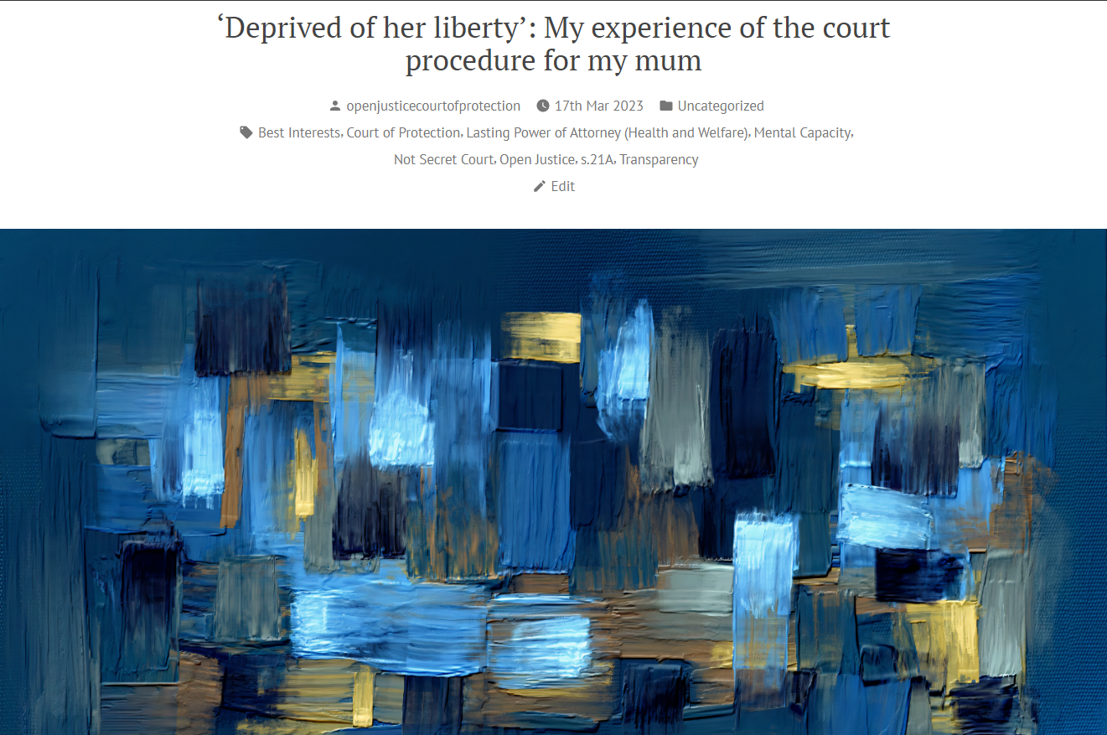
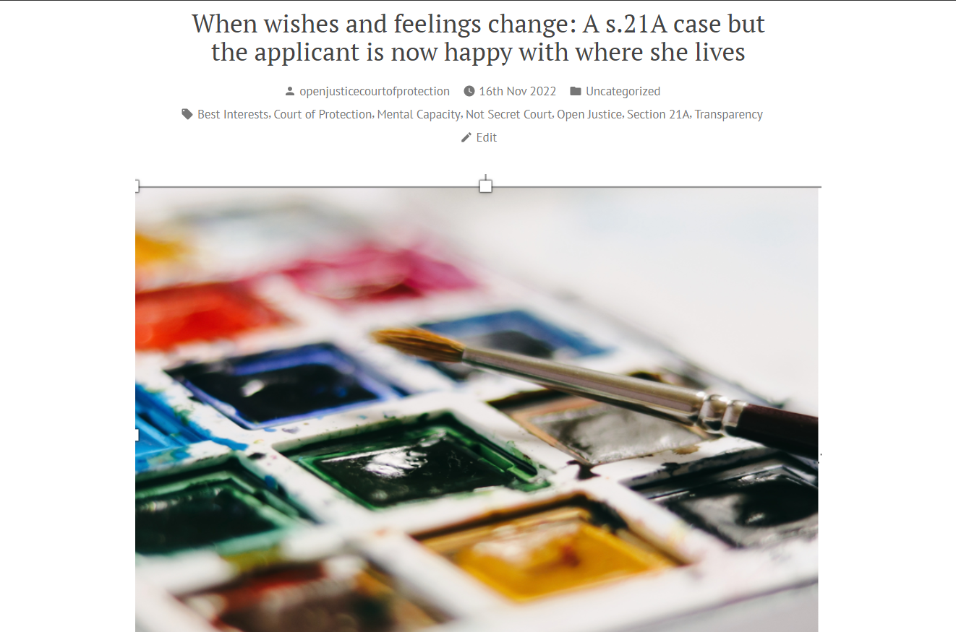
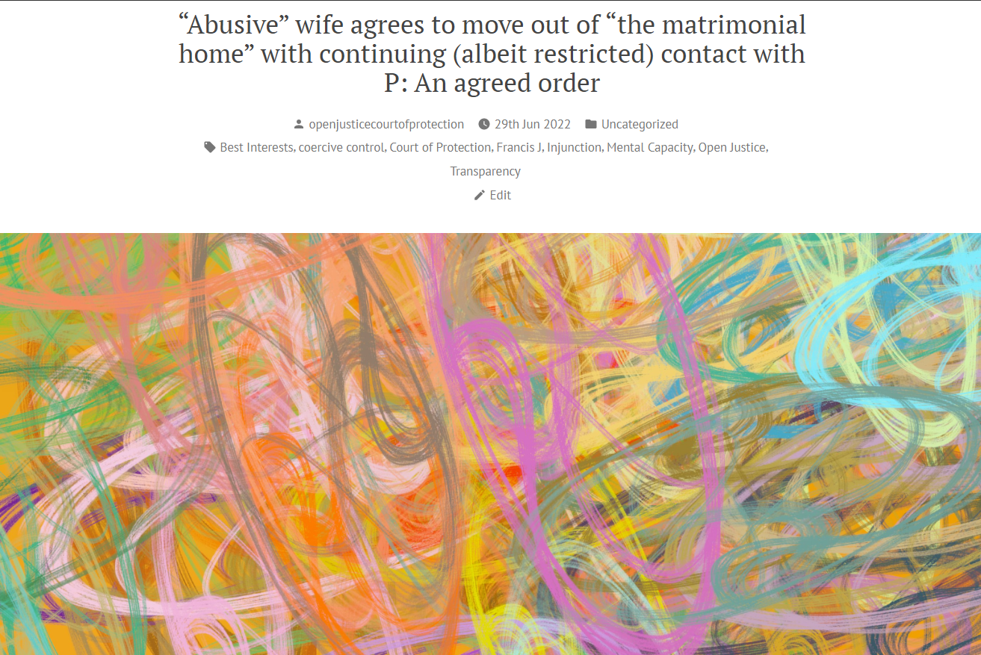
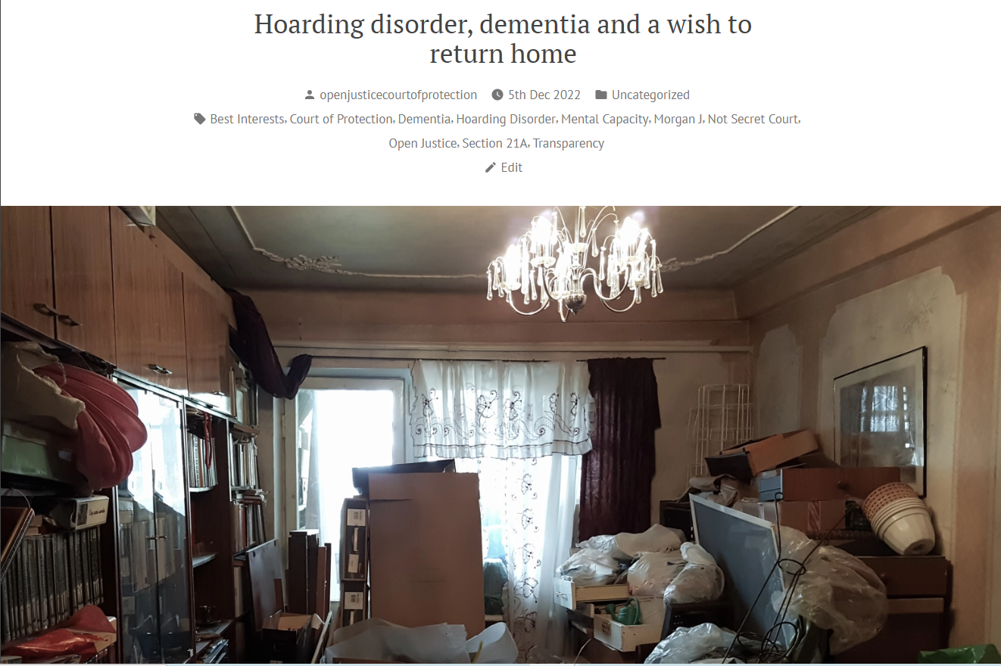
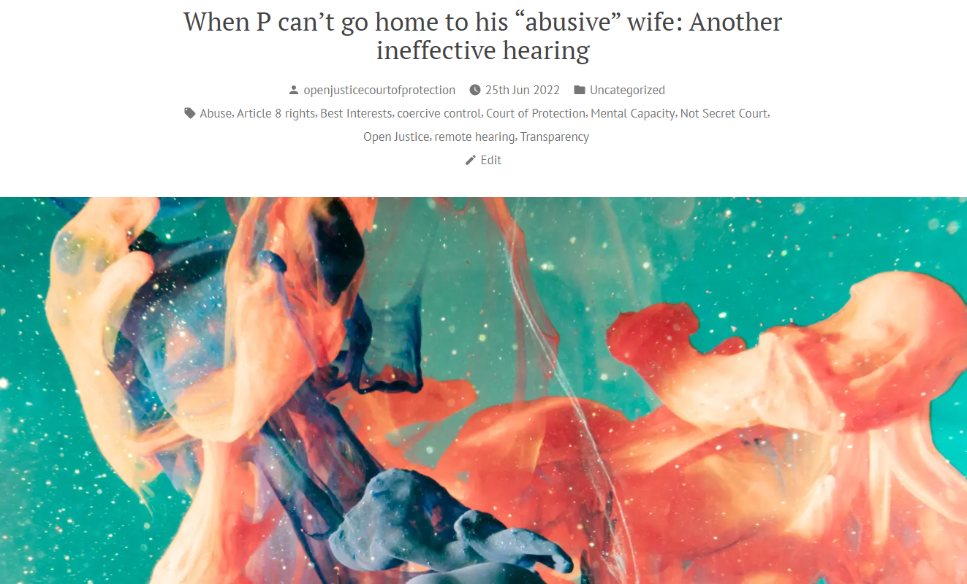


1. Read and Subscribe to our Blog
Nearly 400 blog posts to date
Around 3 posts per week
Subscribe via ‘subscribe’ box at the bottom of each page.
Search for key terms (e.g., ‘dementia’) via ‘search’ box at bottom of each page.

Slide 30


2. Observe a Hearing
(and maybe write a blog?)
Featured Hearings
Selection of most accessible hearings each day
Probably best ‘first step’ for anyone interested in observing CoP in action
@OpenJusticeCoP
More hearings (including regional)
Ad hoc updates
openjusticecourtofprotection.org

Slide 31

3. Further Details and Contact
Website:
openjusticecourtofprotection.org
The OJCOP Team
Celia Kitzinger
Co-Director
Gill Loomes-Quinn
Co-Director
Claire Martin
Core Team Member
Anna Jones Brown
Core Team Member
Daniel Clark
Core Team Member
Twitter:
@OpenJusticeCoP
Email:
OpenJustice@yahoo.com

Slide 32
Thanks for listening
I’ll have a go at answering any questions!

