Slide 1

Open Justice in the Court of Protection:
Opportunities for Social Workers
Dr Gill loomes- Quinn
Co-director – open justice court of protection project
&
AMANDA HILL
pHd researcher

Slide 2


Talk Outline
‘Open Justice’ in the Court of Protection
The OJCOP Project:
  The Project
  Twitter
  The Website
  The Blog
  Observer Feedback Form
Why Observe the CoP in Action?
Transparency Orders & Families

Slide 3
The Court of Protection
&
Transparency

Slide 4

OVERVIEW: The Court of Protection
Established in current form by the Mental Capacity Act 2005
Makes determinations about mental capacity
Makes Best Interests decisions on behalf of incapacitous adults
Impairments – e.g. dementia, learning disability, autism, psychiatric
Wide range of cases (health, welfare, property and affairs, DoLS)
Significant implications for Disability Justice
Sits in London (RCJ and First Avenue House) and Regions
Approx. 30 hearings scheduled per day
High percentage of adjournments/vacations (impact on observers)
Low numbers of published judgments (2015: 85, 2016: 66, 2017: 31, 2018: 38, 2019: 58, 2022: 65, 2021: 65 – out of 1000s of hearings each year. Most hearings are Directions etc, but this is a lot of court work not available to be scrutinised via reading published judgments).
So how else to scrutinise the work of the court?

Slide 5
Transparency: Promises and Parsnips
Lord Justice Toulson R (Guardian News and Media Ltd) v City of Westminster Magistrates’ Court [2012] QB 618
Open justice. The words express a principle at the heart of our system of justice and vital to the rule of law. The rule of law is a fine concept, but fine words butter no parsnips. How is the rule of law itself to be policed? It is an age-old question. Quis custodiet ipsos custodes - who will guard the guards themselves? In a democracy, where power depends on the consent of the people governed, the answer must lie in the transparency of the legal process. Open justice lets in the light and allows the public to scrutinise the workings of the law, for better or for worse.
Jeremy Bentham said in a well-known passage quoted by Lord Shaw of Dunfermline in Scott v Scott [1913] AC 417, 477:
    "Publicity is the very soul of justice. It is the keenest spur to exertion and the surest of all guards against improbity. It keeps the judge himself while trying under trial."

Slide 6







Transparency: Practicalities
Short notice – Listings published evening before.
Significant number of hearings vacated/adjourned.
Inaccurate contact details listed.
Lack of information – Time-estimates, case details, impairments concerned etc.
Under-resourced courts – overstretched staff.
Delays in responding to observers’ requests.
Delays for judges receiving requests.
Last-minute access arrangements.
Delays – late starts and late finishes.
Observers may want a specific geographic location or judge (these are possible to facilitate).

Slide 7
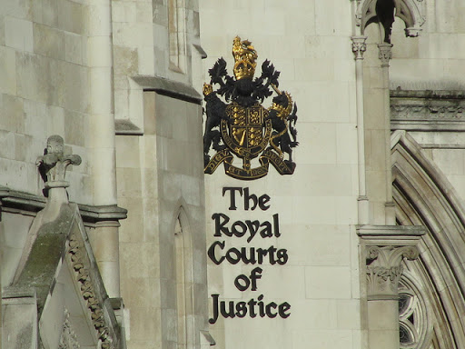
Where Hearings are Listed:
Family Division of the High Court (Royal Courts of Justice)
https://www.justice.gov.uk/courts/court-lists/list-family
Central Family Court (First Avenue House)
https://www.gov.uk/government/publications/court-of-protection-daily-hearing-list
Regional courts (listings on Courtserve)
https://www.courtserve.net/

Slide 8
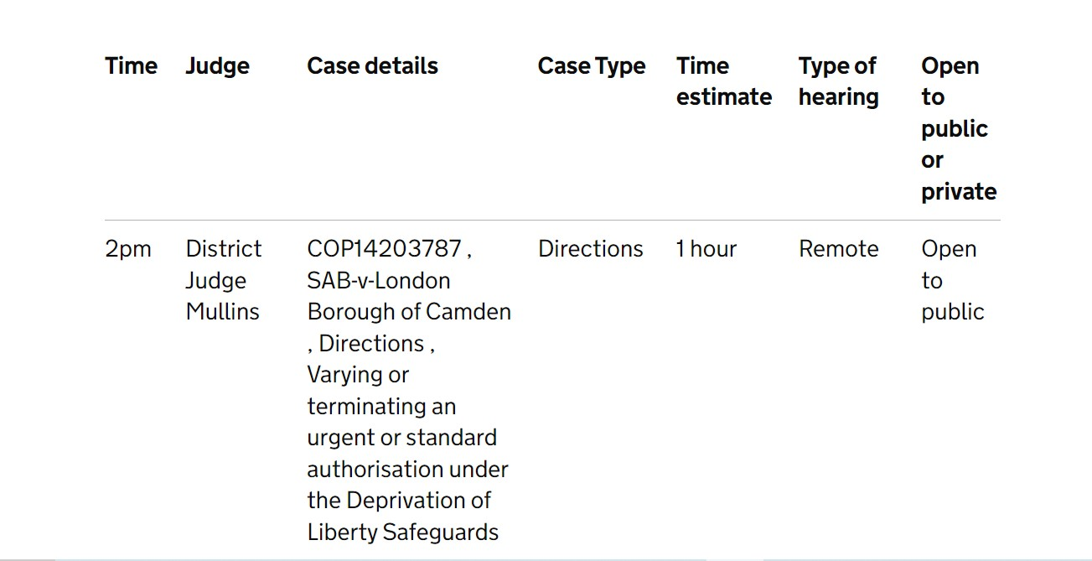
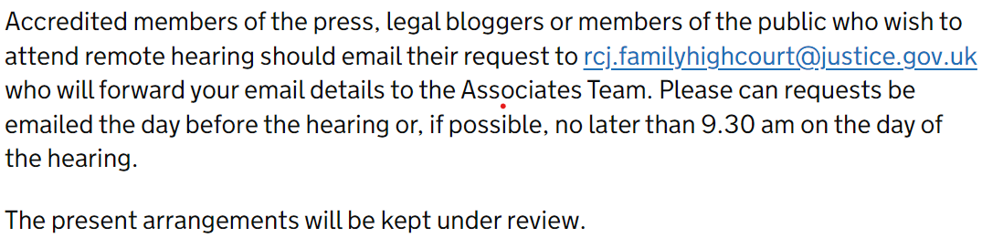
How Hearings are Listed:
From FAH Daily Cause List
Instructions on RCJ Daily Cause List

Slide 9
OJCOP:
What We Do

Slide 10
The Project
Provides information and practical support to Public Observers
Shares updates on developments in the CoP
Reports on hearings we’ve observed
Uses our experiences to impact the development of Open Justice in the CoP
Launched 15th June 2020
Shares court listings
Provides links to published judgments

Slide 11
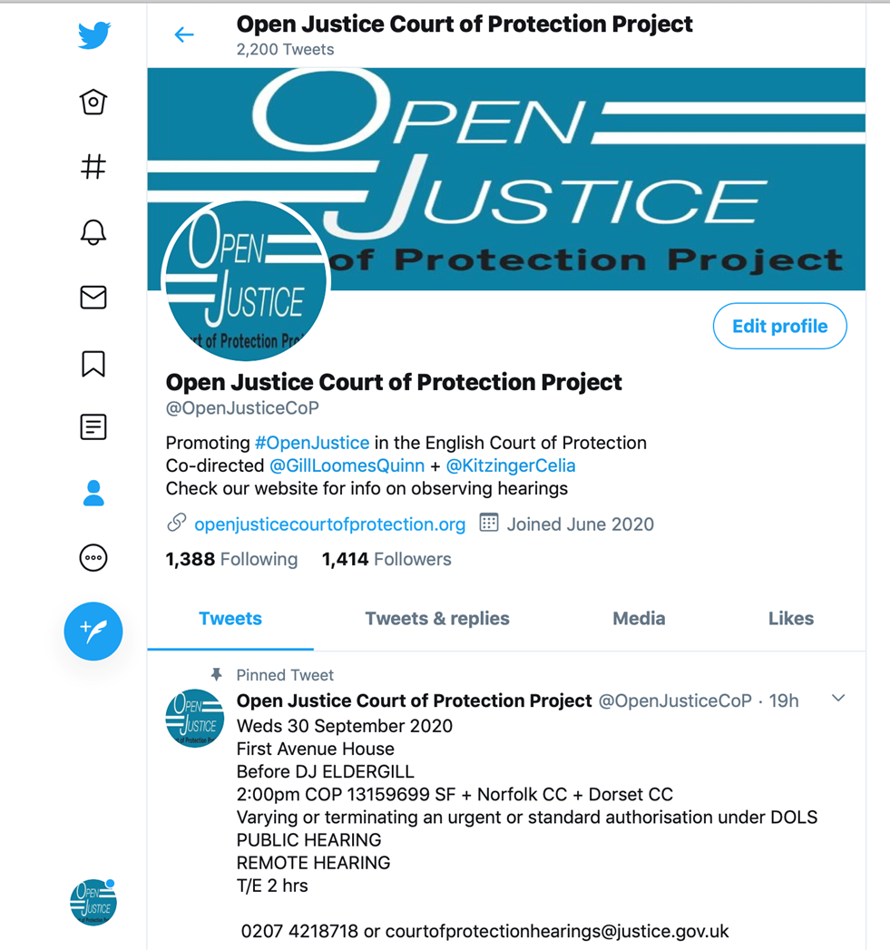

Twitter – now ‘X’
@OpenJusticeCOP

Slide 12


The Website
Publicising CoP hearings
Featured Hearings
Complexities: Short notice, incoherent/inconsistent, lack of details (issues, impairments etc)
Providing support and information to Public Observers about what to expect during a CoP hearing.
In particular how to access CoP hearings remotely.
openjusticecourtofprotection.org

Slide 13
How to Observe (Available on OJCOP homepage)
Check what hearings are listed.
Pick one to observe (consider e.g., time, platform used, issues (if known)).
For in-person hearings you can just go along to the court. If the hearing is remote email the address given. Put “Observer Request” in subject header with case number and name of judge*.
They will send you a link – MS Teams or Cloud Video Platform (CVP) are used.
Allow plenty of time (court buildings have airport-type security and you may have connection issues in remote hearings. Join with your camera and mic off.
You’re mostly not required to speak in court – Though court staff may ask who you are when checking who is present (just say “I’m’ a public observer”); at in-person hearings you may have to sign in; and at remote hearings the judge occasionally asks you to confirm you’ve received and understood the Transparency Order (if you haven’t received it, this is a good opportunity for the judge to arrange for it to be sent to you).
*N.B. Template email wording on OJCOP homepage – under our Featured Hearings, at “How to Access a Hearing” (Point 3).

Slide 14
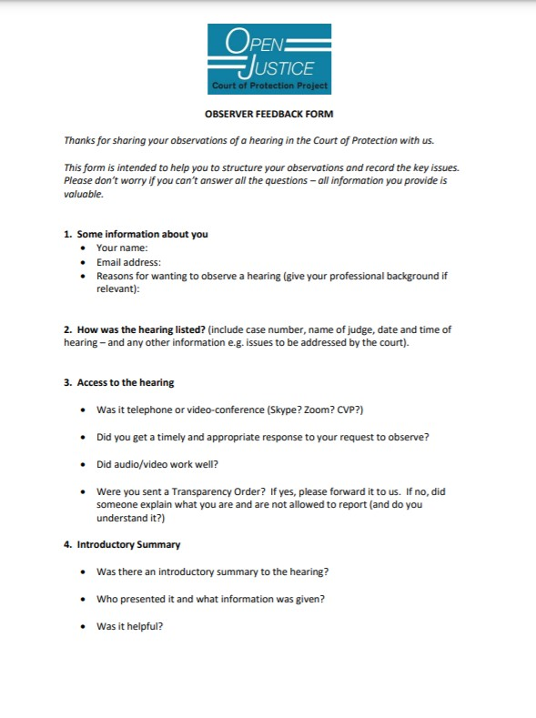
Observer Feedback Form
How was the hearing listed?
How did you access the hearing? (Phone? MS Teams? CVP?)
Response to your request?
Were you sent a Transparency Order?
Introductory summary (Was there one? By whom? Did you find it helpful?)
Structure of the hearing
Who was the applicant? Who was the respondent?
Were there any disagreements between them?
Were any witnesses called? What happened?
What did the judge decide?
Were any further hearings scheduled?
https://openjusticecourtofprotection.org/hearing-feedback-questions/

Slide 15
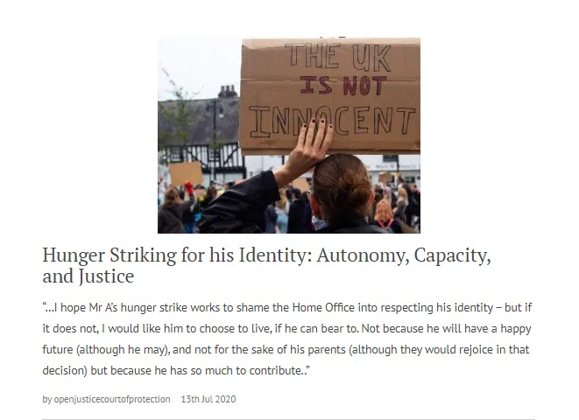
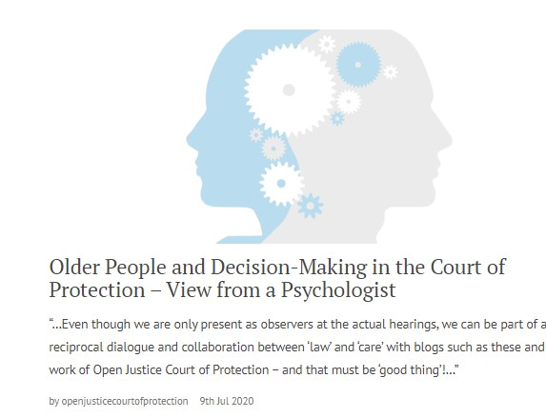
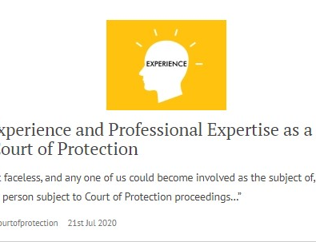
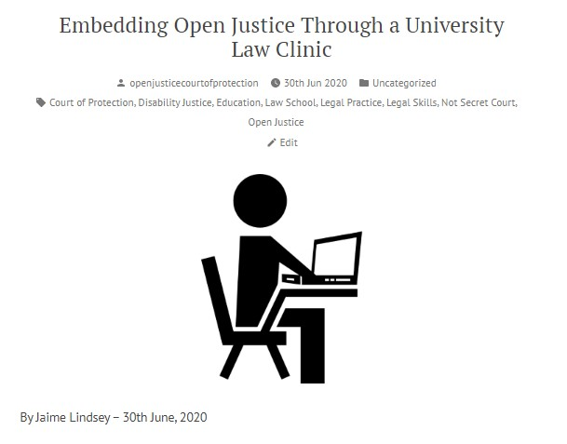
The Blog
Public Observer Reports Over 500 blog posts published since 15th June 2020
Public Observers Mostly health/social care professionals, then (aspiring) lawyers, and then family members – others include MCA 2005 trainers, and voluntary sector stakeholders
‘Explainers’ Commissioned on aspects of Court of Protection practice – explaining the work of the court and specific key roles (e.g. transparency orders, court bundles, how BSL interpreters work).
Project News – Including details of short-term collaborations with other organizations and projects.

Slide 16
What Do Observers Think?
  “Human Rights has become real and applied. I can see more clearly that down at the coal face, we have real opportunity to empower our service users. And based on what I have observed, I have confidence that if the situation of our service users should ever require consideration by the Court of Protection, the judge will ensure their right to participate is facilitated and their right to self-determination, if at all possible, is respected.”
  (Louise Burrell, social worker)

Slide 17
What Do Observers Think?
“As a nurse my main focus is that the person remains at the centre of everything. It was so reassuring to see that this also was the primary focus within a formal court hearing for Mr Justice Hayden. The person-centred approach to this hearing epitomises and reflects exactly what I believe the Mental Capacity Act is all about.” (Sara Shorten)
“Mr Justice Williams maintained unwavering focus on what is right for P and preventing him being exposed to a toxic atmosphere … I left feeling reassured that person-centred decision-making, an issue I feel strongly about, prevailed” (Upeka de Silva)
“In this virtual courtroom with Mr Justice Hayden the law enabled a person with a learning disability to access the same rights and healthcare as any other citizen. This give me a huge sense of relief that my family member will be safe and listened to with these structures in place, and free to live the life he chooses.” (NB)

Slide 18
Why Observe the Court in Action?
Observing the hearing was interesting and made me reflect on my own experience of conducting capacity assessments and the extent to which they would hold up in court. I do wish, though, that the judge or the applicant had done a proper introduction to the issues to be covered in court so that I would have been better placed to understand what was happening and use the experience more effectively for professional development.
(Jacqui Bond, social worker)

Slide 19
Why Observe the Court in Action?
I have found the whole observation experience very beneficial. The googling, looking up of legislation, reading up of quoted case law – both during and after the court attendance – has given me a crash course in legislation, that I now realise, I only thought I understood. Listening to a talk about how the Mental Capacity Act is implemented in the courts is one thing – actually observing it as it happens is very different!
(Louise Burrell, social worker)

Slide 20
Why Observe the Court in Action?
In terms of my role as an IMCA or RPR, I learnt that it is essential to be even-handed and remain as calm as possible, when contributing in court. There can be many emotions involved for family members, and as a professional it is essential that all the evidence is available before the Judge can make a decision in the best interests of the person at the centre of the proceedings.
(Hilary Paxton, trainee IMCA)

Slide 21

Why Observe the CoP in Action?
See justice being done – Public scrutiny and informed critique.
Learn how the court may work with your clients, and how the MCA 2005 may be applied.
“CPD”
See how witnesses are engaged with by legal professionals.
Observe professional roles and interactions.
Develop legal literacy – and work on embedding this in public and political contexts.
Engage in debates from a more informed perspective – understand the nuanced, textured, contextualised background to a case, and contribute to public advocacy.
Personal impact (6 million people per year impacted by MCA 2005, either as P or as carers – a small proportion directly encounter CoP but need to understand its role in the “grand scheme”).

Slide 22
Transparency Orders
&
Families

Slide 23
Introduction
Amanda Hill
New PhD student at the School of Journalism, Media and Culture, Cardiff University
Research subject: The Court of Protection - family experiences, media representations and social media activity
Observer and blogger for the Open Justice Court of Protection Project
Interested in family experiences of being subject to Transparency Orders in the COP

Slide 24
What I’m Going to Cover
What is a Transparency Order (TO)?
What information does it prevent being reported?
Who does it apply to?
What happens if a TO is not complied with?
How long does it apply for?
Varying or discharging a TO
What impact does it have on families in practice?
Recommendations

Slide 25
What is a Transparency Order (TO)
& Why Do The Exist?
A TO is an injunction preventing reporting of certain information about a COP case
A standard TO can be found here:
https://www.judiciary.uk/wp-content/uploads/2017/11/cop-transparency-template-order-for-2017-rules.pdf
(search for Standard Transparency Order Court of Protection)
It is a court order and must be complied with
Objective is to protect the privacy of P and P’s family
A Transparency Order?

Slide 26
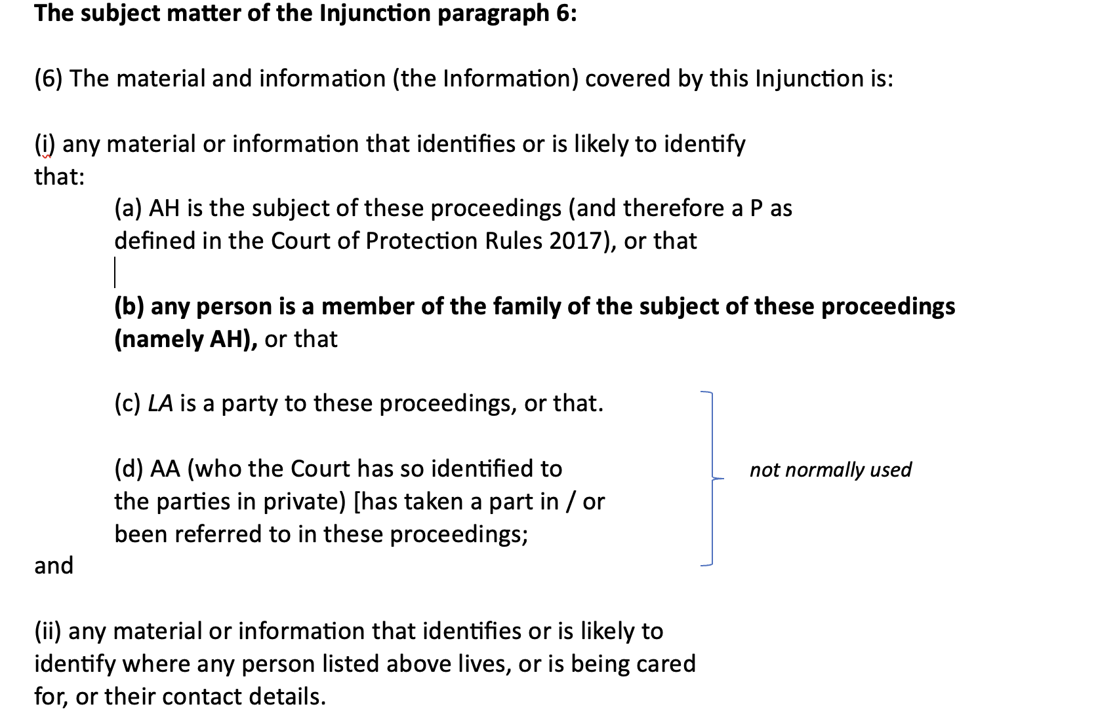
What information does it prevent being reported? Paragraph 6
Assumes that P and family do NOT want to be identifiable in reports of the case, which is often, but not always true.
Some P’s and family members have been identified – e.g., Sergei & Yulia Skripal, Sudiksha Thirumalesh.

Slide 27
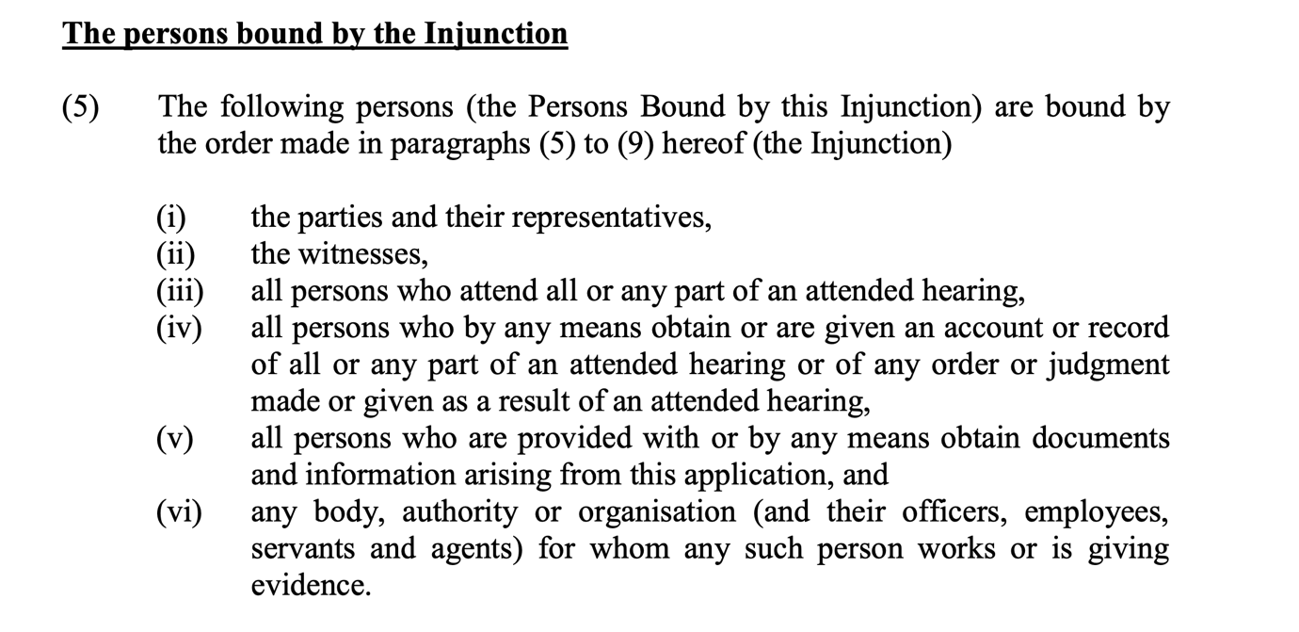
Who Does it Apply to?
Parties, legal teams, witnesses, family members, observers, social workers, carers etc.

Slide 28
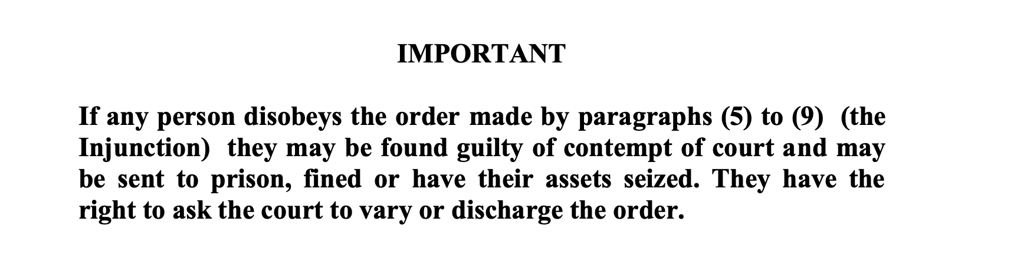
What Happens if a TO is not Complied with?
Example of Luba Macpherson: Warrant for arrest of P’s mother by ‘Anna’, 7th December 2023

Slide 29
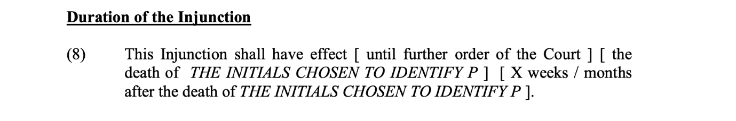
How Long Does it Apply?
Usually until further order of the court.
So, it applies even after P has died…Unless an application is made to vary or discharge it.

Slide 30
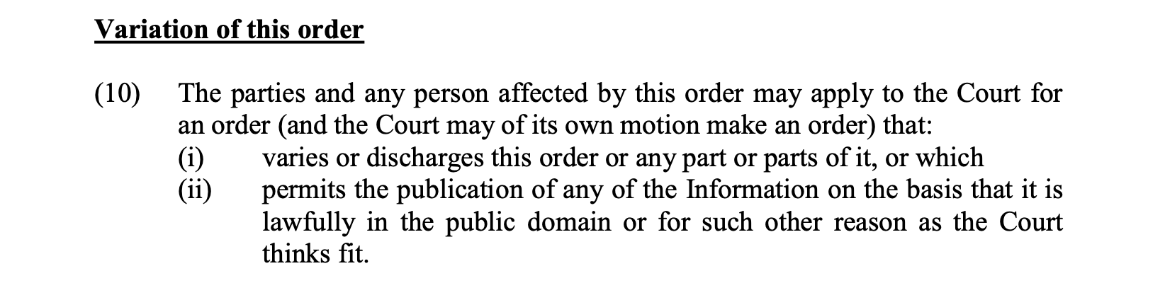
Varying or discharging a TO –
Paragraph 10
Varying or discharging – how easy for family members?
  27th February 2024 When families want to tell their story: Discharging a transparency order by Celia Kitzinger and “Anna”
  6th August 2024 She wants to tell her Court of Protection story but will the court allow her? by Amanda Hill

Slide 31
Impact on families in practice
A family member can’t reveal to anybody that their loved one is or was involved in a COP case once they are subject to a TO, even if that person has died.
An observer of a COP hearing can write about a hearing in their own name, but a family member can’t write in their own name about their experience.
Example of Anna, OJCOP Core Team member:
  17th March 2023 ‘Deprived of her liberty’: My experience of the court procedure for my mum, by “Anna” (daughter of P).
  7th July 2023 Gagged – in whose best interests? by Anna.
Celia Kitzinger role in applications to vary or discharge a TO.

Slide 32
What You Can Do to Help Families
Families often tell the OJCOP that a TO is rarely discussed with them and they don’t understand it – until it goes wrong
It is easier to vary a TO before or at the start of a hearing – explaining to families would help
Don’t underestimate the stress families are usually under - understanding the TO should not be taken for granted
Final thoughts

Slide 33
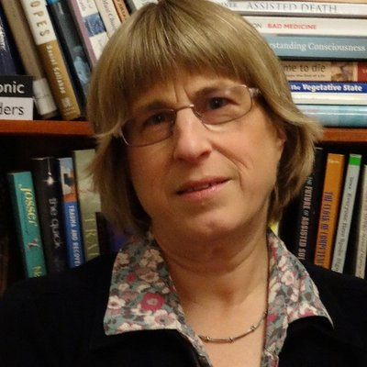

Further Details and Contact
Website:
openjusticecourtofprotection.org
Twitter:
@OpenJusticeCoP
The Open Justice Court of Protection Project is co-directed by Celia Kitzinger and Gill Loomes-Quinn.
Email:
OpenJustice@yahoo.com

