Slide 1

Deprivation of Liberty cases – what we see in court
Celia Kitzinger
Open Justice Court of Protection Project
For Kent County Council, DoLS/Best Interests Assessors Forum, 2nd June 2025

Slide 2


Slide 3

Court of Protection
“We make decisions on financial or welfare matters for people who can’t make decisions at the time they need to be made (they ‘lack mental capacity’)” (https://www.gov.uk/courts-tribunals/court-of-protection)
Majority of hearings are about deprivation of liberty (or include DOLS)
HQ is First Avenue House London – Senior Judge HHJ Hilder
Most cases heard in regional courts across the country
Kent is in the “South East Regional hub” (admin centre is Reading) – many cases heard in regional courts (e.g. Canterbury, Chatham); some in London (occasionally before the most senior judges in the Royal Courts of Justice)
Almost all hearings are open to the public
Most hearings via video-link; contested and final hearings more likely to be in person
Person at centre of case (“P”) and family members often attend (and contribute)

Slide 4
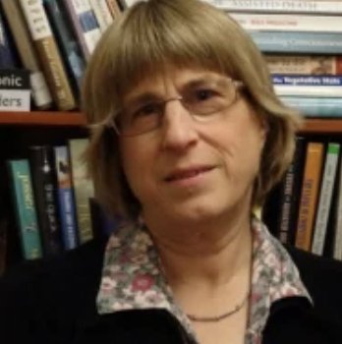
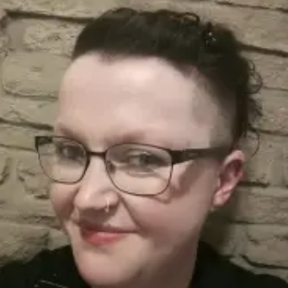
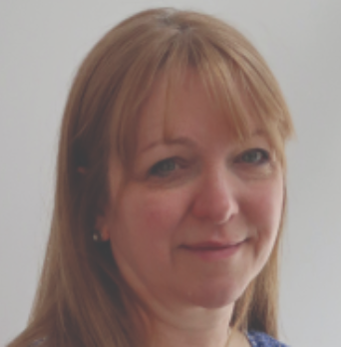
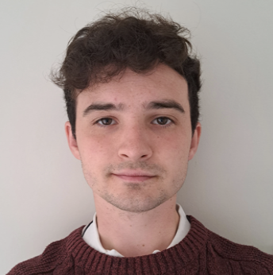

Court of Protection Open Justice Project
Run by five members of the public – none of us lawyers or journalists
The principle of open justice (”Tom, Dick and Harry”)
Justice should be ‘seen to be done’ – sunlight is the best disinfectant
Celia Kitzinger
Retired academic
Claire Martin
Clinical psychologist
Daniel Clark
Former paid carer, PhD student
Amanda Hill
Former COP LIP in s.21A case, PhD student
Gill Loomes-Quinn
Advocate

Slide 5
Observing hearings
Almost all are open to the public (not “Dispute Resolution Hearings” DRH)
Go along to the court in person or send an email asking to observe. (Template for request letter on our website)
For video-hearings you receive email with MS Teams or Cloud Video Platform (CVP) link.
You must be in a quiet place where you cannot be overheard + you may not record the hearing
You must comply with the “Transparency Order” (reporting restrictions)
Hearings generally begin with a summary of the case

Slide 6
Benefits
Watching justice in action – supporting fundamental principle of ‘open justice’
Seeing how capacity assessments and best interests reports are used in the court
Watching expert witnesses give evidence and be cross-questioned
Understanding how a judgment emerges from facts + law (including ‘dead ends’ and rejected arguments). Very different from seeing final judgment
Frustrations – inadequate advance info about issues in listings, many are adjourned + vacated, failure to respond to emails, forgetting to do introductory summary, we don’t get position statements!

Slide 7
I have found the whole observation experience very beneficial. The googling, looking up of legislation, reading up of quoted case law – both during and after the court attendance – has given me a crash course in legislation, that I now realise, I only thought I understood. Listening to a talk about how the Mental Capacity Act is implemented in the courts is one thing – actually observing it as it happens is very different! (Louise Burrell, social worker)

Slide 8
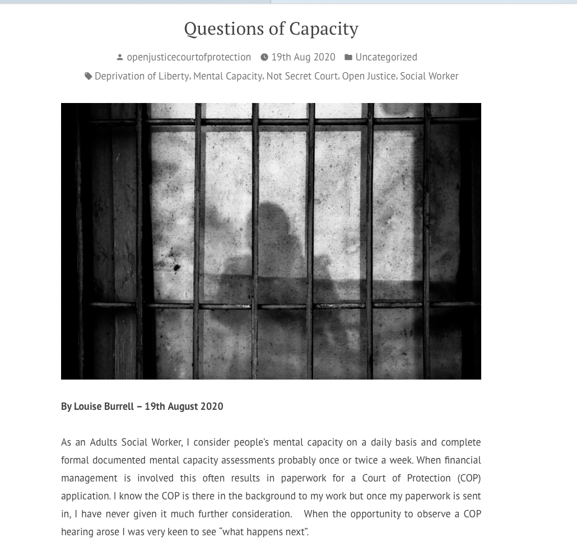
Click here to read blog
“Having just been allocated a case concerning a lady in a care home who wanted to return to her own home, with a mental capacity assessment needed and a possible Section 21a appeal on the horizon, I was particularly keen to attend a Section 21a hearing.”
It’s the “DP v Hillingdon” judgment from Hayden J (which you can read here)
Hugely important for practice and procedure in s21A proceedings and more broadly in the approach taken to DoLS assessments.
“…the guiding principle is the need for speedy determination of the lawfulness of detention mandated by Article 5(4)”

Slide 9

Click here to read blog
Ms Doe hates her current placement and has been saying for more than a year that it’s a “horrid place” and that she wants to go back to Poland to be with her family.
S.21A challenge on best interests
Big concerns – pension + social security entitlements, nationality, healthcare needs, travel during pandemic, etc
Hayden J ordered qualifying requirement of best interests not met + made order it’s in her best interests to return to Poland.

Slide 10
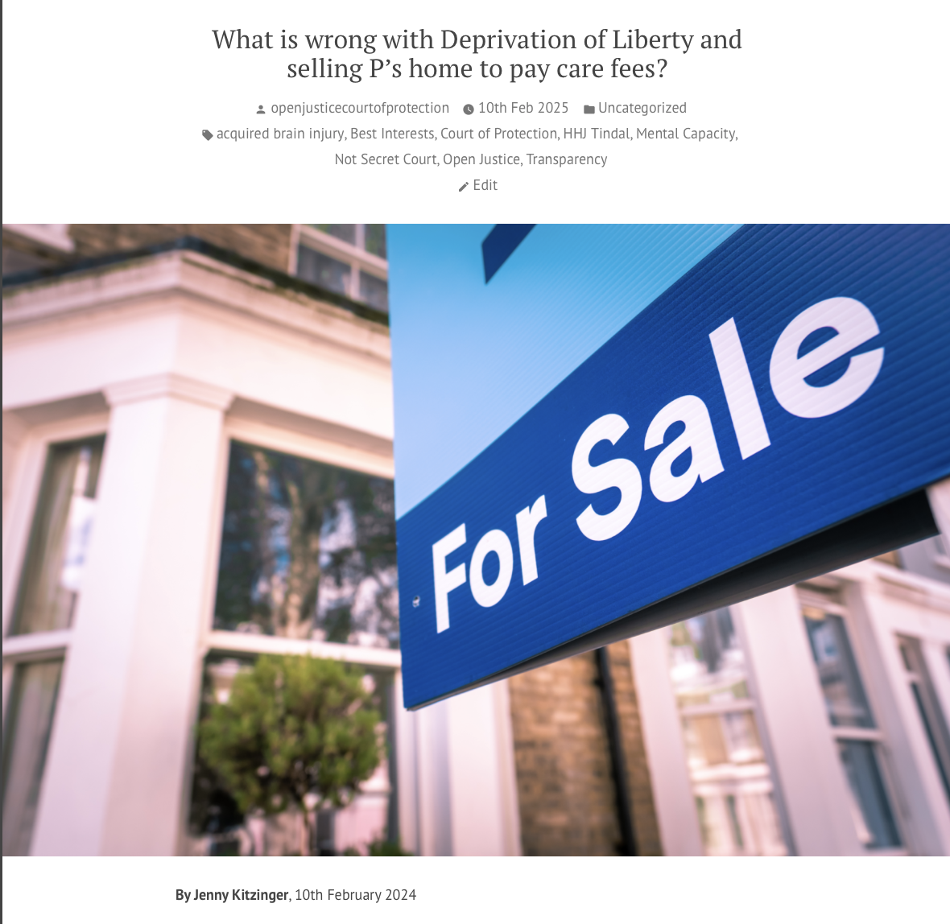
Click here to read blog
Mr G has acquired brain injury – wants to leave ABI centre + live in community.
Has been found to lack capacity to make this decision himself (he contests this, articulately)
Best interests requirement was then contested – is there a less restrictive option? S.21A hearings 2020-2021
Delay of more than a year - both HHJ Tindal and Mr G expressed frustration
Trial of living at home – broke down
8 blog posts covering 10+ hearings over 5 year period

Slide 11
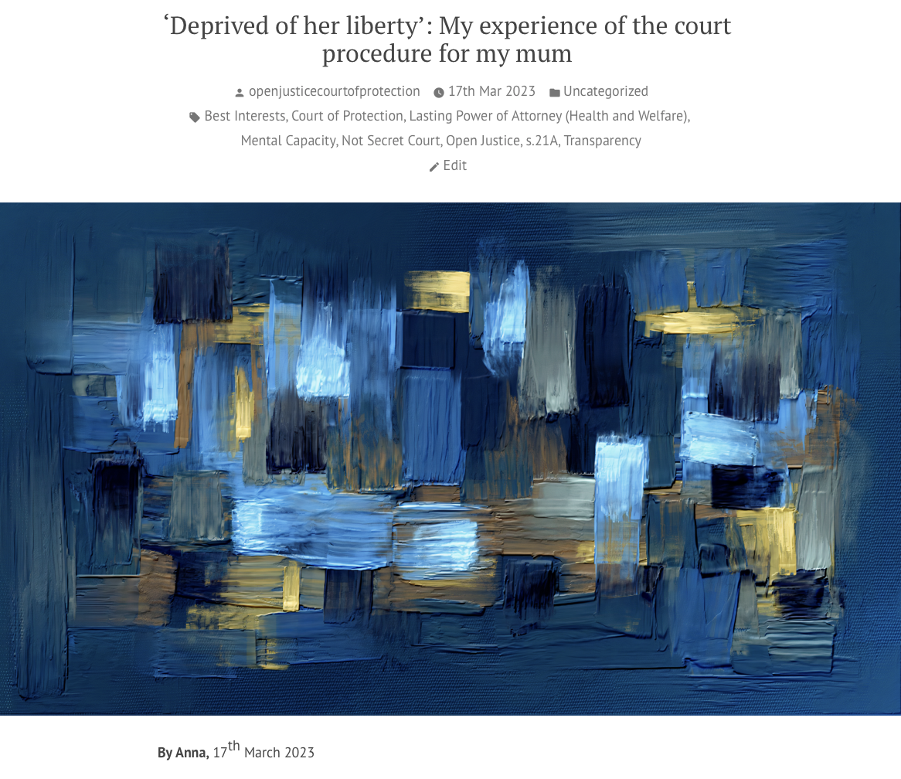
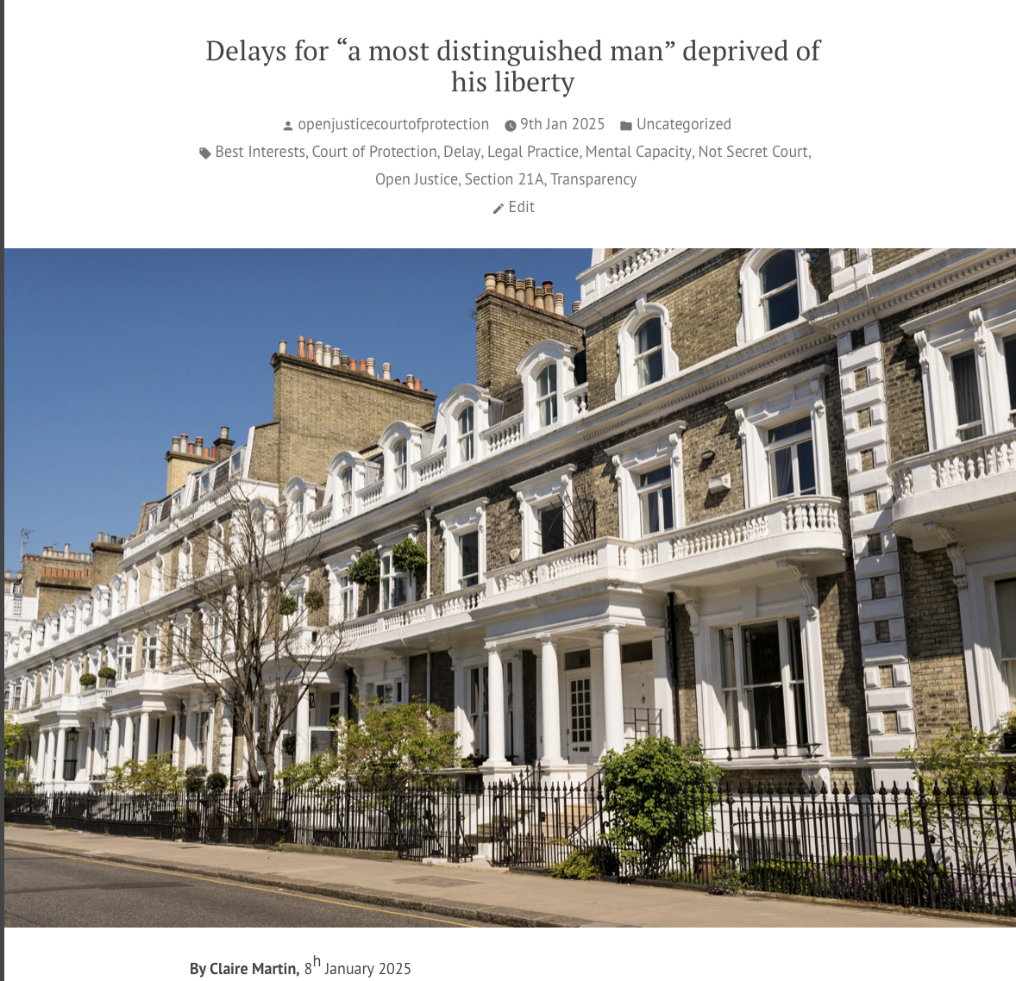
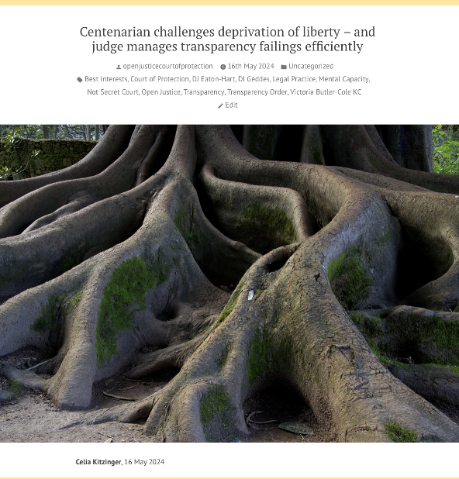
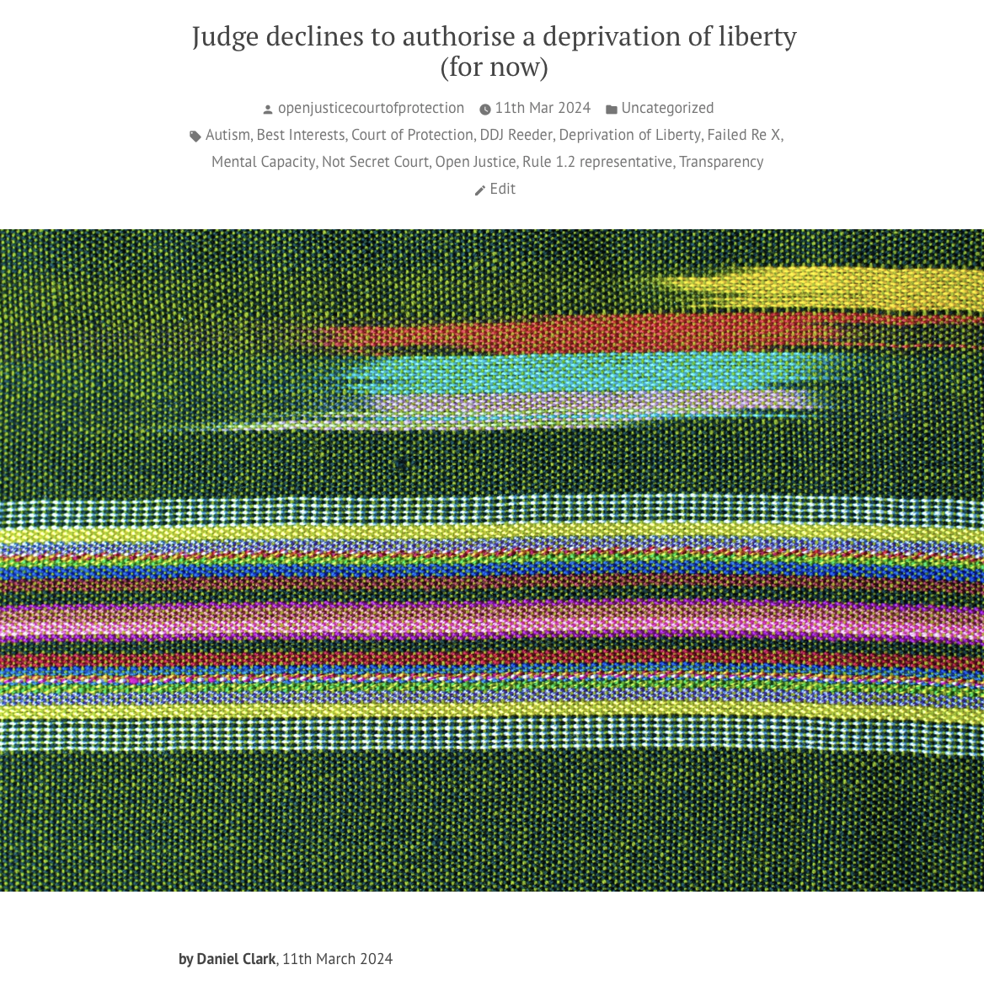


Slide 12


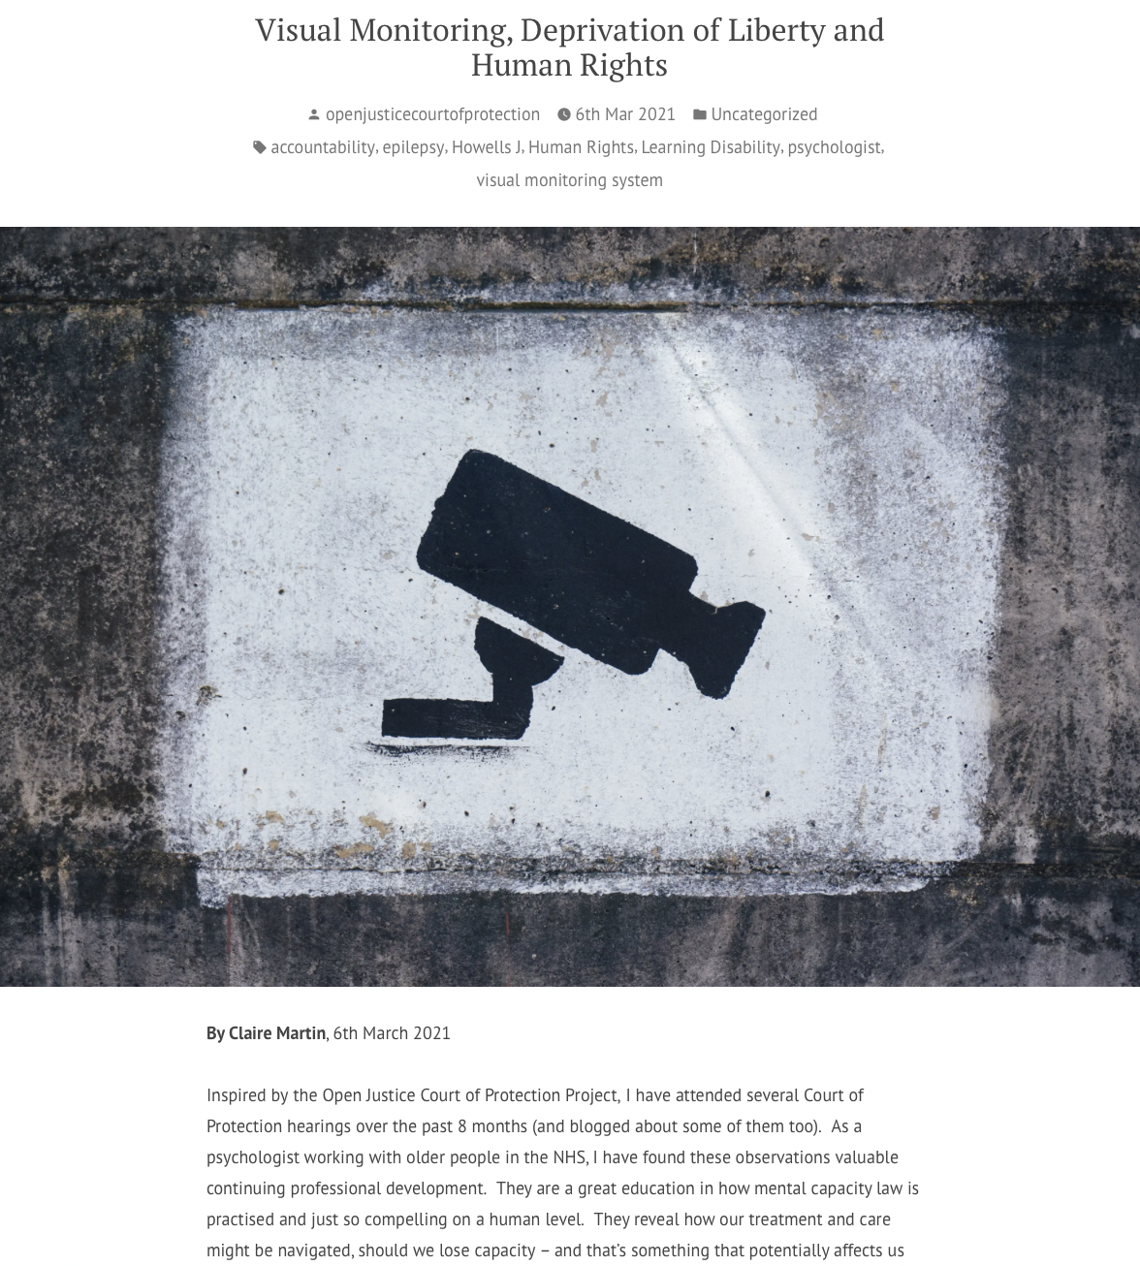
Click here for Authorising restraint blog
Click here for covert medication blog
Sample blog posts
Click here for Visual monitoring blog

Slide 13
Repeated concerns for us/judges in DOLS cases
Delays in carrying out robust capacity assessments
Lack of clarity about what the ‘relevant information’ is
Not explaining to P what the purpose of the assessment is
Conflating capacity and best interests (‘protection imperative’ – combined with failure of provision/support in areas of capacity)
Delays in making s.21A applications – and some are hard to understand (which qualifying requirement is contested?)
Need for parallel work on BOTH ‘capacity’ + ‘BI’ requirements
ICommon requests from counsel for ‘expert’ evidence (= further delay)
Delays in court process – not HRA Art.5(4) compliant
Also…
Unsuitable/unregulated placements (or stuck in hospitals) - no alternative options
Disputes between public bodies (esp LA/CCG/ICB) about whose responsibility it is + failure to act
Insufficient explanation for families about the whole DOLS procedure

Slide 14


Slide 15
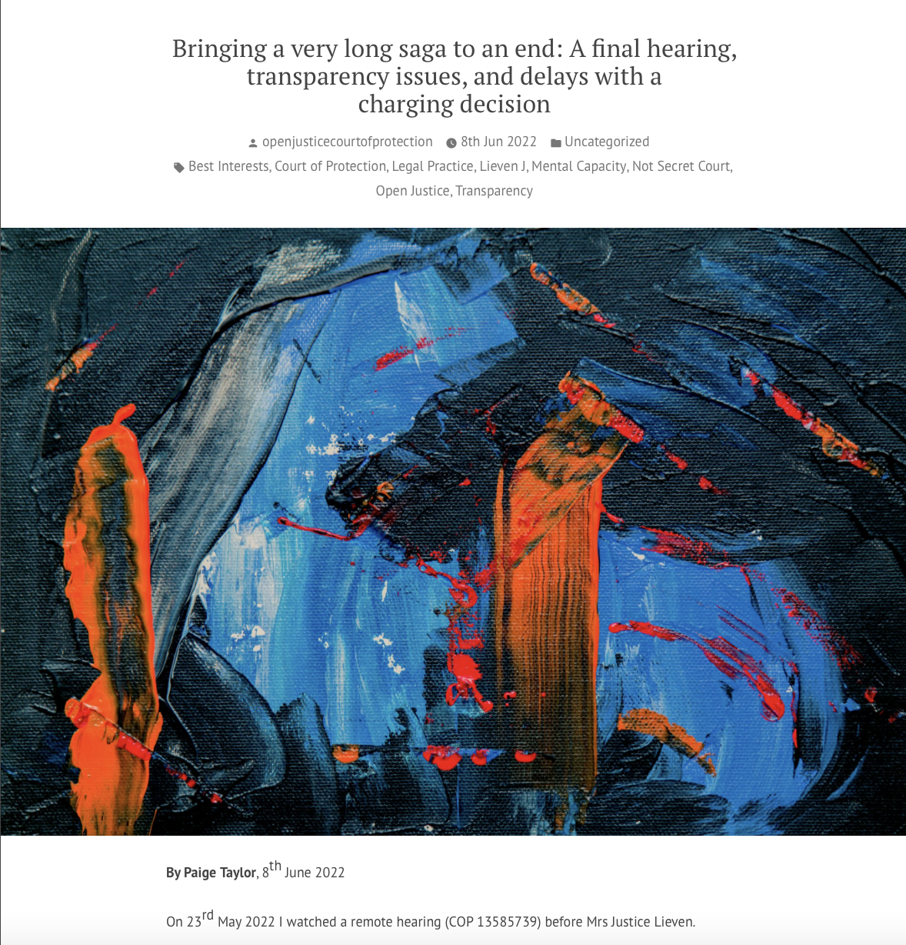
Two Kent cases we’ve blogged about
1. Neglect, criminal proceedings + DOLS
Before Lieven J in RCJ (for 2 years)
Judgment published here
21-year-old woman neglected + malnourished in parents’ home – placed in flat with team of carers – police involvement
Kent County Council brought case for declaration in P’s BI to live + receive care in placement. Case heard in private
Judge concerned about delay in criminal case + made proceedings public: “I do think that the public has the right to know that in a case such as this it will have taken over 2 and a half years to even get to a charging decision. If there are charges brought, it is unknown how much longer it will take to get to trial. Delays in the system of justice, whether the police or the CPS, are a matter of legitimate public interest.”
Journalist published story in Care Appointments here: https://careappointments.com/care-news/england/174306/judge-concerned-over-how-long-it-has-taken-police-to-investigate-extreme-neglect-of-teenager/
https://openjusticecourtofprotection.org/2022/06/08/bringing-a-very-long-saga-to-an-end-a-final-hearing-transparency-issues-and-delays-with-a-charging-decision/

Slide 16
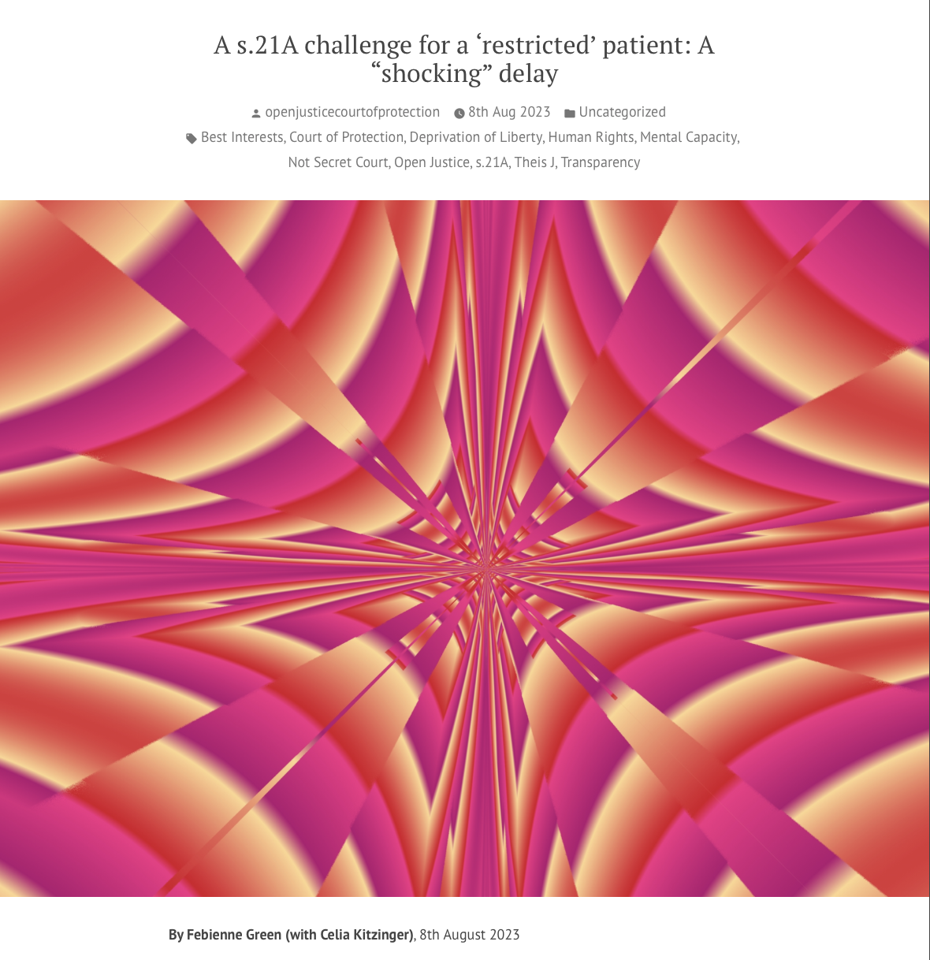
Two Kent cases we’ve blogged about
2. Confusion between MHA + MCA leads to unacceptable delay
Before Theis J in RCJ (5th July 2023)
S.21A challenge to standard authorization depriving Mr N of his liberty in a care home
Judge very critical about the delay in this case and criticised the lack of “robust management”: “It’s shocking, frankly. Here we are 8 months later, effectively having the first hearing”.
Confusion from KCC as Mr N had been conditionally discharged under section 37 and 41 of the Mental Health Act 1983 + KCC believed (wrongly) COP did not have jurisdiction
https://openjusticecourtofprotection.org/2023/08/08/a-s-21a-challenge-for-a-restricted-patient-a-shocking-delay/

Slide 17

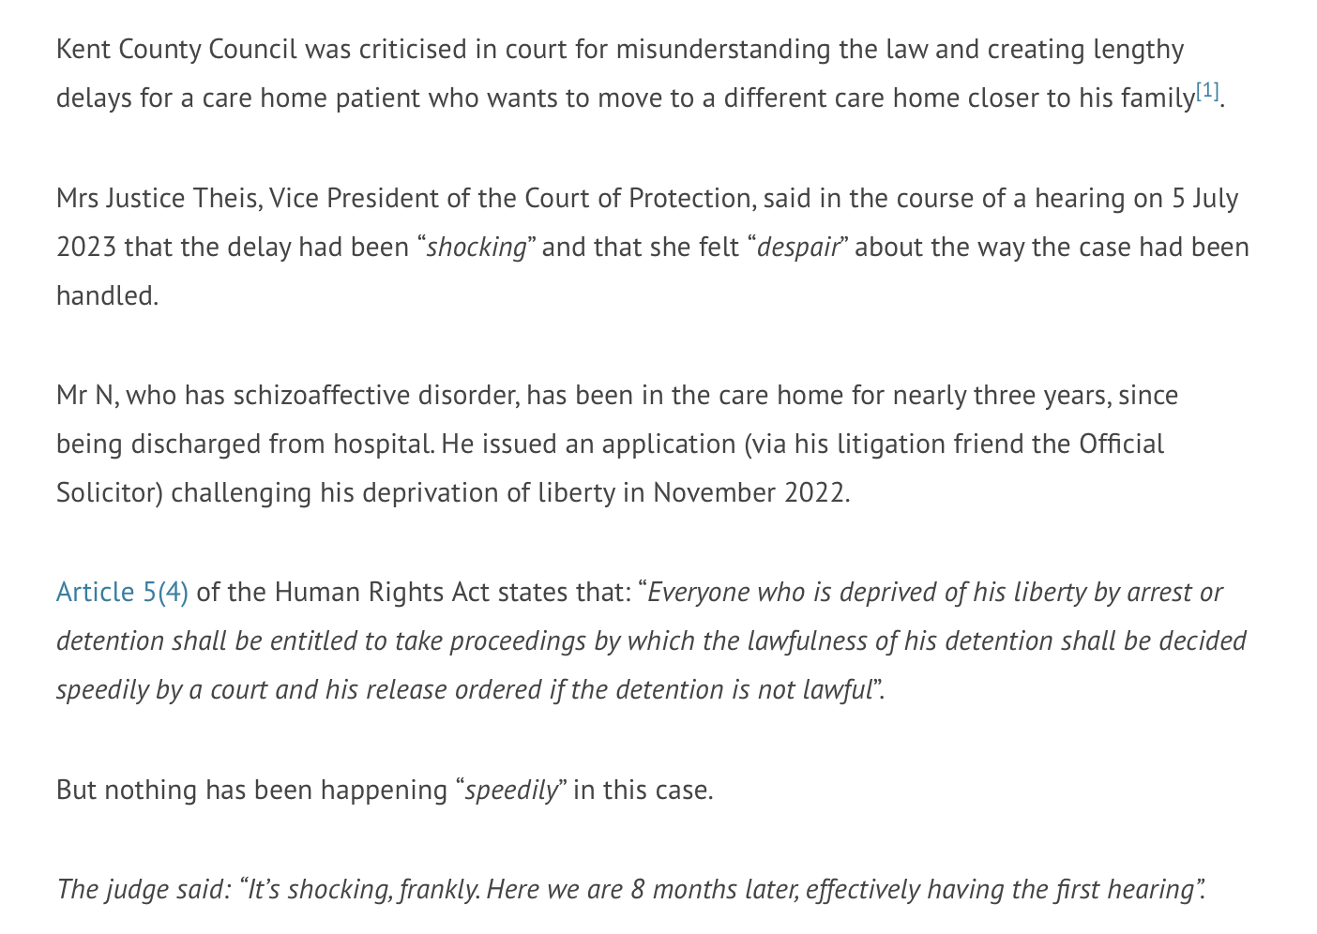
Also concerns about transparency – naming Kent County Council was initially prohibited. (We challenged that.)
https://openjusticecourtofprotection.org/2023/08/11/varying-reporting-restrictions-to-name-kent-county-council-in-shocking-delay-case/

Slide 18

A happy ending (19 October 2023)
Mr N been moved to a new placement shortly after the last hearing
Expert opinion (accepted by judge) that he did not have capacity to decide where to live and receive care
Judge ruled new placement was in his best interests
Mr N attended hearings via video-link
https://openjusticecourtofprotection.org/2023/10/27/another-case-of-s-21a-delay-with-a-happy-ending/

Slide 20
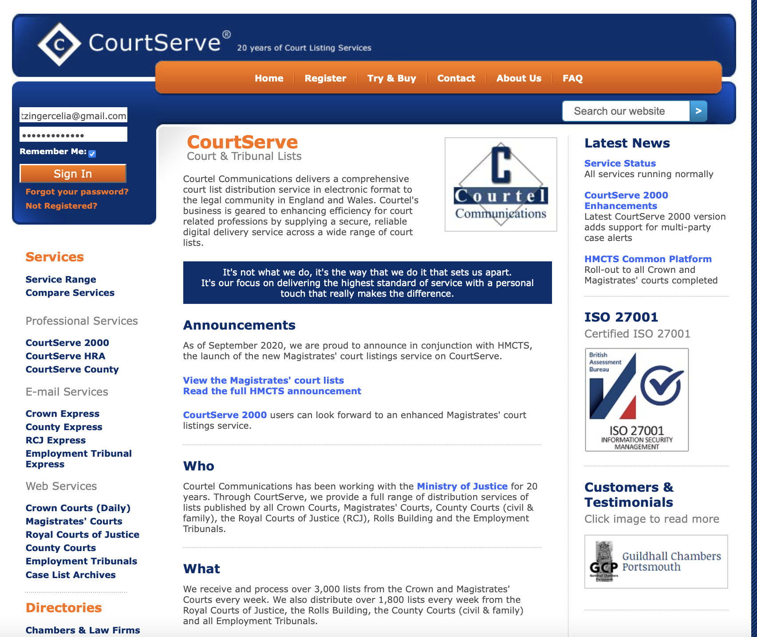
How to find hearings to observe
Go to courtserve.net
Enter your email address and a password to register

Slide 21

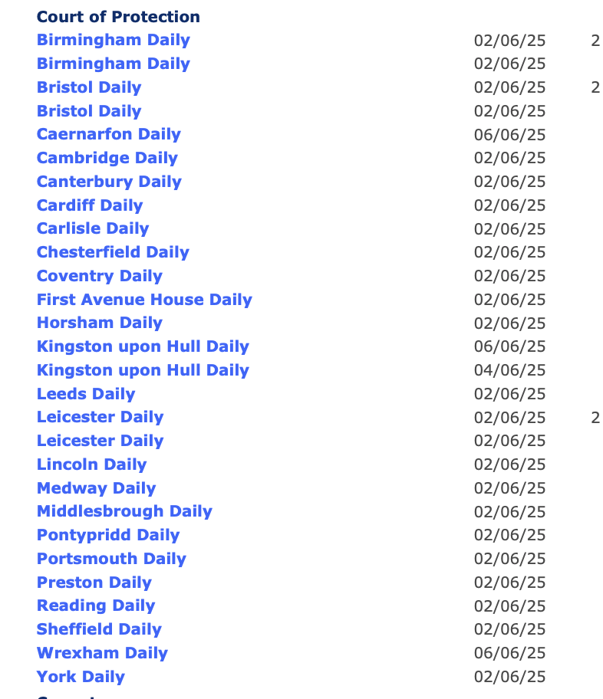
Click on “county courts”
Scroll down to “Court of Protection”

Slide 22
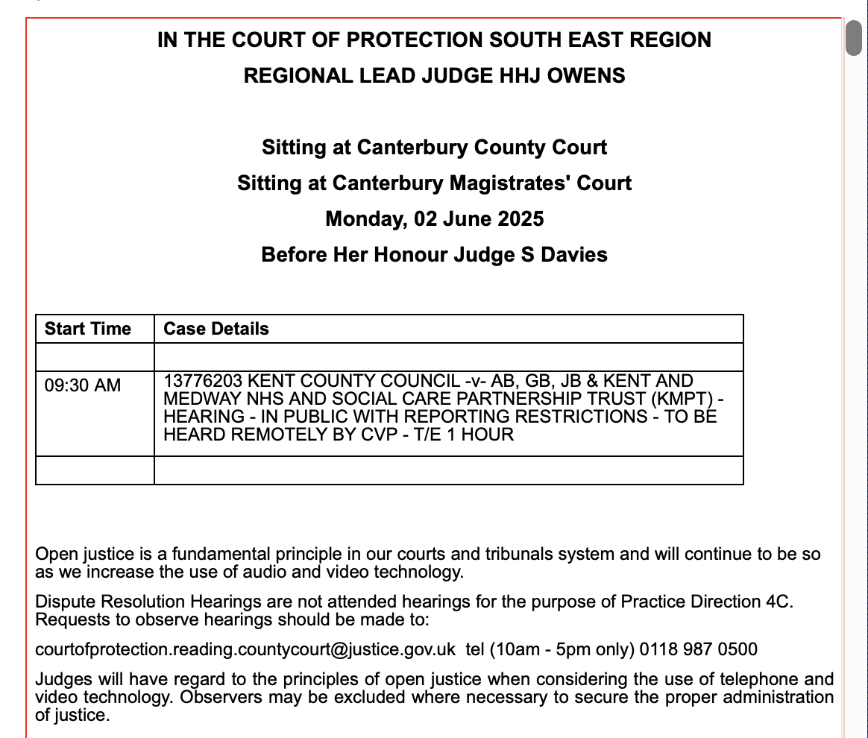
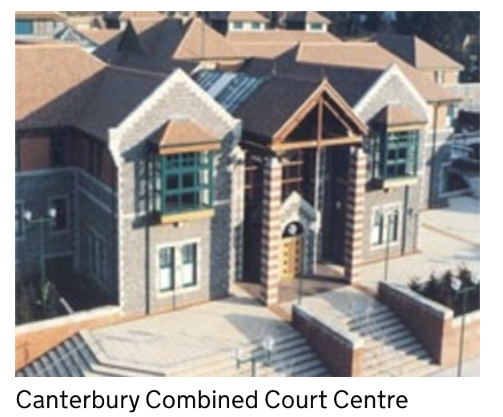
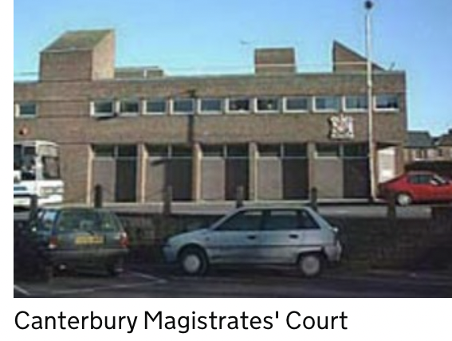
Canterbury Combined Court Family Court Hearing Centre
The Law Courts
Chaucer Road
Canterbury
CT1 1ZA
Broad Street, Canterbury, CT1 2UE

Slide 23
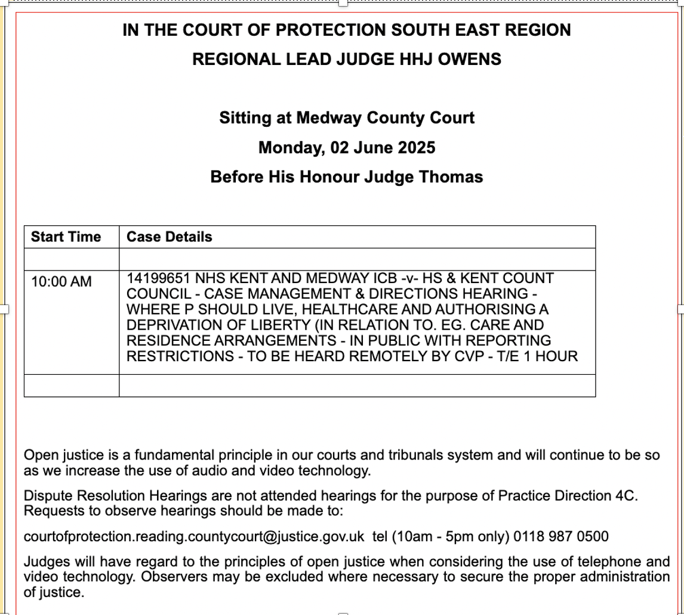
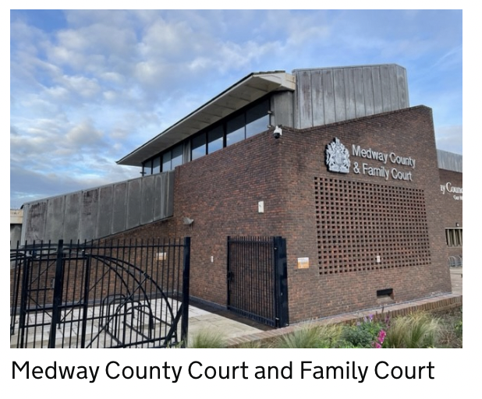
HMCTS Main Entrance
Gun Wharf
Chatham
ME4 4AR

Slide 24
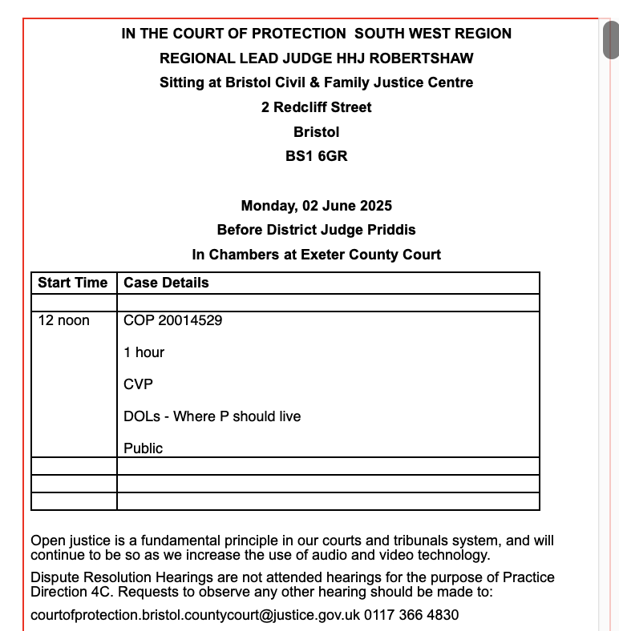

Slide 25
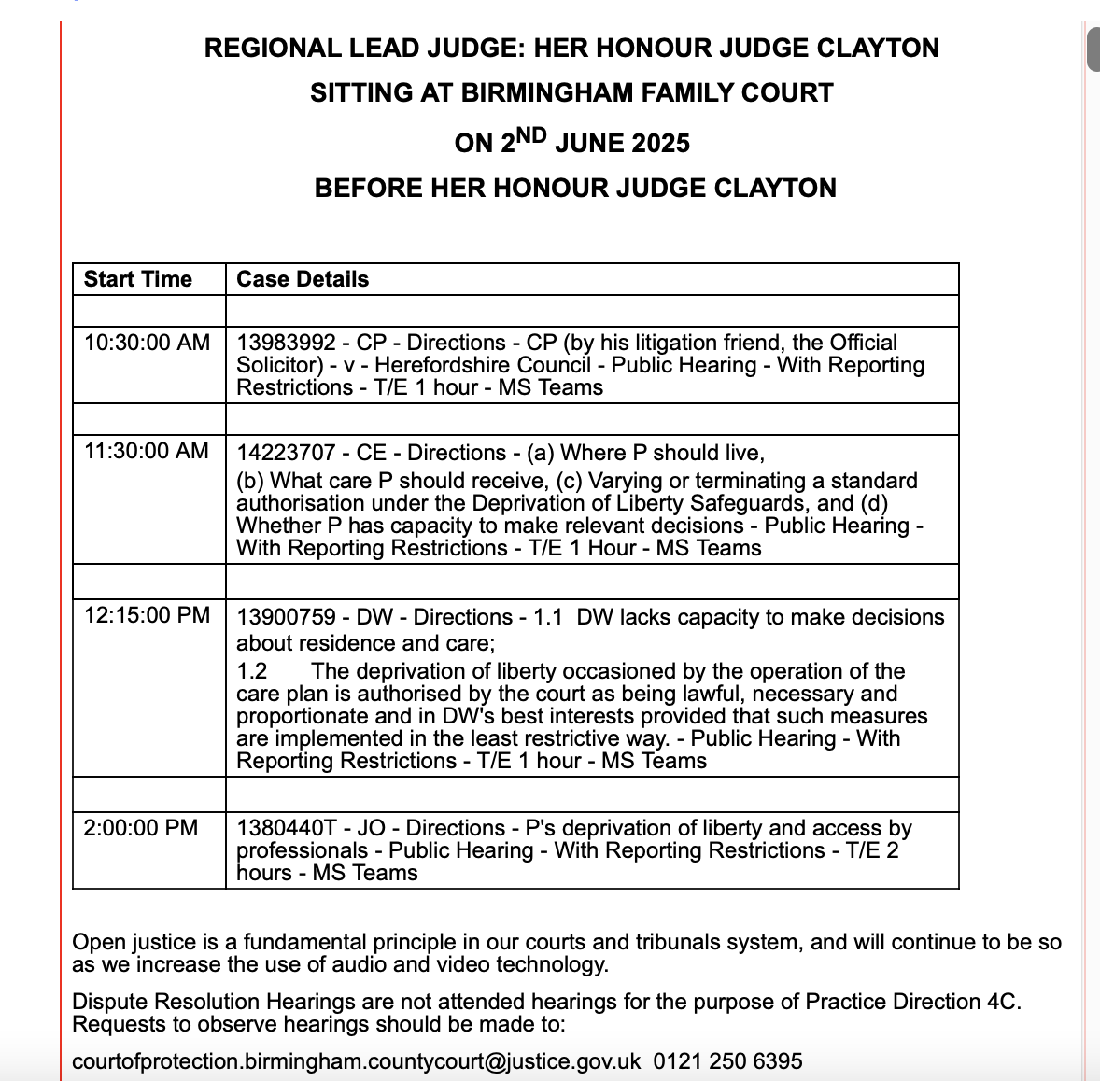

Slide 26
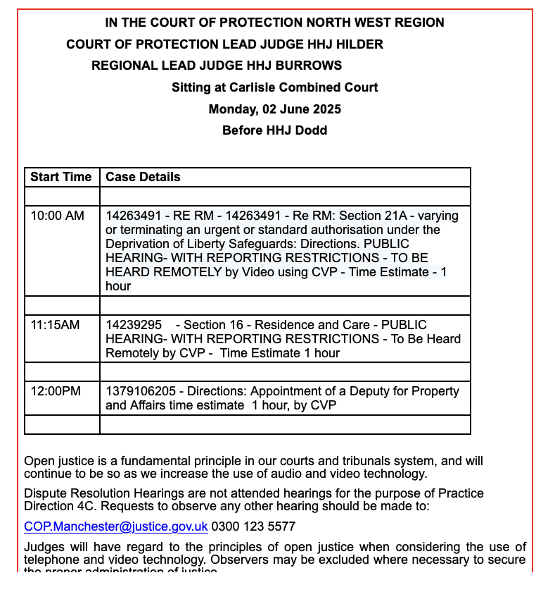

Slide 27
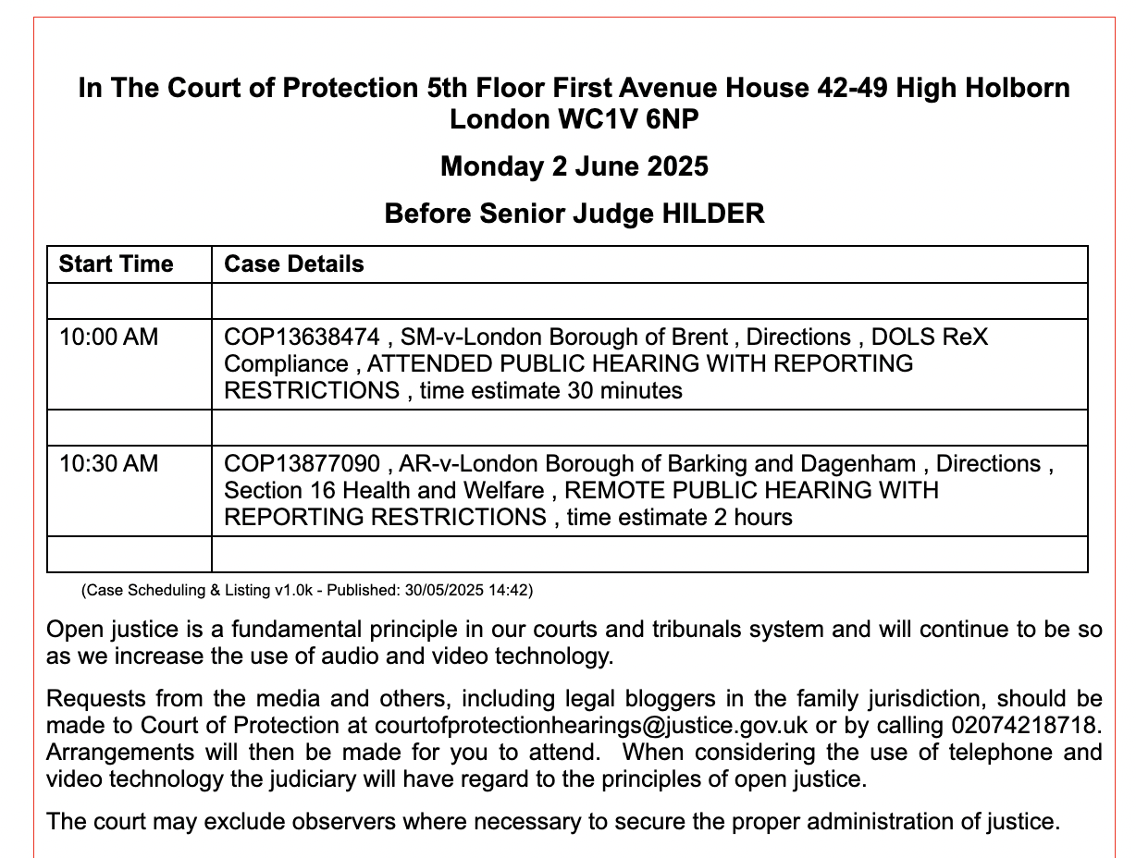
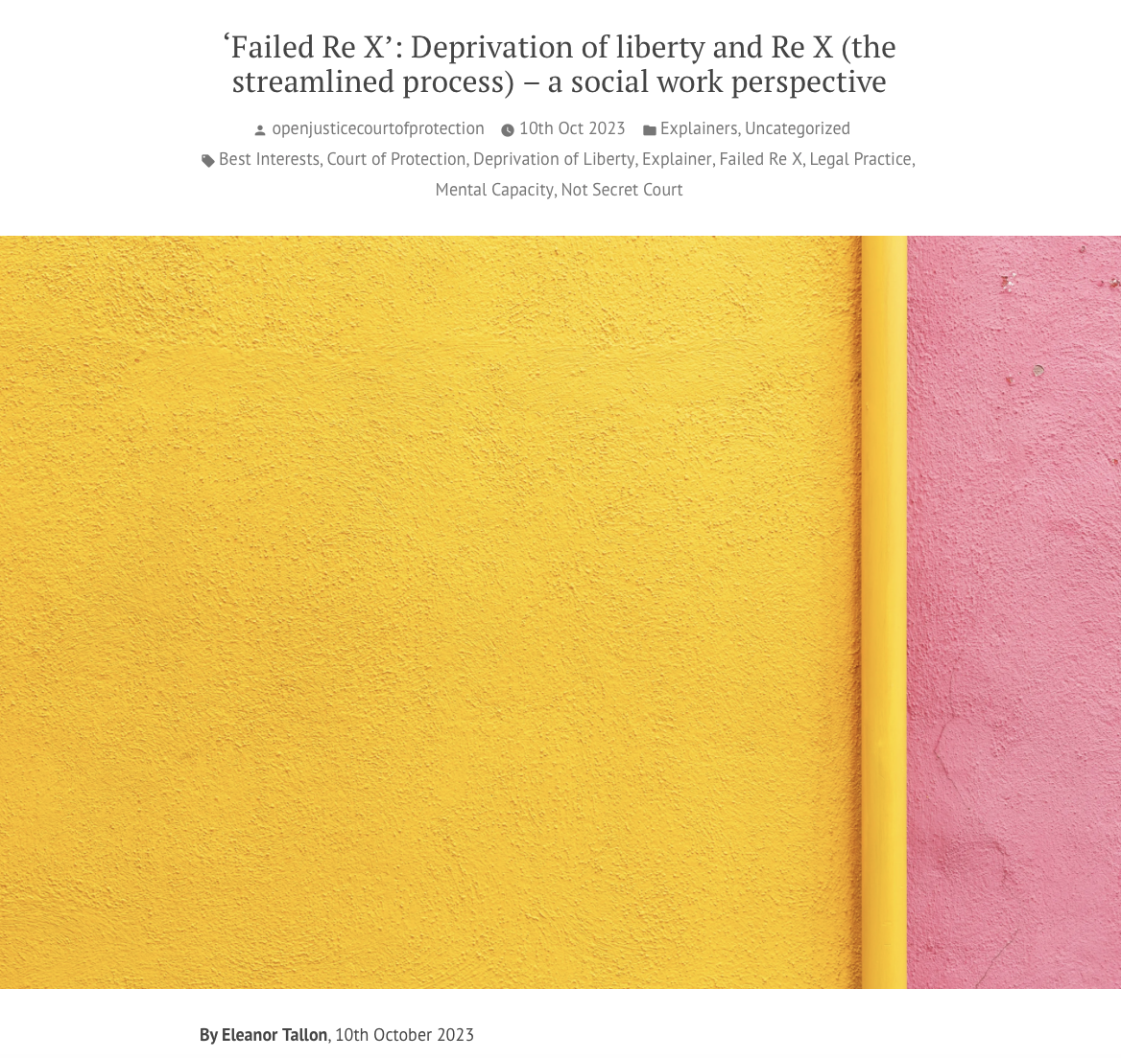
https://openjusticecourtofprotection.org/2023/10/10/failed-re-x-deprivation-of-liberty-and-re-x-the-streamlined-process-a-social-work-perspective/

Slide 28
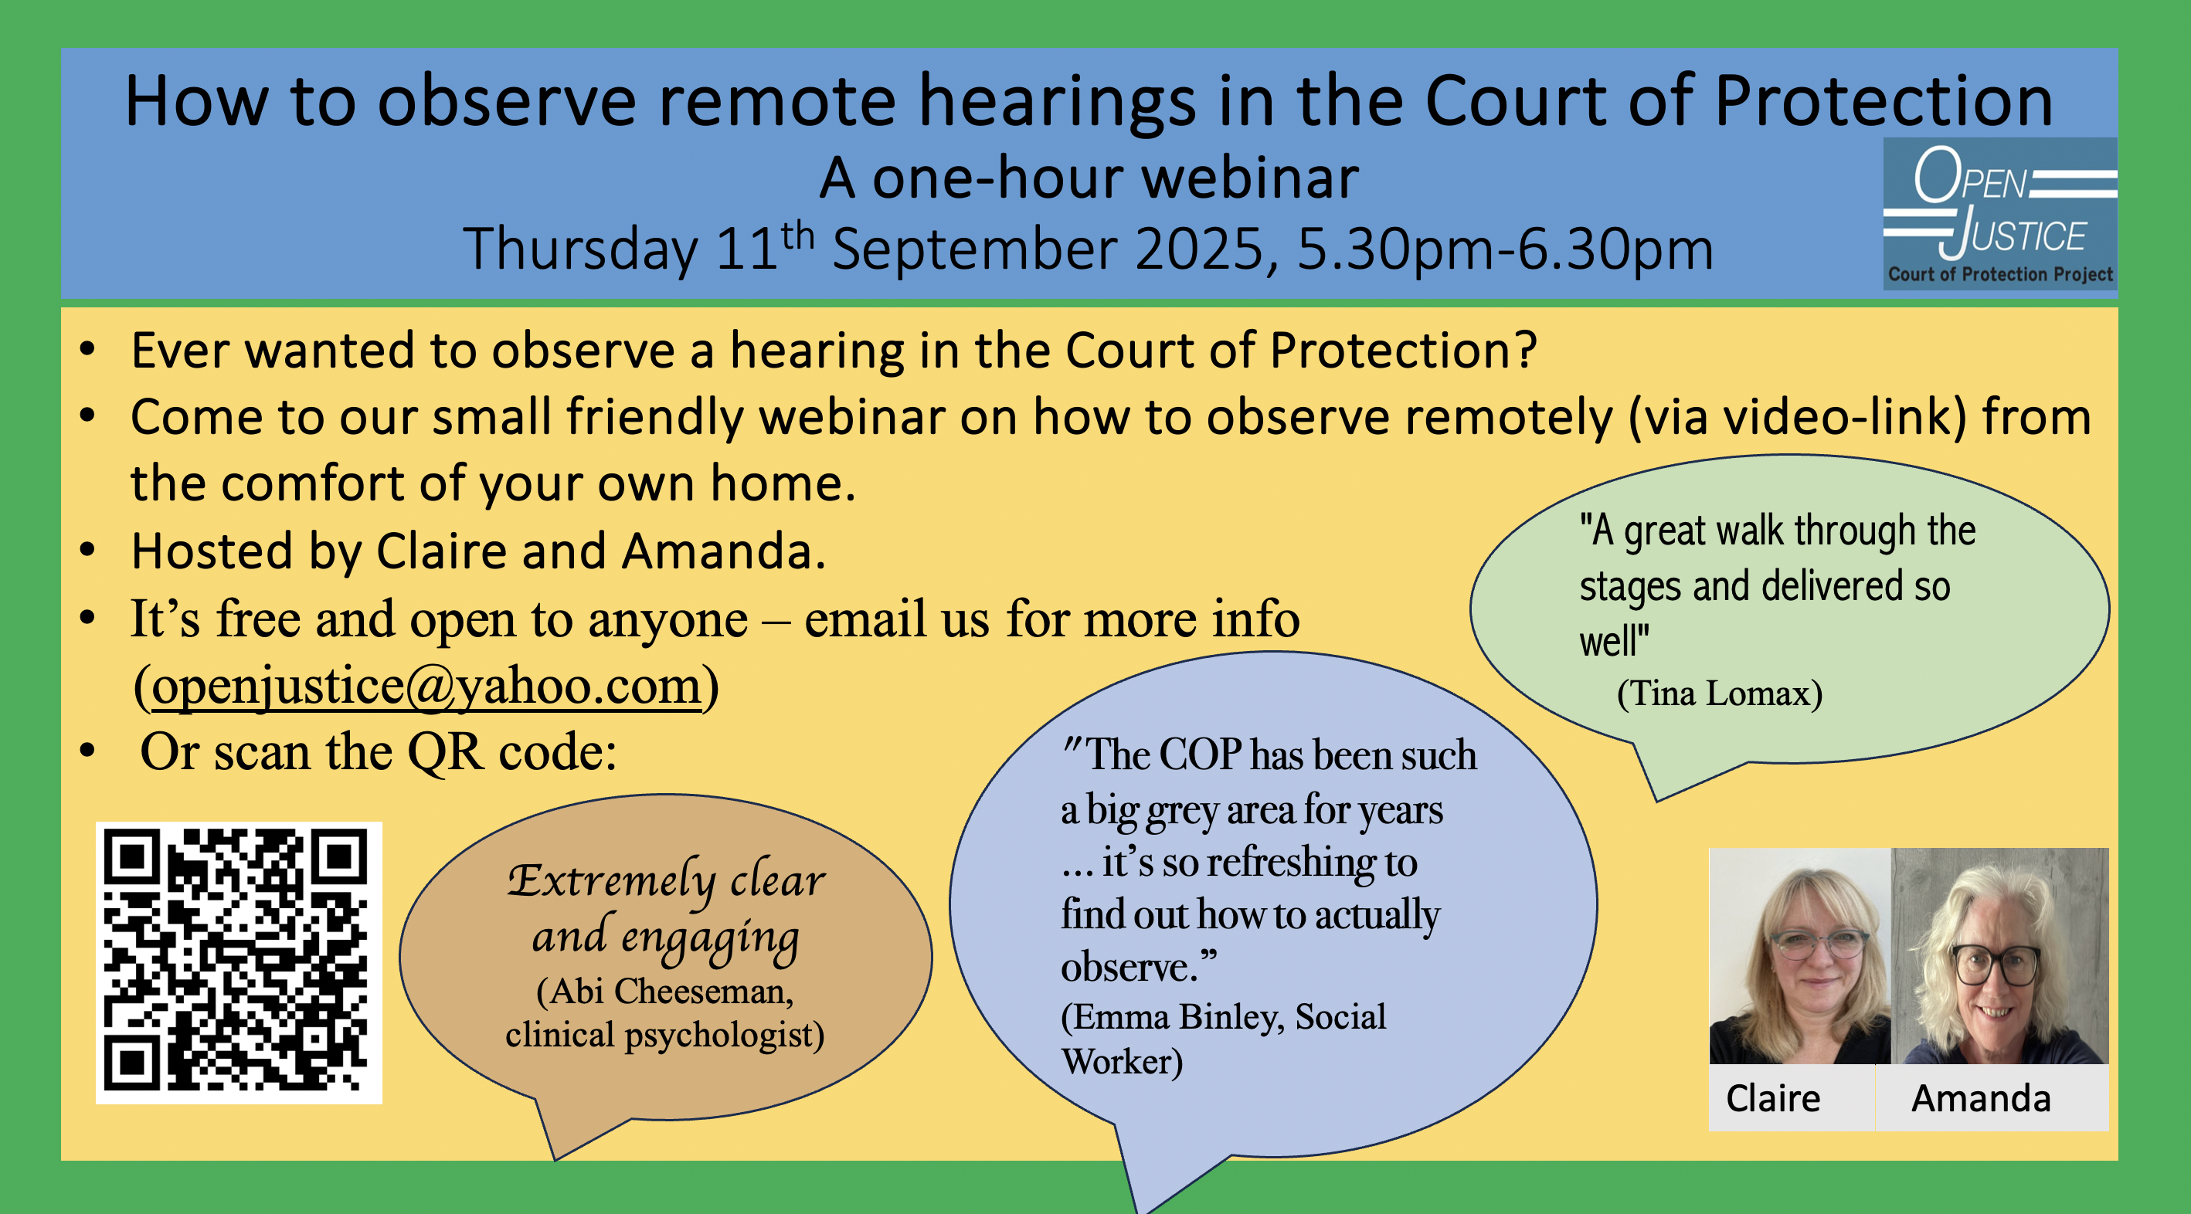
Join our small and friendly webinar
Our next webinar is 11th September 2025 at 5.30pm (for one hour)
Email us to request the webinar link openjustice@yahoo.com
Or just email to request a “buddy” for observing before then

Slide 30
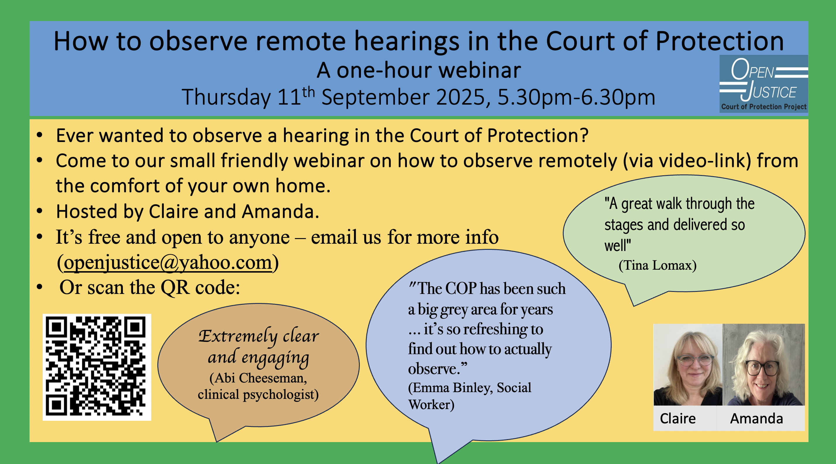
Thank you!

